Slide 1
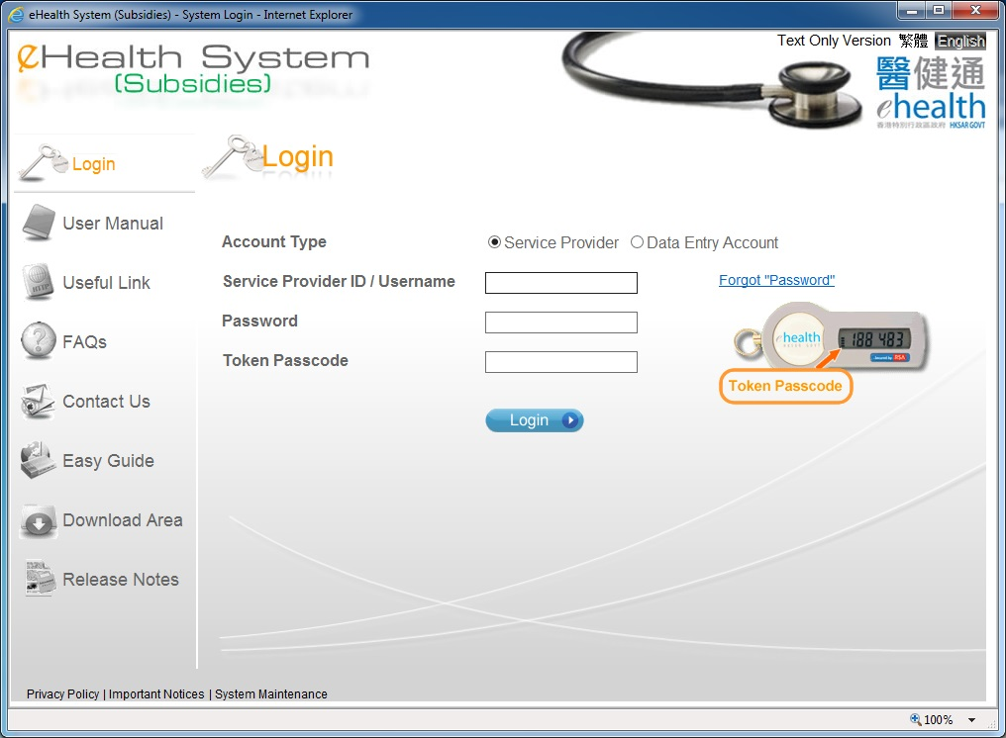
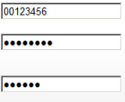
eHealth (Subsidies) Account Rectification

Slide 2
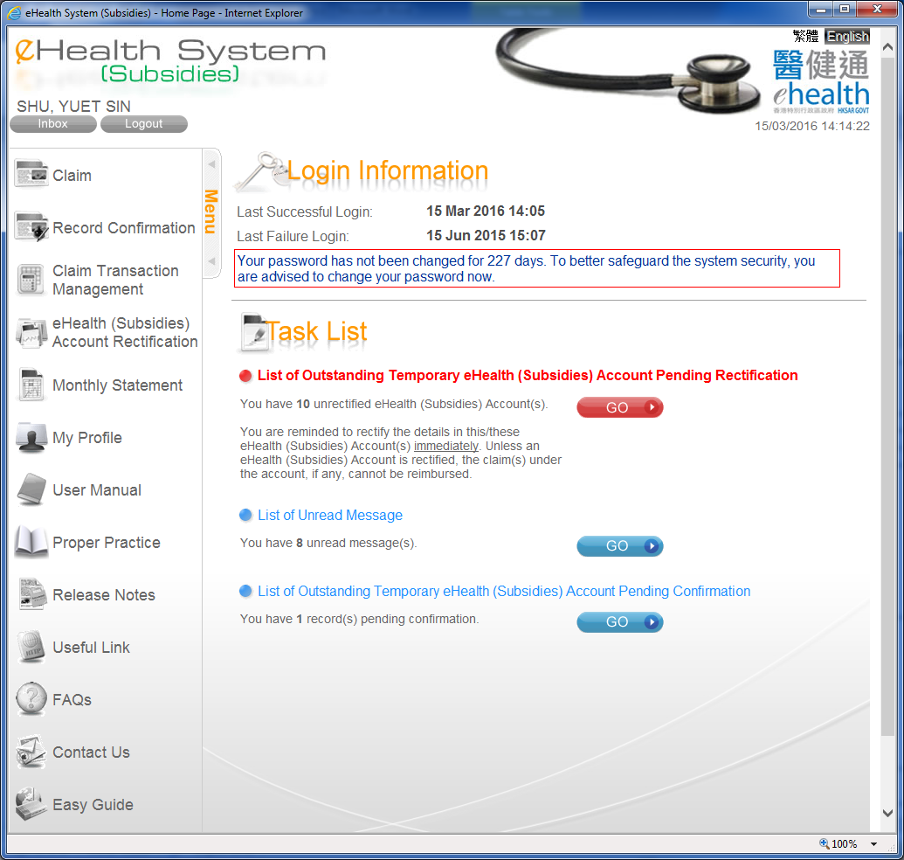
eHealth (Subsidies) Account Rectification
Select ”Go” or “eHealth (Subsidies) Account rectification”

Slide 3
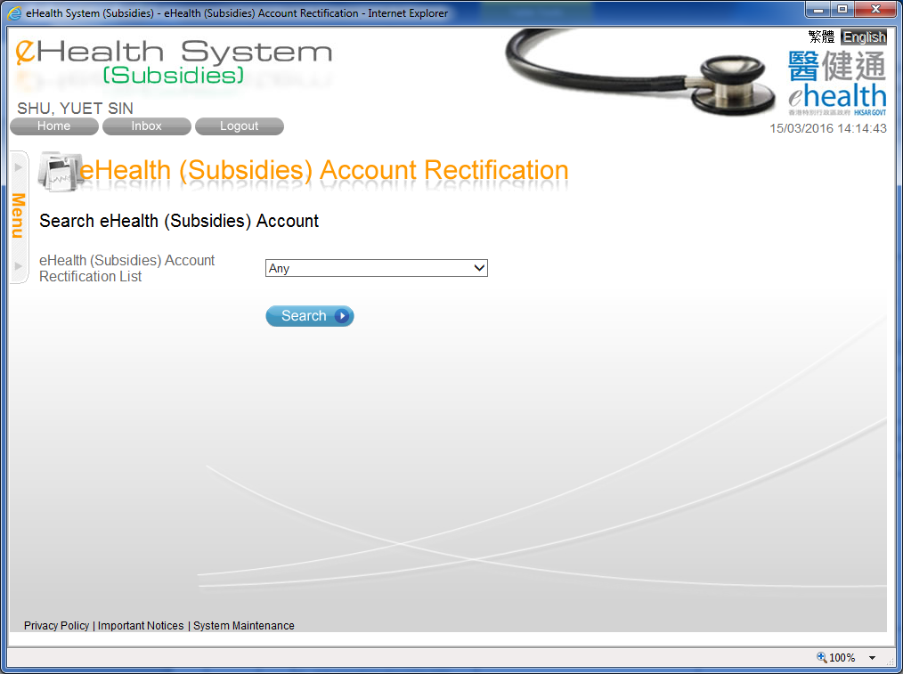
eHealth (Subsidies) Account Rectification

Slide 4
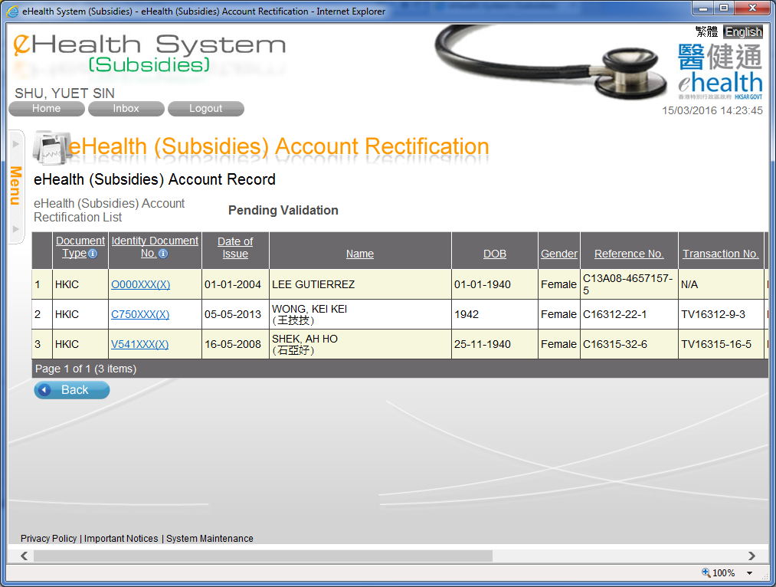
eHealth (Subsidies) Account Rectification
You may press the document no. to rectify the account details.

Slide 5
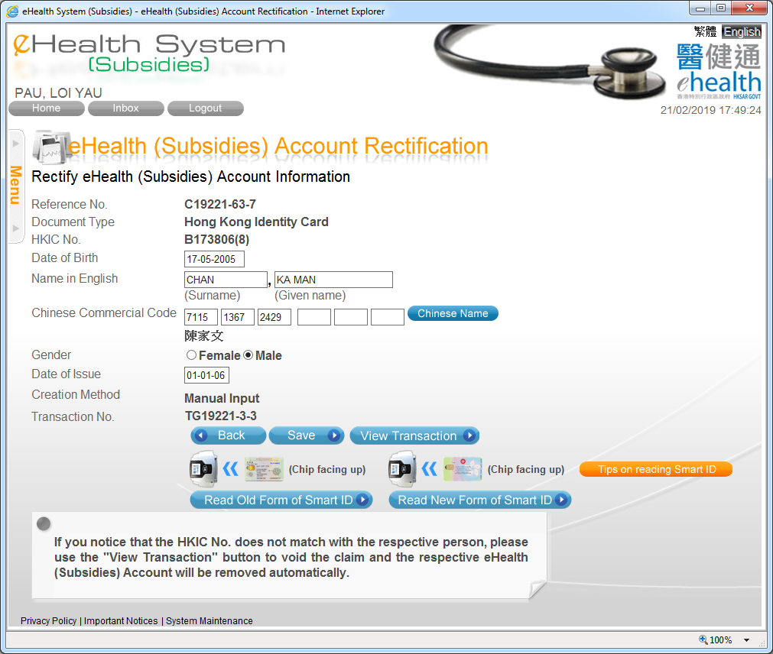
eHealth (Subsidies) Account Rectification
You may rectify the information as needed. Then press ‘Save’ button.

Slide 6
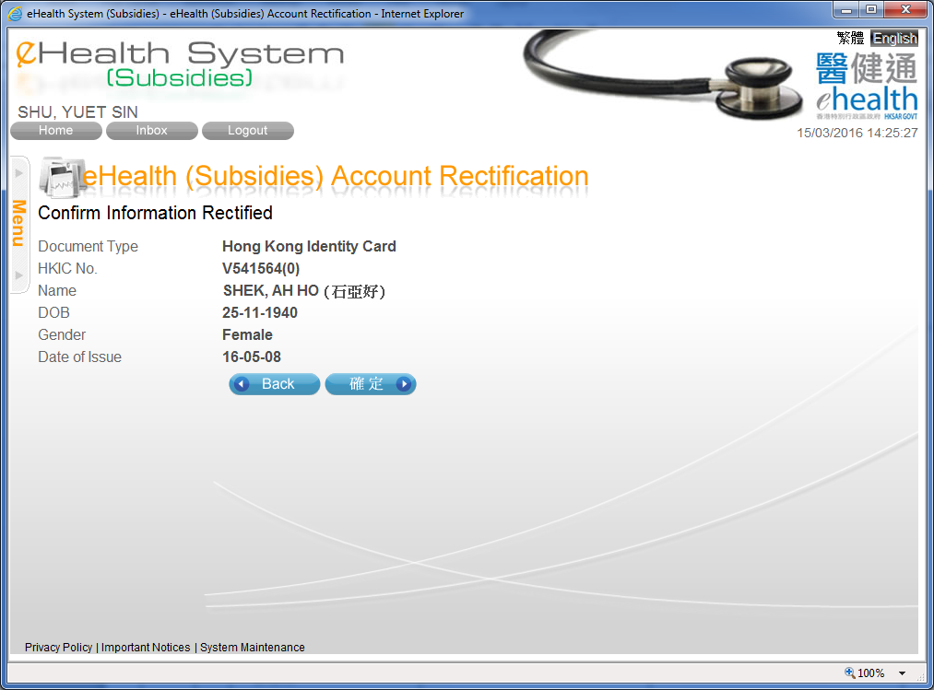

eHealth (Subsidies) Account Rectification
You have to confirm the rectified information. You may press ‘Confirm’ button to confirm the change.
After the rectification, the details will be verified again.

Slide 7
~ Thanks for watching ~

