Slide 1
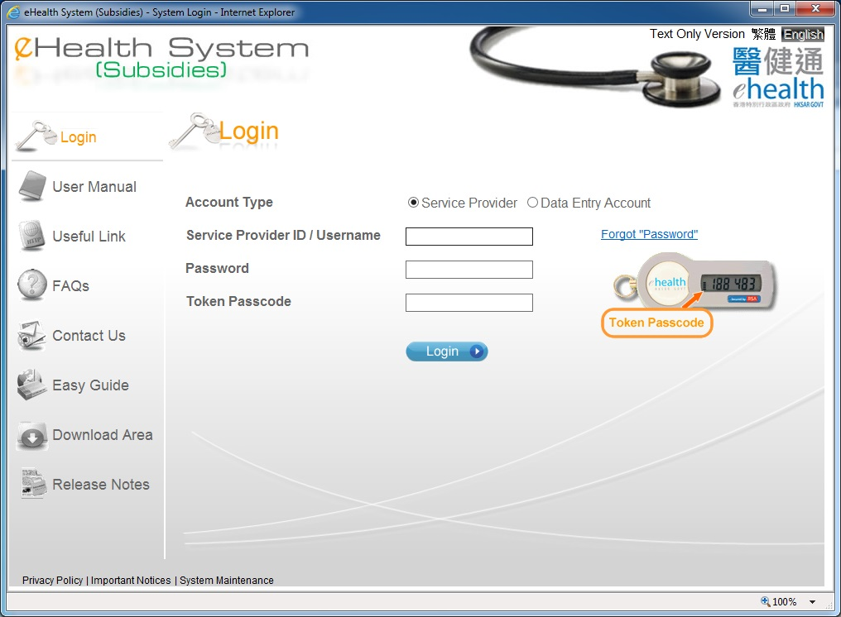
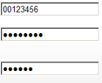
Claim Transaction Confirmation
Only service provider can perform claim transaction confirmation.

Slide 2
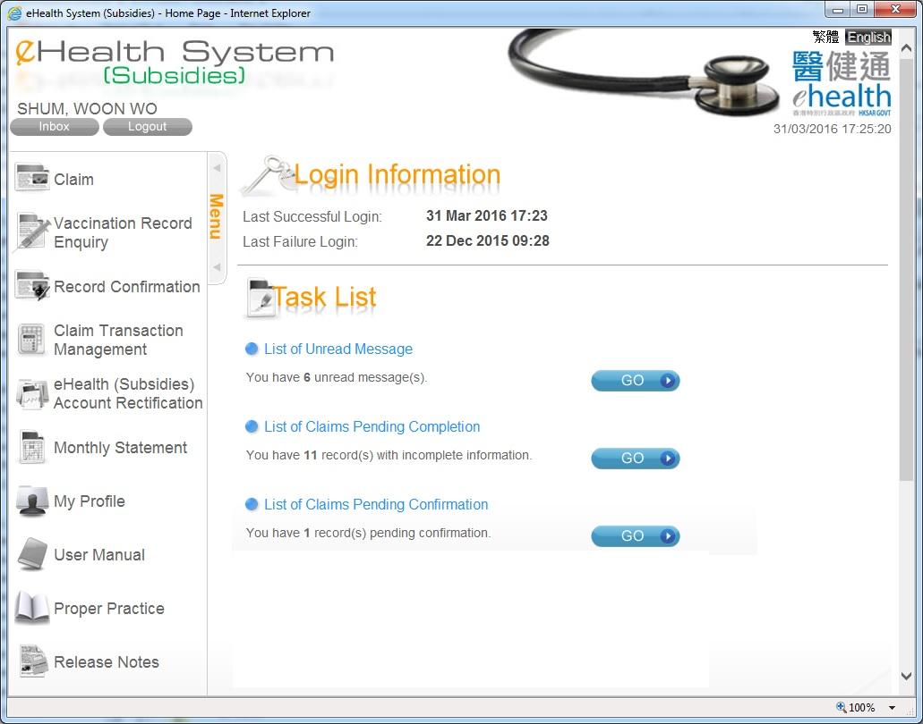
Claim Transaction Confirmation
You may click ‘GO’ or press ‘Record Confirmation’ of the menu to proceed with claim transaction confirmation.

Slide 3
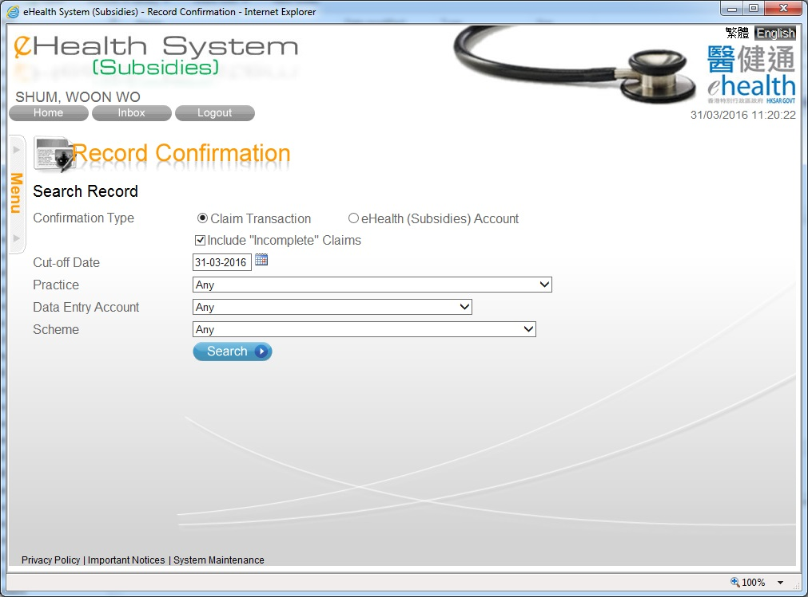
Claim Transaction Confirmation
You can include the “List of claims pending completion” in the search result.
You can search the records by different criteria.

Slide 4
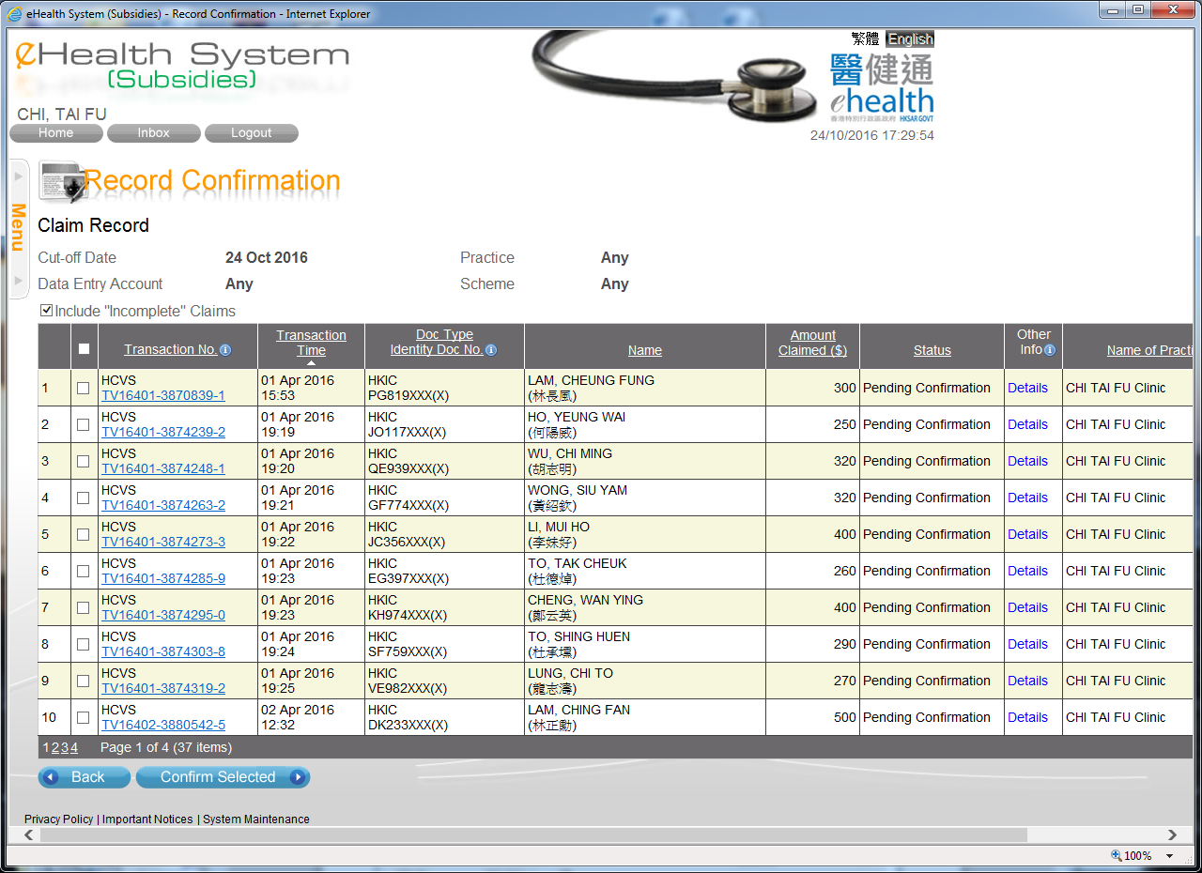
Claim Transaction Confirmation
You may press the column header to sort the records.
You may press the transaction no. to view, to void or to modify the claim details.
You may select the record(s) by clicking the checkbox, or clicking the checkbox at the column header for all records. Then press ‘Confirm Selected’ button.

Slide 5
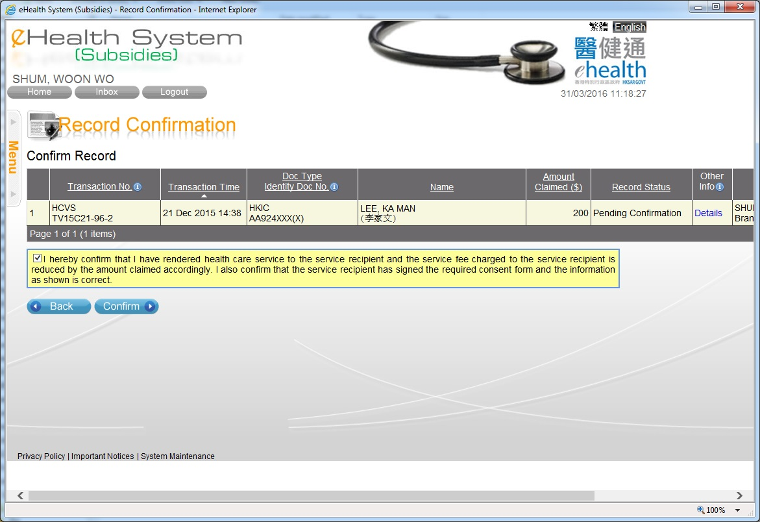
Claim Transaction Confirmation
The selected claim transactions are shown.

Slide 6
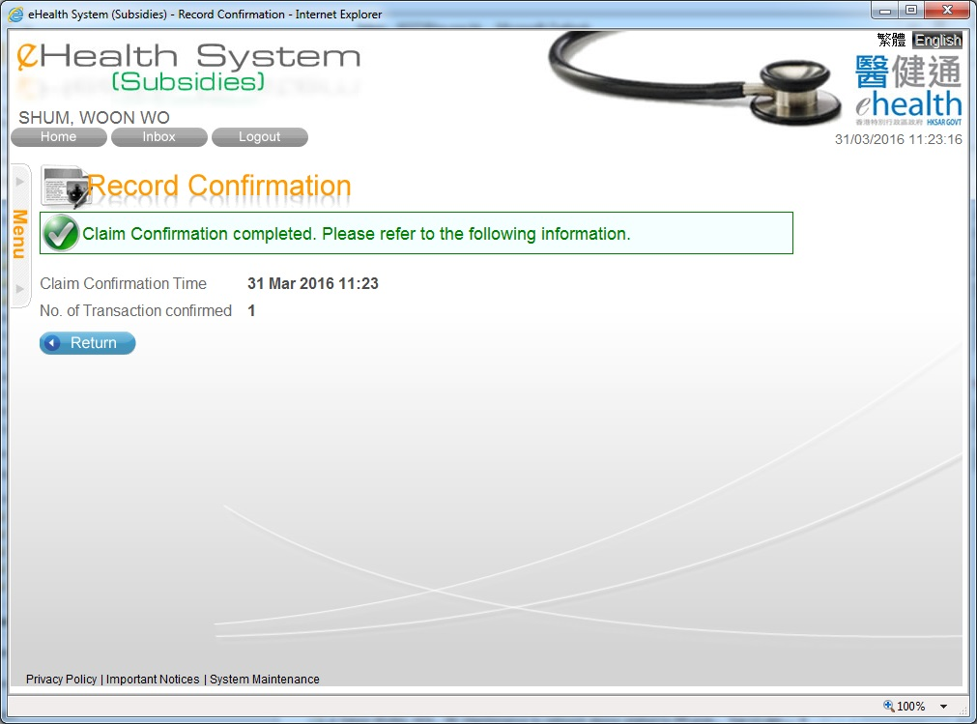
Claim Transaction Confirmation

Slide 7
~ Thanks for watching ~

