Slide 1
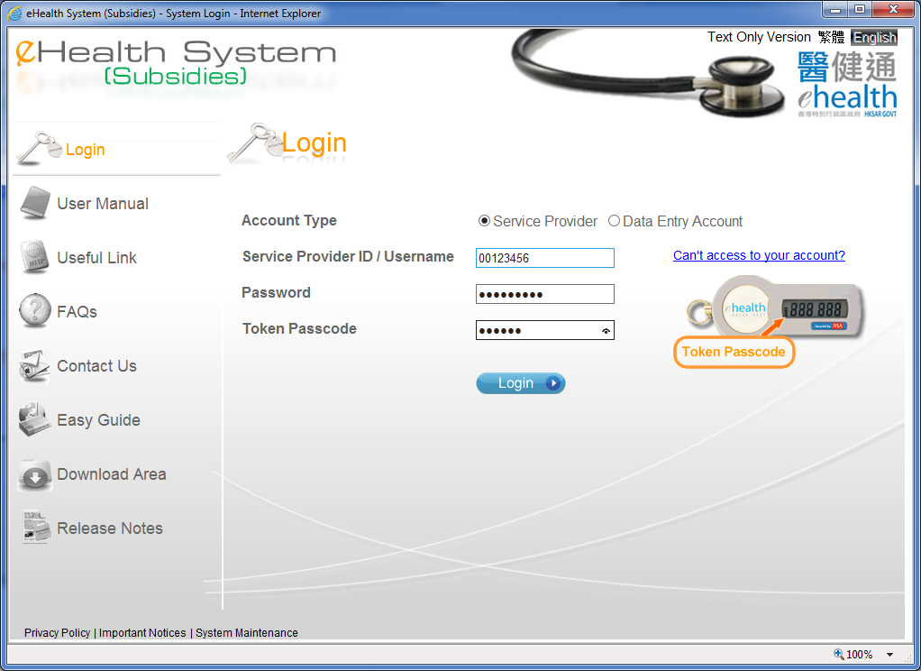
Claim Transaction Management

Slide 2
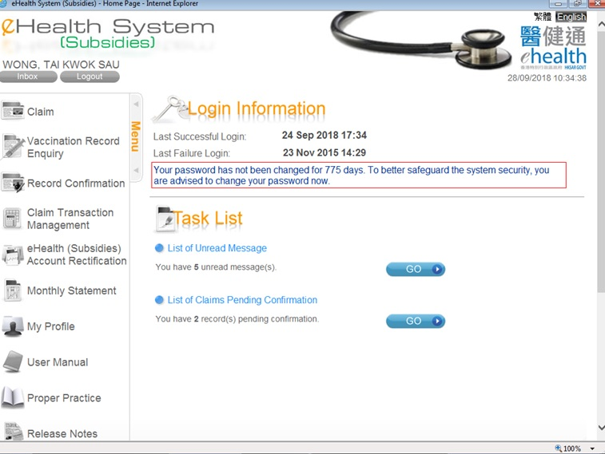
Claim Transaction Management

Slide 3
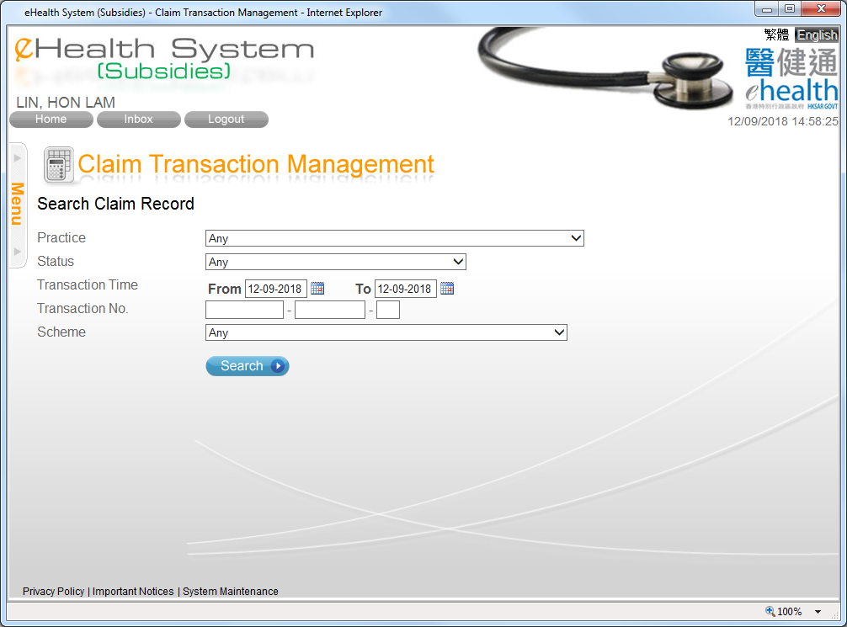
Claim Transaction Management
You may search the claim records by different criteria.

Slide 4
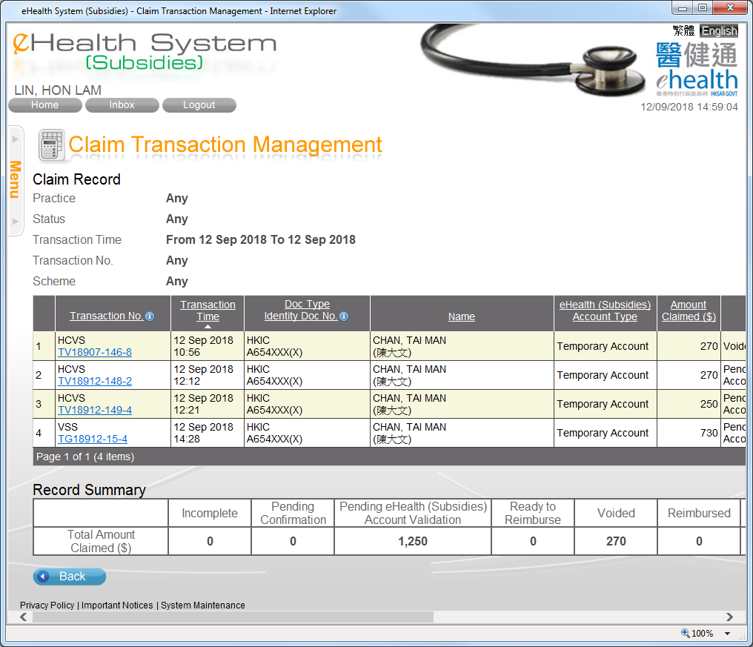
Claim Transaction Management
You may press the column header to sort the records.
You may press the transaction no. to view, to void and to modify the claim details.

Slide 5
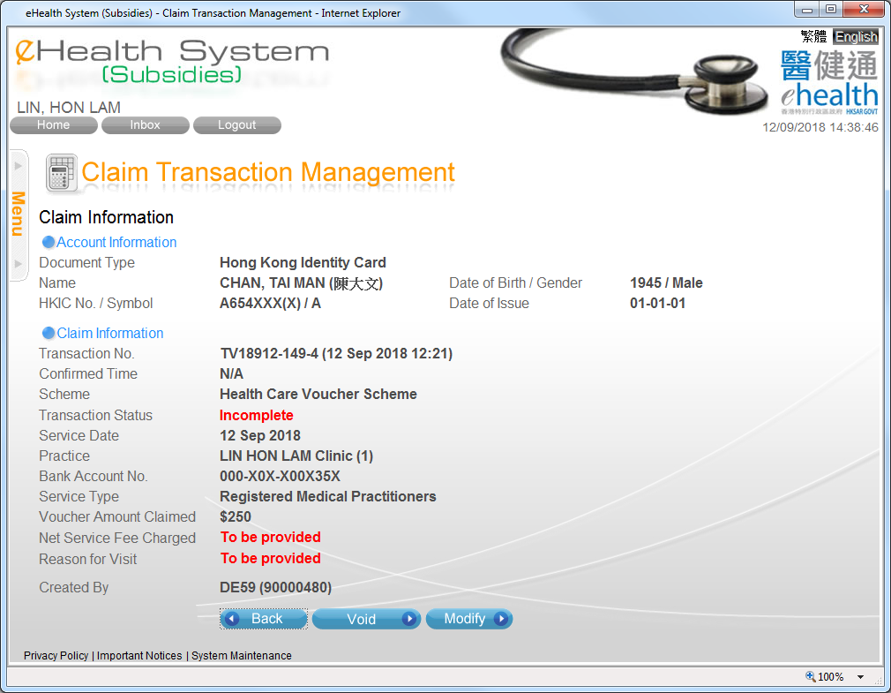
Claim Transaction Management
The claim transaction details are shown.
You may void the claim by pressing “Void”.

Slide 6
Input outstanding claim information for HCVS

Slide 7
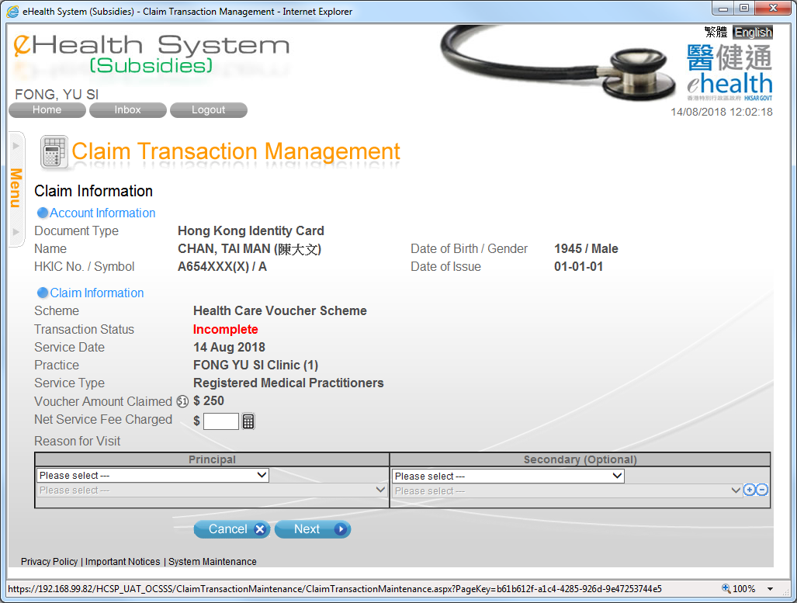
Input outstanding claim information for HCVS
You should enter the “Net Service Fee Charged” and select the “Reason for Visit” to complete the claim.

Slide 8
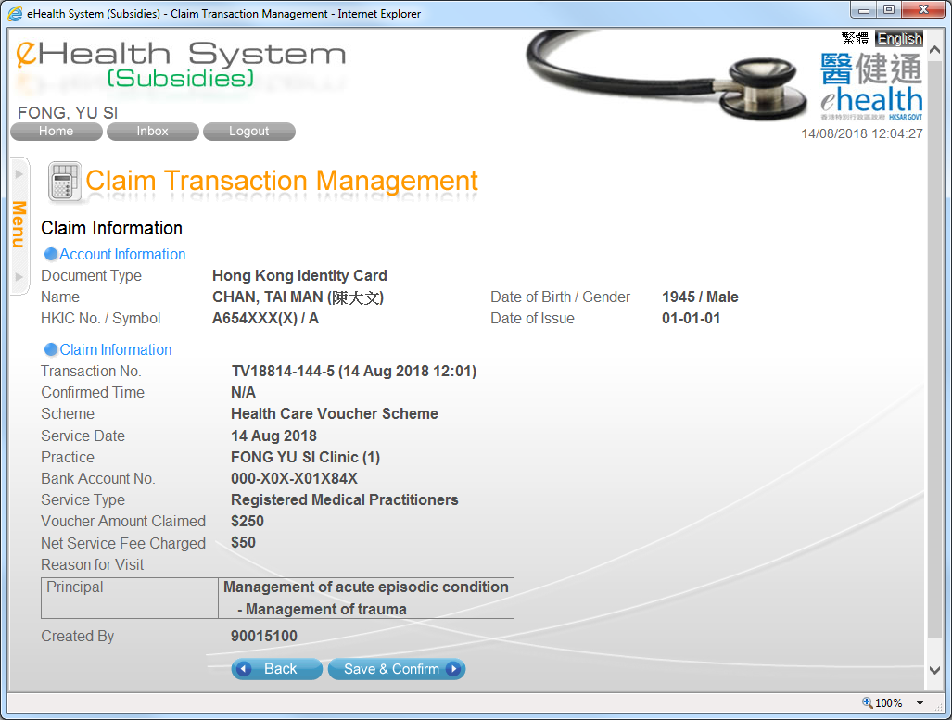
Input outstanding claim information for HCVS
Press “Save & Confirm” to confirm the claim.

Slide 9
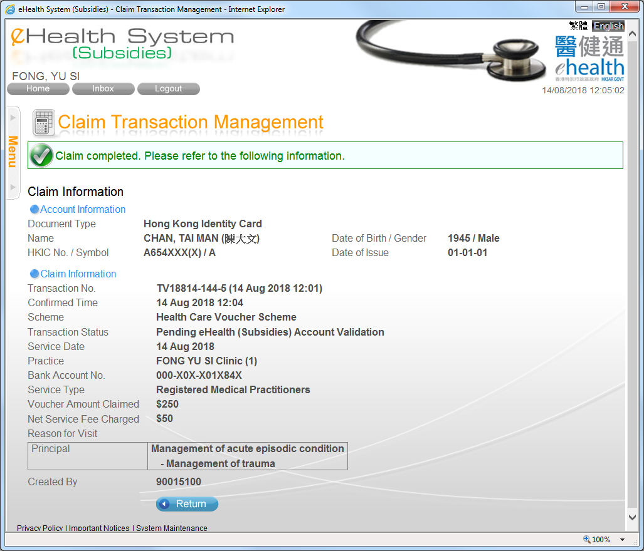
Input outstanding claim information for HCVS
Return to “Claim Transaction Management” front page.

Slide 10
~ Thanks for watching ~

