Slide 1
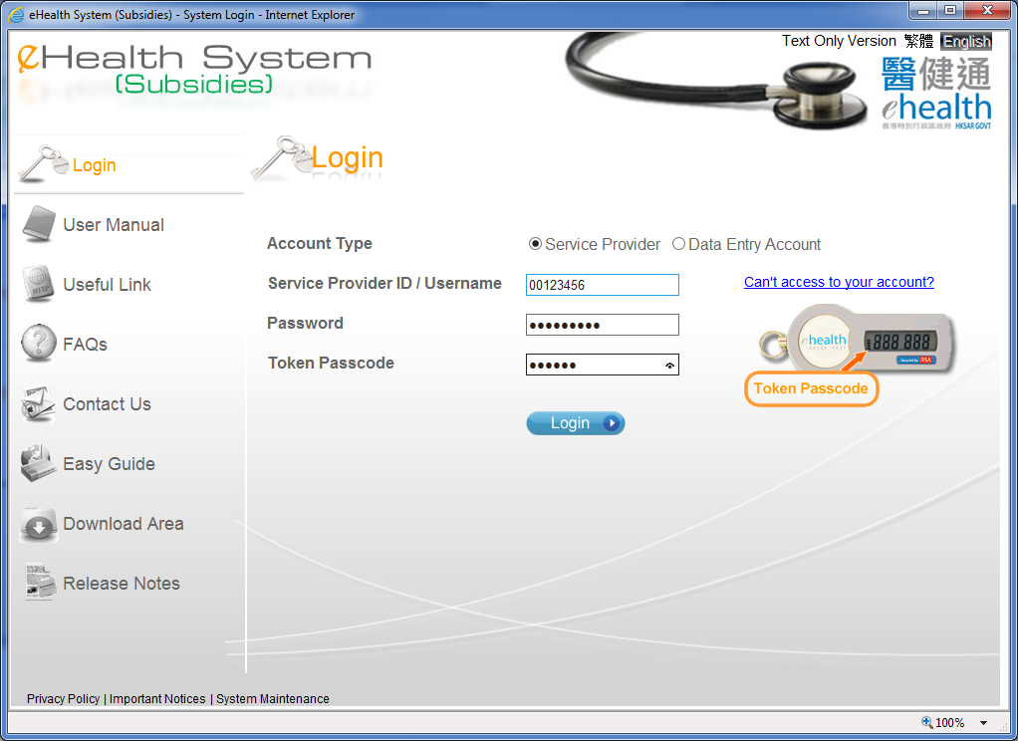
Void Claim Management

Slide 2
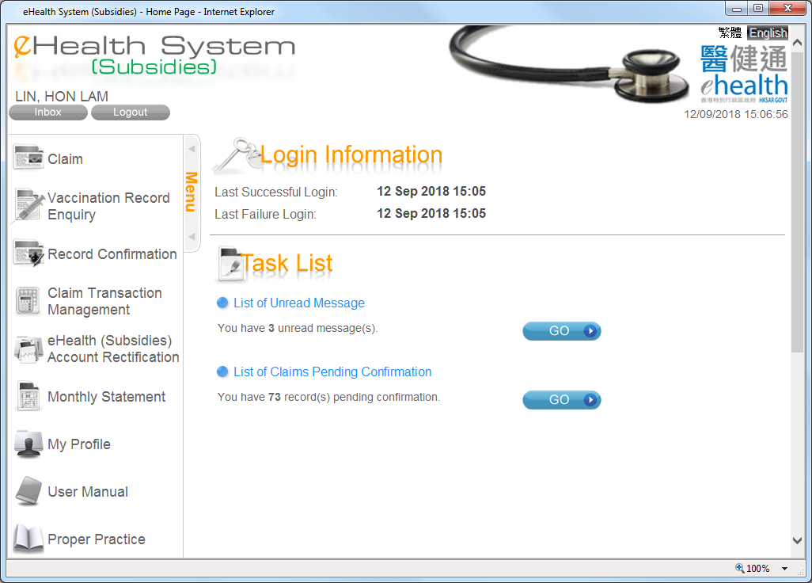
Void Claim Management

Slide 3
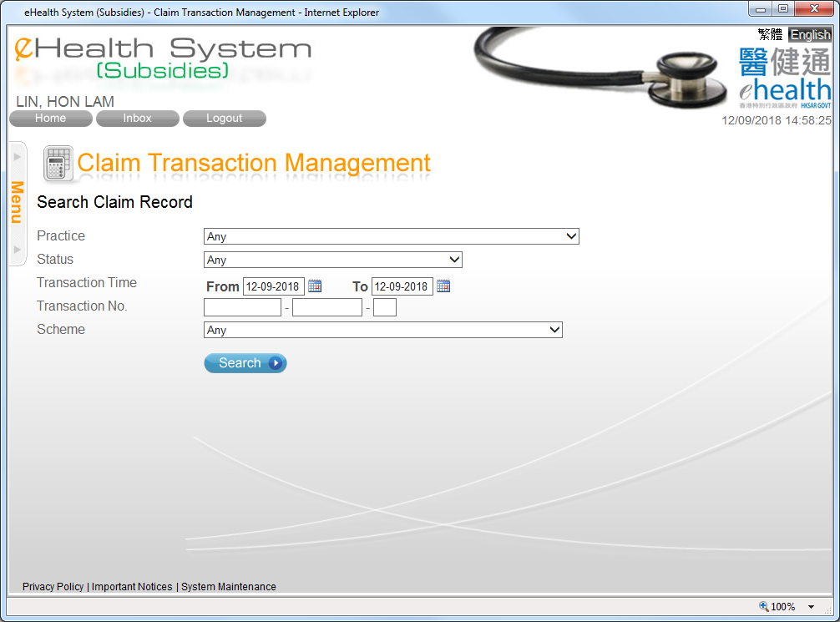

Void Claim Management
You can search the claim records by different criteria.

Slide 4
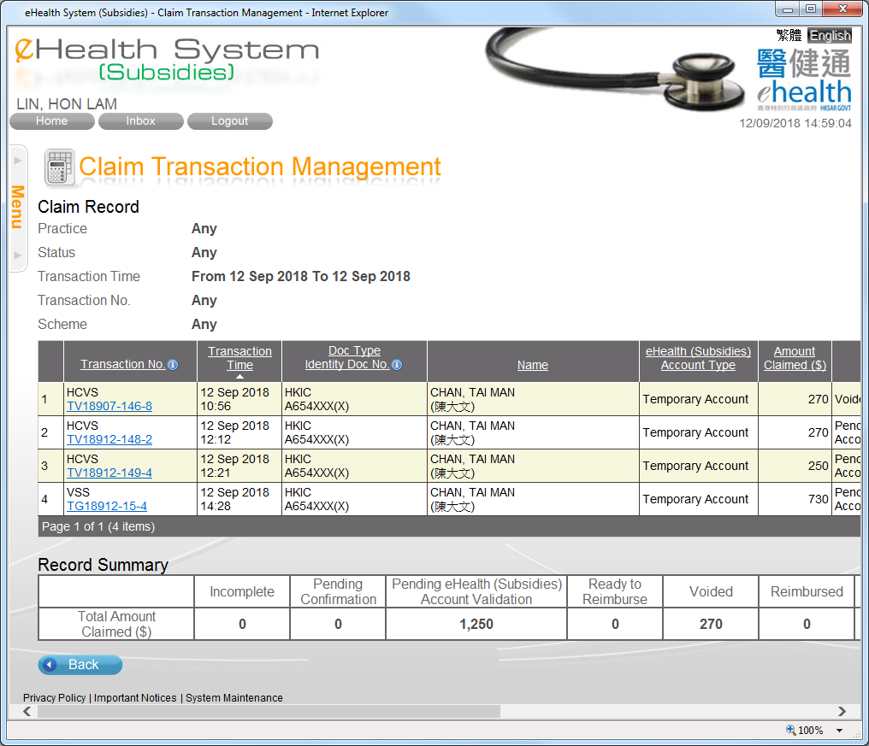
Void Claim Management
You may press the column header to sort the records.
You may press the transaction no. to view and to void the claim details.

Slide 5
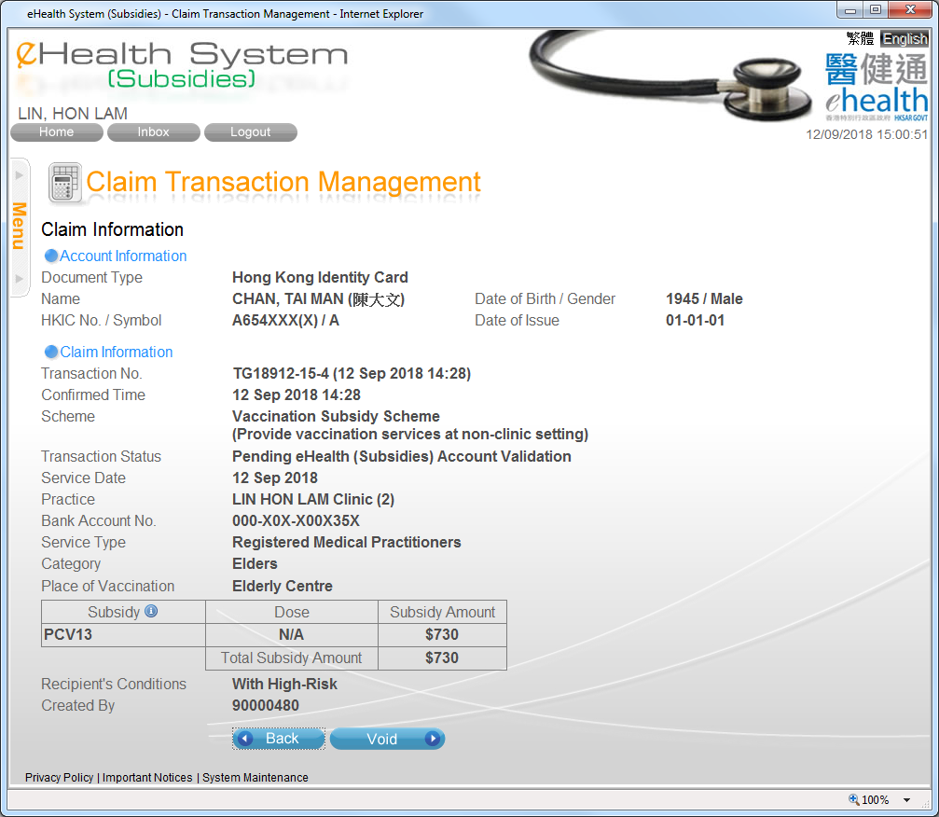
Void Claim Management
The claim transaction details are shown.
You may void the claim by pressing “Void”.

Slide 6
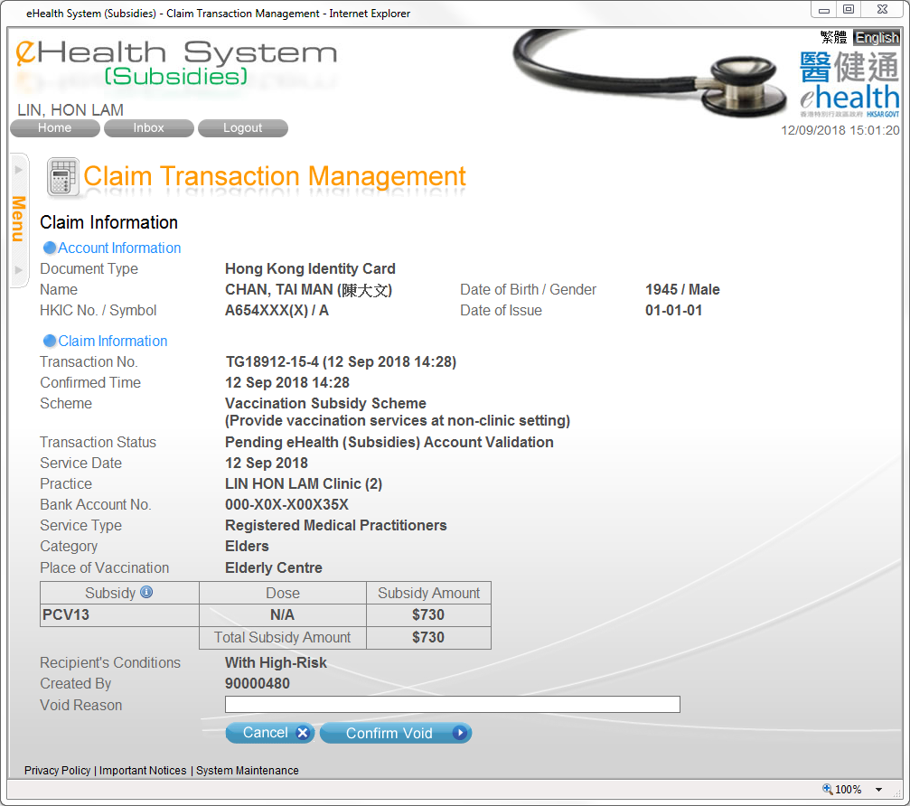
Void Claim Management
You should enter the void reason and press “Confirm Void”.

Slide 7
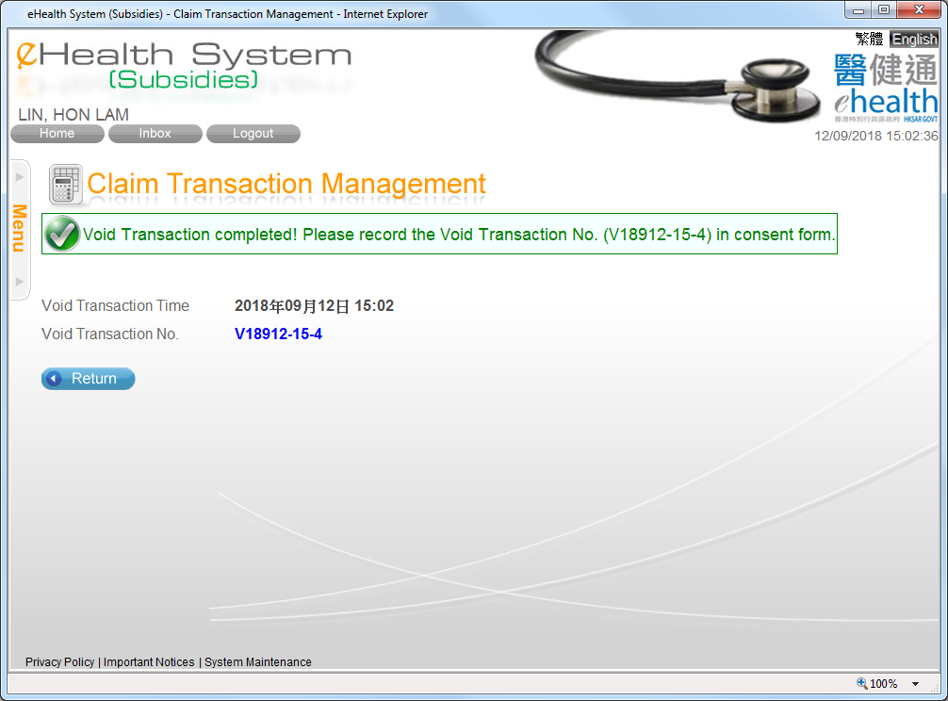
Void Claim Management
You should record the void transaction number in consent form

Slide 8
~ Thanks for watching ~

