Slide 1

Vaccination Record Enquiry

Slide 2
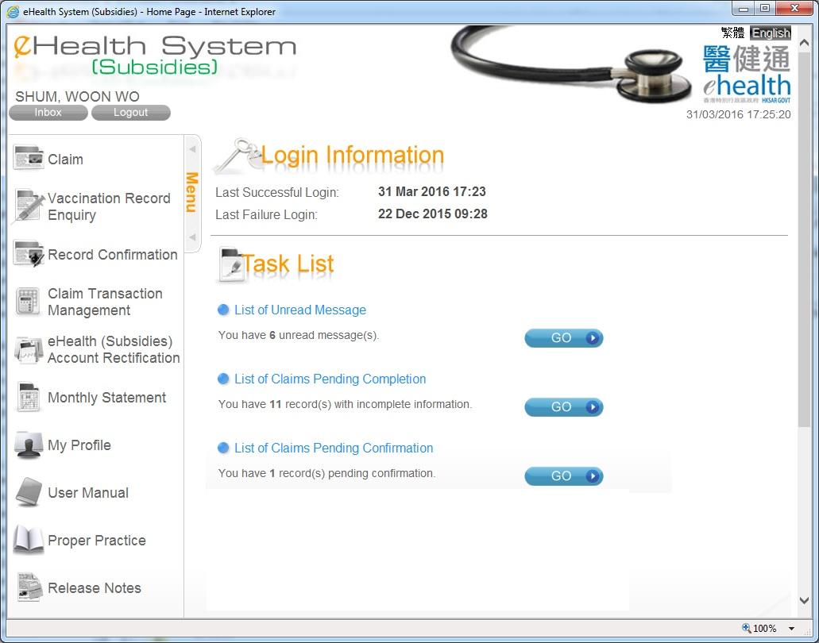
Vaccination Record Enquiry
Select Vaccination Record Enquiry.

Slide 3
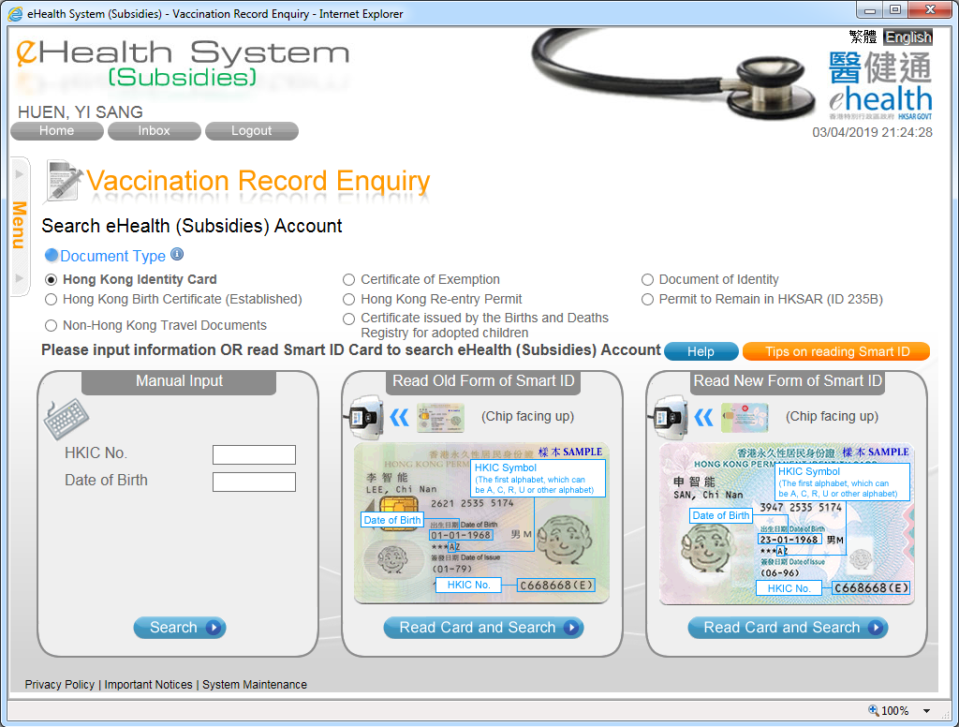
Vaccination Record Enquiry
– Search account
You can press ‘Search’ button to search account or choose to read data from Smart IC.

Slide 4
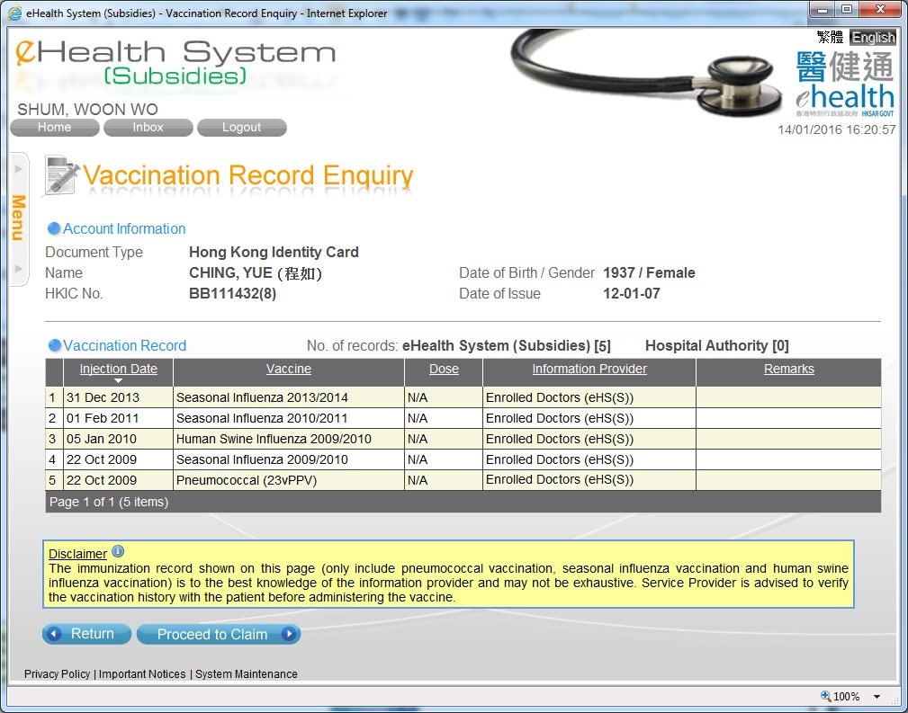
Vaccination Record Enquiry – vaccination records (for validated eHealth account)
If the patient is a validated eHealth (Subsidies) account and the matched vaccination records are found, the records are shown.
You may press ‘Proceed to Claim’ to claim subsidy.

Slide 5
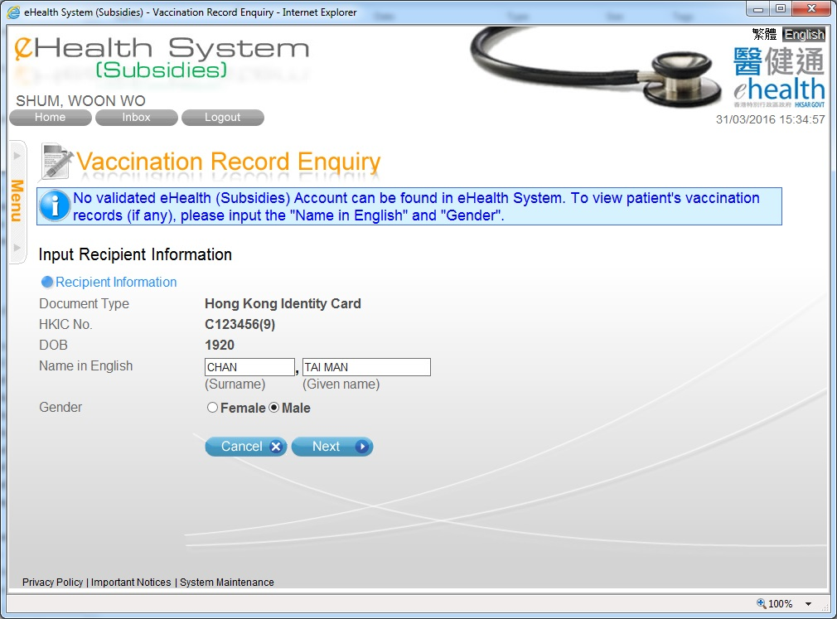
Vaccination Record Enquiry
– input details (for non-validated eHealth account)
If the recipient is not a validated eHealth (Subsidies) account, you have to input name and gender for matching vaccination records.

Slide 6
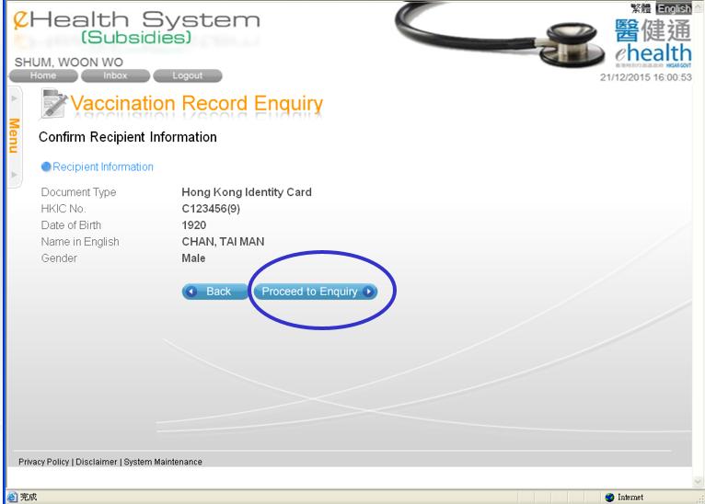
Vaccination Record Enquiry – confirm entered details (for non-validated eHealth account)

Slide 7
Vaccination Record Enquiry – vaccination records (for non-validated eHealth account)
Vaccination records are shown.
Press ‘Proceed to Claim’ to continue.

Slide 8
~ Thanks for watching ~

