Slide 1
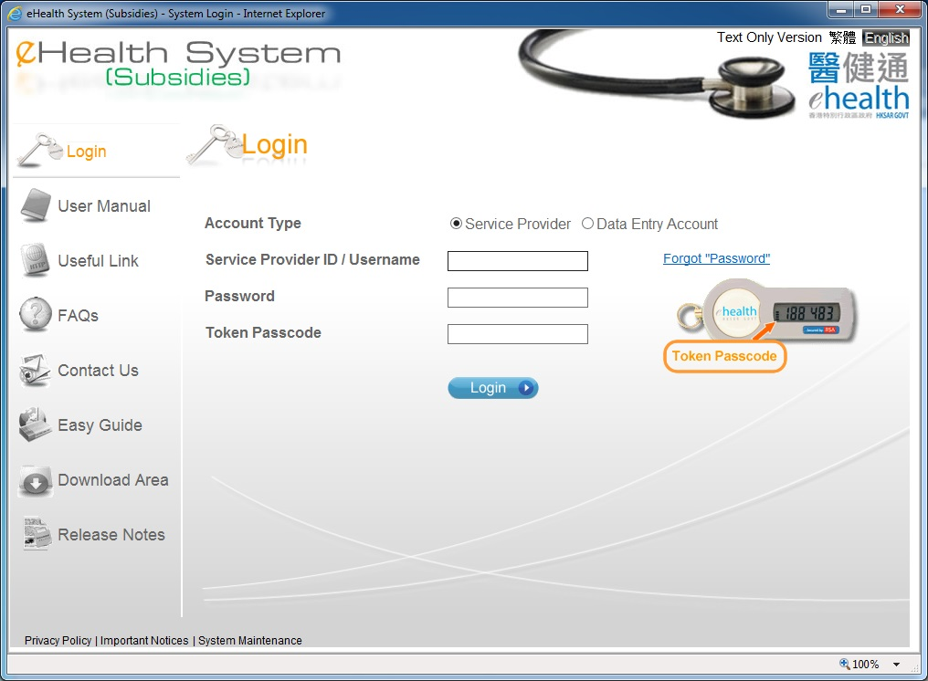
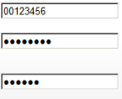
Create Data Entry Account

Slide 2
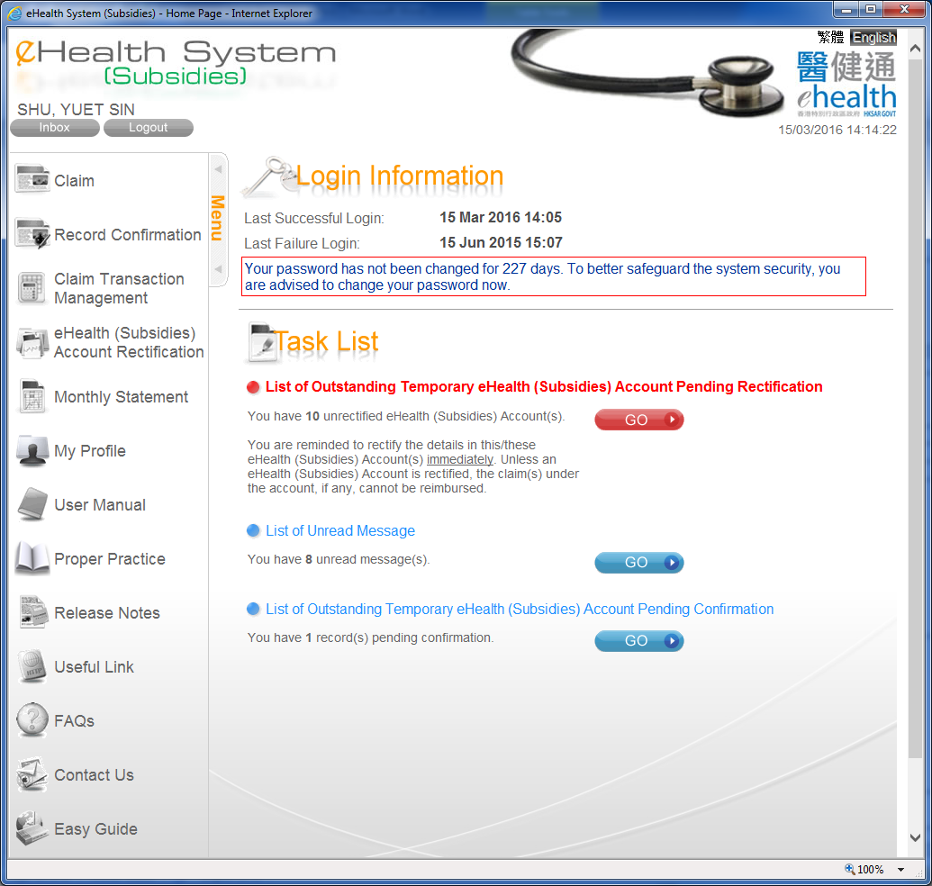
Create Data Entry Account

Slide 3
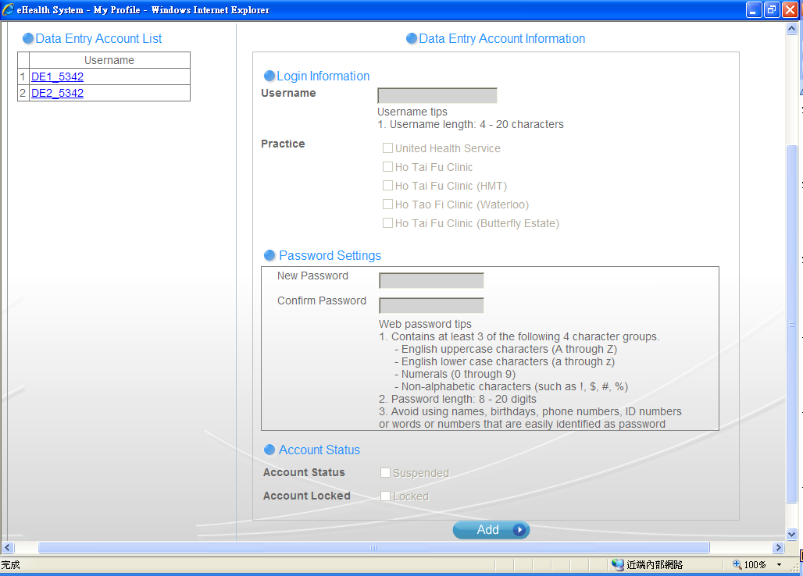
Create Data Entry Account

Slide 4
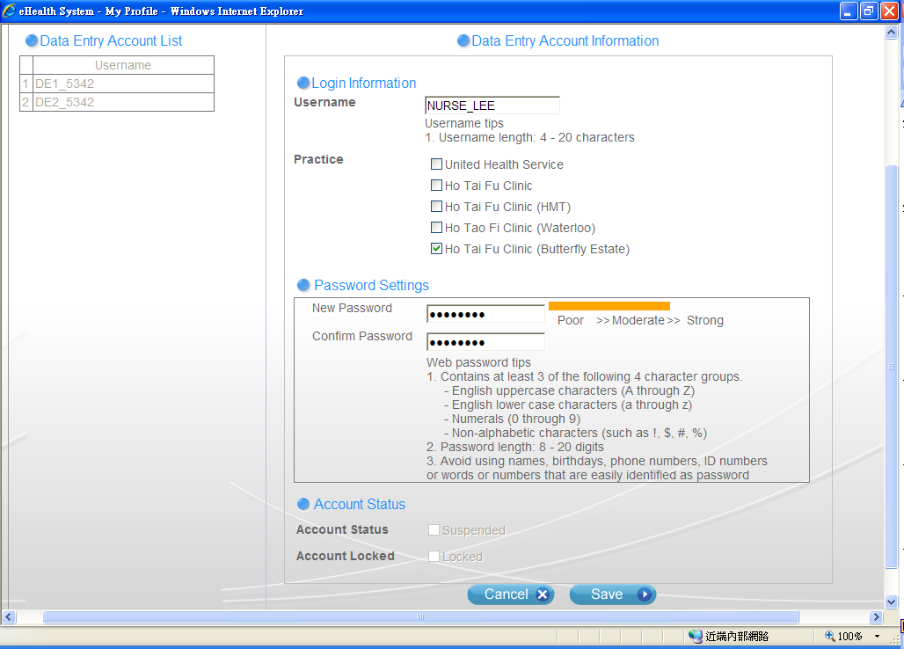
Create Data Entry Account
Select the practice for the data entry account.
Press “Save’ to add Data Entry Account.

Slide 5
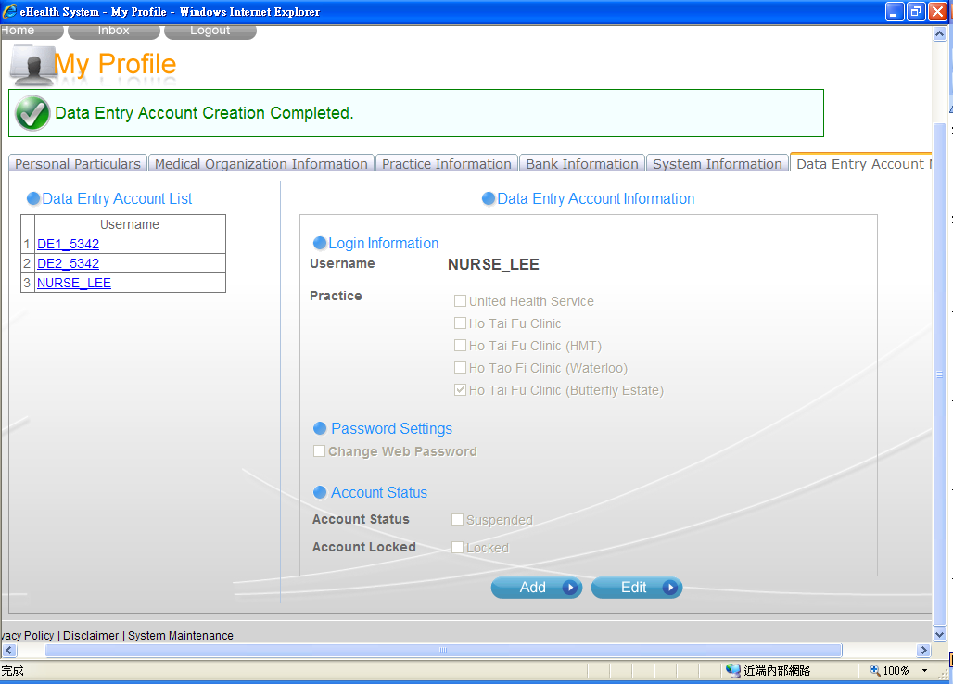
Create Data Entry Account

Slide 6
~ Thanks for watching ~

