Slide 1
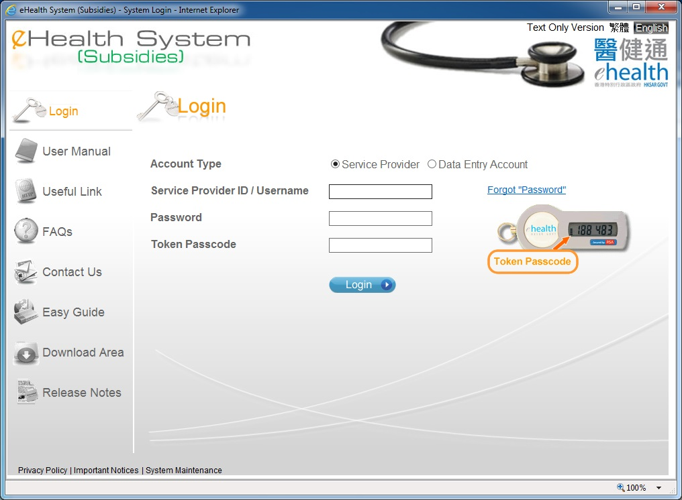
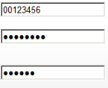
Edit Data Entry Account

Slide 2
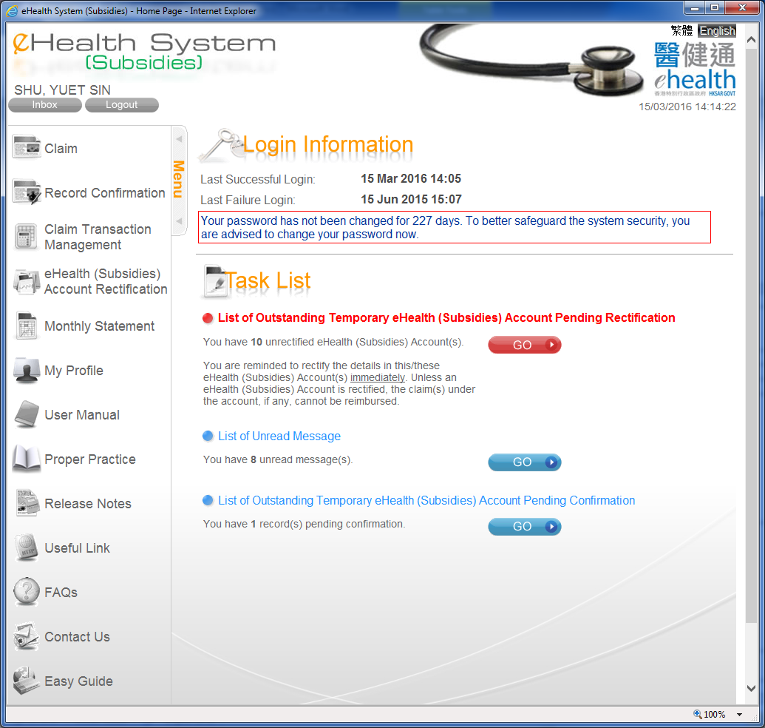
Edit Data Entry Account

Slide 3
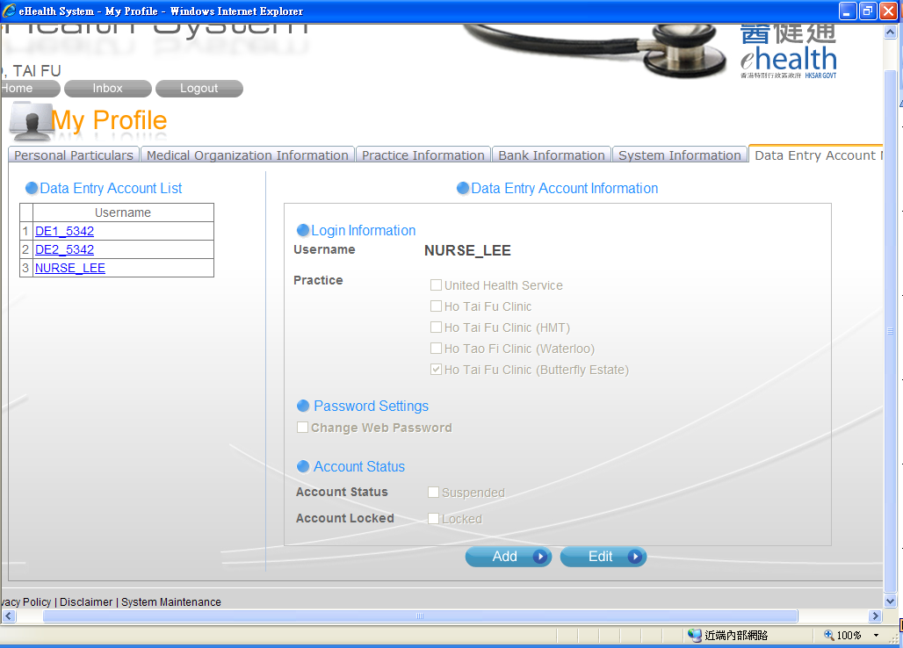
Edit Data Entry Account
Click the Data Entry account. Then the Data Entry Account details is shown.
Click ‘Edit’ button.

Slide 4
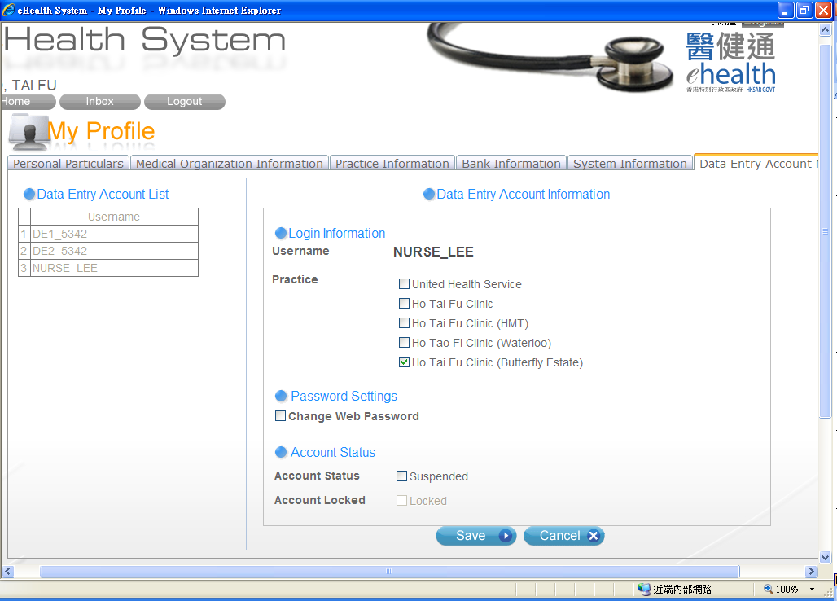
Edit Data Entry Account
You can change the practice for the Data Entry Account.
Click this to change the password.
Suspend the account by clicking this checkbox.
If the account is locked after 5 consecutive invalid login attempts, you can unlock the account by unclick this checkbox.

Slide 5
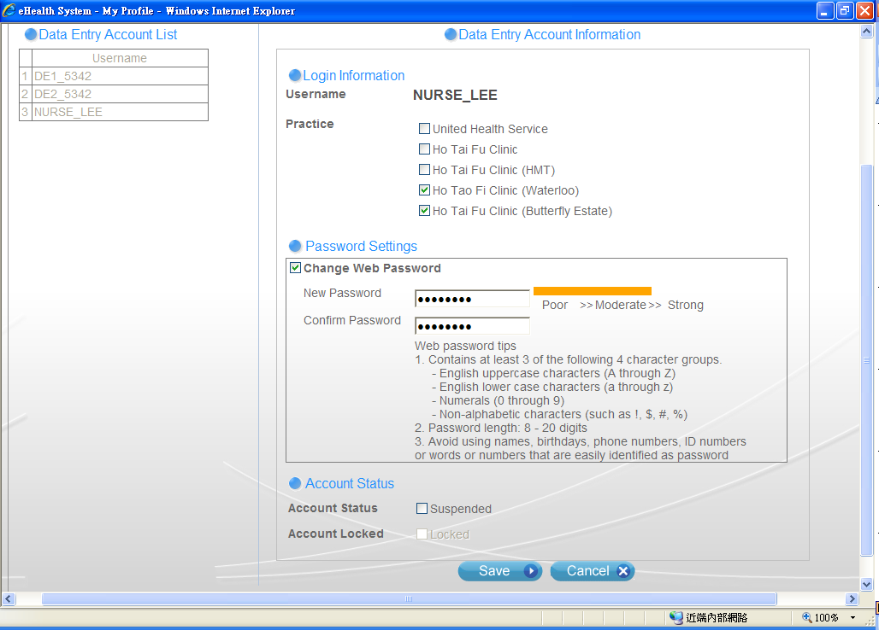
Edit Data Entry Account
After clicking the checkbox, you may input the new password.
Click ‘Save’ to save the changes.

Slide 6
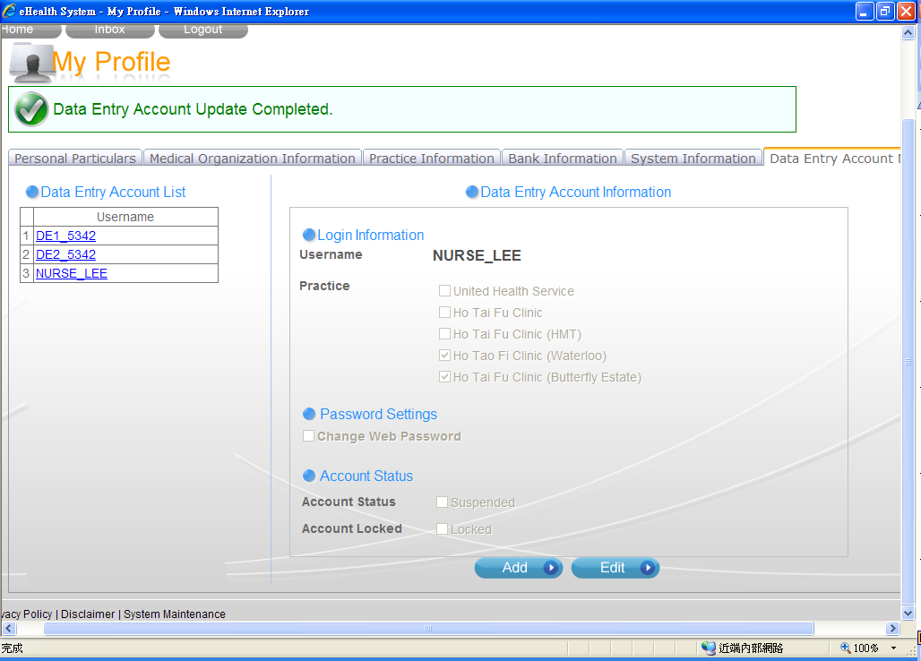
Edit Data Entry Account

Slide 7
~ Thanks for watching ~

