Slide 1
Service Provider recover login

Slide 2
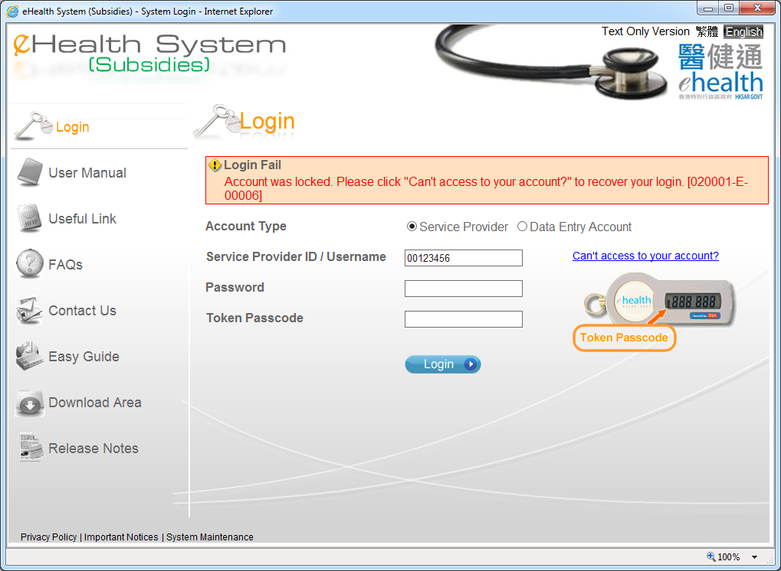

If your account was locked or you have forgot your password, you can click “Can’t access to your account” to recover your login.

Slide 3
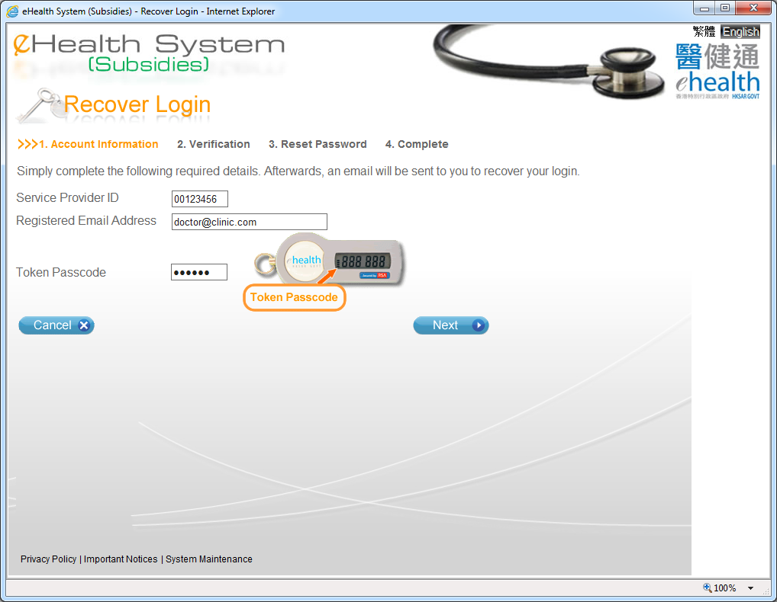
Please input your contact email address as recorded in the eHealth System (Subsidies).

Slide 4
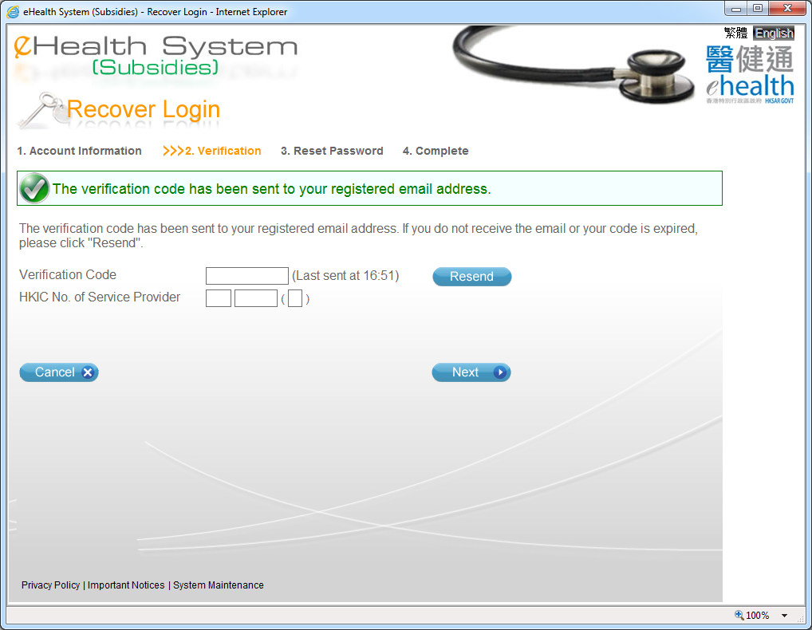

User check email to get the verification code
The verification code would be valid for 10 minutes and the last sending time is shown for reference
If the account is locked, HKIC No. of service provider is required for further identification checking

Slide 5
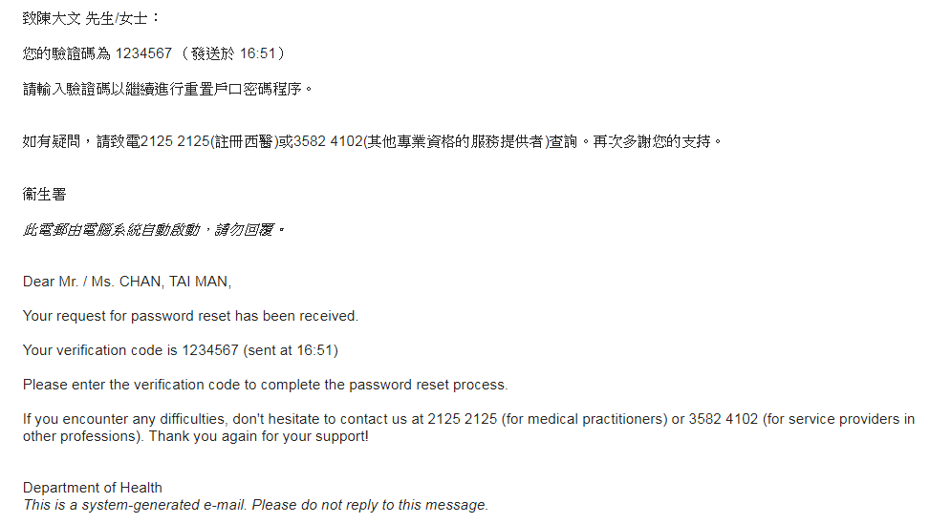

Slide 6
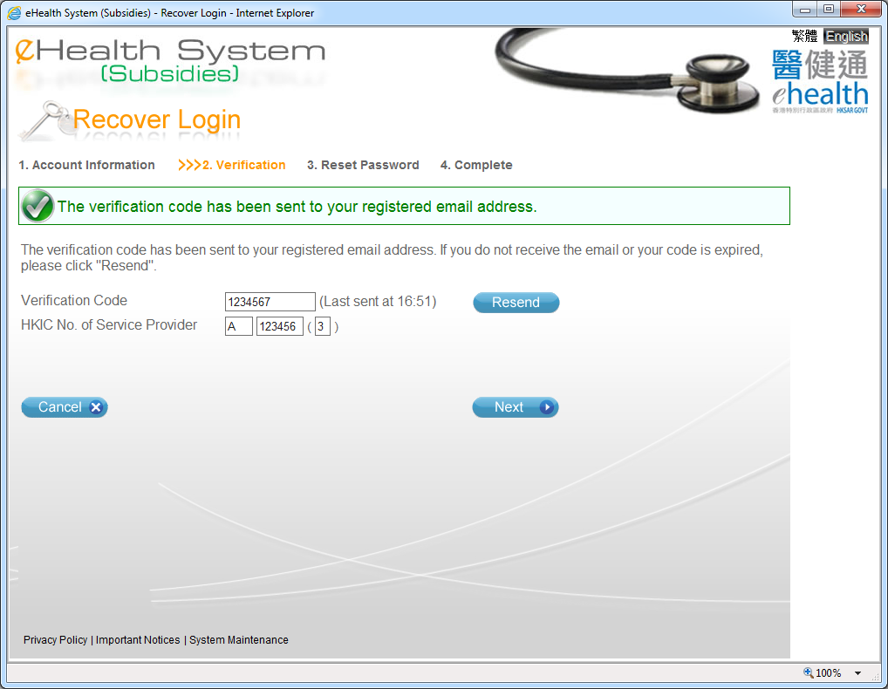
User is required to input the verification code as shown in the email
In case the code is expired or user can’t receive the email, user can click the “Resend” button to resend the verification code

Slide 7
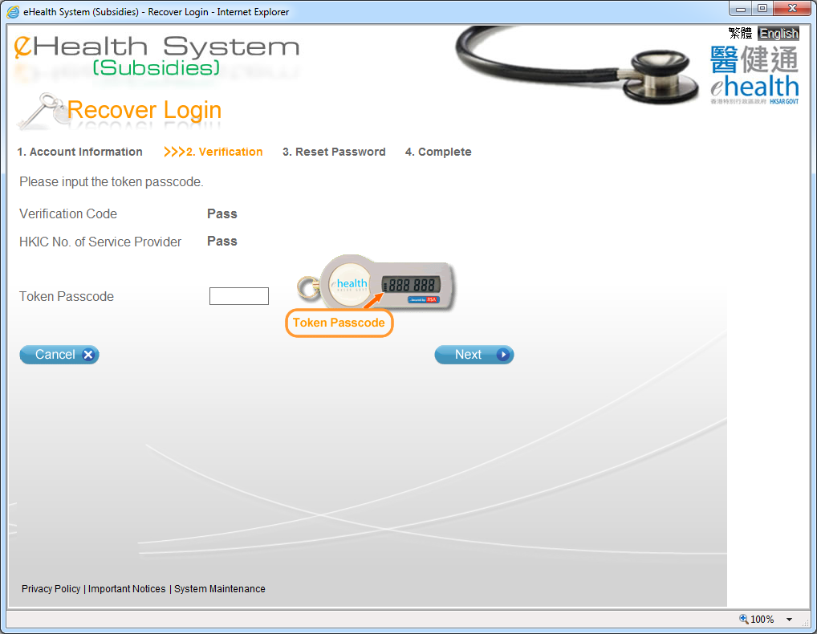
User has to input the token passcode again and only token which is well functioning would be accepted

Slide 8


Slide 9
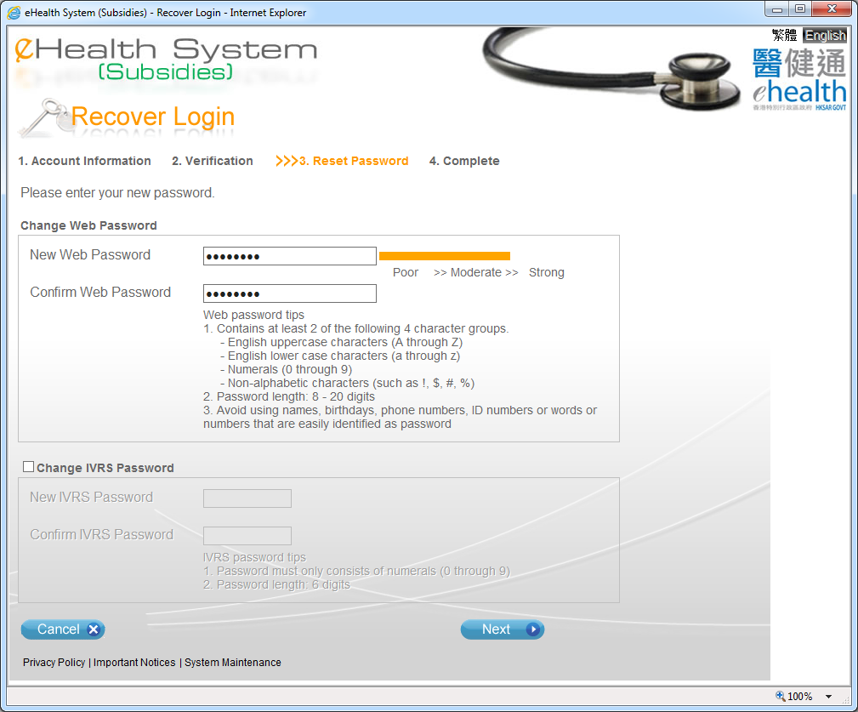
User is required to change the web password
If the IVRS account is not locked, changing IVRS password is optional
A checkbox will be shown for user to choose whether to change IVRS password or not (Default uncheck)

Slide 10

If IVRS account is locked, it is necessary to change the IVRS password

Slide 11
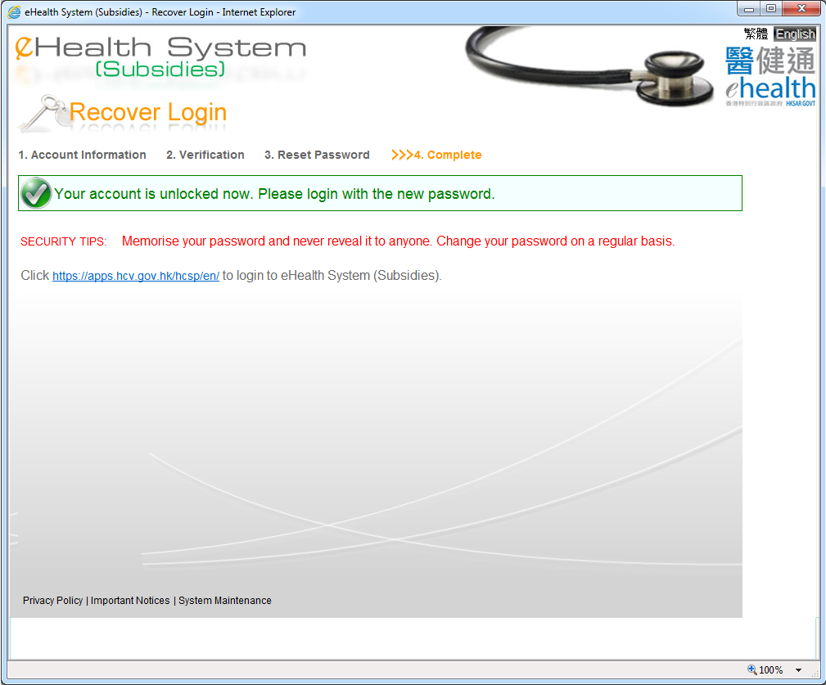
If the account is unlocked, a message will appear to indicate that the account has been unlocked
User can login to eHS(S) with new password

Slide 12
Data Entry Account recover login

Slide 13
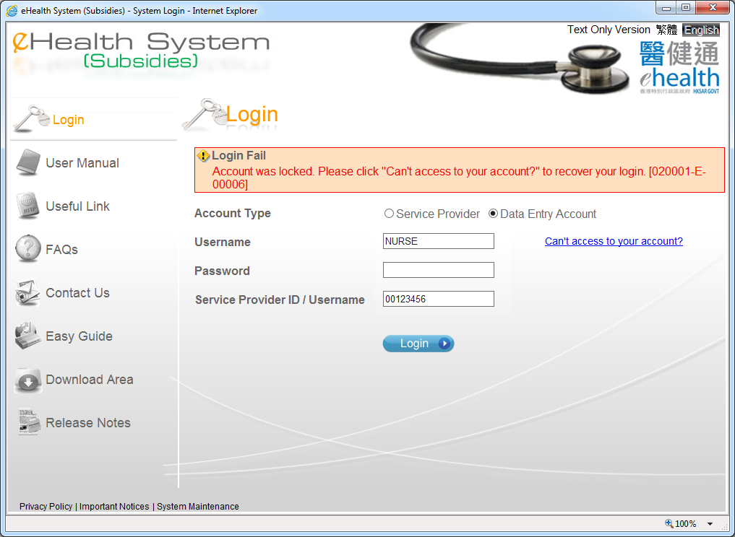
If your account was locked or you have forgot your password, you can click “Can’t access to your account” to recover your login.

Slide 14
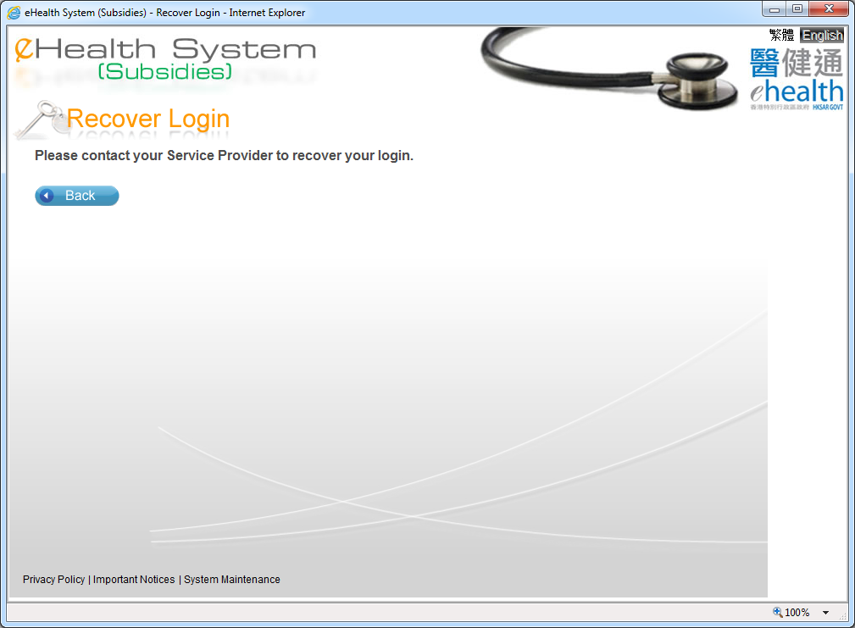

Slide 15
~ Thanks for watching ~

