Slide 1
Content
e-Enrolment
Account Activation

Slide 2
e-Enrolment

Slide 3


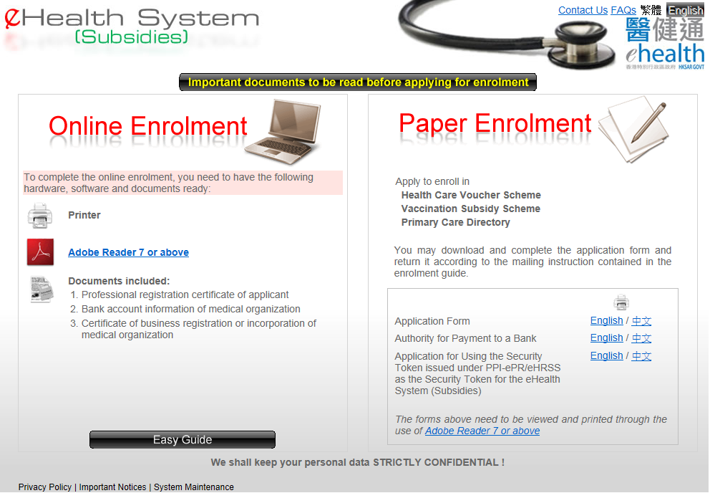


e-Enrolment
You can apply the eHealth System (Subsidies) either online or via paper.
You need to read the “Important documents to be read” before completing the enrolment.
For paper enrolment, you may click the links to download the common enrolment forms for the scheme.
Please have the documents handy and you may click the "Online enrolment" to start.

Slide 4
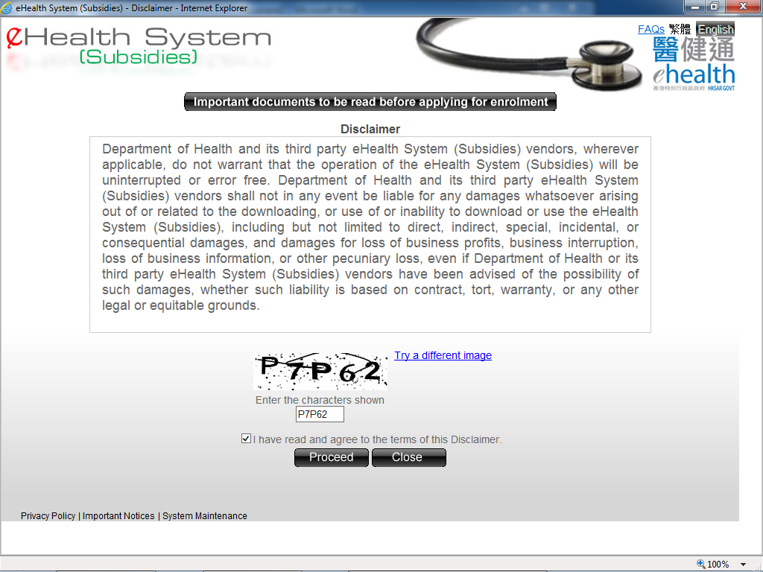


e-Enrolment
Please read the "Disclaimer" carefully.
You should key in the characters shown in the image. Also click the checkbox to agree to the terms of the "Disclaimer".

Slide 5
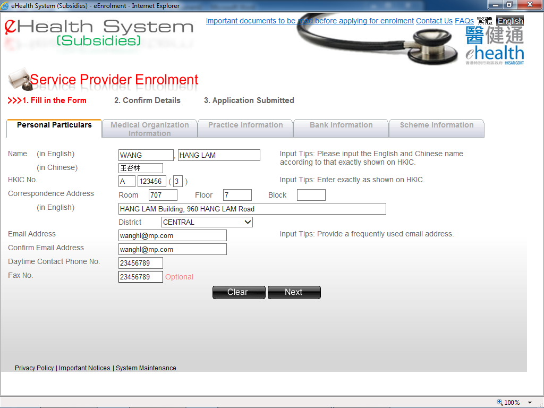

e-Enrolment
Enter the personal information such as English Name, Chinese Name and HKIC No. exactly as shown on the HKIC.

Slide 6
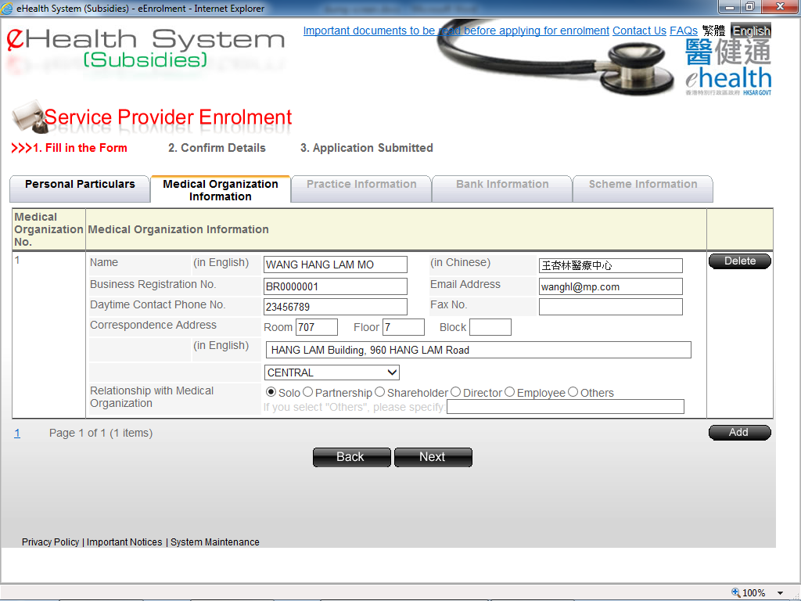


e-Enrolment
Please ready the business registration certification of the medical organization to fill in the information.
You may press “Add” to add another Medical organization.

Slide 7
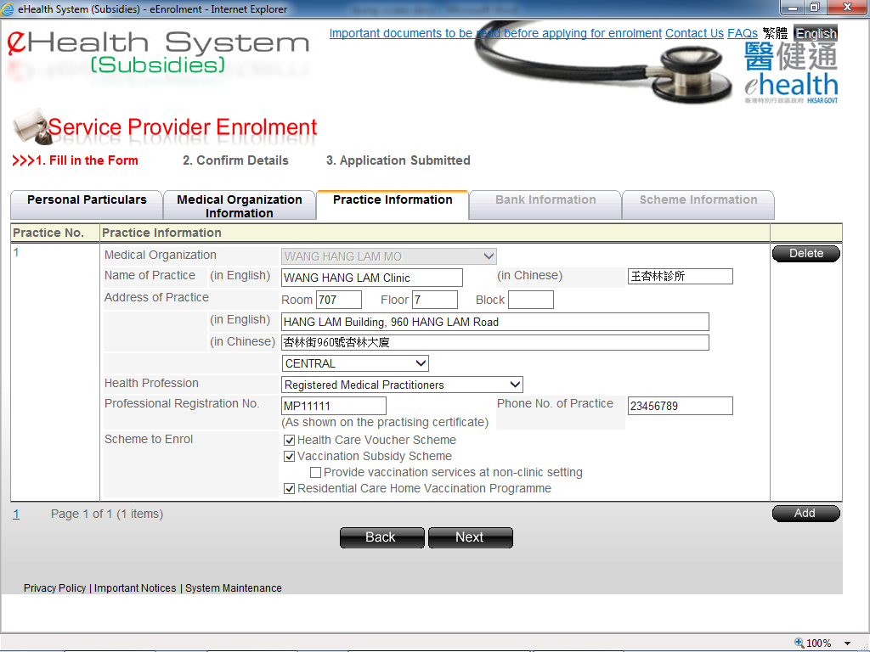



e-Enrolment
Please fill in the practice information.
Please select the scheme.
You may press “Add” to add more practices.

Slide 8
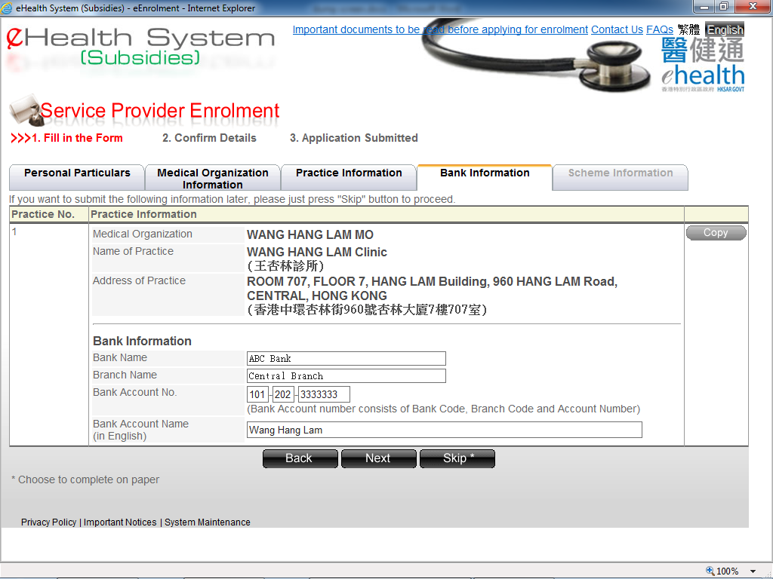

e-Enrolment
Please ready the bank account information to fill in.

Slide 9
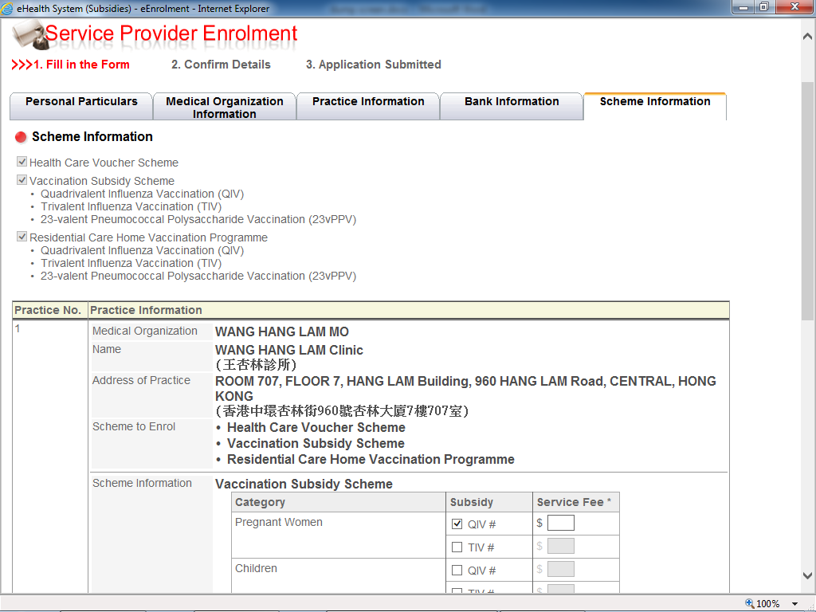

e-Enrolment
Please enter the service fee if you have selected the Vaccination Subsidy Scheme.

Slide 10
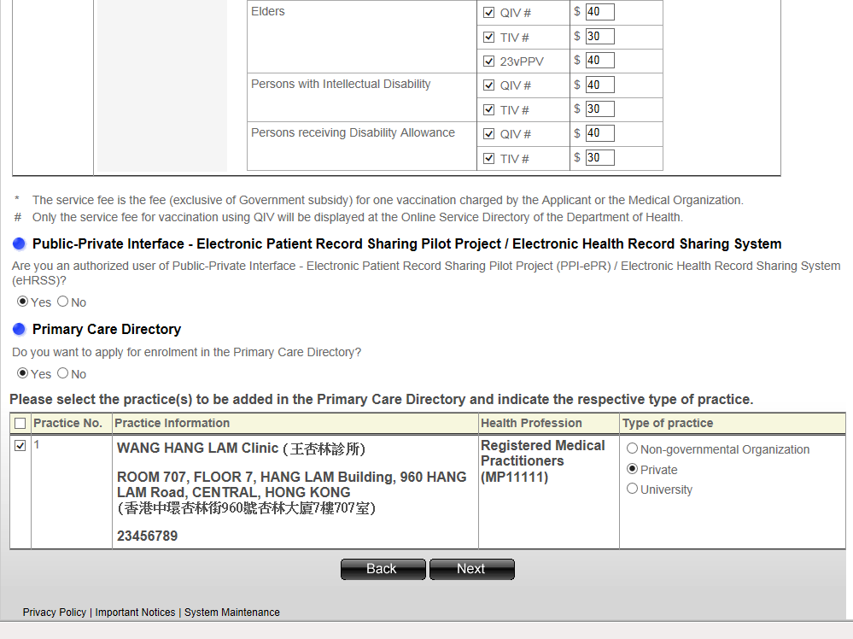


e-Enrolment
For professional of medical practitioner, Chinese medicine practitioner, dentist, enrolled nurse and registered nurse, please indicate whether you are already a PPI-ePR/eHRSS user.
You may select the practices to join the Primary Care Directory.

Slide 11
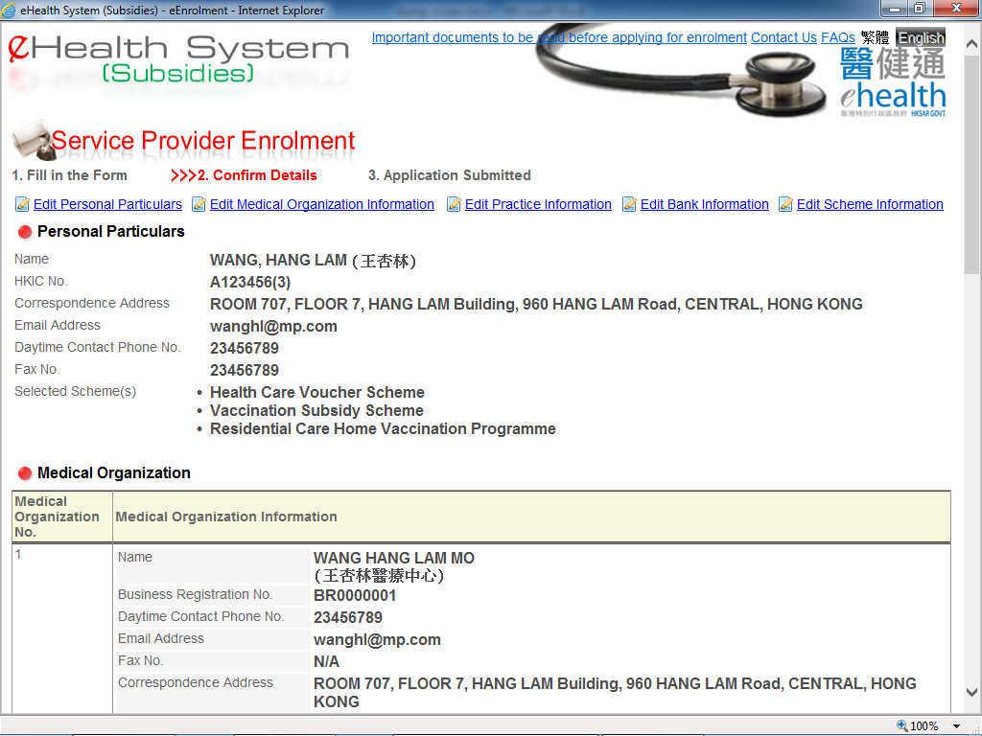


e-Enrolment
You may press the link to go directly to the page for modification.
Please double check the application information before submission.

Slide 12
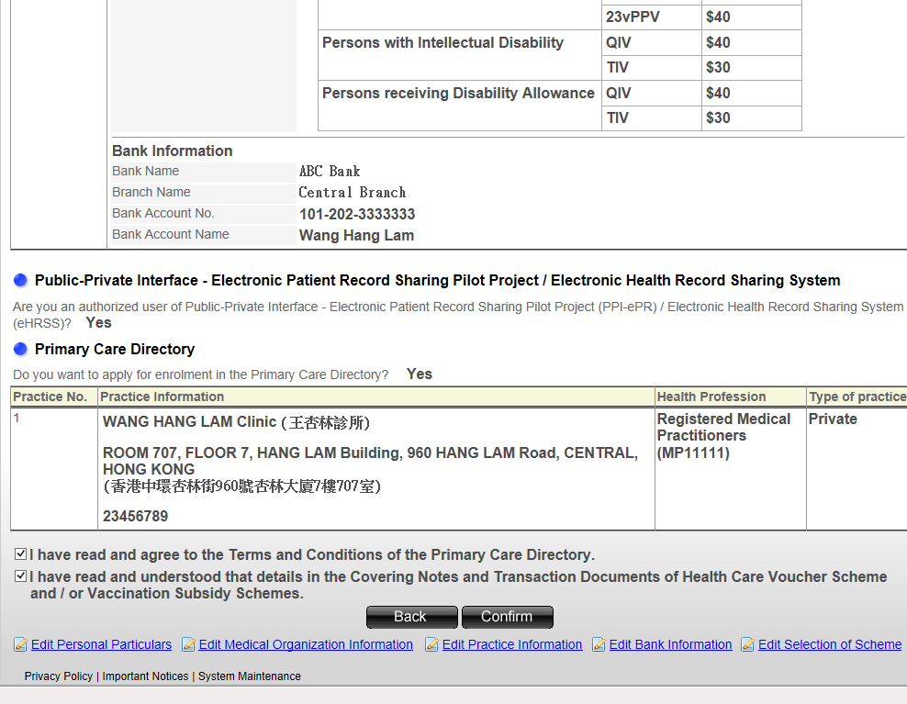

e-Enrolment
You must click the checkbox to confirm you have read and understood the forms and documents.

Slide 13
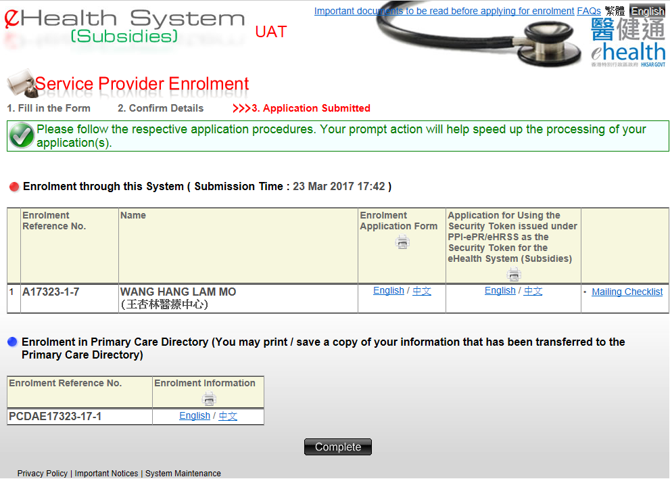


e-Enrolment
An enrolment reference no. is created for the application.
Press the "English/中文" to view and print out the enrolment application form (English or Chinese version).

Slide 14
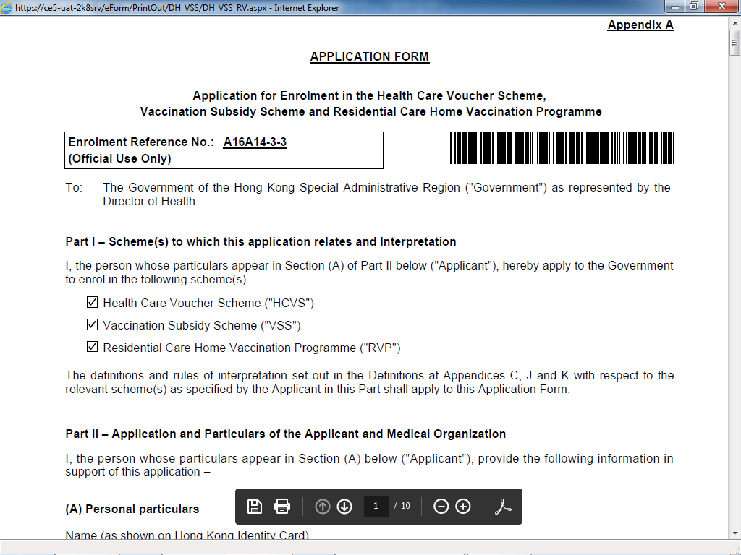

e-Enrolment
You must print out the enrolment application form.
Afterwards, please mail the application forms with required documents for us to process your application.

Slide 15
Account Activation

Slide 16
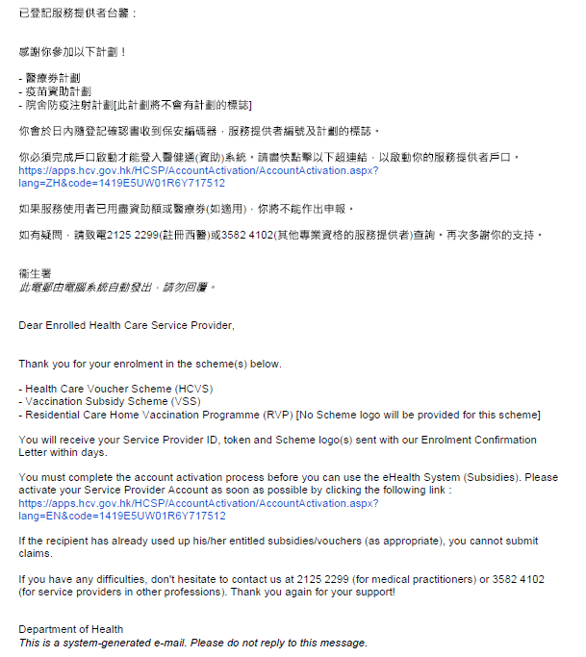


Account Activation
Please ready your service provider ID and token. Then you may click the link to continue the activation process.
If your application is approved, an email will send to your registered email address. Also, an Enrolment confirmation letter with a token will be sent to your correspondence address.

Slide 17
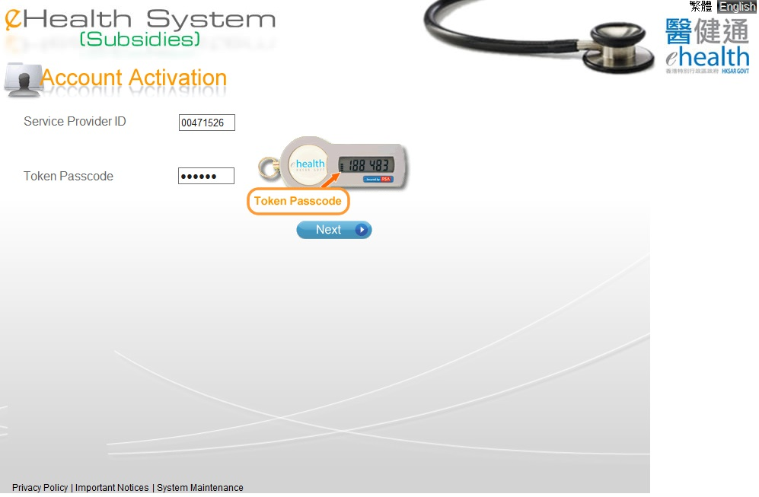

Account Activation
Input the service provider ID and the Token Passcode.

Slide 18

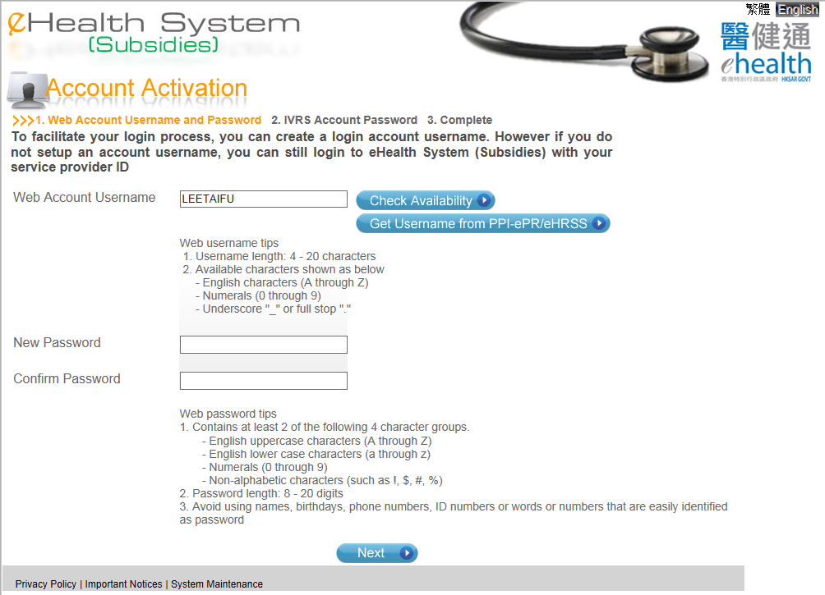

Account Activation
You may create your own account username.
You may then check the username availability by clicking the "Check Availability".

Slide 19
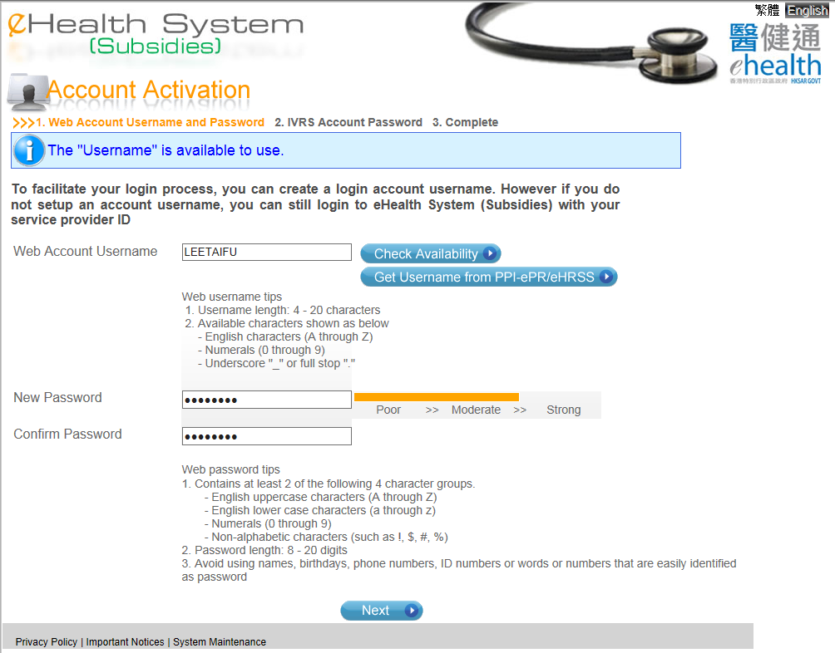

Account Activation
Please ensure your new password is set according to the password tips.

Slide 20
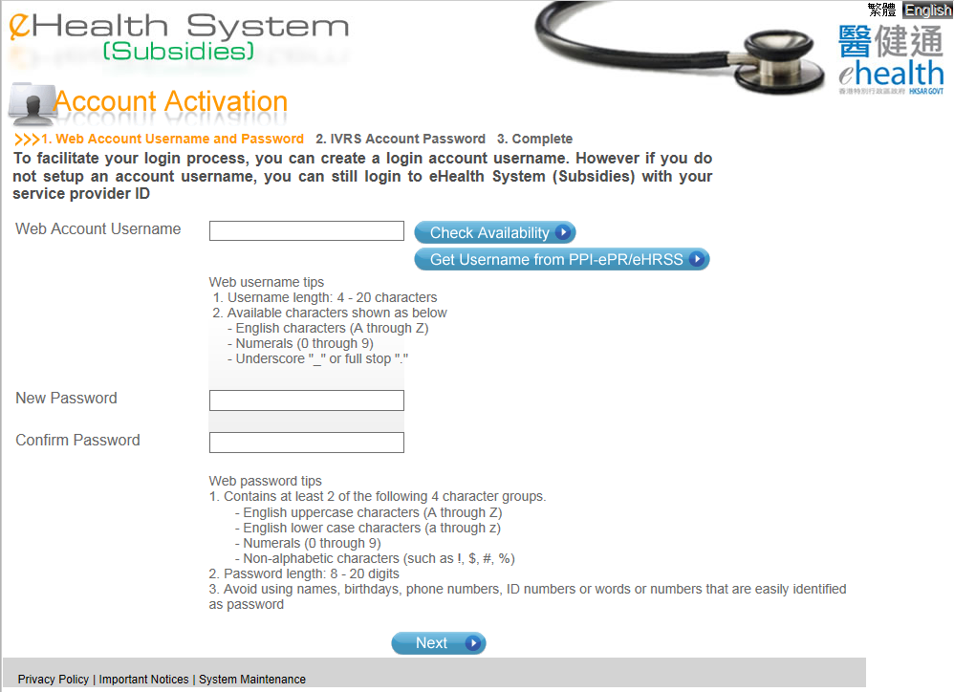

Account Activation
If you are the current user of PPI-ePR/eHRSS, you can get your username from PPI-ePR/eHRSS by pressing “Get Username from PPI-ePR/eHRSS” button.

Slide 21
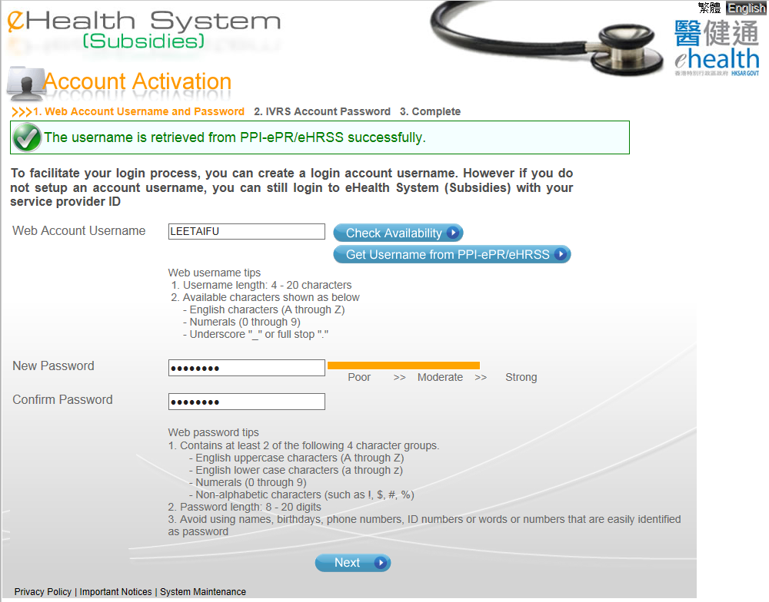

Account Activation
Please ensure your new password is set according to the password tips.

Slide 22
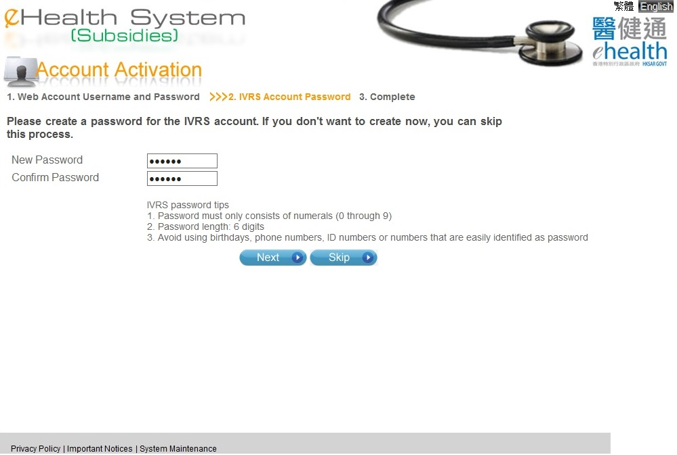

Account Activation
If you have enrolled in Health Care Voucher Scheme, you may activate your IVRS account.
Please ensure your new password is set according to the IVRS password tips.

Slide 23
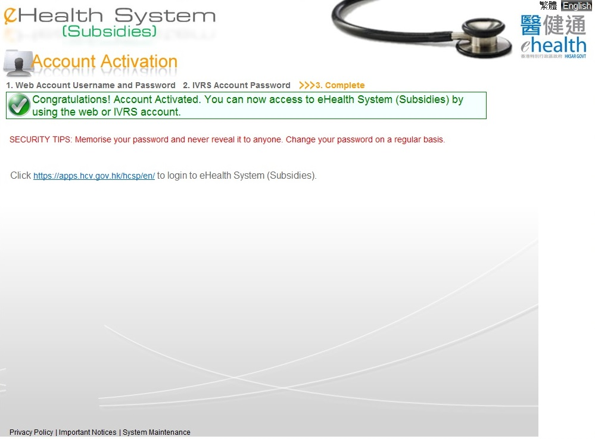

Account Activation
You may click this link to access the eHealth System (Subsidies) .

Slide 24
~ Thanks for watching ~

