Slide 1
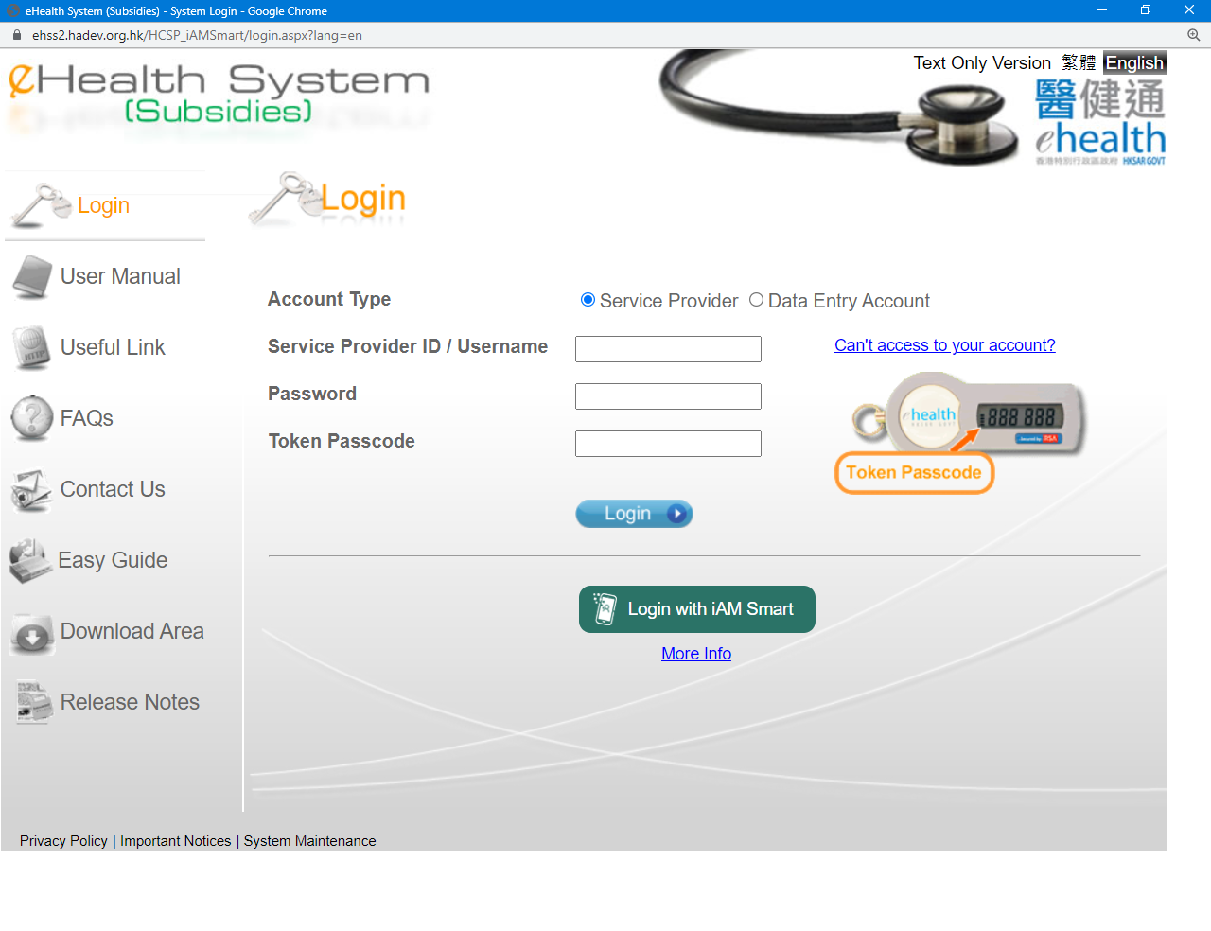
Login with password and token – Service Provider
Please select Service provider.
Please input your service provider ID or Username, password and token passcode.
Click ‘Login’ button.

Slide 2
Login with “iAM Smart” –
Service Provider
Please select Service provider.
Click ‘Login with iAM Smart’ button. Follow instructions on iAM Smart and eHS(S).

Slide 3
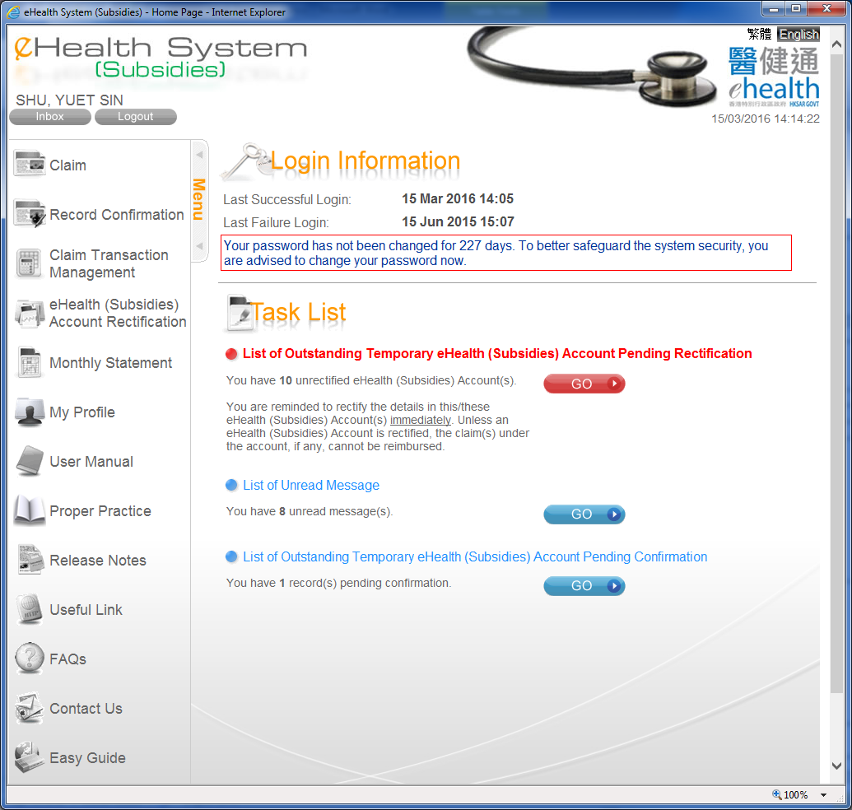
Login – Service Provider
It shows the last successful login and last failed login for user reference.
It shows any outstanding works pending your input.

Slide 4
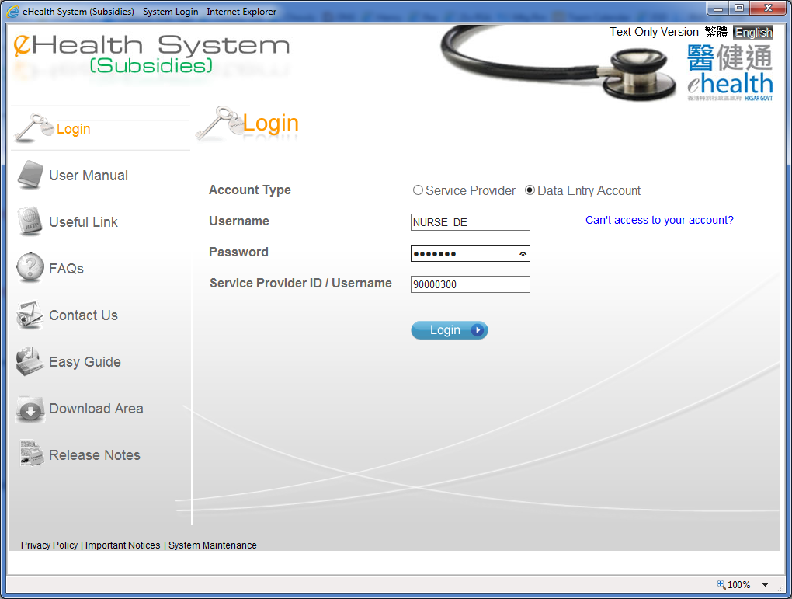
Login – Data Entry Account
Please select Data Entry Account.
Please input username, password and the service provider ID or Username.
Click ‘Login’ button.

Slide 5
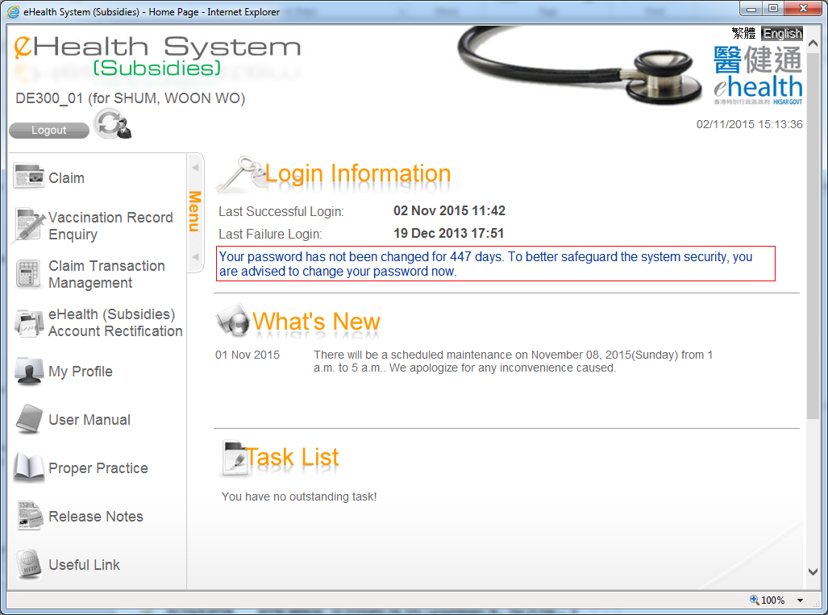
Login – Data Entry Account
It shows the last successful login and last failed login for user reference.

Slide 6
~ Thanks for watching ~

