Slide 1
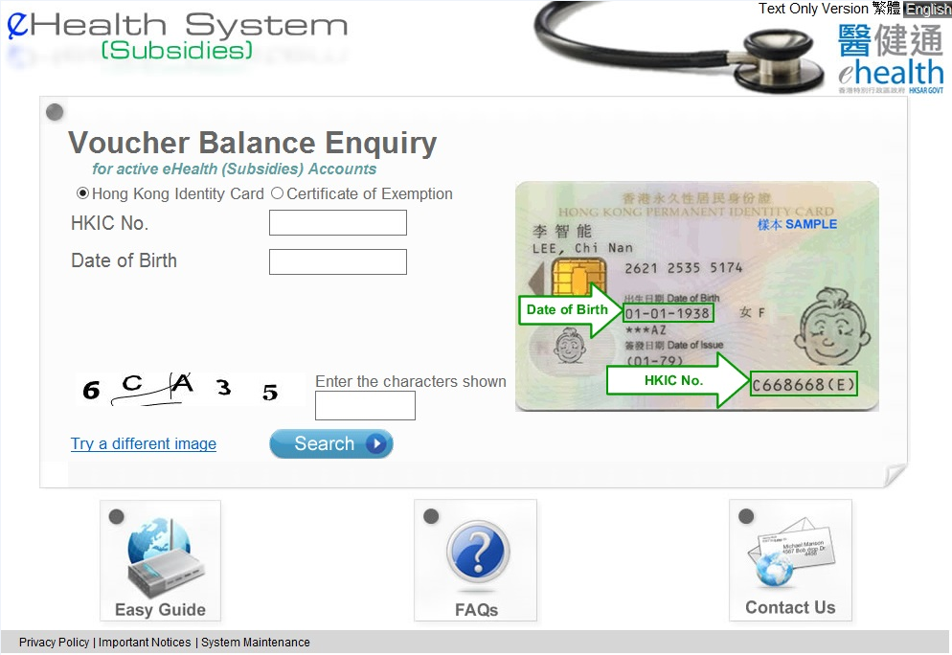
Voucher Balance Enquiry
Enter “HKIC No.” and “Date of Birth” shown on Hong Kong Identity Card
Enter the characters shown and press “Search”

Slide 2
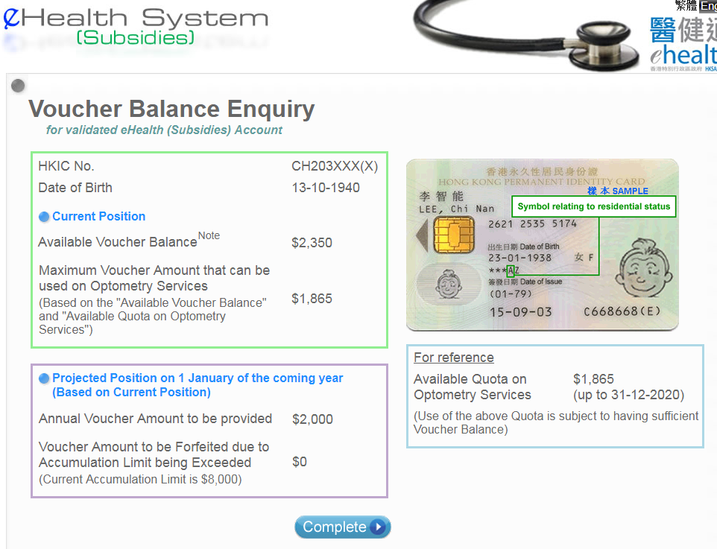
Voucher Balance Enquiry
The available voucher balance and maximum voucher amount that can be used on Optometry Services are shown on the screen

Slide 3
Voucher Balance Enquiry
–
Text only Version

Slide 4
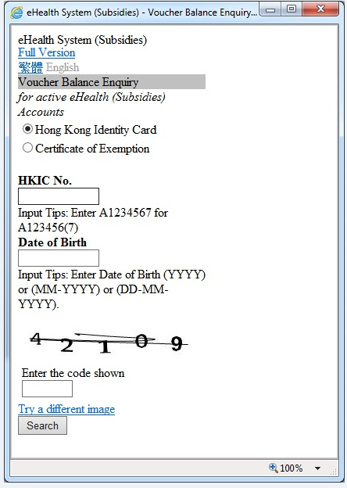
Voucher Balance Enquiry – Text only Version
Enter “HKIC No.” and “Date of Birth” shown on Hong Kong Identity Card
Enter the code shown and press “Search”

Slide 5
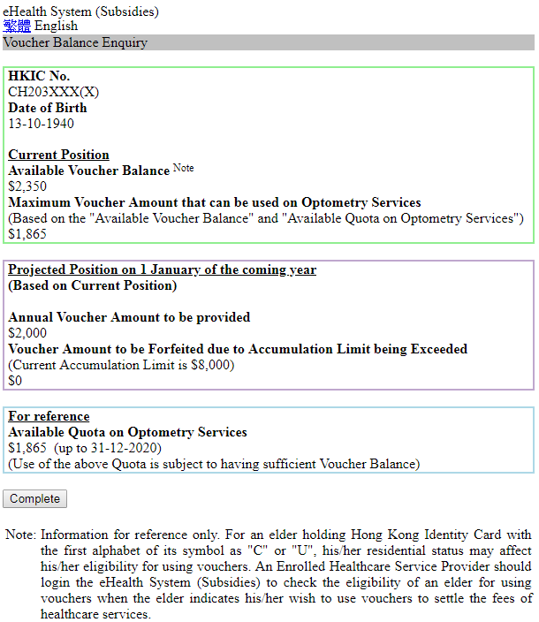
Voucher Balance Enquiry – Text only Version
The available voucher balance and maximum voucher amount that can be used on Optometry Services are shown on the screen

