Slide 1
Content
Claim subsidy under different schemes
  VSS
  RVP
  HCVS

Slide 2
VSS – Enter Claim Details

Slide 3
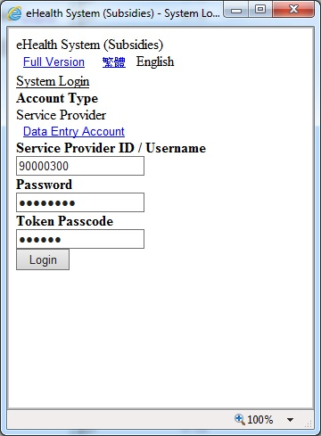
Claim (Text only version)

Slide 4
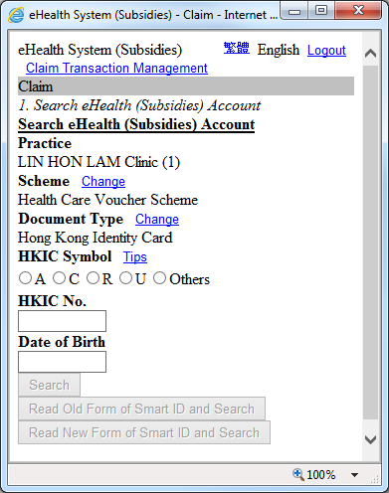
Claim (Text Only Version) – Search Account
For choosing Hong Kong Identity Card as the document type, please choose the HKIC symbol. The HKIC symbol can be A, C, R, U or Others, and you must choose the correct alphabet according to the symbol on the HKIC of the HKIC holder concerned.
Click ‘Search’ after input the HKIC No. and date of birth as shown on the HKIC of the HKIC holder. The System will check the HKIC holder’s residential status in Hong Kong automatically.

Slide 5
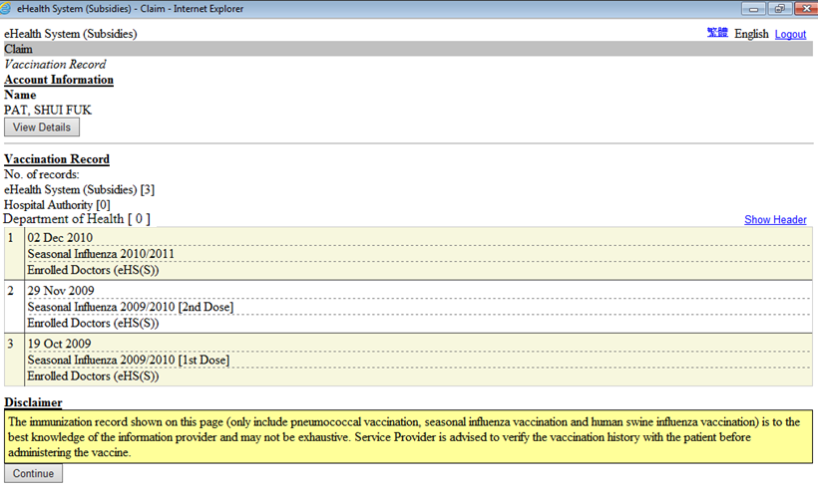
Claim (Text Only Version)–Vaccination Record
You will see the vaccination record of service recipient if available.
Press “Continue” to claim.

Slide 6
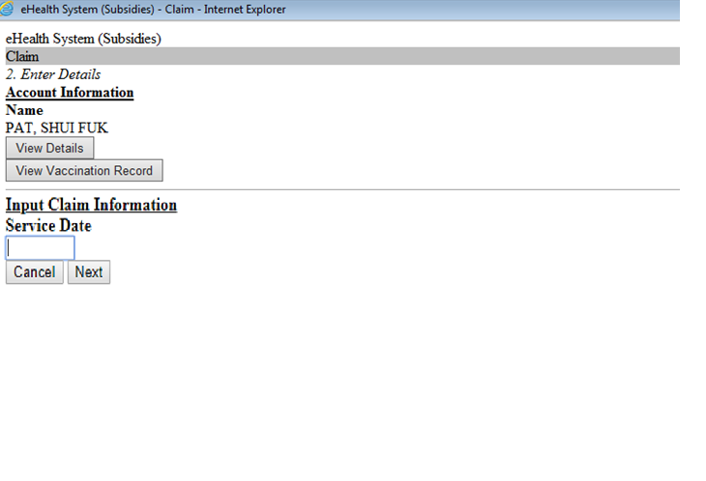
Claim (Text Only Version)–Enter Claim Details
Press “Next” to continue.

Slide 7
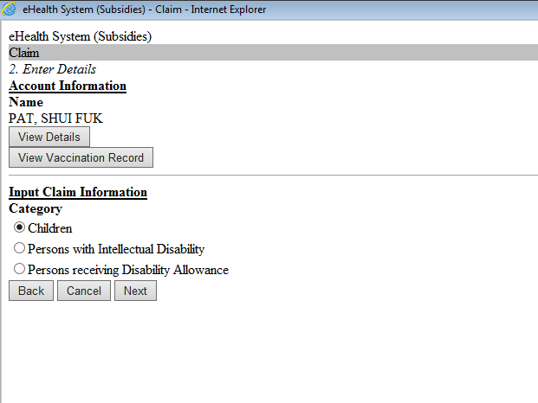
Claim (Text Only Version)–Enter Claim Details
Select the appropriate category and press “Next” button.

Slide 8
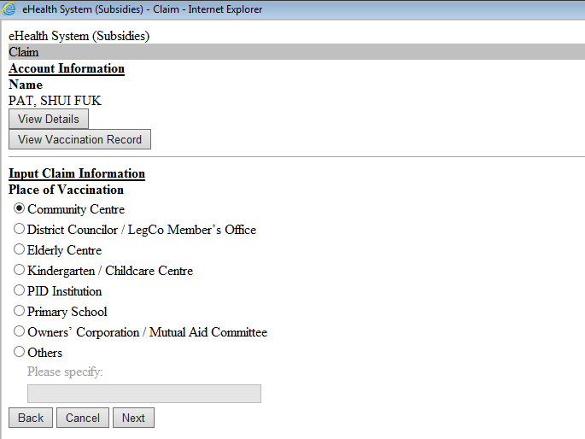
Claim (Text Only Version)–Enter Claim Details
Select the appropriate type of venue and press “Next” button.
(applicable to outreaching vaccination at non-clinic setting)

Slide 9
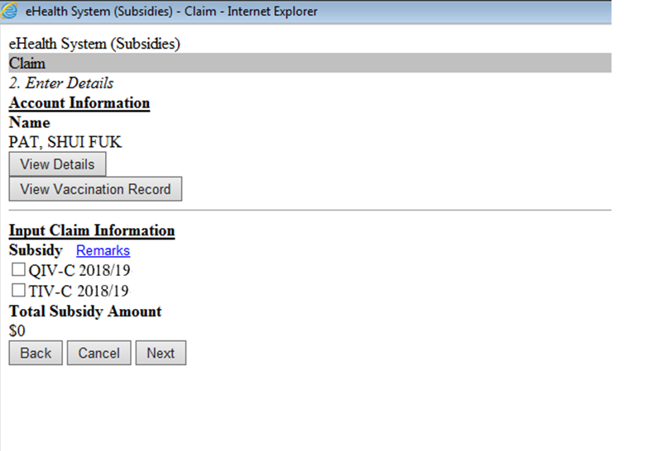
Claim (Text Only Version)–Enter Claim Details
Select the vaccine Code and press “Next” button.

Slide 10
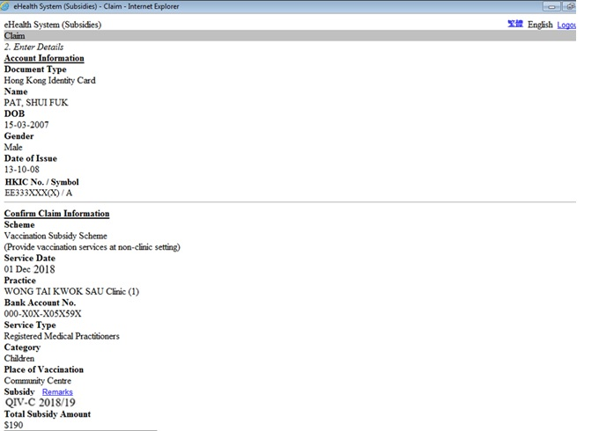
Claim (Text Only Version)– Confirm Claim Details
You will see the claim information

Slide 11
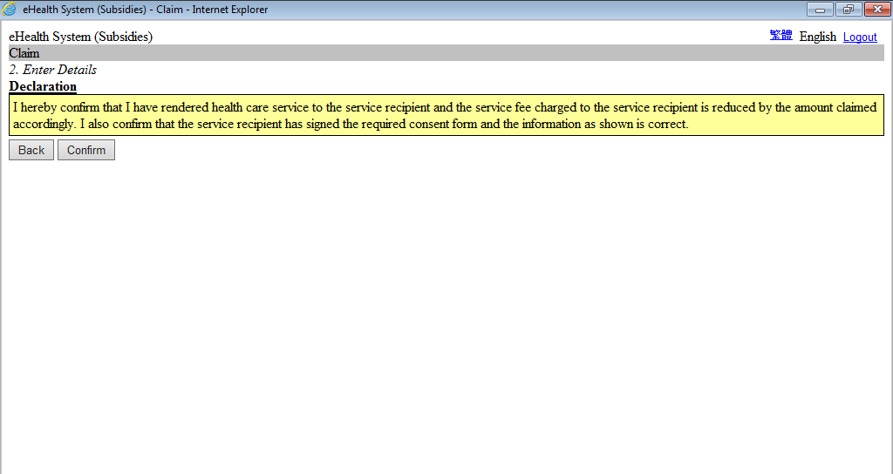
Claim (Text Only Version)– Confirm
Press “Confirm” button to declare.

Slide 12
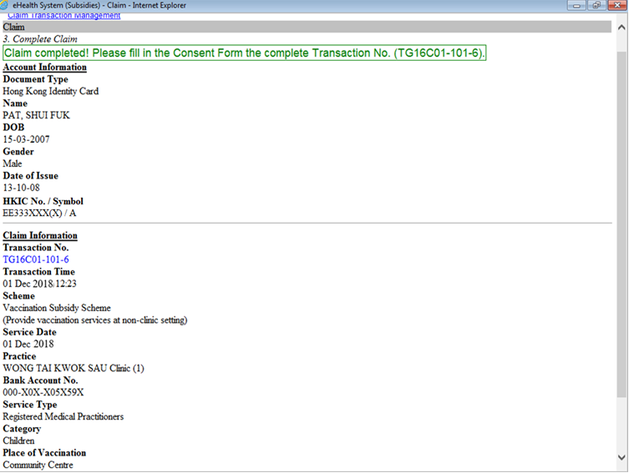
Claim (Text Only Version)– Complete Claim

Slide 13
RVP – Enter Claim Details

Slide 14
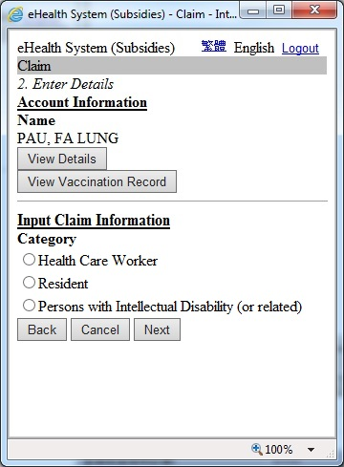
Claim (Text Only Version)–Enter Claim Details
Select the Category and press “Next” button.

Slide 15
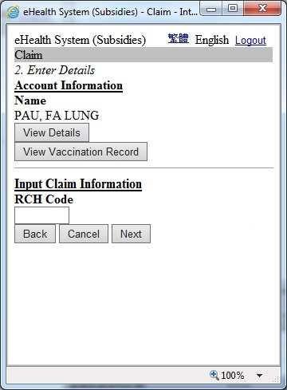
Claim (Text Only Version)– Enter Claim Details
Input the RCH Code and press “Next” button.

Slide 16
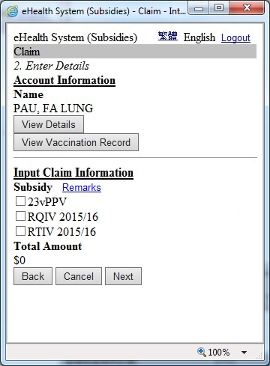
Claim (Text Only Version)– Enter Claim Details
Select the vaccine Code and press “Next” button.

Slide 17
HCVS – Enter Claim Details

Slide 18
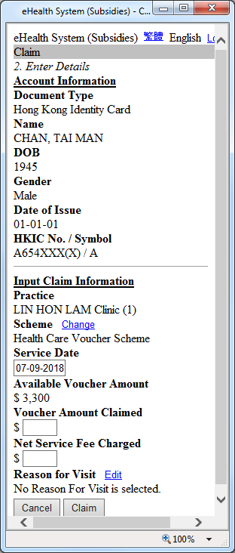
Claim (Text Only Version)–Enter Claim Details
For an elder eligible to use vouchers and an existing eH(S)A is found, you can proceed to enter claim details for the elder concerned following the existing procedures.
Note
For an elder holding HKIC with the first alphabet of its symbol as C or U, you should make the claim for use of vouchers on the same date as the date of provision of the related healthcare services to the elder concerned.
You should enter the exact voucher amount claimed to the nearest dollar ($).
You should enter the “Net Service Fee Charged”.
You should select the “Reason for Visit”.

Slide 19
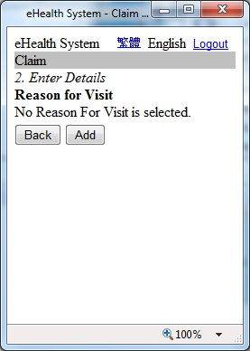
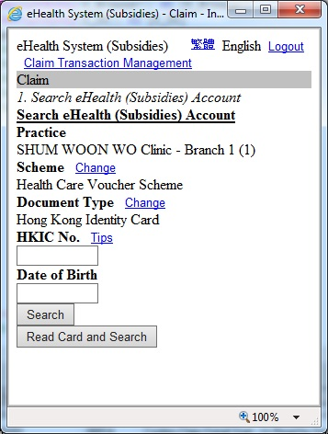
Claim (Text Only Version)–
Select Reason for Visit
Press “Add” button to add reason for visit.

Slide 20
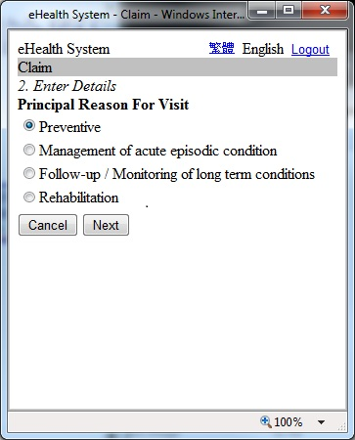
Claim (Text Only Version)–
Select Reason for Visit
Select the 1st level “Principal Reason for Visit” and press “Next”.

Slide 21
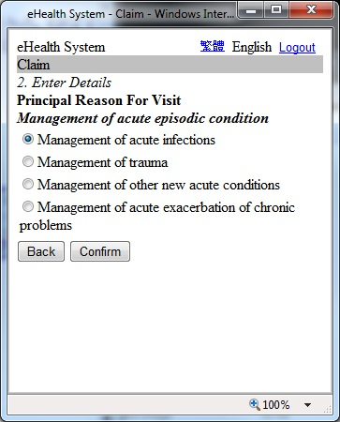
Claim (Text Only Version)–
Select Reason for Visit
Select the 2nd level “Principal Reason for Visit” and press “Confirm”.

Slide 22
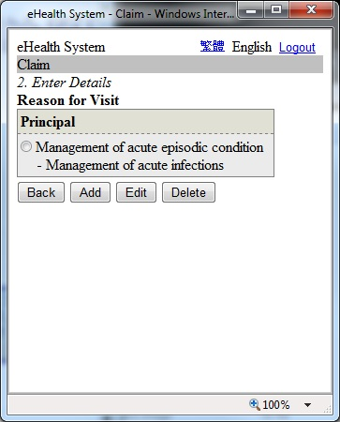
Claim (Text Only Version)–
Select Reason for Visit
The “Principal Reason for Visit” is added.
Press “Back” to return.

Slide 23
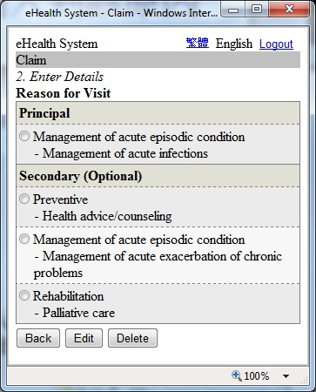
Claim (Text Only Version)–
Select Reason for Visit
You should select the “Principal Reason for Visit”. And then, you can select at most three “Secondary Reason for Visit”.

Slide 24
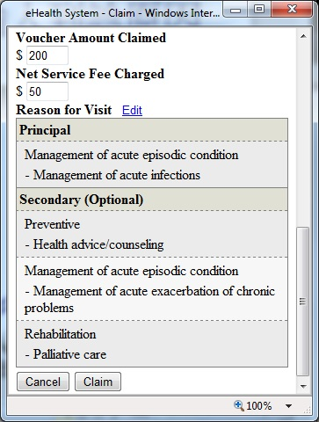
Claim (Text Only Version)–
Enter Claim Details
Press “Claim” button to confirm.

Slide 25
~ Thanks for watching ~

