Slide 1
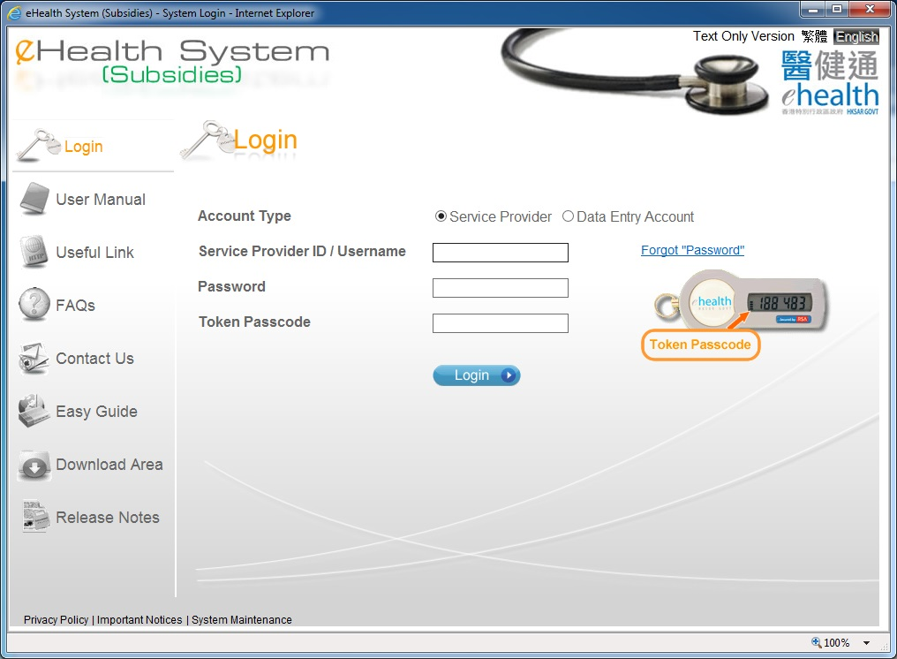
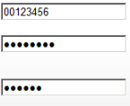
Temporary Account Confirmation
Only service provider can perform account confirmation.

Slide 2
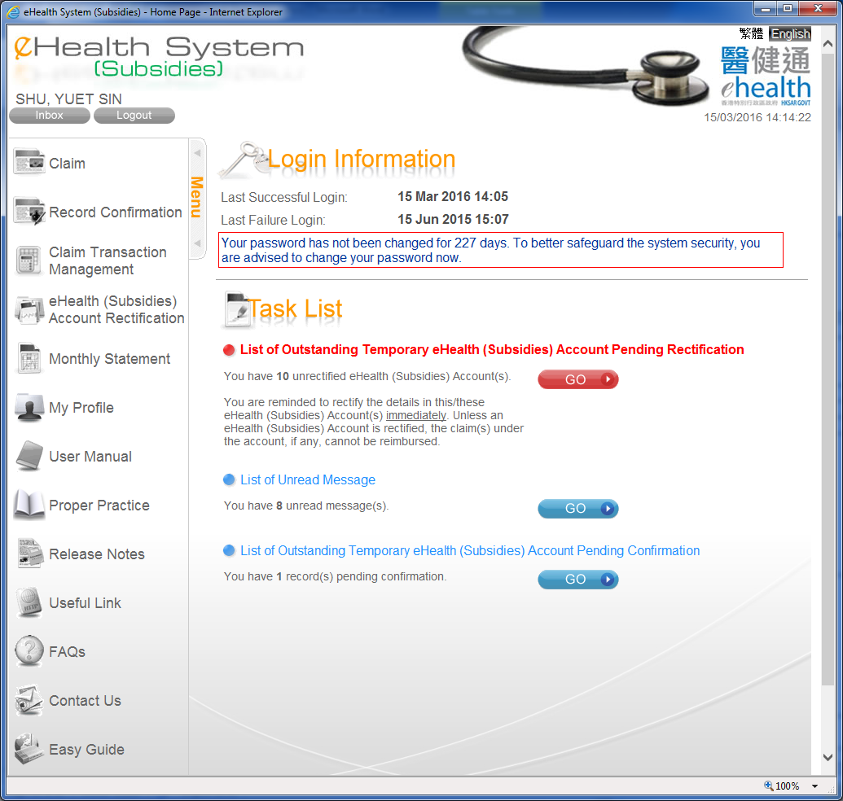
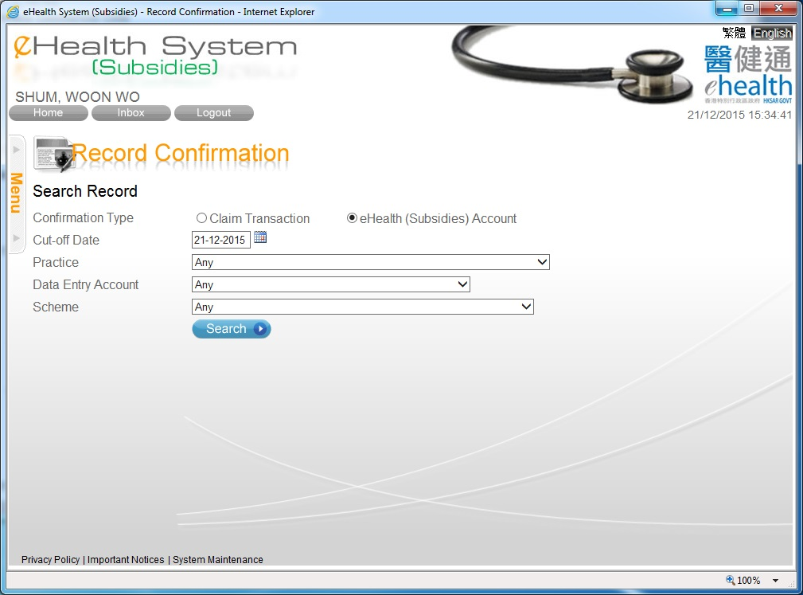
Temporary Account Confirmation

Slide 3
Temporary Account Confirmation
You can select the records by different criteria.

Slide 4
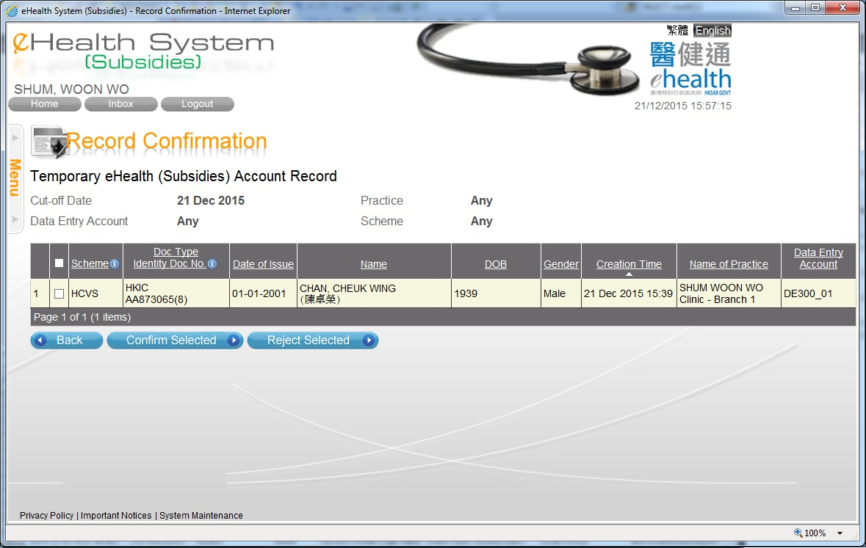
Temporary Account Confirmation
You may select the record(s) by clicking the checkbox, or clicking the checkbox at the column header for all records.
You may press the column header to sort the records.
You may confirm or reject the selected temporary accounts.

Slide 5
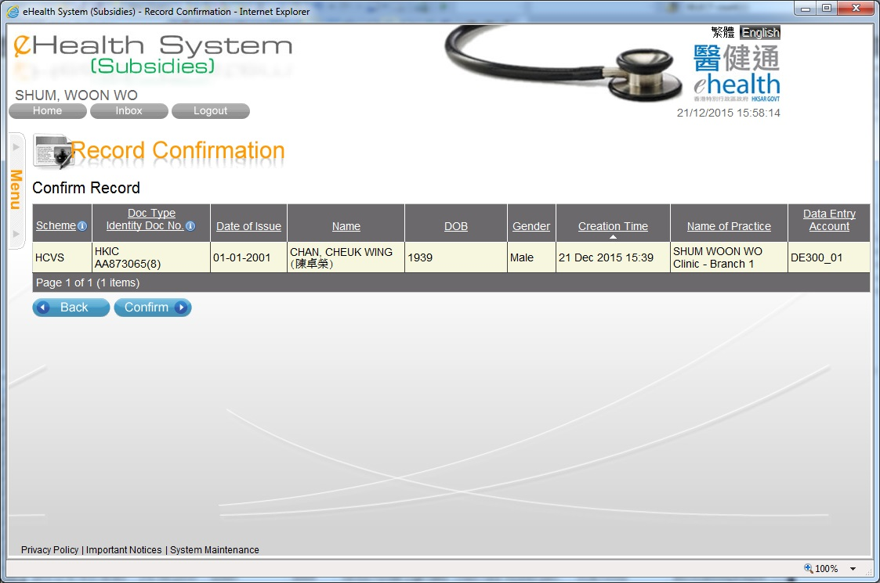
Temporary Account Confirmation
The selected accounts are shown.

Slide 6
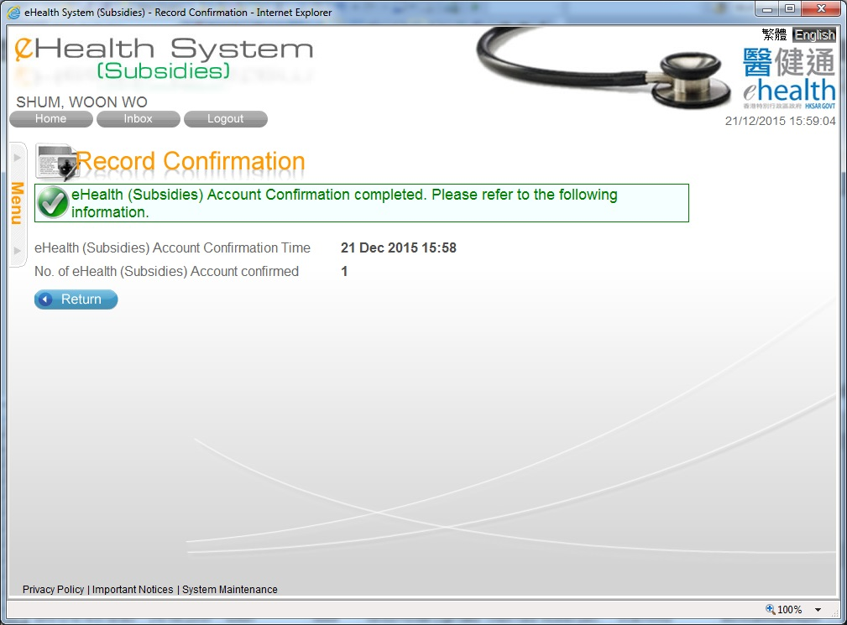
Temporary Account Confirmation

Slide 7
~ Thanks for watching ~

