Slide 1
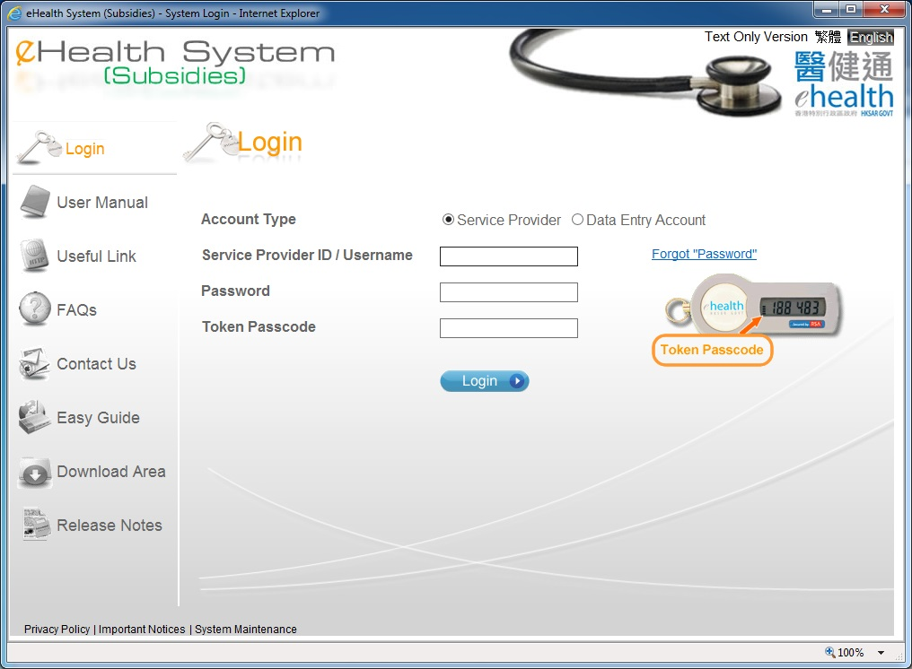
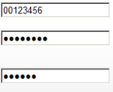
Monthly Statement
Only service provider can view monthly statement.

Slide 2
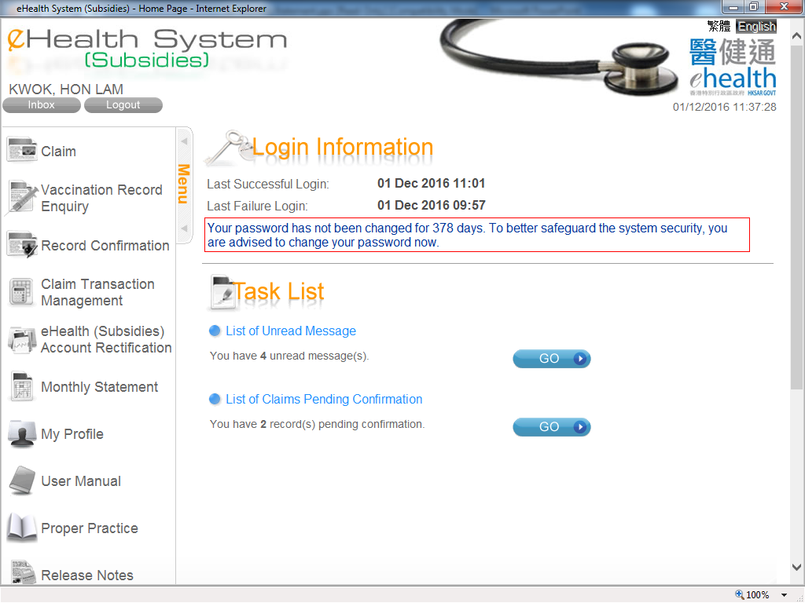
Monthly Statement

Slide 3
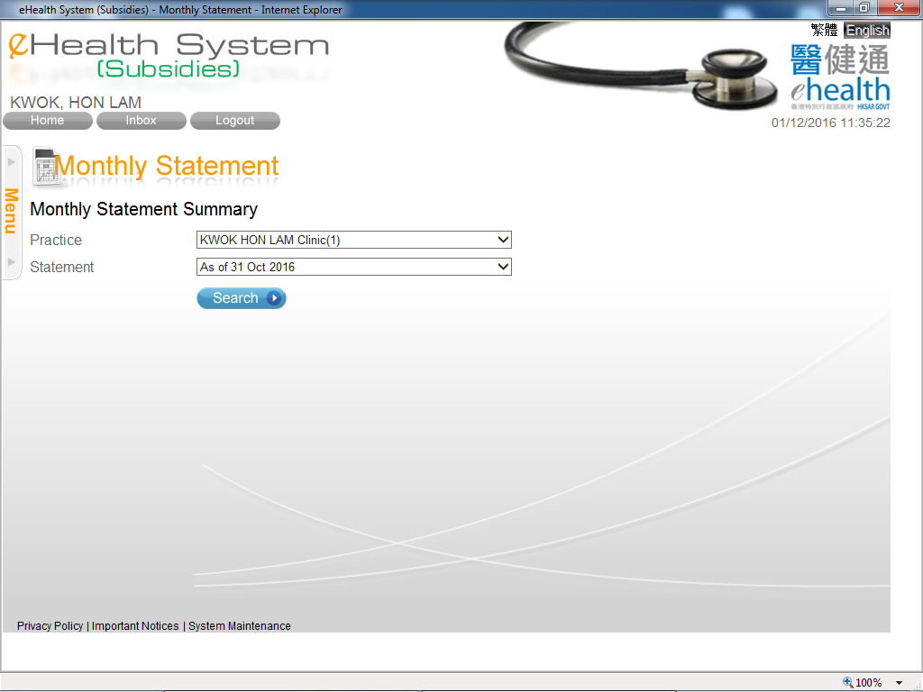
Monthly Statement
You can select the monthly statement for different practices.

Slide 4
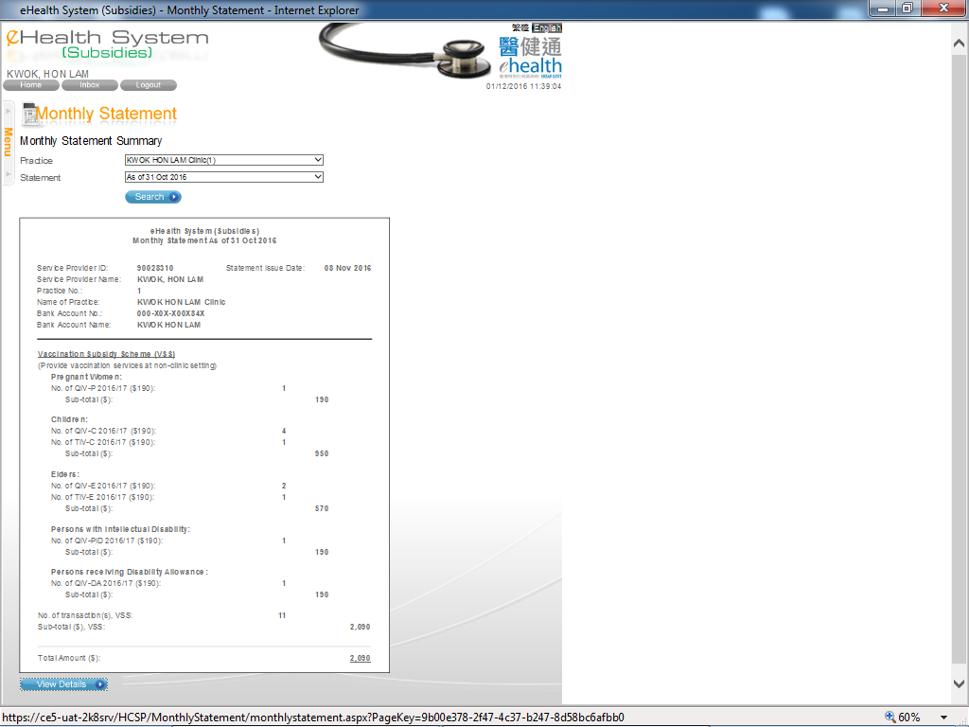
Monthly Statement
The monthly statement is shown.
You may press “View Details” to view the reimbursed claim records.

Slide 5
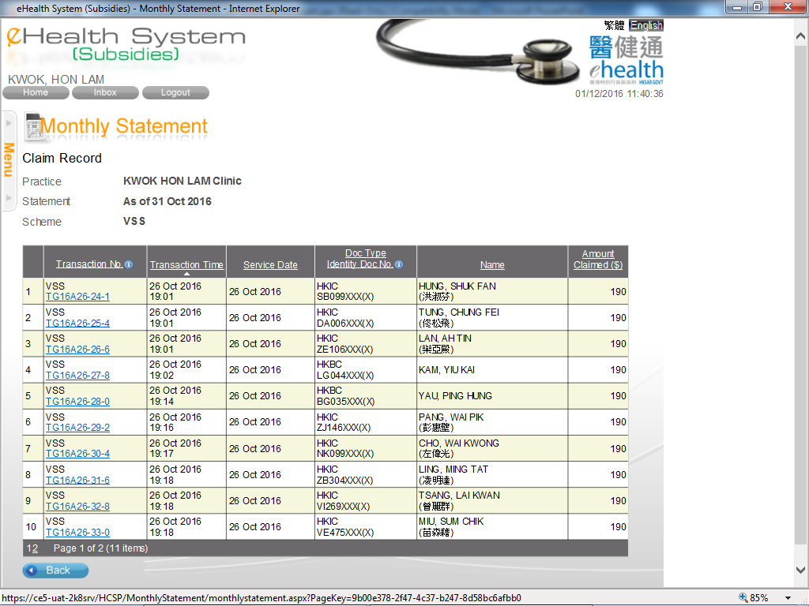
Monthly Statement
You may press the transaction no. to view the claim details.

Slide 6
~ Thanks for watching ~

