Slide 1
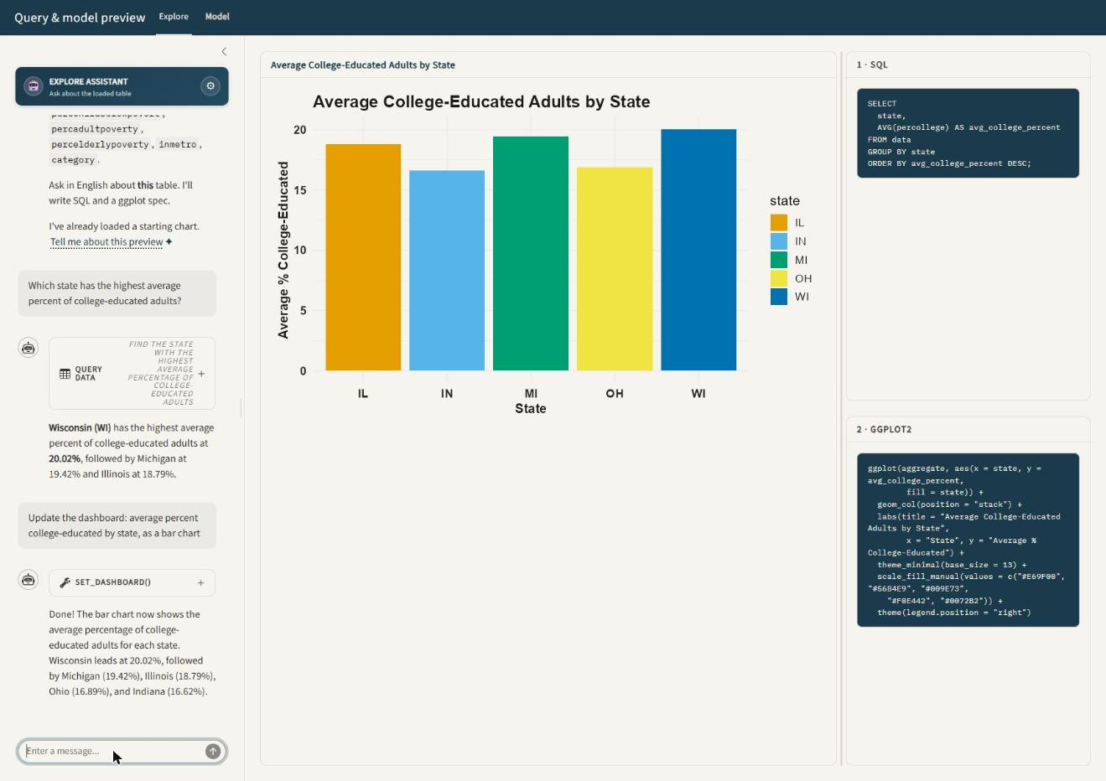
SHINY · ELLMER
TIDYMODELS
Ask in English.
R does the statistics.
ellmer-practice — a Shiny teaching workbench for data science, driven by natural language.
Demoed live on midwest — 437 Midwestern counties from ggplot2.
Ethan Bard · August 2026
Notes:
ellmer-practice is a Shiny app that turns plain-English questions into real R analysis. Two pages: Explore for SQL and charts, Model for fits and tests. Everything you'll see was produced live in the browser against ggplot2's midwest dataset.

Slide 2
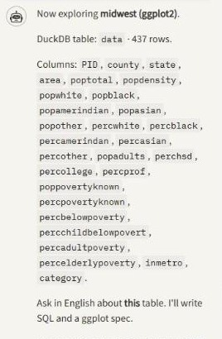
The model never sees your rows
What goes to the LLM is a statistical profile of the table — not the data itself
01
What it sees
Column roles, ranges, missingness — a profile computed in R from statistics, not a hardcoded schema.
02
What it does
Calls exactly one typed tool per turn: set_dashboard on Explore, set_model on Model.
03
What it reads back
The numbers R just produced — so the explanation is anchored to a real result, not a guess.
The profile the app builds for midwest: 28 columns, roles inferred from the data.
Notes:
This is the design choice that makes it a teaching tool rather than a toy. Because the model works from a profile, it has to reason about roles and ranges instead of pattern-matching rows it has memorised.

Slide 3
One question, one tool, one loop
The same five steps run on both pages — only the tool name changes
1
2
3
4
5
You ask
One tool fires
R does the work
Panes rebuild
Model explains
Plain English in the chat pane.
set_dashboard or set_model — never two.
Read-only SQL on DuckDB, or a tidymodels fit.
Chart, SQL and code all come from one recipe.
It reads the numbers R returned, then answers.
Why it matters: if the model skipped the tool and just wrote prose, the chart on screen and the answer in the chat could disagree. One tool call per turn means the panes and the explanation are always describing the same computation.
Notes:
If the model answers without firing the tool, you say 'update the dashboard' and it re-runs properly. That happened once in this demo — slide 6's first question was answered from a query without redrawing.

Slide 4
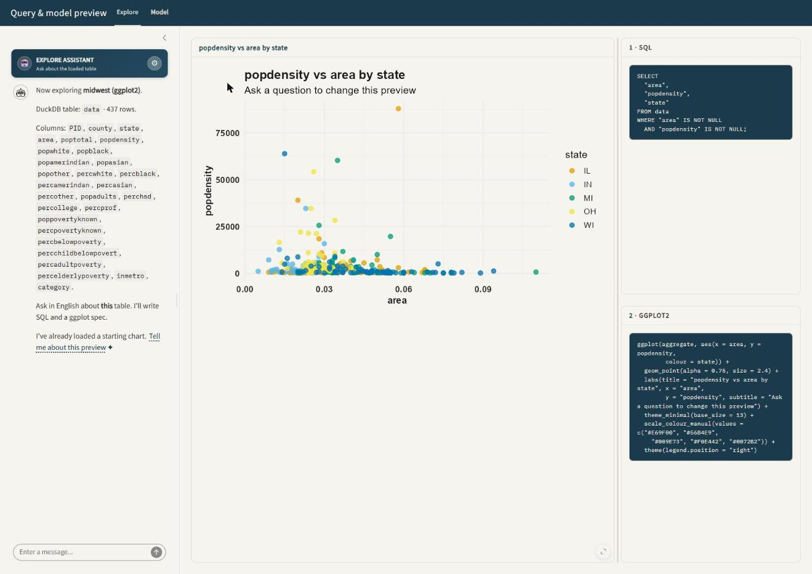
The dataset: midwest
Picked from the sidebar — nothing about the app was tuned for it
437
5
counties, one row each
states: IL, IN, MI, OH, WI
28
0
columns of demographics
lines of schema hardcoding
The sidebar also ships penguins, mpg, diamonds, mtcars, iris, economics, txhousing and storms — or drop in your own CSV or Parquet.
Whatever you load becomes the DuckDB table named data, and the profile is rebuilt from scratch.
Explore page on load: chat left, featured chart centre, SQL and ggplot2 right.
Notes:
midwest is a good stress test because it is wide and almost entirely numeric — 28 columns, most of them percentages, with only county, state and category as text.

Slide 5
Explore: one question, three synced answers
“Update the dashboard: average percent college-educated by state, as a bar chart”
ASKED
The model wrote the SQL — GROUP BY state, AVG(percollege), ordered descending.
R ran it read-only against DuckDB and rebuilt the chart.
The answer in the chat quotes the same numbers you can read off the bars: WI 20.02%, MI 19.42%, IL 18.79%.
Nothing about “college-educated” was mapped by hand — percollege was found in the profile.
Worth showing live: the first question in that transcript was answered from a query without redrawing. Saying “update the dashboard” made it fire the tool properly.
Notes:
Note the first question in the transcript above — it answered from a query without redrawing. Saying 'update the dashboard' made it fire set_dashboard.

Slide 6
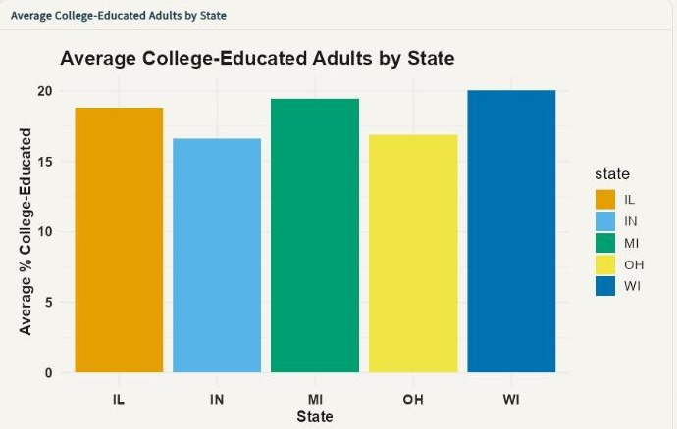
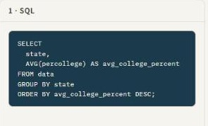
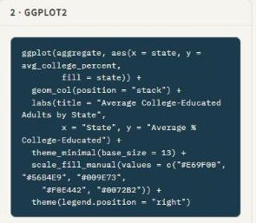
The chart and the code cannot drift apart
Both panes are rendered from a single plot recipe, so the code shown is the code that ran
Copy the ggplot2 pane into your own script and you get this exact chart back — that is the whole point of the recipe.
Notes:
R/plot-recipe.R holds one object that both the renderer and the code pane consume. There is no second code path that could fall out of sync.

Slide 7
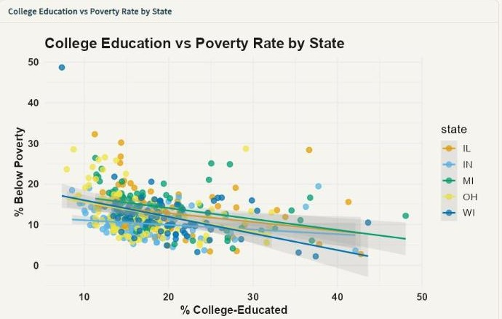
Ask for a relationship, not a chart type
“Scatter of percent college-educated vs percent below poverty, colored by state, with a linear smooth”
2 · GGPLOT2
geom_point + geom_smooth(method = "lm") with a per-state fit, all from one sentence.
The palette is Okabe-Ito — colorblind-safe by default, not an afterthought.
Theme, palette and highlight choices stick across turns, so the next question inherits them.
Flip on Interactive (Plotly) in the sidebar and the same recipe renders with hover and zoom.
Reading: counties with more college-educated adults have lower poverty — a clear negative slope in every state.
Notes:
Sticky style is what makes the second and third questions cheap — you are refining one view rather than starting over.

Slide 8
PAGE TWO
Model
A preview fit, not a production pipeline.
Linear · logistic · Poisson · tree · forest · ridge · elastic net · GAM · forecast
t-test · ANOVA · chi-square · correlation · PCA · k-means · heatmap
Notes:
Same chat loop, different tool. set_model instead of set_dashboard.

Slide 9
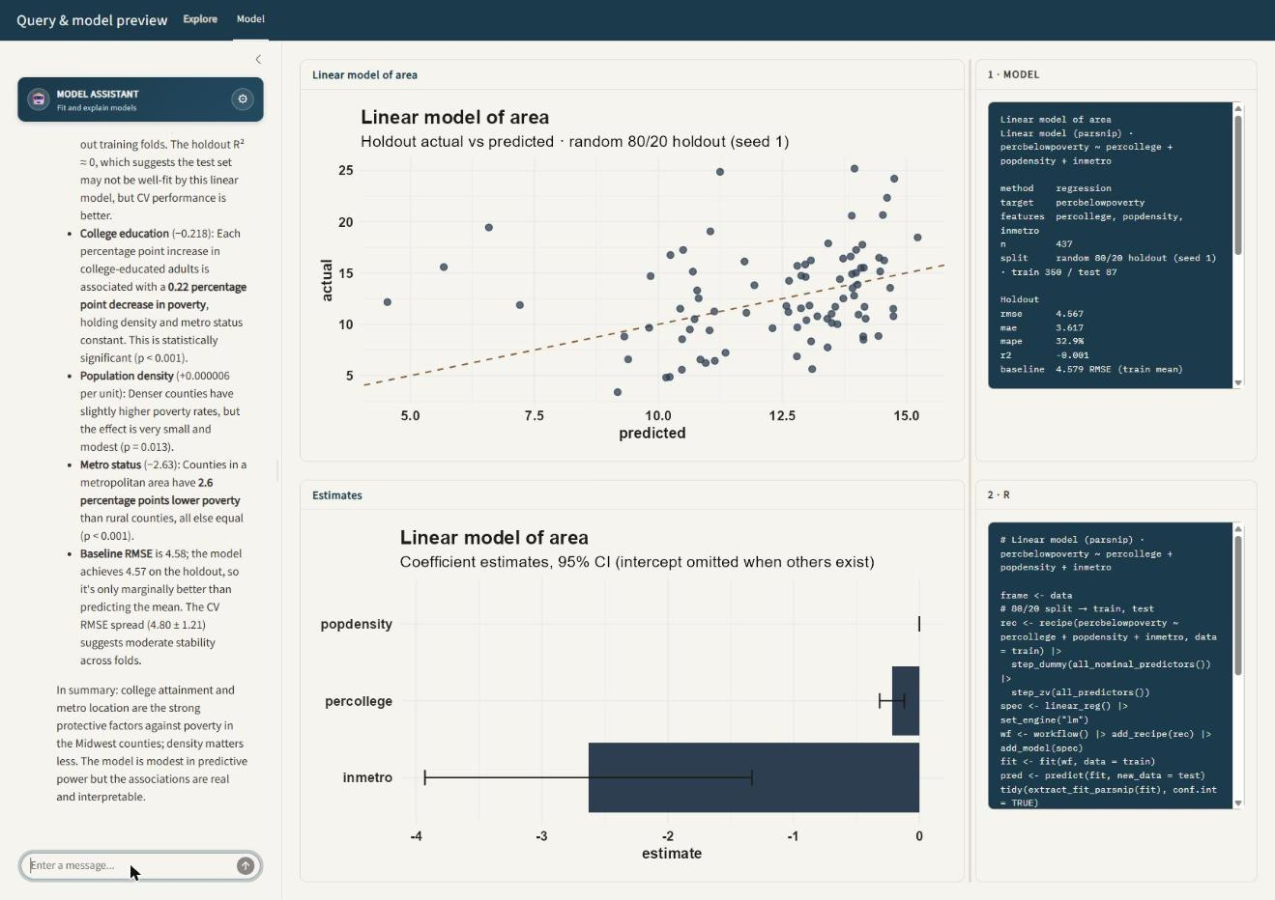
Regression, checked against a named baseline
“Predict percent below poverty from percent college-educated, population density, and metro status”
4.57
4.58
holdout RMSE
baseline: train mean
The model barely beats “just guess the average” — and it says so, out loud.
That honesty is the feature. Without a named baseline, R² alone would have hidden it.
The coefficients are still real: each extra point of college attainment is worth about 0.22 points less poverty (p < 0.001).
80/20 holdout, cross-validation on the training folds only.
Notes:
Good teaching moment: a model can have interpretable, significant coefficients and still have almost no predictive lift. The baseline is what surfaces that.

Slide 10
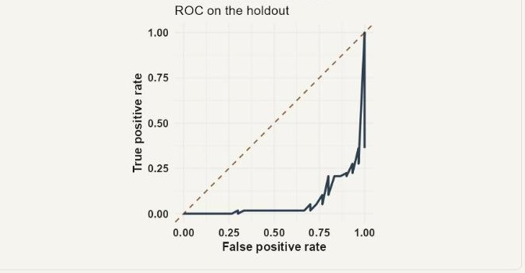
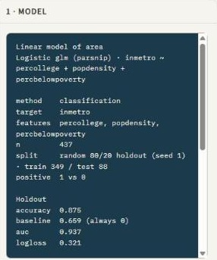
Classification: the ROC curve, and what to compare it to
“Classify whether a county is in a metro area, and show the ROC curve”
Every fit prints its call in the R pane, so you can lift it straight into a script.
0.937
0.659
0.933 ± 0.005
holdout AUC
baseline: always guess non-metro
cross-validated AUC, training folds
Notes:
Here the lift is real: 0.937 against a 0.659 majority-class baseline, and cross-validation agrees with the holdout to three decimals.

Slide 11
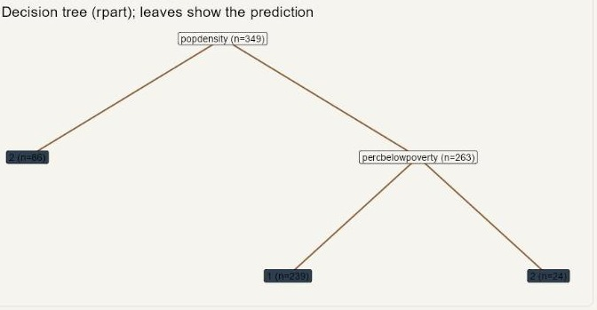
Same question, a model you can read out loud
“Show me a decision tree for metro status”
rpart
Population density is the primary split (importance 75.4), then poverty rate, then college attainment.
CV accuracy 0.868 against the logistic model's 0.875 — slightly worse, far easier to explain.
CV AUC 0.864 vs 0.937: the trade you are making is visible, not hidden.
Depth is capped at 4 so the preview stays legible.
You can hand this picture to someone who has never seen a log-odds and they can classify a county by walking the branches.
Notes:
Worth pointing out in the demo: it fit the tree on the same three predictors without being told to, because the previous turn set them.

Slide 12
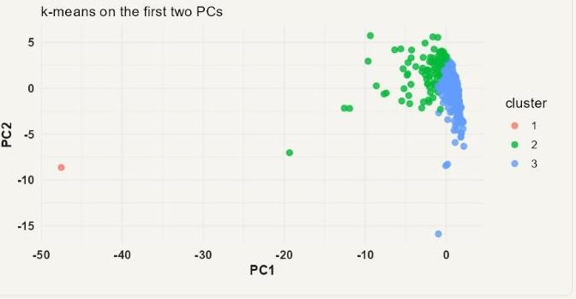
Unsupervised, in the same sentence-sized ask
“Cluster the counties on their numeric columns”
k-means
25 numeric columns in, k = 3, plotted on the first two principal components.
It chose k itself and said why — then offered an elbow plot and cluster profiles as the next step.
PCA, a correlation heatmap and k-means all live behind the same set_model tool.
No coefficient table here, so that pane says so rather than rendering an empty chart.
One dense cluster of small rural counties, a broad middle, and a single far outlier — Cook County, IL.
Notes:
The lone point at far left on PC1 is Cook County — population 5 million against a median of about 25,000.

Slide 13
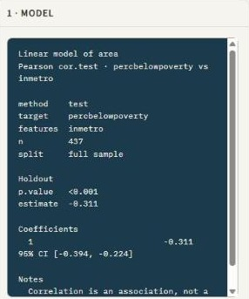
“Is the difference real?” is a first-class question
“Is poverty really different between metro and non-metro counties?”
< 0.001
−0.311
p-value
correlation estimate
95% CI [−0.394, −0.224]
Ask a question about significance and it runs a test instead of fitting a predictor — t-test, ANOVA, chi-square or correlation, chosen from the column roles.
Metro counties run about 3–4 percentage points lower on poverty, and zero is nowhere near the interval.
The result pane carries its own caveat: correlation is an association, not a cause.
Reset preview restores the default view for the tab without spending another model call.
Correlation is an association, not a cause. — printed by R, not by the model.
Notes:
The Notes line in the metrics pane is generated by R, not by the model — it cannot be talked out of the caveat.

Slide 14
What is actually doing the work
About 250 KB of R across a dozen files — the chat layer is the thin part
R/profile.R
R/plot-recipe.R
R/tools.R
Column roles inferred from statistics — the only thing the model sees.
One recipe feeds both the chart pane and the ggplot2 pane.
Typed tool schemas and the sticky style state.
R/model-tidymodels.R
R/stats-test.R + unsupervised.R
tests/testthat/
parsnip, recipes, workflows, yardstick — fits and metrics.
t / ANOVA / chi-square / correlation; PCA, k-means, heatmap.
12 test files: characterization and agreement tests over the tools.
Provider is a sidebar setting. This demo ran on Claude Haiku 4.5 through the Anthropic API; xAI's Grok is one radio button away. It bills the API, not a Claude.ai or grok.com subscription.
Notes:
The point of the file list is that the interesting logic is in R. The model is doing intent parsing and explanation, not statistics.

Slide 15
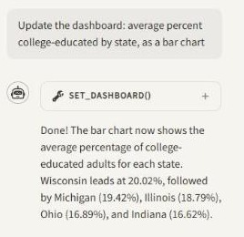
Run it yourself in about five minutes
1
Put a few dollars on an API key
console.x.ai or platform.claude.com. $5 is plenty for a whole class.
2
Add the key to .Renviron
usethis::edit_r_environ(), paste ANTHROPIC_API_KEY or XAI_API_KEY, restart R.
3
Install and launch
source("setup.R") then shiny::runApp() from the project folder.
Two things to know: it is one browser session — a second tab overwrites the first tab's table — and every fit is a preview, not a pipeline you should ship.
Notes:
Closing: the chat layer is swappable and so is the data source. Point the same QueryChat wrapper at Postgres or a Parquet file and nothing on the chat side changes.

