Slide 1
P
Pokémon CRM
An advising-style CRM, built on the National Pokédex
1,025
8
6
24
Pokémon seeded
pages
tables
API endpoints
Vite · React · TypeScript · Tailwind · Express · Drizzle · PostgreSQL · Recharts
Notes:
Pokémon CRM is a learning sandbox that borrows the shape of a student-advising CRM. Everything is real: 1,025 Pokémon seeded from PokeAPI into Postgres, a full Express API, and eight pages.

Slide 2
The analogy
Every CRM concept maps onto something in the Pokémon domain.
1
Trainer
2
Roster
3
Pokémon
the advisor
the caseload
the student
Owns a roster. Has a region and a specialty, like a department.
A many-to-many join. Members are starter, active, reserve, or retired.
Carries notes, status flags, and progress toward a milestone.
Evolution chains are the degree plan. A chain is a programme of study: stage N of L is progress, and the level requirement for the next stage is a milestone somebody has to sign off.
Notes:
The mapping is what makes the sandbox useful — every feature has a real advising counterpart. Evolution chains as a degree plan is the one that unlocked the most.

Slide 3
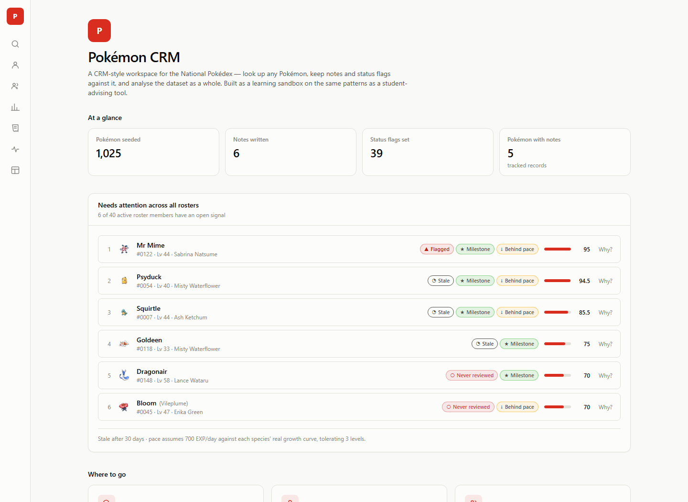
Home — what needs you today
The landing page opens on the workspace-wide early-alert queue.
1
Ranked, not listed
Every active roster member is scored; only those with an open signal appear.
2
Explains itself
Each row carries its reasons — a score with no explanation is not actionable.
3
Live counters
Seeded Pokémon, notes written, flags set, records tracked.
Notes:
The queue turns the app from something you browse into something that tells you what to do.

Slide 4
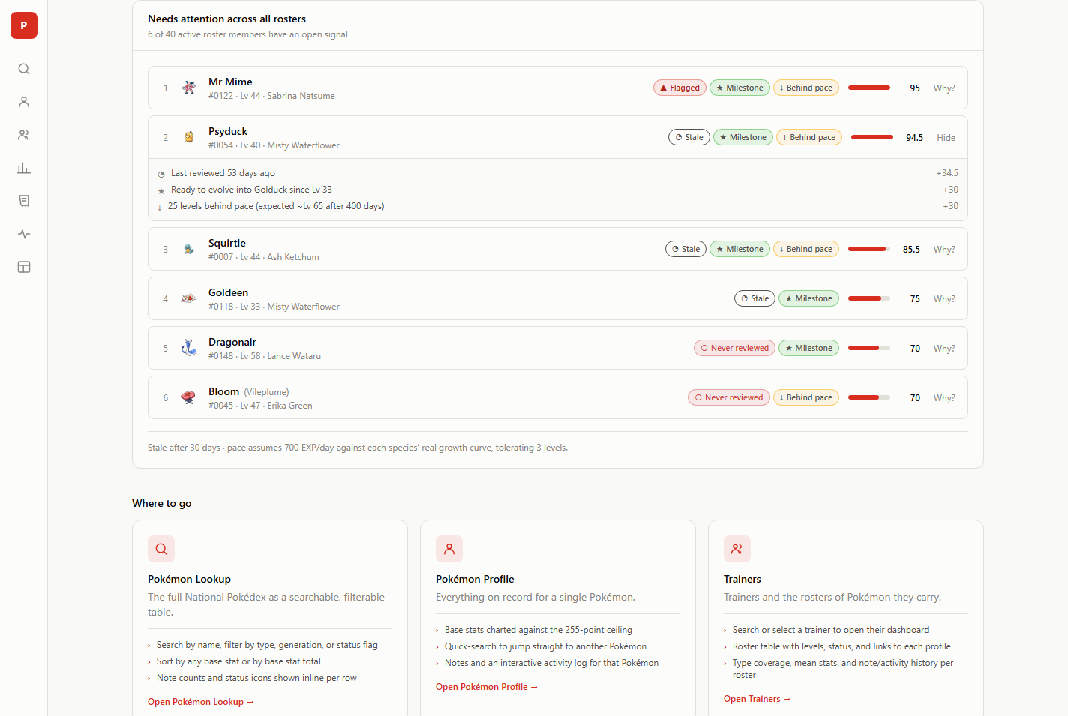
Five signals, one scorer
SQL gathers the facts; TypeScript applies the weights, so the score and the reasons never drift apart.
Never reviewed
40
No review has ever been recorded
Stale review
up to 45
Past the 30-day contact window
Flagged
35
Someone already raised a concern
Milestone overdue
30
Met its evolution requirement, not signed off
Behind pace
up to 30
“Behind pace” is real maths
Below the level its growth curve implies
Each species' true EXP curve is seeded from PokeAPI. Time on roster × an assumed training rate gives an expected level — and the app says so, rather than passing the assumption off as measurement.
Notes:
Weights live in one constants file. Because the same numbers produce the score and the reason text, they cannot disagree. The pace assumption is disclosed in the API response and printed under the queue.

Slide 5
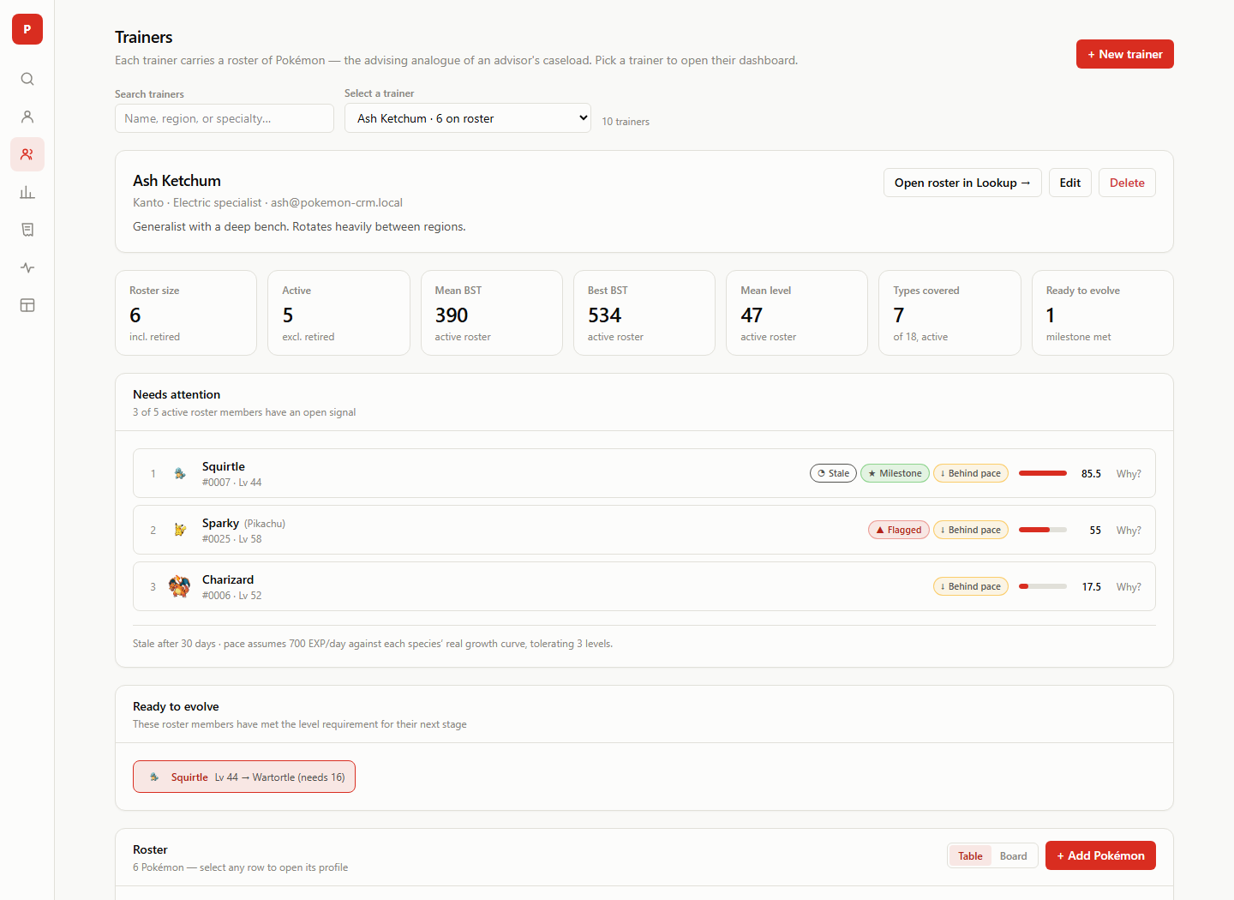
Trainers — the caseload view
Search or pick a trainer, then work their roster.
1
Stats that agree
Roster size counts everyone; every quality metric is computed over the active roster and labelled as such.
2
Ready to evolve
Milestones met but unsigned, surfaced as their own panel.
3
Full CRUD
Create, edit, delete trainers; add, edit, transfer, and remove roster members.
Notes:
A mixed-up version of these tiles shipped once — "5 active" beside a mean computed over 6. Now everything filters retired consistently.

Slide 6
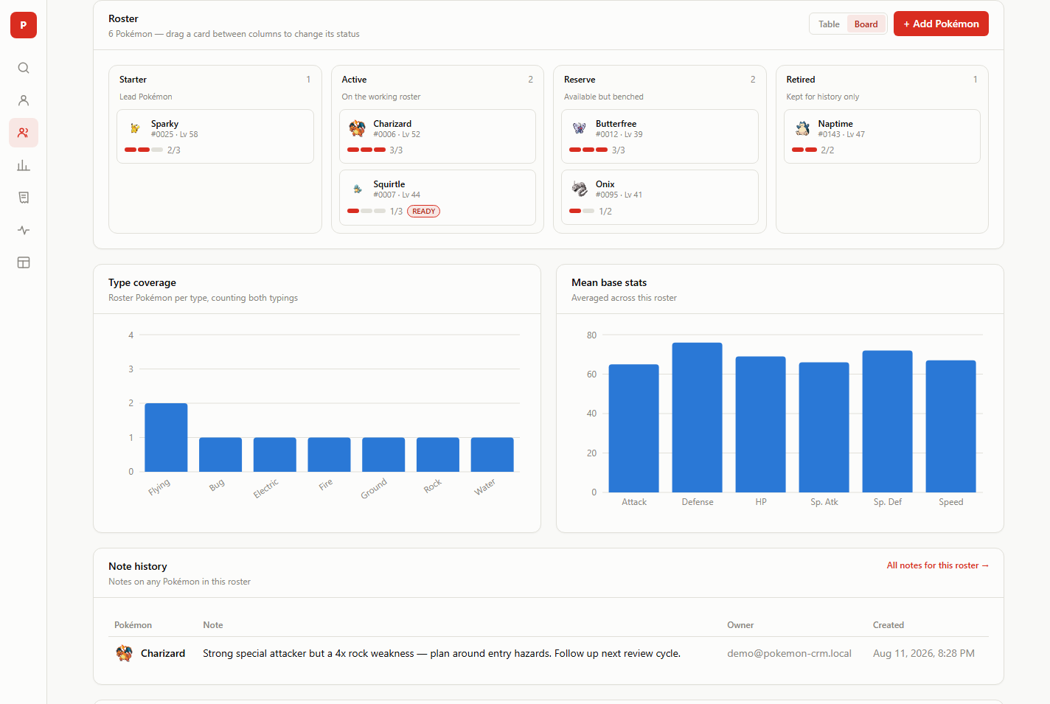
Roster board
The same roster as a drag-and-drop board — move a card to change its status.
Starter · Active · Reserve · Retired — the same enum the API already enforced, made physical. Moves are optimistic and undoable.
Notes:
Native HTML5 drag events — four fixed targets, no reordering within a column, which is exactly the case native DnD handles well.

Slide 7
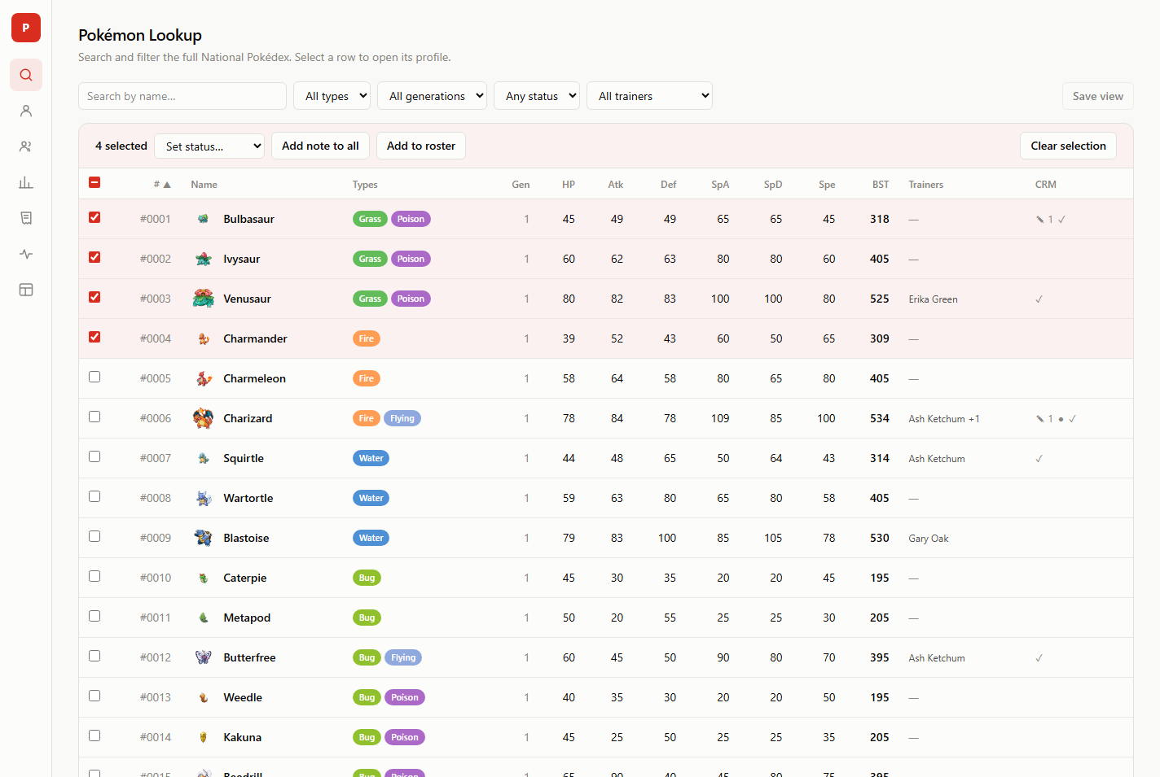
Lookup — and bulk actions
All 1,025 Pokémon, filterable by type, generation, status, and trainer.
Selection spans pages
Set or clear a flag on many
One note across a selection
Add many to a roster at once
Notes:
Bulk flag actions set an explicit target state rather than toggling — toggling a mixed selection would leave it inconsistent.

Slide 8
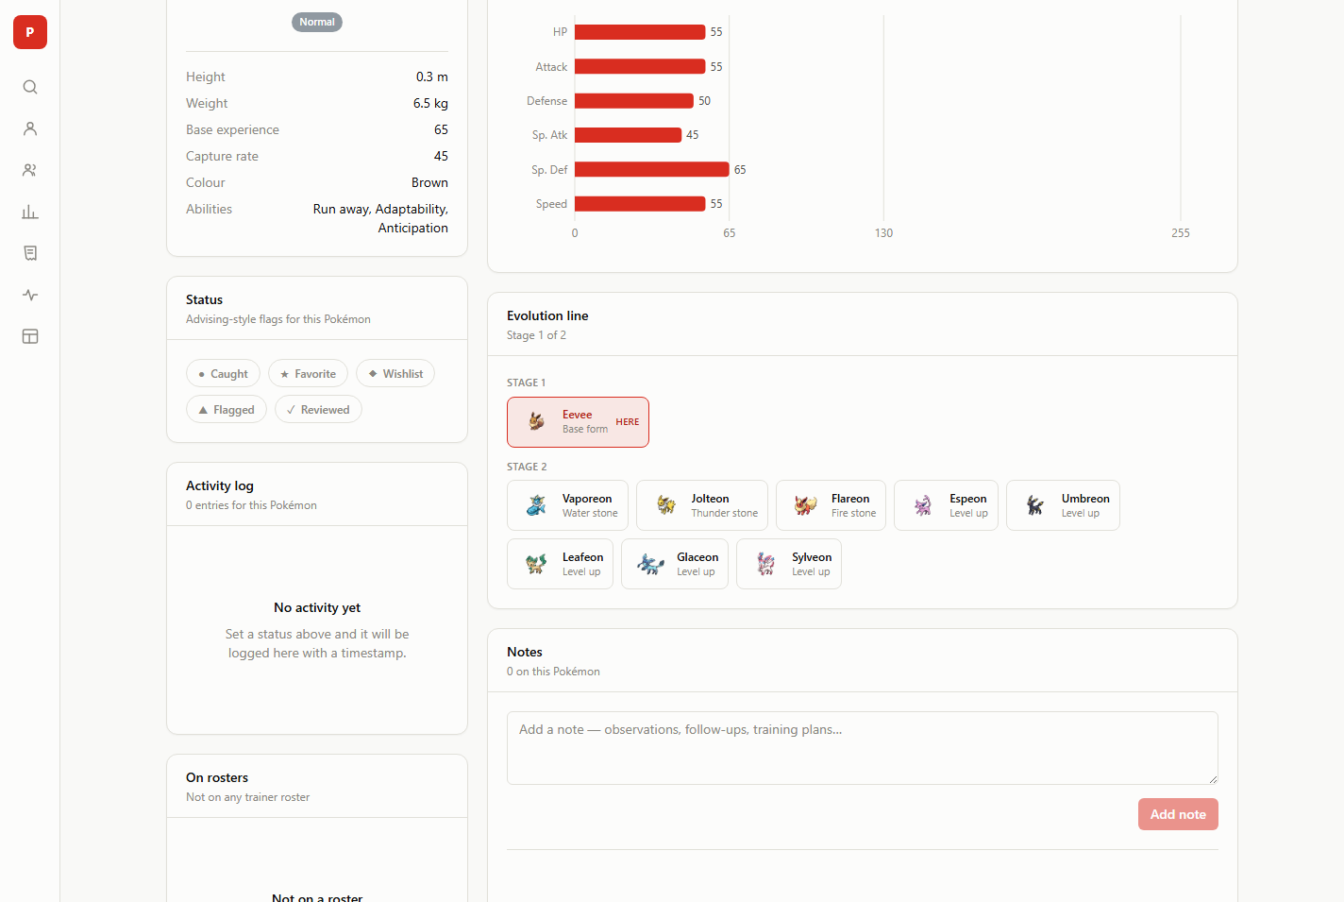
Profile — progress as a degree plan
Every stage of the chain, with the requirement to reach it.
1
Branching handled
Eevee resolves to all eight options, each labelled with its own trigger.
2
Not every path is a level
Roughly a third evolve by stone, trade, or friendship — those store the reason instead.
3
Feeds the queue
A met level requirement becomes a milestone on the trainer dashboard.
Notes:
541 evolution chains fetched once each and walked into per-species facts. Chain length is the deepest branch.

Slide 9
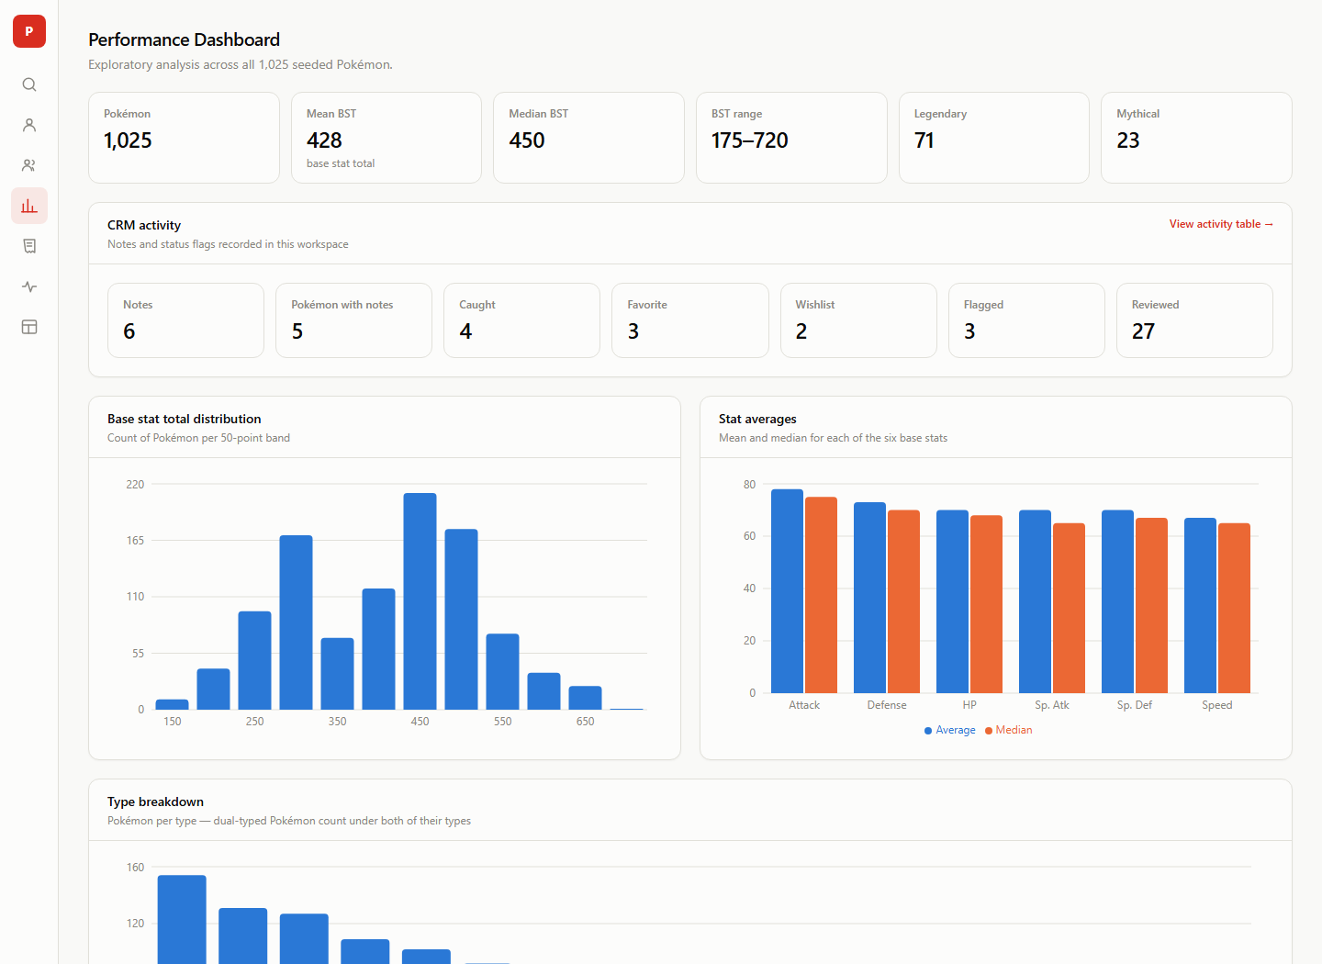
Performance dashboard
Exploratory analysis across the whole dataset, computed in SQL.
Distributions, per-stat averages, type and generation breakdowns, and an attack-vs-speed scatter — every aggregation in one round trip.
Notes:
No dual-axis charts anywhere: two measures on different scales become two charts.

Slide 10
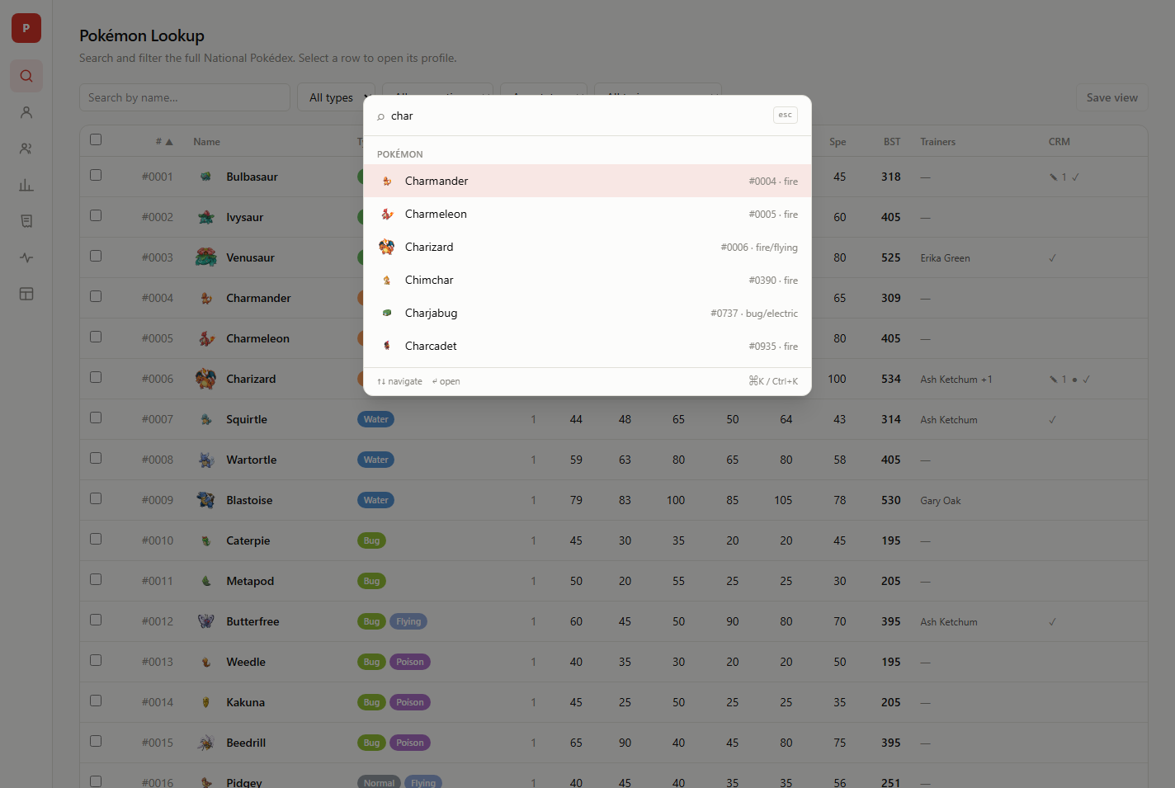
Getting around
Ctrl+K from anywhere — Pokémon, trainers, and pages in one list.
1
No second index
It searches the same endpoints the pages use, so results can never drift.
2
Undo, not confirm
Destructive actions happen, then offer Undo in a toast.
3
Saved views
Name a set of filters on Lookup, Notes, or Activity and reopen it.
Notes:
With 1,025 records the palette is the biggest usability win per line of code in the app.

Slide 11
Where it goes next
1
Type-effectiveness coverage
2
Encounters and abilities
Eighteen requests turn the roster type chart into a real gap report — “no answer to Steel”.
Where a Pokémon comes from, and ability text as prose instead of slugs.
3
Moves as coursework
4
Tests
The richest unused data in the API, and the one item that is a schema project.
A silent subquery bug shipped once. API-level tests over the aggregations would have caught it.
Backlog lives in TODO.md · architecture and conventions in CLAUDE.md
Notes:
The remaining backlog is mostly PokeAPI data the seed already fetches and throws away, plus test coverage.

