Slide 1
DIY MIDI Controller
Audio Engineering Club – Ethan Thomas

Slide 2
Agenda
Part 1: The Musical Instrument Digital Interface (MIDI) Protocol
What is MIDI and why should you care?
MIDI message types and structure
Part 2: Building a Basic MIDI Controller
Arduino basics
Hardware
Software
USB-MIDI on Arduino

Slide 3
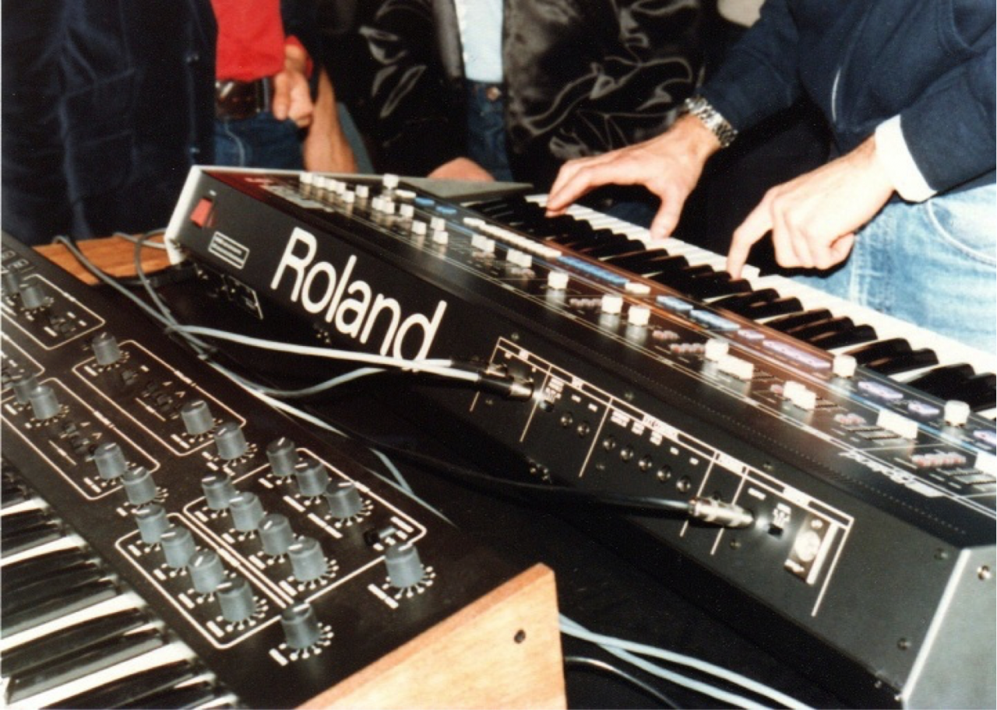
What is MIDI anyway?
De-facto standard for electronic musical instruments, devices, and software
First spec published in 1983¹
Powers everything from keyboard controllers to the timeline in your DAW
Roland Jupiter 6 and Sequential Prophet 600 connected via MIDI at NAMM 1983²

Slide 4
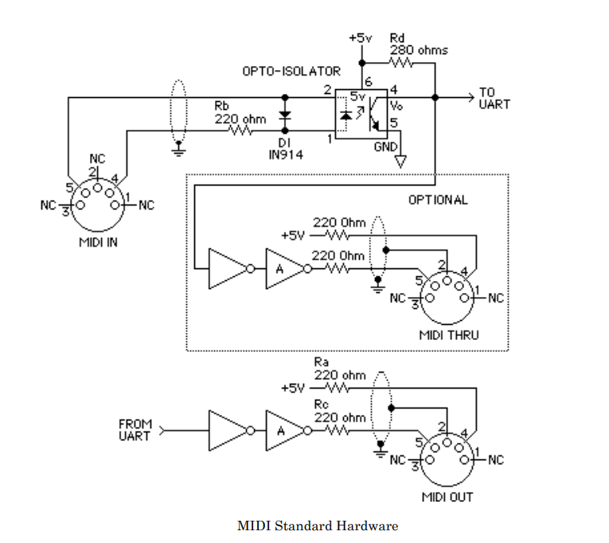
Technical Specifications
31.25 kbps UART with 1 start bit, 8 data bits, and 1 stop bit
Original spec only included 5-pin DIN connection
MIDI over USB defined later
MIDI in, out, and thru circuits³

Slide 5
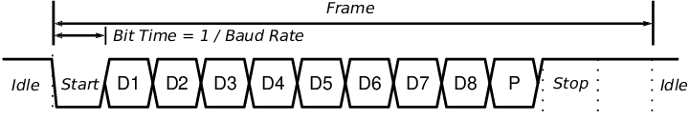
MIDI Byte Types
Bytes signify either status or data and are differentiated by their most significant bit
Status (0x80 – 0xFF)
Upper 4 bits used for status
Lower 4 bits used for MIDI channel
Data (0x00 – 0x7F)
Meaning depends on context and location
Generic UART frame format
MIDI does not use parity, so this bit is omitted in MIDI frames

Slide 6
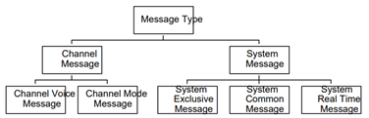
MIDI Message Types
Basic message format*: <status> <data 1><data 2>
Data bytes may or may not be present depending on message
This workshop will focus on channel voice messages
MIDI message types³
*Status byte can sometimes be omitted due to running status
Notes:
MIDI supports many message types for a wide array of tasks, including playing notes, controlling device parameters, synchronizing MIDI devices, and even transferring files.

Slide 7
Channel Voice Messages
Message | Status | Data Byte 1 | Data Byte 2
Note-off | 0x8n | Note | Velocity
Note-on | 0x9n | Note | Velocity
Control change | 0xBn | Control number | Control value
Program change | 0xCn | Program number
Aftertouch | 0xDn | Value
Pitch bend | 0xEn | LSB | MSB
n = channel number (0x0 = Channel 1, 0x1 = Channel 2, …, 0xF = Channel 16)
Notes:
We will focus on voice messages for this workshop
Note-on and Note-off
Indicates when a note on a channel is pressed (turned on) or released (turned off) and its velocity (how hard it was pressed or released)
Format: <note number> <velocity>
Notes are indexed with middle C (C4) being note 64
Control change
"Used for modifying tones with a controller other than a keyboard key“³
Format: <controller number> <controller value>
Each control has both a number (0-119) and a value (0-127)
Some standardization for which CC controls which parameter (e.g., 0x1 is modulation wheel, 0x2 is breath controller, etc.), but can be used arbitrarily
Program change
Used for selecting programs/patches on the target device
Format: <program number>
Pitch bend
Used to detune the currently playing notes
Format: <LSB><MSB>
14-bit resolution (2 bytes - 2 '0' bits)

Slide 8
Let’s decode some messages!
0x90 0x43 0x78
0xD3 0x0F
0xBB 0x01 0x34
Note-on Channel 1 G4 velocity 120
Aftertouch Channel 4 Pressure=15
Control change Channel 12 CC#=1 Value=52
Message | Status | Data Byte 1 | Data Byte 2
Note-off | 0x8n | Note | Velocity
Note-on | 0x9n | Note | Velocity
Control change | 0xBn | Control number | Control value
Program change | 0xCn | Program number
Aftertouch | 0xDn | Value
Pitch bend | 0xEn | LSB | MSB

Slide 9

Arduino
“Open-source electronics platform based on easy-to-use hardware and software.”⁴
Simple programming language based on C++
Wide array of software libraries to support almost everything including sensors, motors, networking, and displays
This Photo by Unknown Author is licensed under CC BY-SA

Slide 10
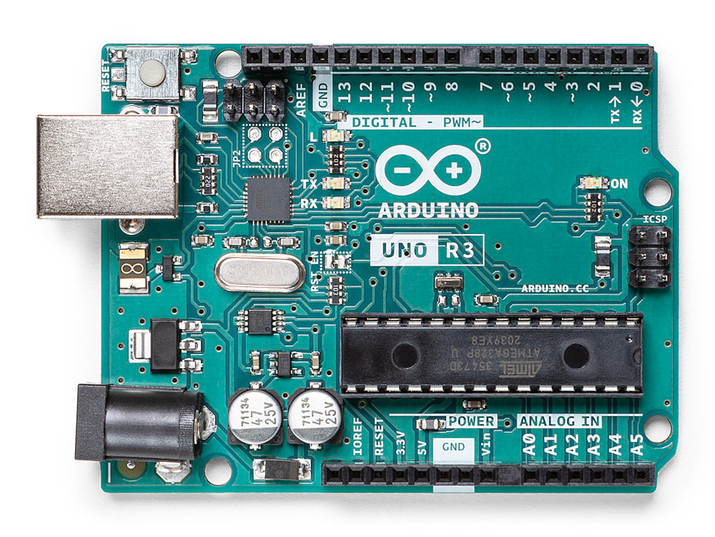
What is an Arduino board?
USB connection for program and data transfer
I/O pins for connecting devices to the board
Secondary MCU
(ATMEL ATMEGA16U2)
Primary MCU
(ATMEL ATMEGA328P)
Notes:
What is an Arduino board?
Circuit board containing two microcontrollers (MCUs)
MCU = tiny computer with its own processor, RAM, flash storage, and I/O, among other peripherals
The main one you program (ATMEGA328P)
The one that provides a USB interface to the main MCU for programming and serial communication (ATMEGA 16U2)
Both digital and analog I/O for connecting to other devices

Slide 11
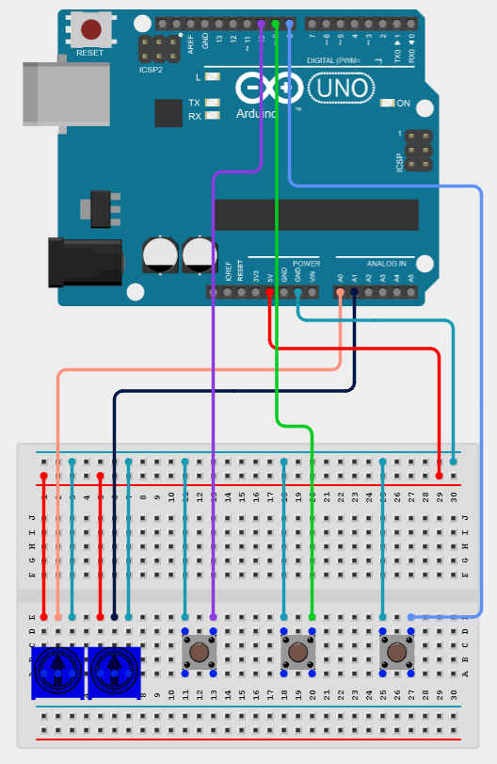
Let’s build a MIDI controller!
Buttons to send note messages
Knobs to send CC messages
Breadboard to connect everything

Slide 12

MIDI Controller Software
The Arduino board is inert until we write software for it
Our software needs to do two things
Read input from buttons and knobs
analogRead() function for reading single knob value
OneButton library and callbacks for handling button events
Send appropriate MIDI message(s) based on input
Arduino MIDI library
MIDI.sendNoteOn(note, velocity, channel);
MIDI.sendNoteOff(note, velocity, channel);
MIDI.sendControlChange(controlNumber, controlValue);

Slide 13
USB-MIDI with Arduino
All communication passes through the secondary MCU
Problem: The secondary MCU presents itself as a serial interface to the computer, so we can’t use it as a MIDI device.
Solution: Reprogram the secondary MCU to act as a USB-MIDI interface
Short pins in purple box to put this MCU into programming mode
Use Atmel Flip to flash USB-MIDI firmware on secondary MCU⁵

Slide 14
References
https://midi.org/midi-1-0
https://midi.org/midi-history-chapter-6-midi-begins-1981-1983
https://drive.google.com/file/d/1ewRrvMEFRPlKon6nfSCxqnTMEu70sz0c
https://www.arduino.cc/
https://www.youtube.com/watch?v=s-gcZ61Dj5g
https://github.com/ddiakopoulos/hiduino

