Slide 1

Programming a
2056
Robot
2056 Ways to Inspire Conference

Slide 2
Coding for Success
Notes:
Coding For Success -

Slide 3

Design Philosophy
Simple
Robust
Quality
Coding for Success
Notes:
Coding For Success -

Slide 4




Version Control
Git
Mercurial
Coding for Success
Notes:
Coding For Success -

Slide 5
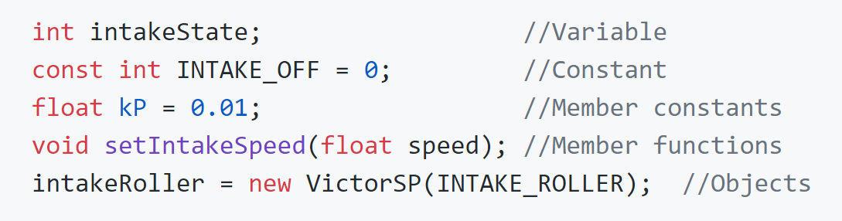
Naming Conventions
Underscore before: _myFunction()
Upercase (Constants): MYCONSTANT
Capital First (classes): MyClass
CamelCase: getValueOfSensor()
Under_score: get_value_of_sensor()
Coding for Success
Notes:
Coding For Success -

Slide 6
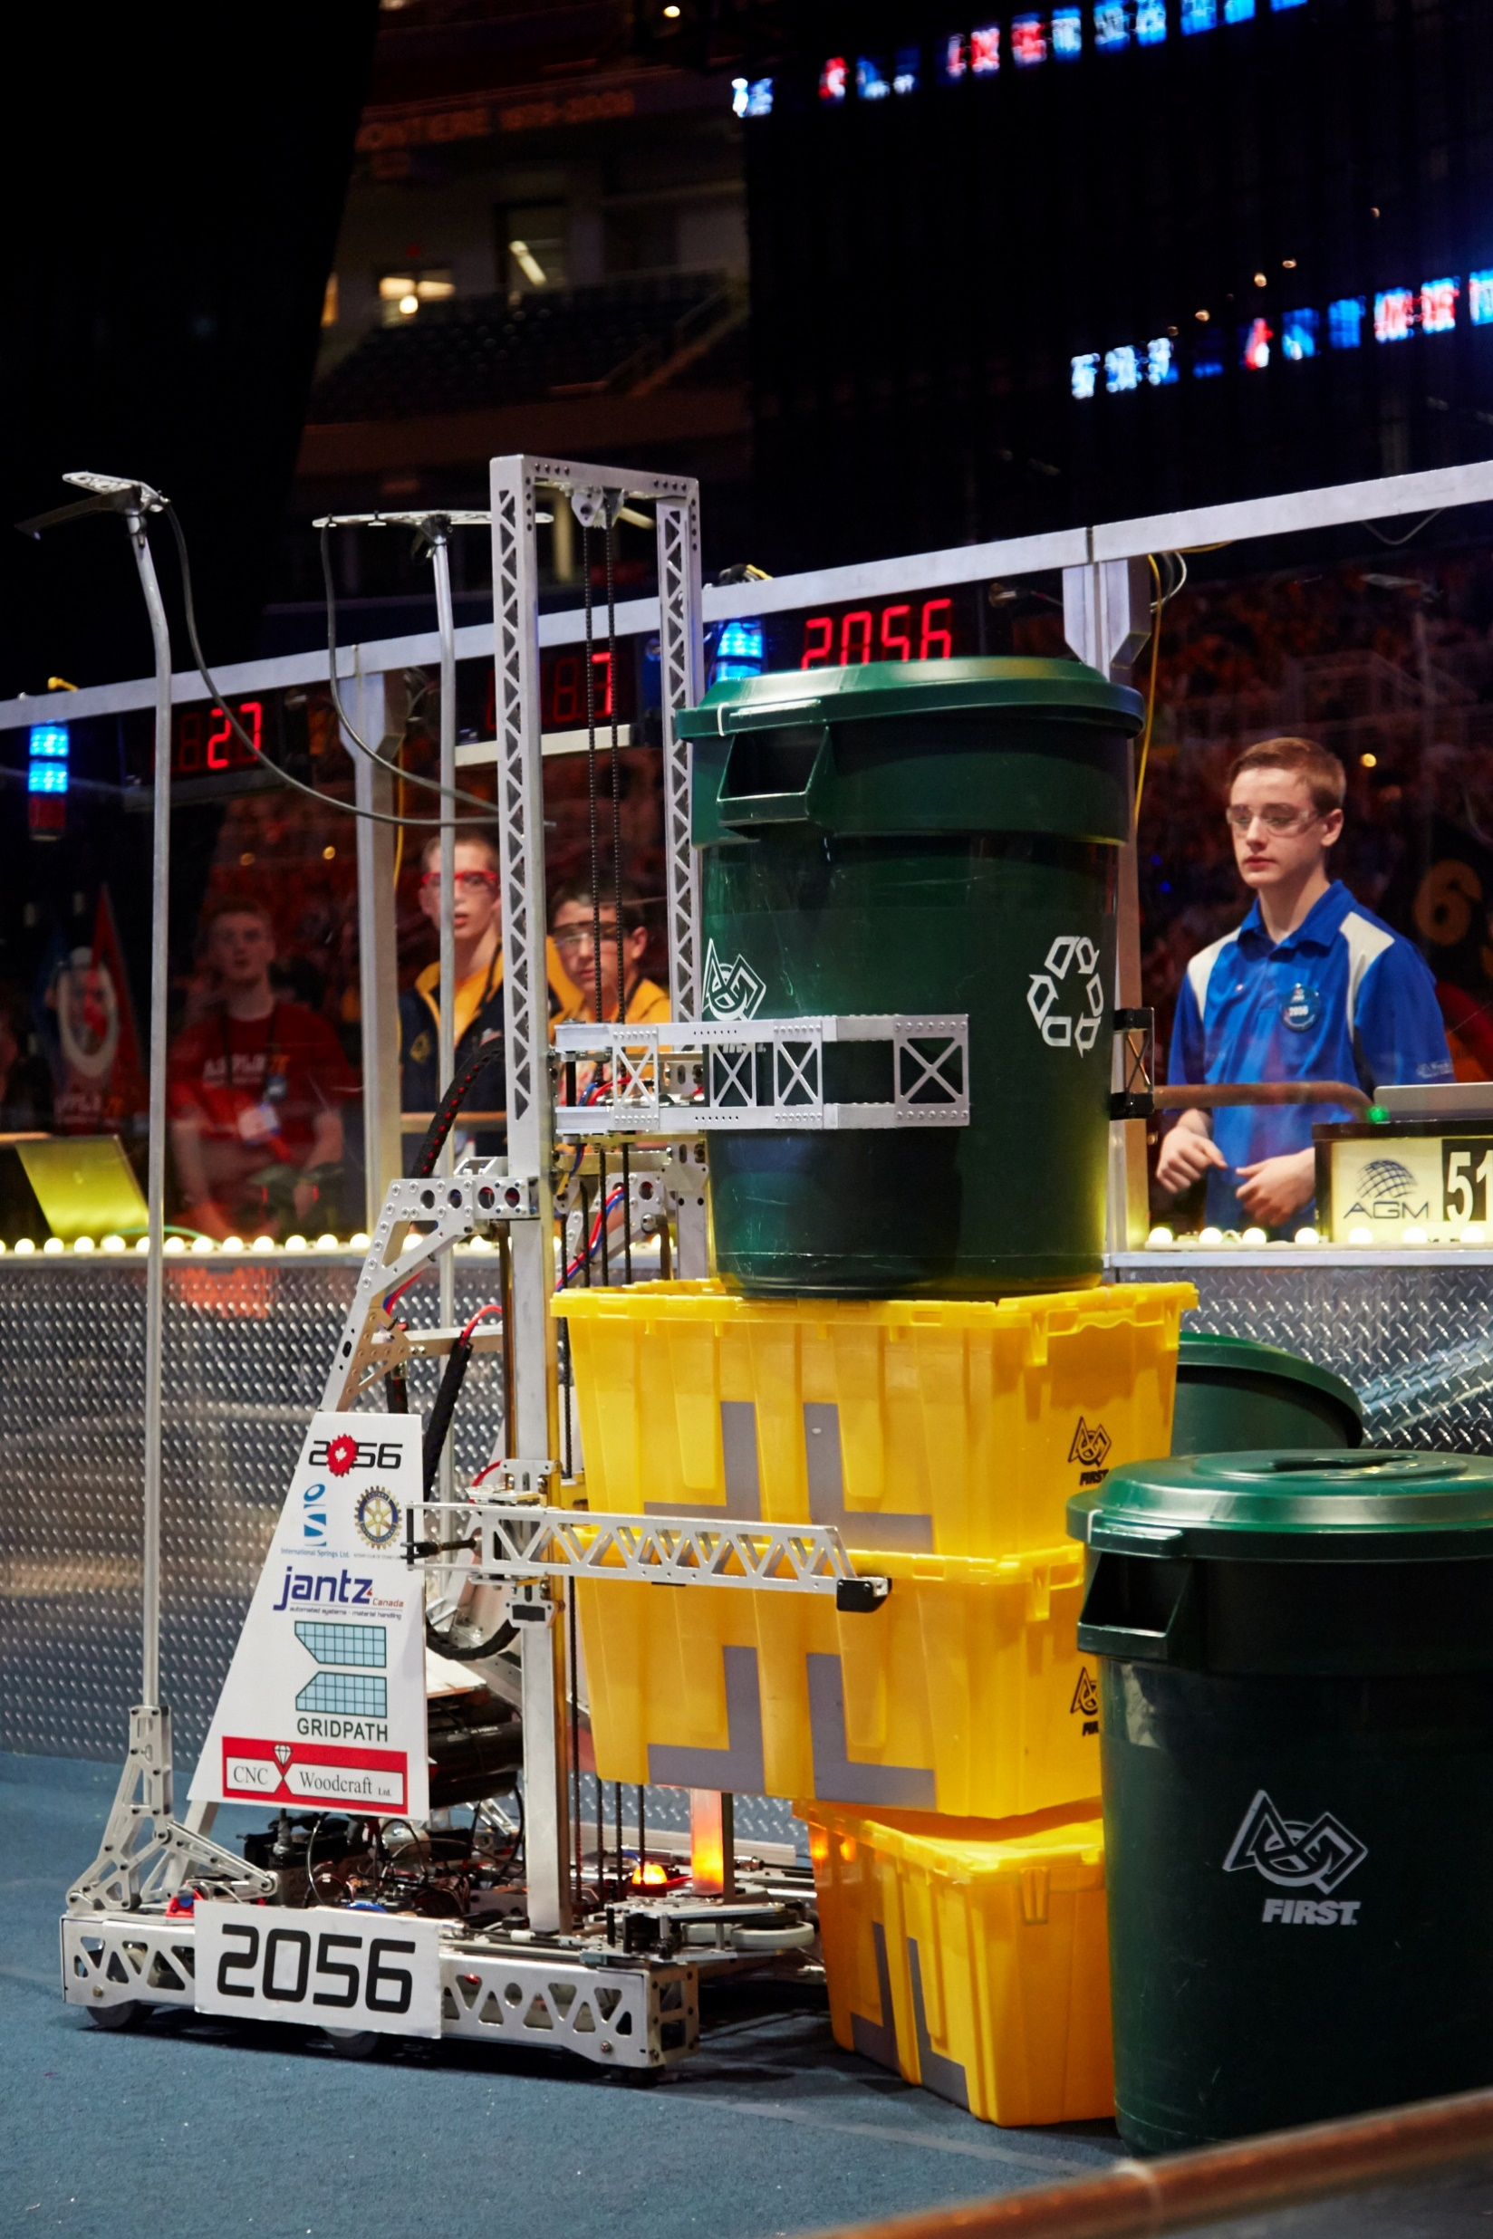
Planning Before You Write
Can Elevator
Can-Arms
Tote Elevator
Drivetrain
Coding for Success
Notes:
Coding For Success -

Slide 7
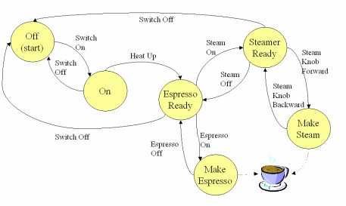
State-Machine Diagrams
Coding for Success
Notes:
Coding For Success -

Slide 8

Multi-File Programming
Coding for Success
Notes:
Coding For Success -

Slide 9
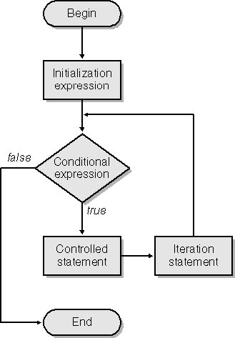
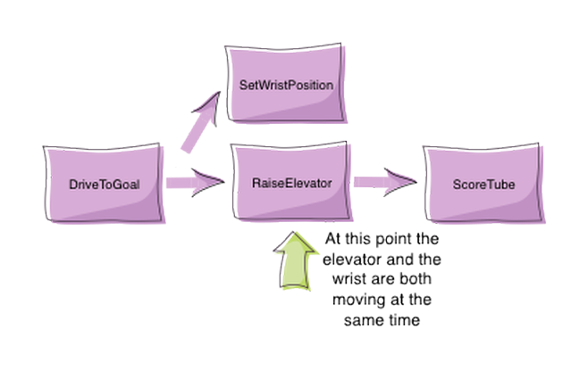
Iterative vs. Command Based
Iterative
Much more simple, but is functionally more limited
Command-Based
More complicated for more complicated robots
Coding for Success
Notes:
Coding For Success -

Slide 10
Robot Controls
Notes:
Coding For Success -

Slide 11

Effective Operator / Driver Layout
Robot Controls
Notes:
Coding For Success -

Slide 12
Sub-System State-Machines
Robot Controls
Notes:
Coding For Success -

Slide 13
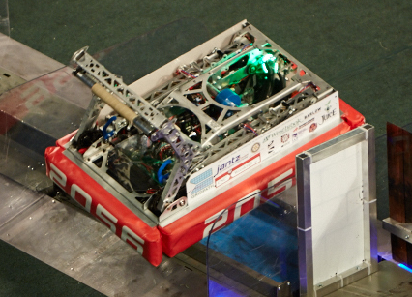
Automating System Interaction
Robot Controls
Notes:
Coding For Success -

Slide 14
Dashboards
Notes:
Coding For Success -

Slide 15
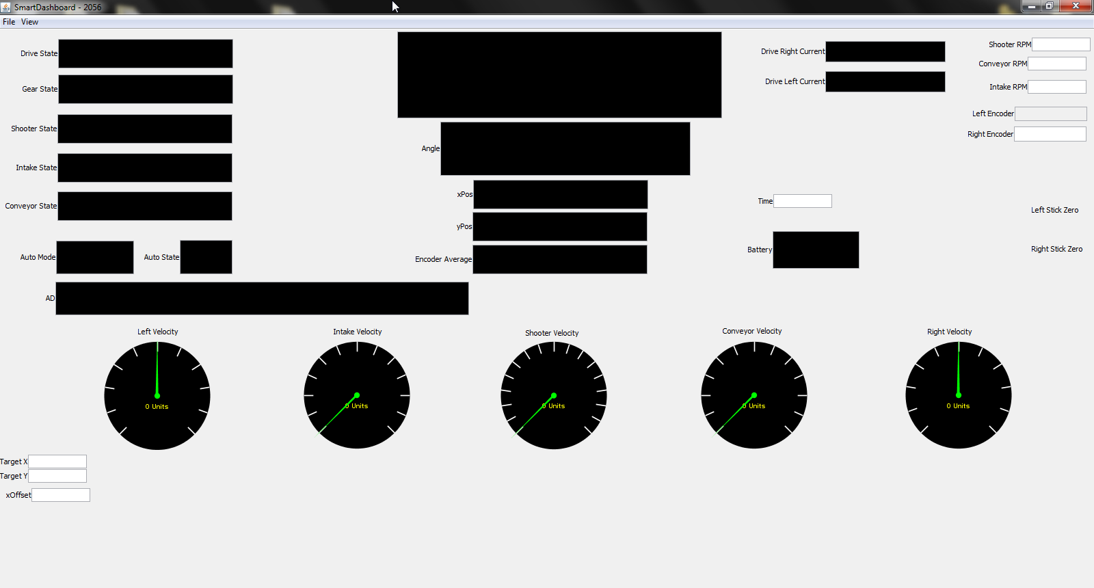
Smart Dashboard
Dashboards
Notes:
Coding For Success -

Slide 16
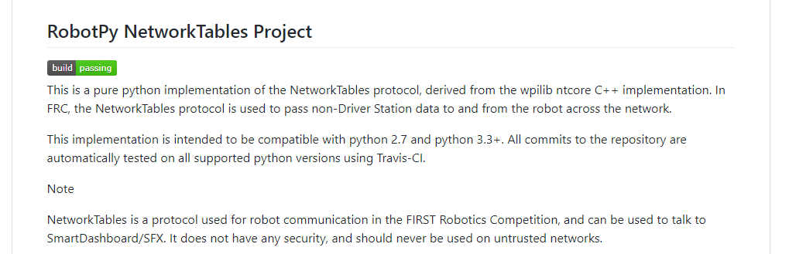
Python Network Tables
Dashboards
Notes:
Coding For Success -

Slide 17
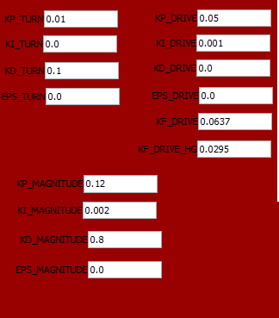
Debug and Competition Dashboards
Dashboards
Notes:
Coding For Success -

Slide 18
Autonomous
Notes:
Coding For Success -

Slide 19
Where to start
Autonomous
Notes:
Coding For Success -

Slide 20
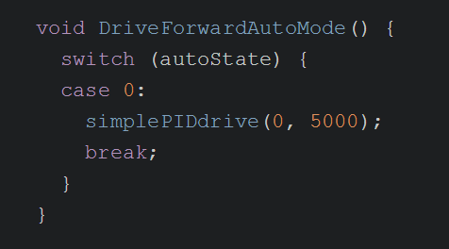
Iterative-based Autonomous Example
Autonomous
Notes:
Coding For Success -

Slide 21
PID
Notes:
Coding For Success -

Slide 22
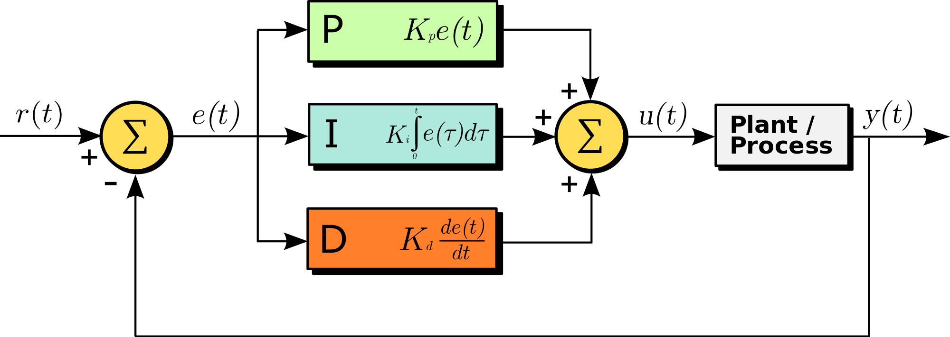
What is it?
Proportional
Integral
Derivative
PID
Notes:
Coding For Success -

Slide 23
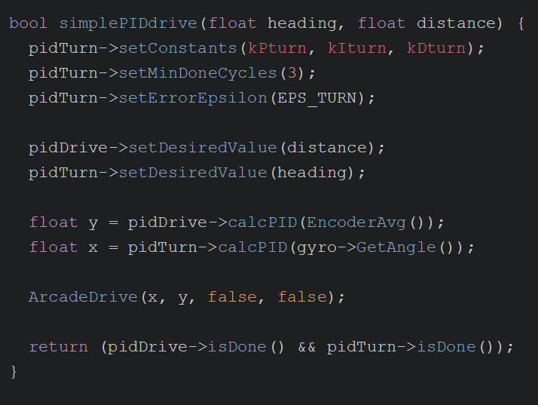
Implementation
PID
Notes:
Coding For Success -

Slide 24
Vision Processing
Notes:
Coding For Success -

Slide 25

The Setup
Image Processing
Notes:
Coding For Success -

Slide 26
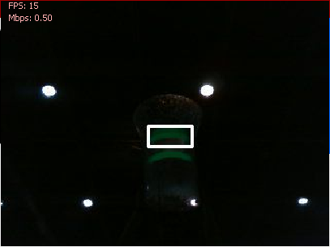
View From the Dashboard
Image Processing
Notes:
Coding For Success -

Slide 27
Multi-Threading
Notes:
Coding For Success -

Slide 28
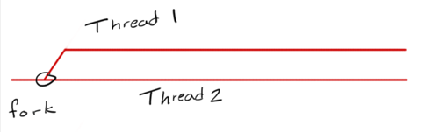
What is it?
Multithreading is a specialized form of multitasking which is the feature that allows your computer to run two or more programs concurrently.
Multi-Threading
Notes:
Coding For Success -

Slide 29
Why is it a Good Idea?
Improved performance
Keeping your processors busy
Balance loads across threads
Do two things at once
Multi-Threading
Notes:
Coding For Success -

Slide 30
Where to Implement it
Vision Processing
PID Controller
Anywhere you want to do two things at once.
Multi-Threading
Notes:
Coding For Success -

Slide 31
Questions
http://github.com/ethanelliott
Notes:
Coding For Success -

