Slide 1
Self-Distillation
Ethan Glaser (eg492)

Slide 2
Overview
Knowledge Distillation Review
Self Distillation
Overview
Implementation details
Experimental performance
Application: BERT
Recap

Slide 3
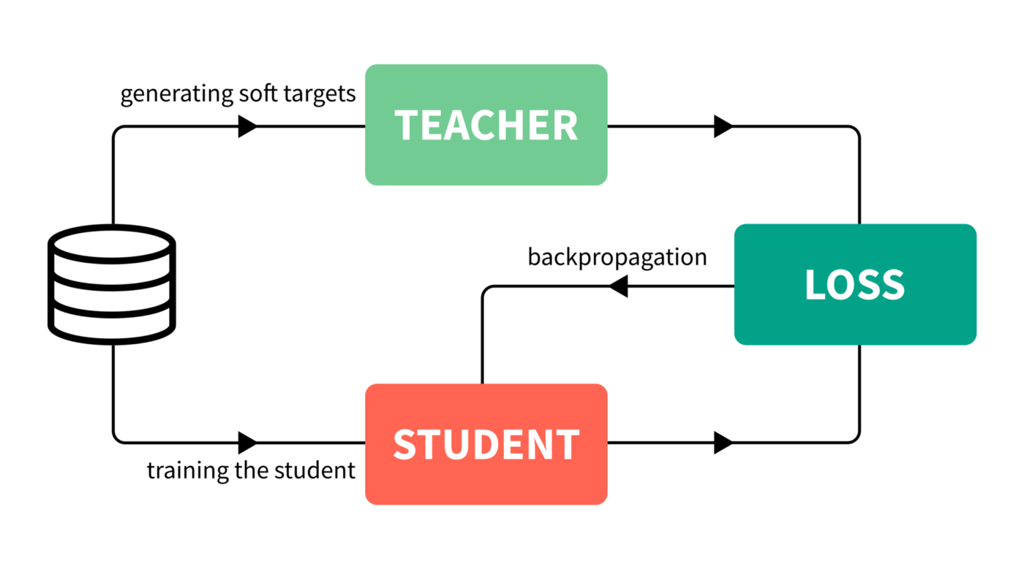
Knowledge Distillation Review
Large pretrained teacher network produces soft targets
Smaller student network trained on both hard and soft targets

Slide 4
Knowledge Distillation Issues
Uncertainty about design and training of teachers
Hard to identify and create good teachers
No formal procedure for optimizing
Low efficiency in knowledge transfer process
Student networks rarely outperform teachers
Time consuming and compute heavy training process

Slide 5
Self-Distillation Overview
Distills knowledge from within the network itself
Target network is divided into several shallow sub-networks according to original architecture
Deeper sub-networks are teachers used to train/distill knowledge to shallower layers
“Use outputs from a trained model together with the original targets as new targets for retraining the same model from scratch”
-Kenneth Borup & Lars Andersen

Slide 6
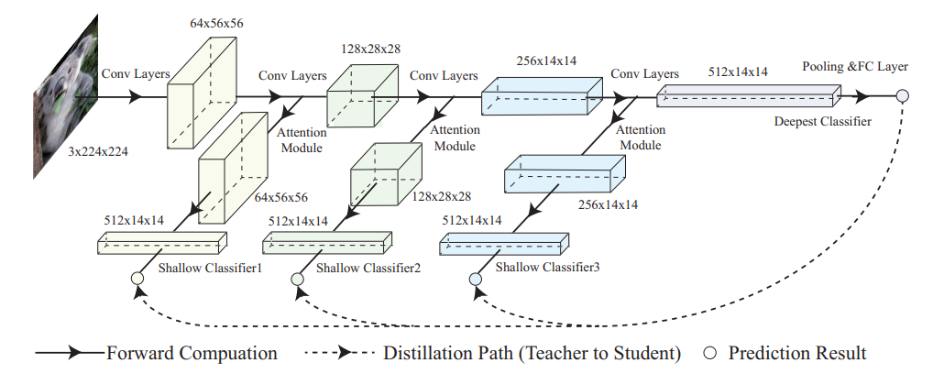
Self-Distillation Visualized
Attention-based classifiers are inserted after each sub-network
Deepest classifier provides soft targets for intermediate classifiers

Slide 7






Self-Distillation Training
3 components to loss function:
Cross entropy loss between training labels and classifier’s softmax output
KL divergence computed between softmax output of students and teachers
L2 loss between feature maps of shallow and deep classifiers
Deeper classifiers used as teachers for shallower sub-networks

Slide 8
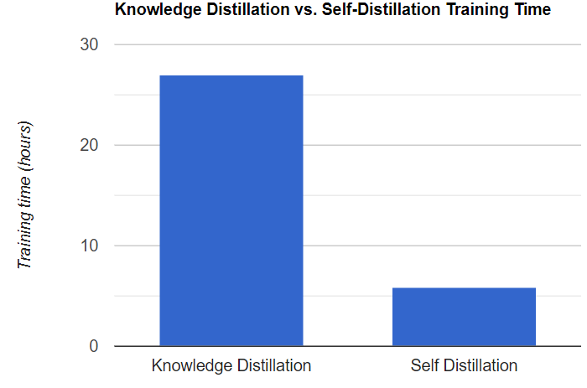
Comparison to Knowledge Distillation
Advantages of self-distillation:
Use of compact teacher model instead of large over-parameterized model leads to high compression and faster training
Discourages vanishing gradient problem
Experimental results indicate performance increase despite greatly reduced training time

Slide 9
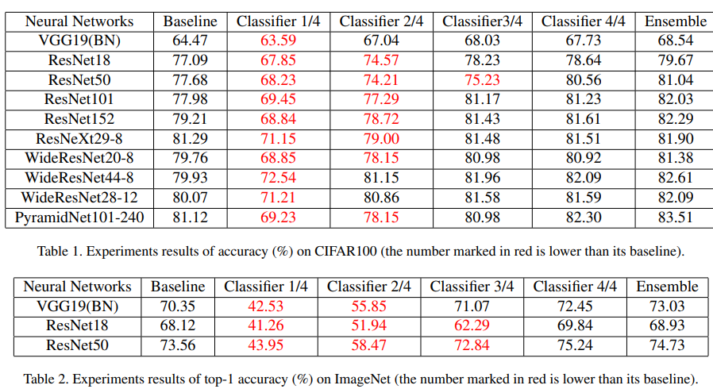
Self-Distillation Experimental Performance
The experimental results of several papers show relative success
The original self-distillation paper tested 5 architectures on both ImageNet and CIFAR100 – 2.65% average boost without slower response time
Self-distillation outperformed standard training on every single combination
Self-distillation outperformed knowledge distillation on most combos
The deeper the network, the more improvement self-distillation yielded

Slide 10
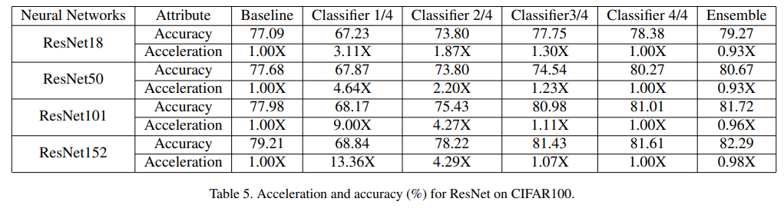
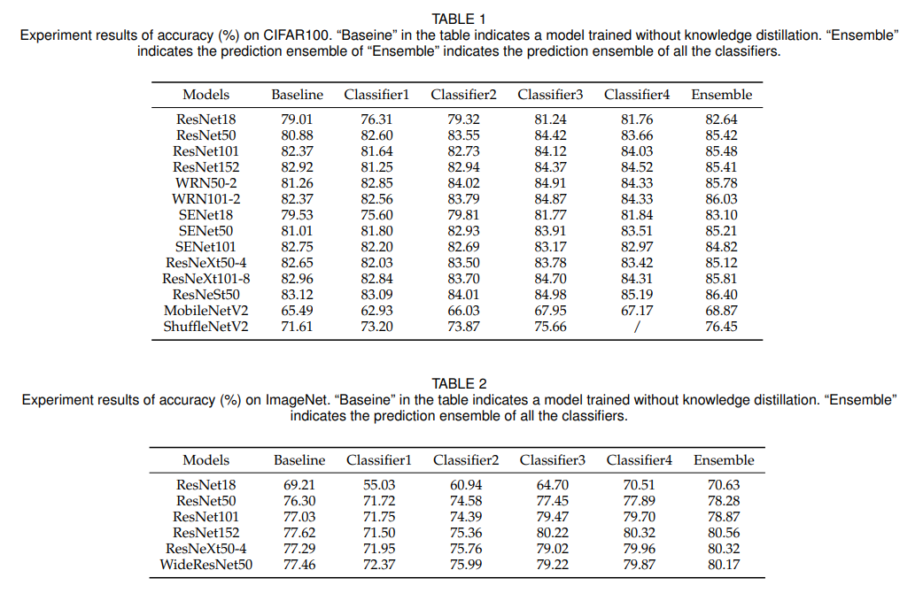

Slide 11
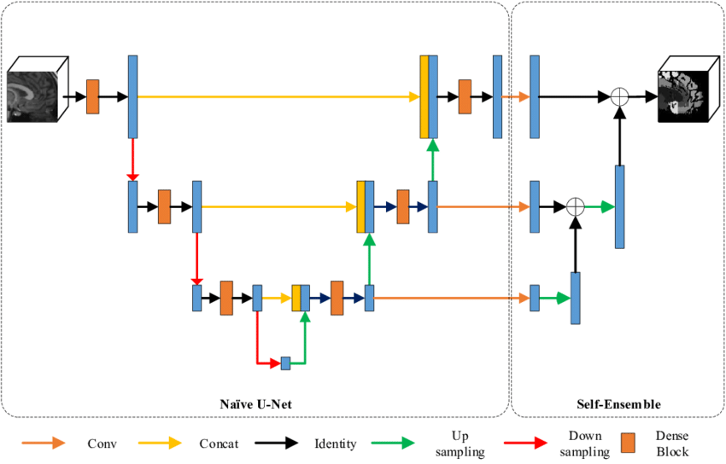

Self Distillation Application: BERT Fine Tuning
Comparison of Self-Ensemble and Self-Distillation for fine-tuning BERT
Self-Ensemble – ensemble of models from different time steps of training process
Self-Distillation – teacher is self-ensemble model along with labeled training data

Slide 12
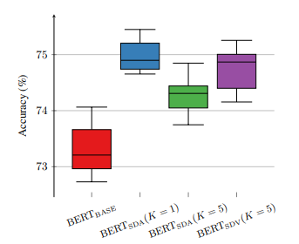
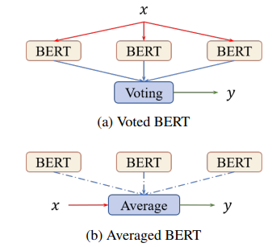
BERT Fine Tuning Experimental Results
Experimentation involved evaluation of Self-Ensemble, Averaged Self-Distillation (average parameters of models), and Voted Self-Distillation (averaged output of models)

Slide 13
BERT Fine Tuning Reflection
Higher potential of BERT when using a better fine-tuning strategy even without leveraging external knowledge or data
BERT performance can be improved without significantly decreasing the training efficiency using self-ensemble with parameter averaging

Slide 14
Summary & Thoughts
Self-distillation is a novel approach towards accurate networks that avoid the massive training overhead of traditional knowledge distillation
Still not clear on why self-distillation performs so well
So much more to explore within knowledge distillation space
Apply same fine-tuning techniques towards any model?
What more can be done to further improve self-distillation?

Slide 15
Papers Referenced
Be Your Own Teacher: Improve the Performance of Convolutional Neural Networks via Self Distillation
Even your Teacher Needs Guidance: Ground-Truth Targets Dampen Regularization Imposed by Self-Distillation
Improving BERT Fine-Tuning via Self-Ensemble and Self-Distillation
Self-Distillation: Towards Efficient and Compact Neural Networks

