Slide 1
RADseq Working Group F_{ST} and Dsuite (ABBA/BABA)
Ethan Gyllenhaal
Spring 2023

Slide 2
Goals of this week
Use VCFtools to calculate genome-wide FST for population pairs
Optional (not in slideshow) visualize isolation-by-distance
Combine tests for gene flow with phylogeny in TreeMix
Test for gene flow with ABBA/BABA tests (Dsuite)

Slide 3
Return to VCFtools outputs
--recode: make a VCF of this filtering scheme
--012: outputs a file with SNPs codes as 0/1/2 for homozygous ref/heterozygous/homozygous alternate
--plink: outputs PLINK format files
--depth: outputs mean depth per individual
--window-pi: outputs mean diversity per window
--weir-fst-pop: most likely to be used here, outputs pairwise F_{ST} for a given pair (or more) of populations, input is a list (like --keep), output to command line includes genome-wide mean, output file has site or window based F_{ST}
Example: vcftools --vcf samples.vcf --recode --max-missing 0.75 --mix-alleles 2 --max-alleles 2 --weir-fst-pop pop1_list --weir-fast-pop pop2_list --not-chrom Z_chrom --out path/to/output_stem

Slide 4
FST in a loop
Updated script and dummy pops folder here: https://github.com/ethangyllenhaal/RADSeqWorkshopSpring2023/tree/main/5_FST_geneflow
Old script and real pops directory here: https://github.com/ethangyllenhaal/SolomonsSymposRad/tree/main/05_pairwise_Fst
Probably a smart way to do this with a popmap, but I haven’t done it yet
Run like sh pairwise_Fst_vcftools.sh name.vcf output.txt
Assumes VCF has been filtered

Slide 5
FST in a loop
Pseudocode:
Print pop names across the first row
For each population
Print the name for the first column
For each population (again)
If the populations are the same
Output a “-”
If the populations aren’t the same
Run vcftools FST on that pair, pull weighted FST from the log file
Print a new line

Slide 6
FST in a loop
Example output
You can re-arrange rows in excel or add a number/letter in front of pop file names to make it in a more sensible order
Pops | choiseul | guad | isabel | ngella | short
choiseul | - | 0.092019 | 0.028978 | 0.095858 | 0.084721
guad | 0.092019 | - | 0.07704 | 0.071744 | 0.17104
isabel | 0.028978 | 0.07704 | - | 0.071058 | 0.11854
ngella | 0.095858 | 0.071744 | 0.071058 | - | 0.17898
short | 0.084721 | 0.17104 | 0.11854 | 0.17898 | -

Slide 7
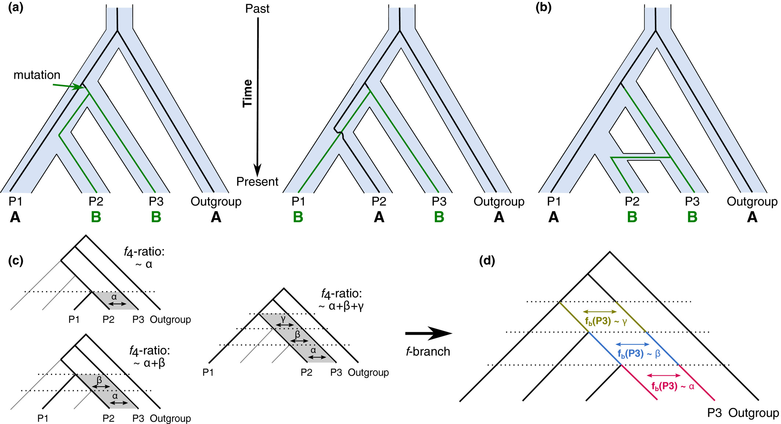
DSuite

Slide 8
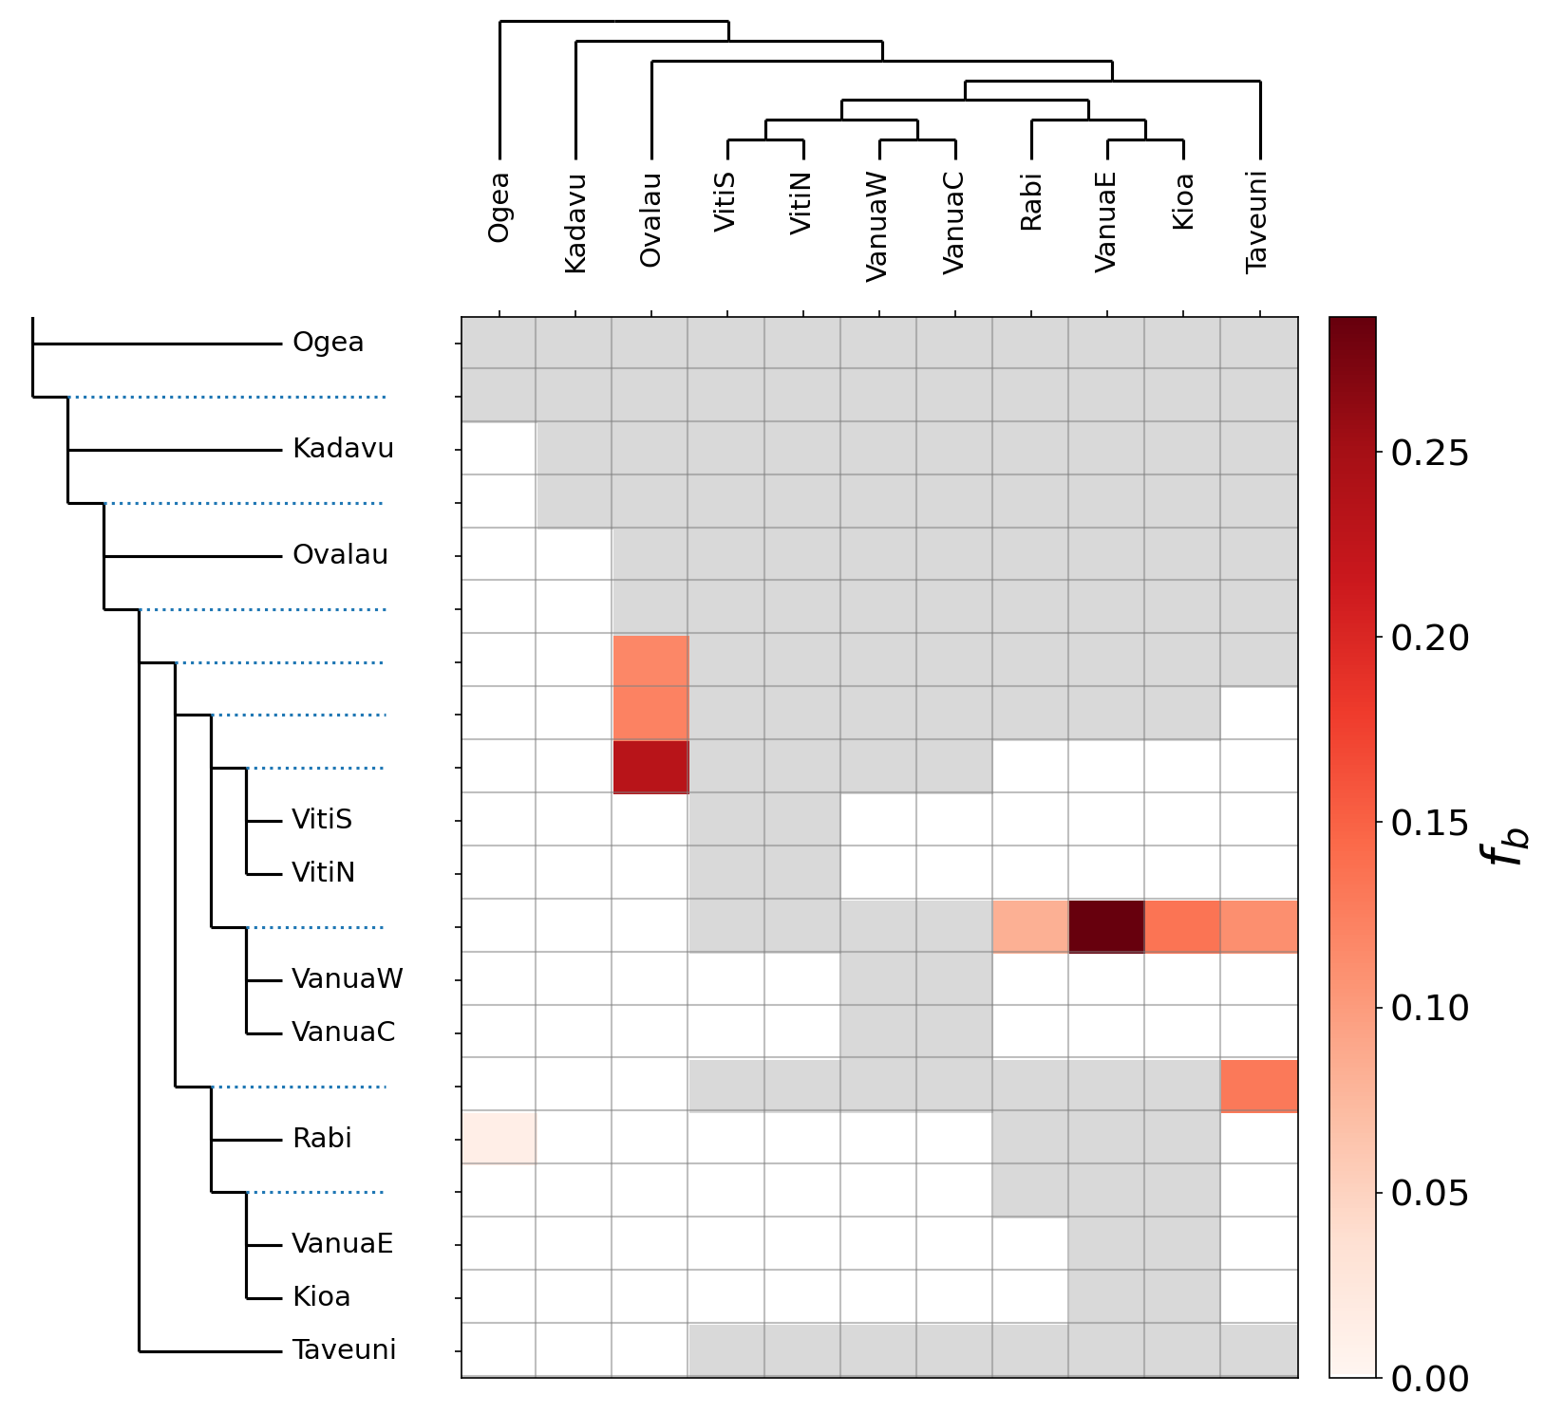
DSuite

Slide 9
DSuite
Not on conda yet, I’d install it locally or in your CARC home directory:
Link and install info here: https://github.com/millanek/Dsuite
Needs a popmap with the outgroup named “Outgroup”
Example here (includes fbranch): https://github.com/ethangyllenhaal/SolomonsSymposRad/tree/main/09_DSuite
Example run for just Dtrios:
/path/to/Dsuite/Build/Dsuite Dtrios full_75.vcf map_main -o full/main -k 50

Slide 10

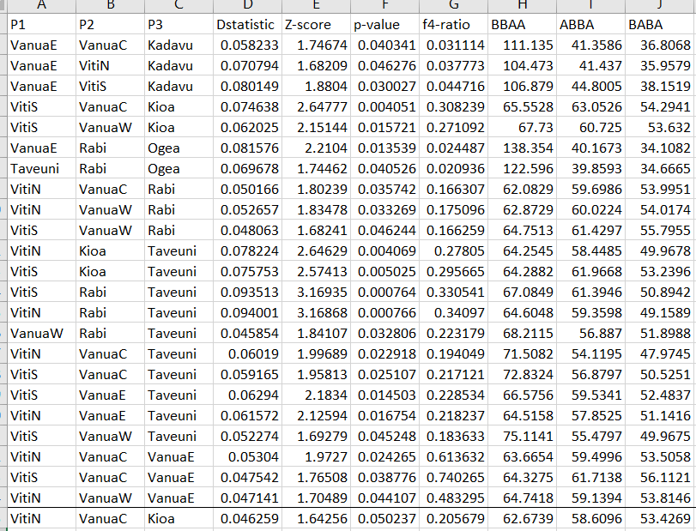
DSuite
Example outdir looks like this, I normally just use BBAA:
It includes all combos, so you should load into excel or R for processing/viewing data
Example of sorted output:

Slide 11
TreeMix
This is on conda, can be run locally or on CARC, but better on CARC (locally can have memory issues)
Weirdly hard to find manual, it’s in here: https://bitbucket.org/nygcresearch/treemix/downloads/
Input is from populations:
populations -P $src/stacks_out/full -M $src/popmaps/popmap_full -O $src/populations_out/full90 --vcf --treemix -R .9 --write-random-snp -t 8
Simple to run, here is code for running 4 edges
treemix -i pachy_full100.treemix.gz -root SantaCruz -o ./out/pachy_jk0 -m 0 –se
treemix -i pachy_full100.treemix.gz -root SantaCruz -o ./out/pachy_jk1 -m 1 –se
treemix -i pachy_full100.treemix.gz -root SantaCruz -o ./out/pachy_jk2 -m 2 –se
treemix -i pachy_full100.treemix.gz -root SantaCruz -o ./out/pachy_jk3 -m 3 -se
treemix -i pachy_full100.treemix.gz -root SantaCruz -o ./out/pachy_jk4 -m 4 -se

Slide 12



Plotting and stats
Before plotting, you need to copy output files to your computer
I tend to do this in R, I added an example script and plotting functions to this repo: https://github.com/ethangyllenhaal/RADSeqWorkshopSpring2023/tree/main/5_FST_geneflow
Good to look 1) at which edge count notably increases likelihood and 2) if a given edge is significant (zless name.edges.gz)

