Slide 1
Examining and aligning reads
USP RADseq Workshop
July 2026

Slide 2
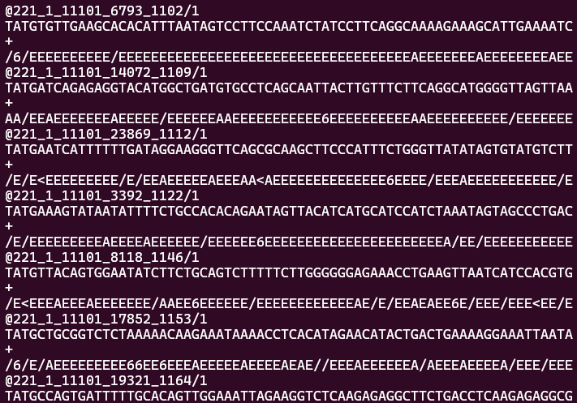
What is a read?
It is the data the sequencer outputs composed of 3 lines
Identifier
Sequence
+
Quality scores
Sequence is what is aligned to reference/assembled, quality scores inform is
Consistent 4 lines lets us count reads easily

Slide 3

Counting reads
Read files are compressed (made smaller but not human readable) with gzip
Tools like zcat and zless look at compressed files
cat commands spit ALL lines of a file into output
The word count command with the line option, wc -l, lets us count the number of lines in a file
Combine them and get the number of lines in read file, divide by 4 for the actual read count (if people get ahead, incorporate that yourself!)

Slide 4
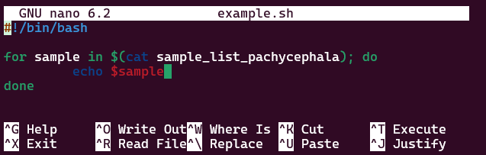
Loops
Common in all programming languages, how to code repetitive taks without parallelization
Basic syntax is: for [iterator]; do command; done

Slide 5
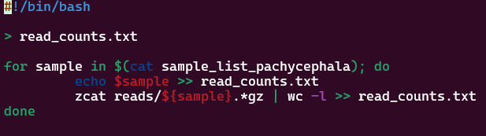
Loops
Combine this loop script with the read counting command (note that file extensions are different between datasets)
Ideally output the sample names and read counts to a file

Slide 6
Reference genome
A list of sequence names and sequences like a fastq… just much larger
View yours with less
If you haven’t already, load your conda environment (conda activate name-of-env)
Index your reference by running this (takes about 20 minutes):
bwa index name_of_reference.fna
While we wait, take a closer look at your population file, compare with your neighbors, and improve your read counting script

Slide 7
Aligning to our reference
This is the big step where we map all our sequence data to the reference genome using that index we just made
The backbone for how we run this is very similar to the other loop
Put the following in a bash script and start running it
for sample in $(cat sample_list_NAME); do
bwa mem -t 2 -M name_of_reference.fna \
reads/${sample}.*.gz \
| samtools view -b -F 4 \
| samtools sort -o bams/${sample}.bam
done

Slide 8
Aligning to our reference
\ means to continue reading
this as the same line
$ tells the program you are referencing a variable
For each sample name in our list, run the following command
Use BWA’s mem algorithm with 2 threads and the focal reference
Use the read file for that sample
Remove any reads that did not match the reference and compress to a BAM
Sort the BAM and output it into a file with the sample name
Go to the next sample
1 for sample in $(cat sample_list_NAME); do
2 bwa mem -t 2 -M name_of_reference.fna \
3 reads/${sample}.*.gz \
4 | samtools view -b -F 4 \
5 | samtools sort -o bams/${sample}.bam
6 done
These pipes (|) are the same as before, taking output from one program and feeding it into another

Slide 9
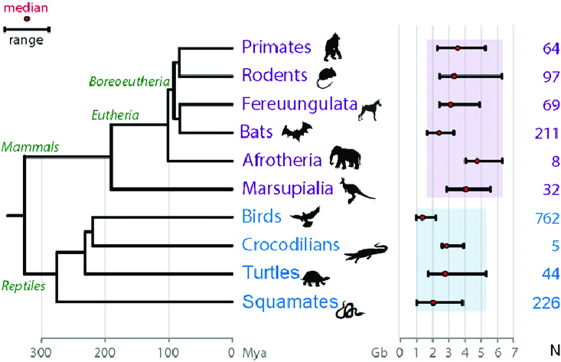
While we wait: de novo RADseq
Birds are an “easy” group
Young, diverse, ubiquitous
Small genomes on average
Conserved genomes compared to other groups
“Easy” groups allow flexible reference genome choice
Genome sequencing is getting cheaper, but still not feasible for everything
De novo assembly of loci is the alternate RAD path

Slide 10

While we wait: de novo RADseq
Basics of the pipeline
Build loci
Put together a catalog of all loci
Match individuals to the catalog
Complexity comes from choices, but you can run it simply with:
denovo_map.pl -T 2 -o denovo -m 10 -M 5 -n 5 --popmap popmap_ingroup --samples reads/

Slide 11
DeNovo choices
There are some important choices when it comes to locus construction in Stacks. I chose some that should work for everyone, but in short, they are:
m, the minimum number of reads required to make a locus (stack)
M, the maximum distance between loci within an individual
n, the maximum distance between loci between individuals

Slide 12
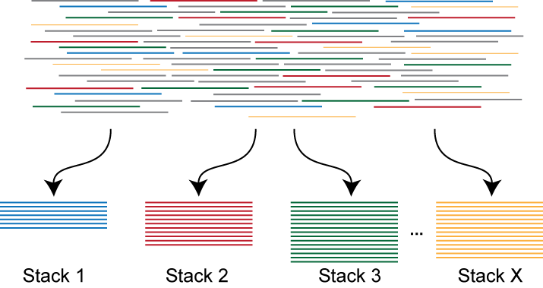
DeNovo choices
m, the minimum number of reads required to make a locus (stack)
Here it is 10, meaning any locus we have we are pretty confident in

Slide 13
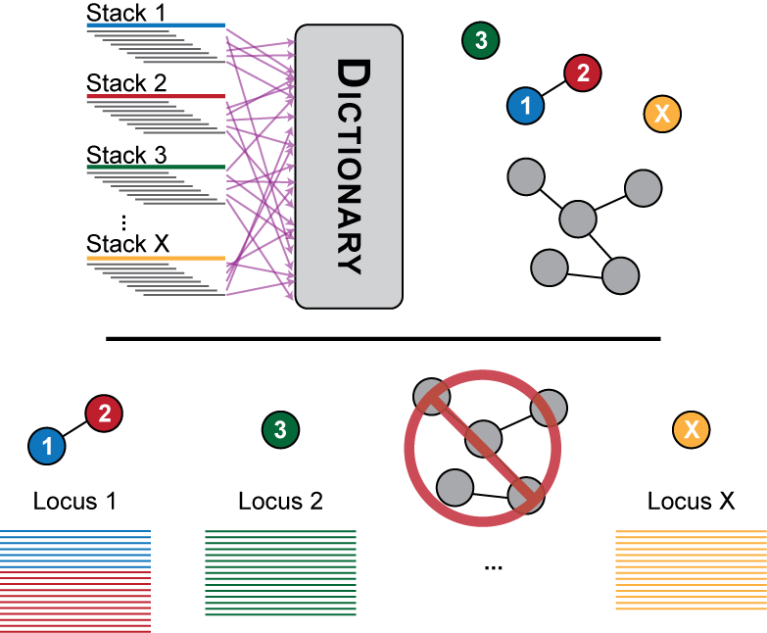
DeNovo choices
M, the maximum distance between loci within an individual
Here is 3, meaning there are a maximum of 3 differences for our ~130 bp loci to be merged into a single locus

Slide 14
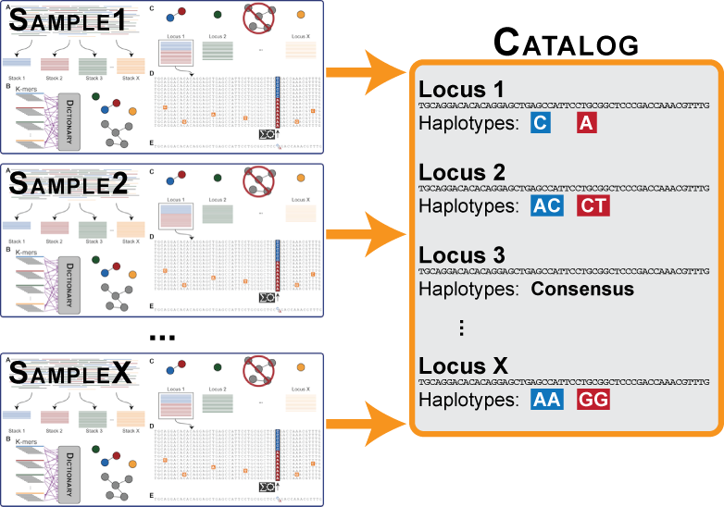
DeNovo choices
n, the maximum distance between loci between individuals
Here it is 3, meaning loci with more than 3 differences will be treated as separate, this fairly low number may mean you lose a lot of loci in multi-species analyses!!

Slide 15
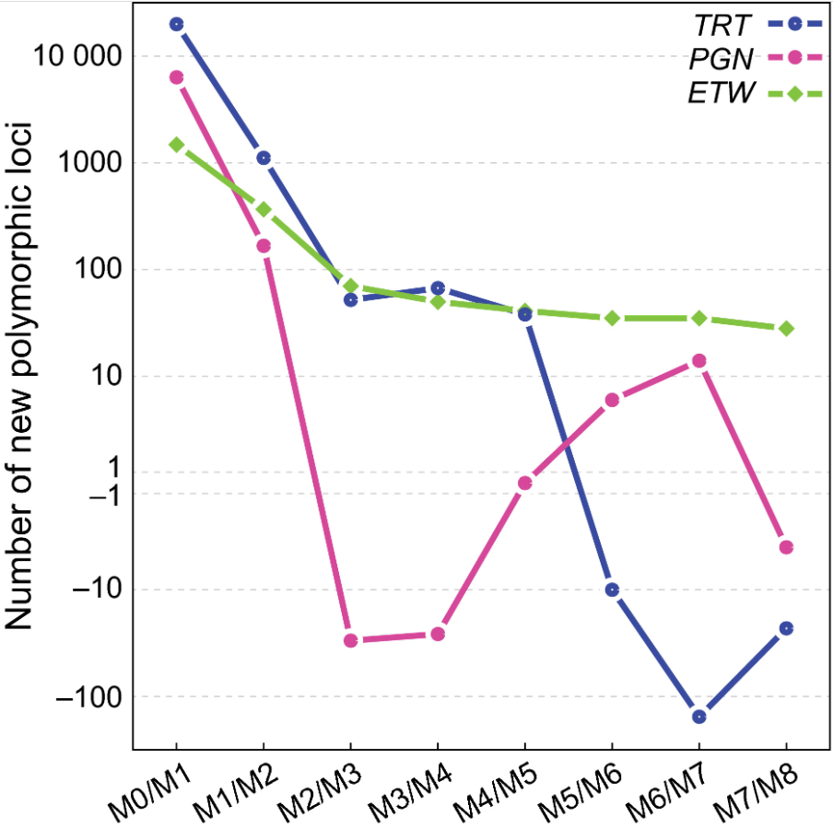
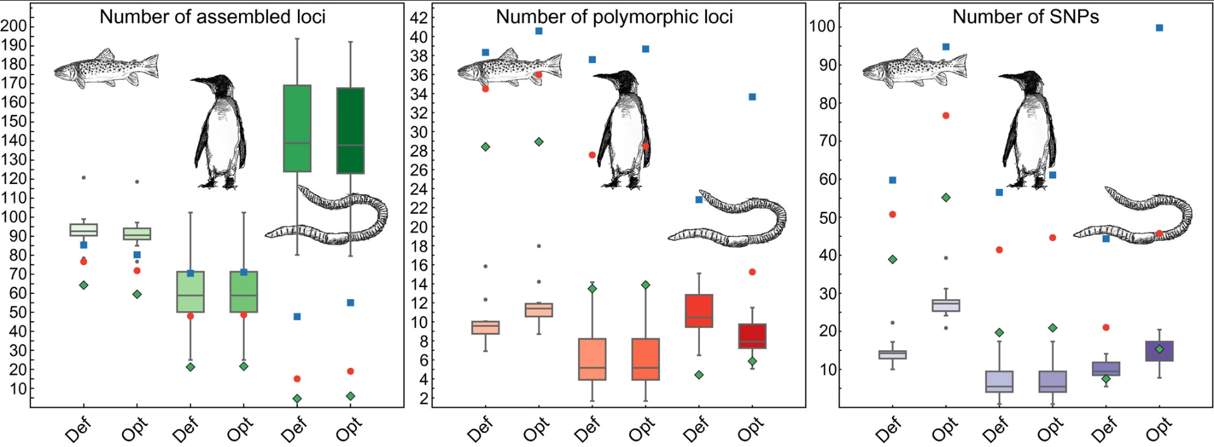
DeNovo choices
Paper goes over ways of selecting values for these parameters here: https://besjournals.onlinelibrary.wiley.com/doi/10.1111/2041-210X.12775

Slide 16
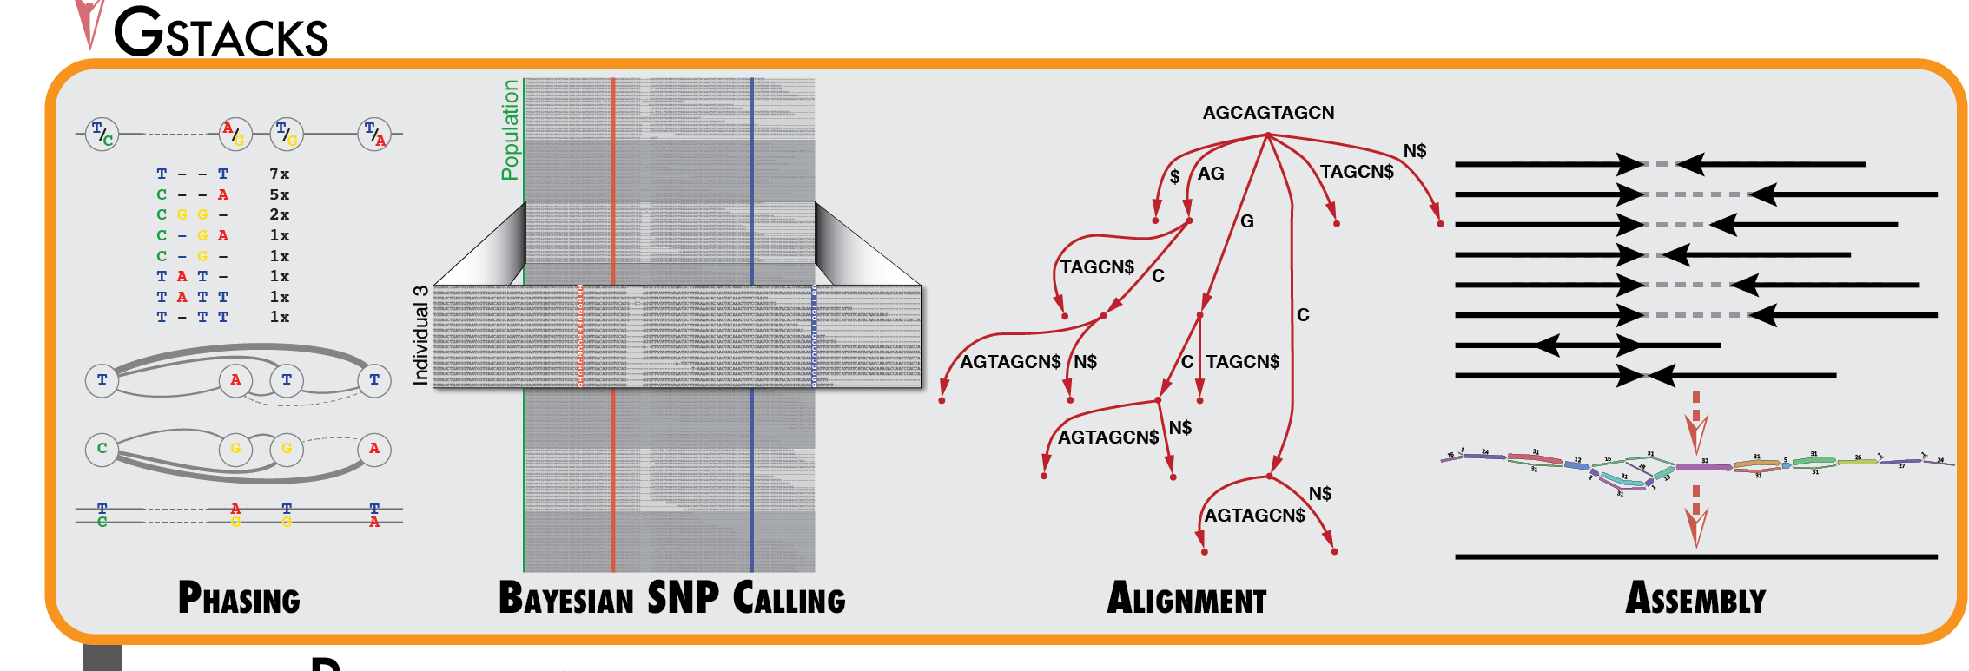
The last big step: gstacks
With reference-based data, just acts as a fast, easy-to-use SNP caller
gstacks -I bams -M popmap_full -O stacks_out/full/
gstacks -I bams -M popmap_ingroup -O stacks_out/ingroup/

