Slide 1
Introduction and genomics basics
USP RADseq Workshop
July 2026

Slide 2

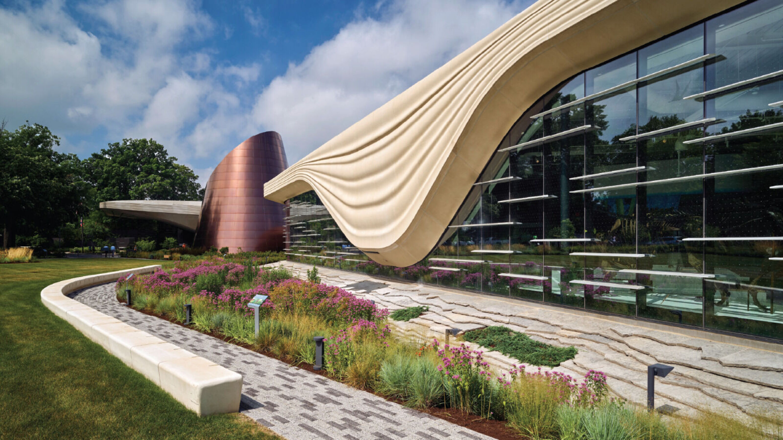
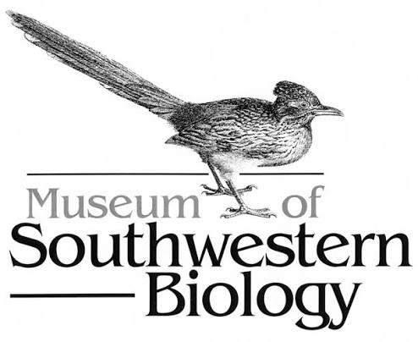
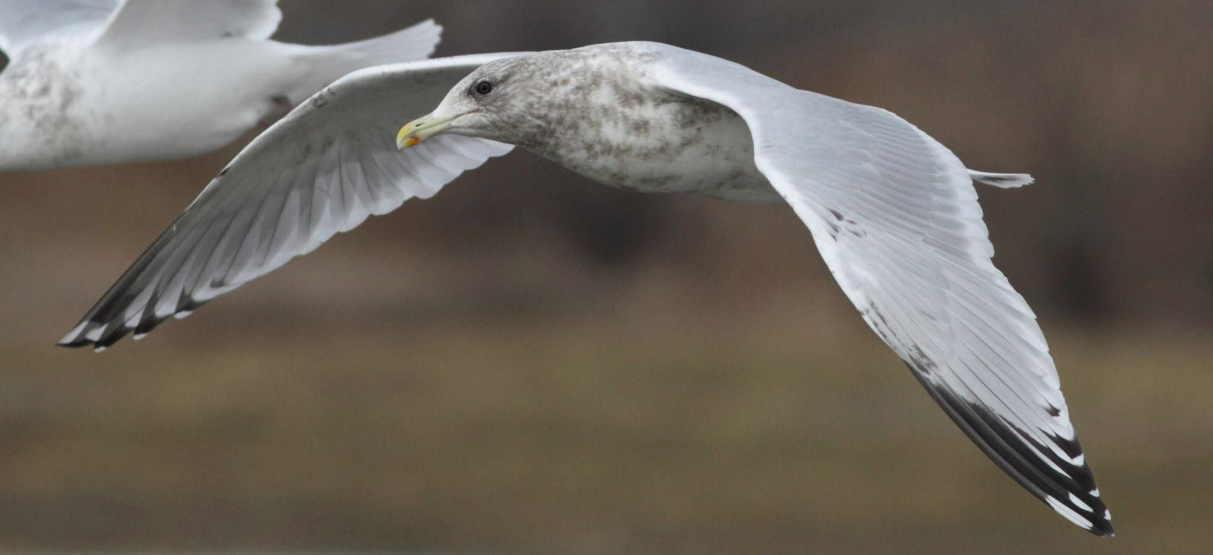





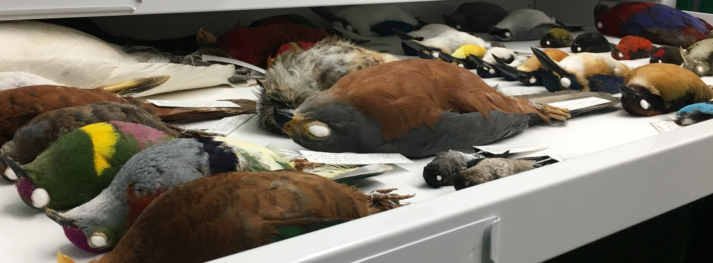
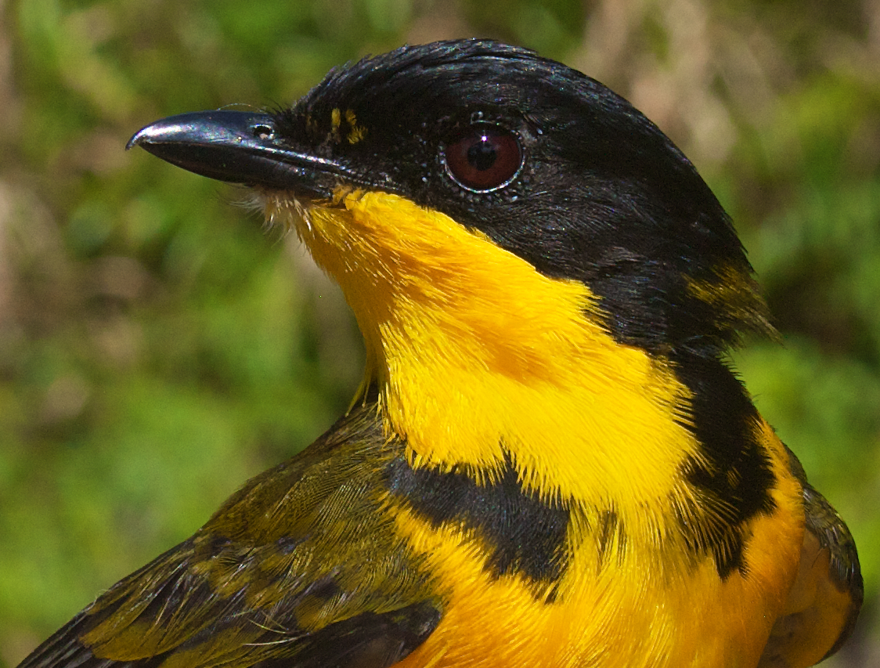
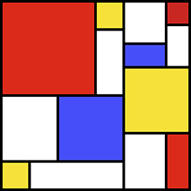
Brief history of me

Slide 3
Through line: using genes and genomes to understand evolution
Genes
Partial Genomes
Full Genomes
Screening for parasites
Few gene phylogeography
Fine-scale population genomics
Genomic basis of traits
In depth conservation genetics
Genomically informed simulations
Phylogenomics
Phylogeography
Coarse genomic landscapes*
Genetic diversity
Landscape genetics
Number of queens in ant colonies
Testing for clonality
Notes:
Framed around my personal background, the kinds of analyses possible with different scales of sequencing. Single genes are useful for application like screening for parasites and large scale low cost analyses like parentage analysis. However, even these are being rolled into high throughput approaches, such as metabarcoding. Partial genomes, or reduced representation sequencing, are used for many of the more basic descriptive measures of how populations are related and have evolved, and these kinds of applications were the focus of my PhD work. Full genomes do offer a few key additional applications we likely won’t have time to cover here, but I am happy to discuss them further.

Slide 4
Through line: using genes and genomes to understand evolution
Genes
Partial Genomes
Full Genomes
Screening for parasites
Few gene phylogeography
Fine-scale population genomics
Genomic basis of traits
In depth conservation genetics
Genomically informed simulations
Phylogenomics
Phylogeography
Coarse genomic landscapes*
Genetic diversity
Landscape genetics
Number of queens in ant colonies
Testing for clonality
Notes:
We will focus on analyses that are well suited for reduced representation methods, and will run most of the ones outlined here.

Slide 5
Workshop goals
Get familiar with command line bioinformatics
Understand how to interpret common population genomic analyses
Work through a dataset from start to finish
Write up the results of your work
Notes:
Short read sequencing is the common technology for many of the analyses we will discuss during this workshop. It always consistent of taking small pieces of the genome, making them readable to a sequencer, aligning or assembling those fragments, determining what variants are real, and analyzing those variants.

Slide 6
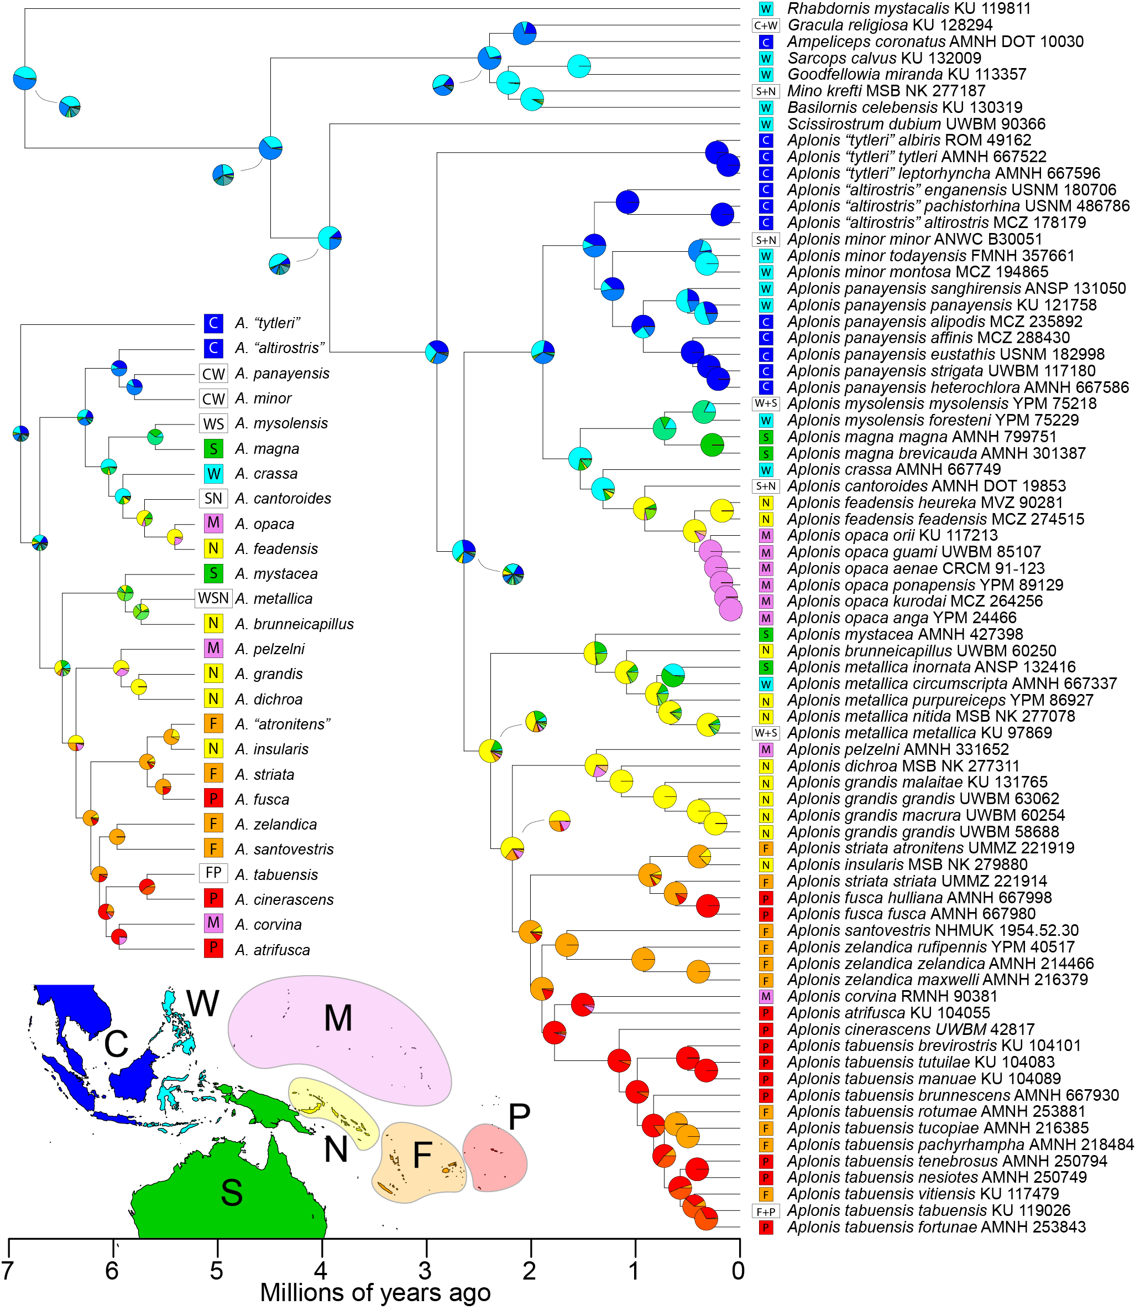
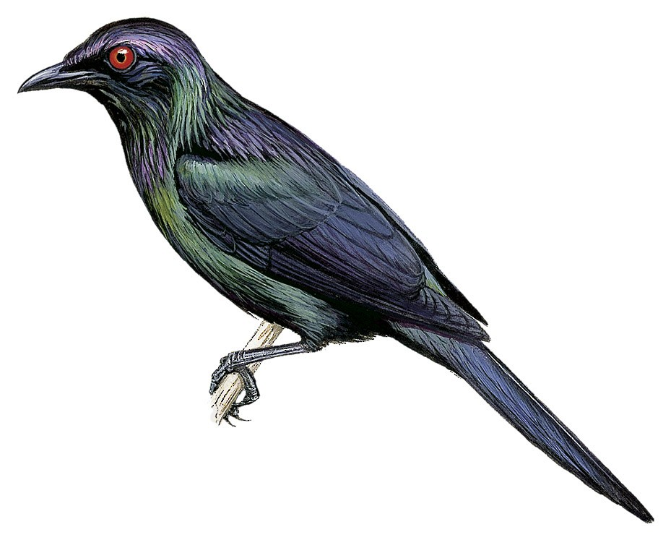
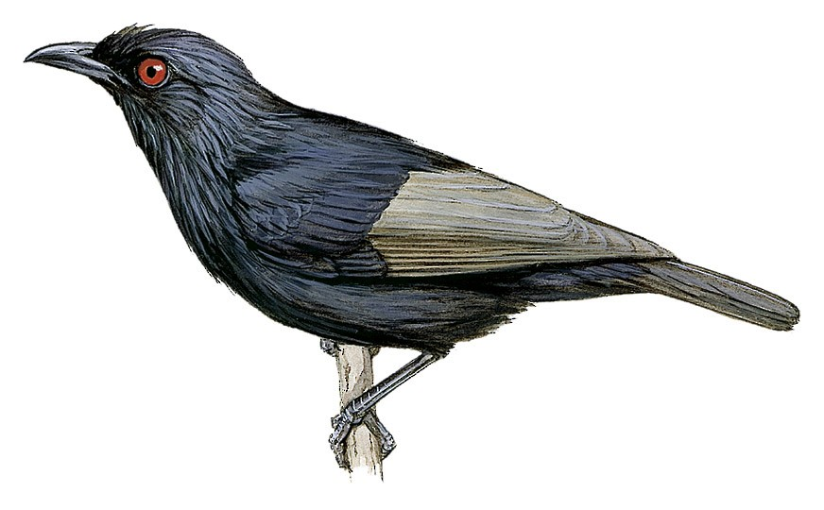
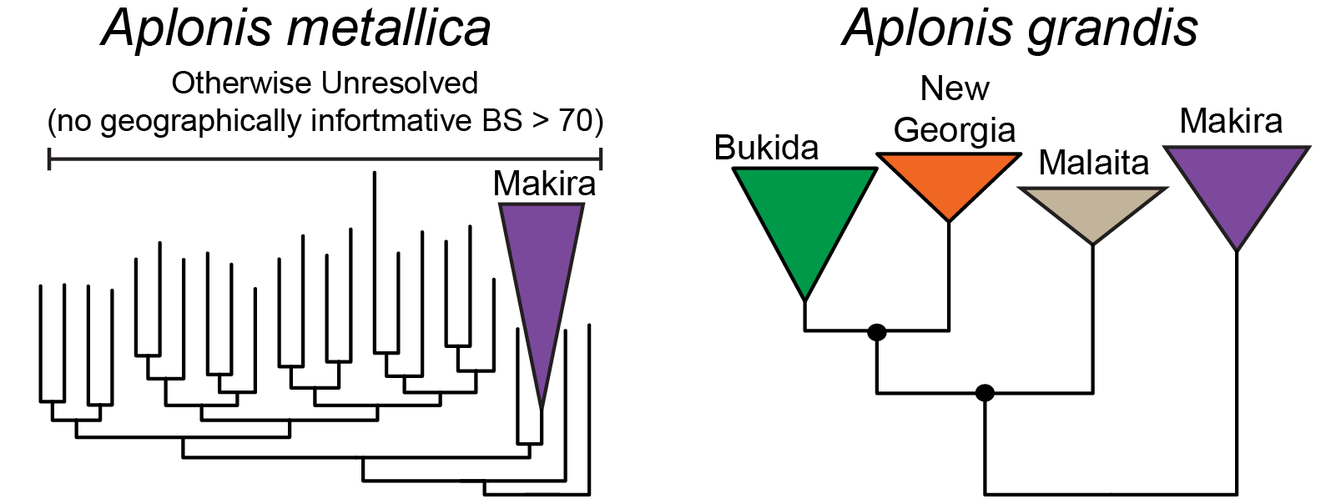
Phylogenomics: How are species related?
Notes:
Phylogenomics can refer to the phylogeography scale questions we will discuss here, and similar methods can be applied across scales. However, where it really shines is enabling confidence in untangling evolutionary histories at deeper time scales. For reasons we’ll discuss, these applications are not where RADseq shines.

Slide 7
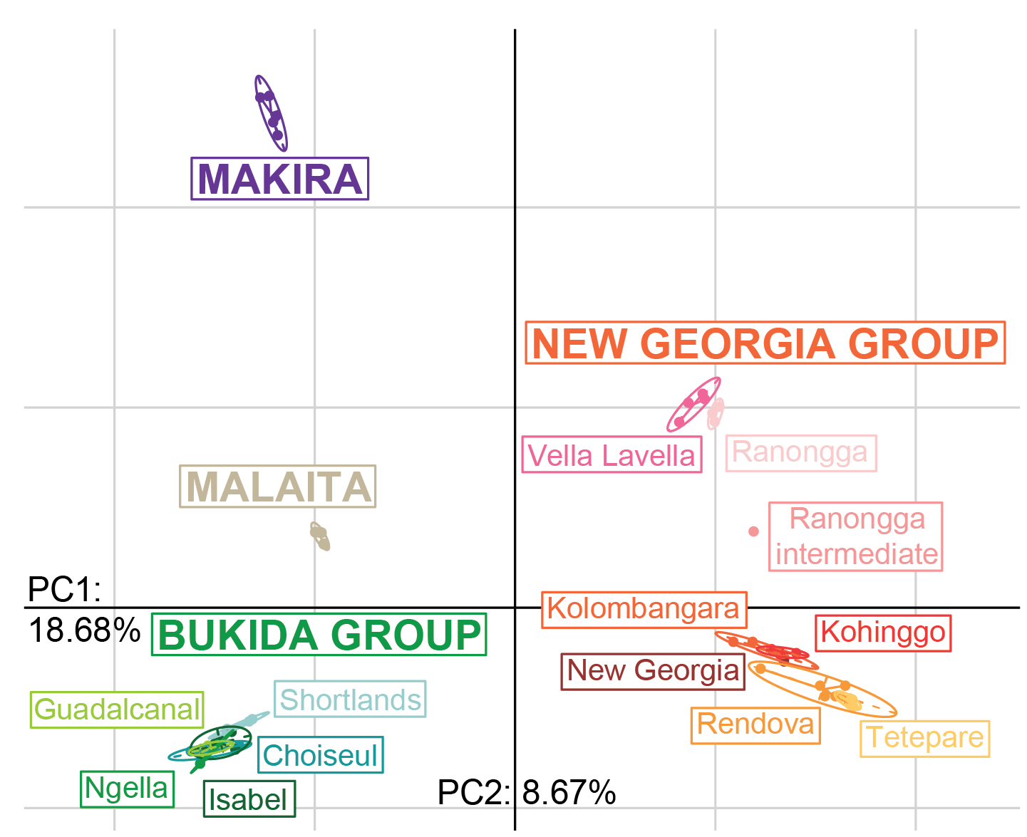
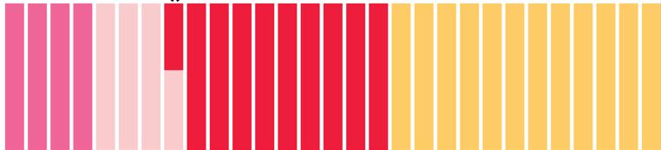
Phylogeography: How are populations connected?
Notes:
One aspect RADseq is best suited for is documenting critical, fundamental information about how populations are connected and related. I view these phylogeographic analyses as including ones of population structure and detection of hybrids, as well as tests for longer-term gene flow.

Slide 8
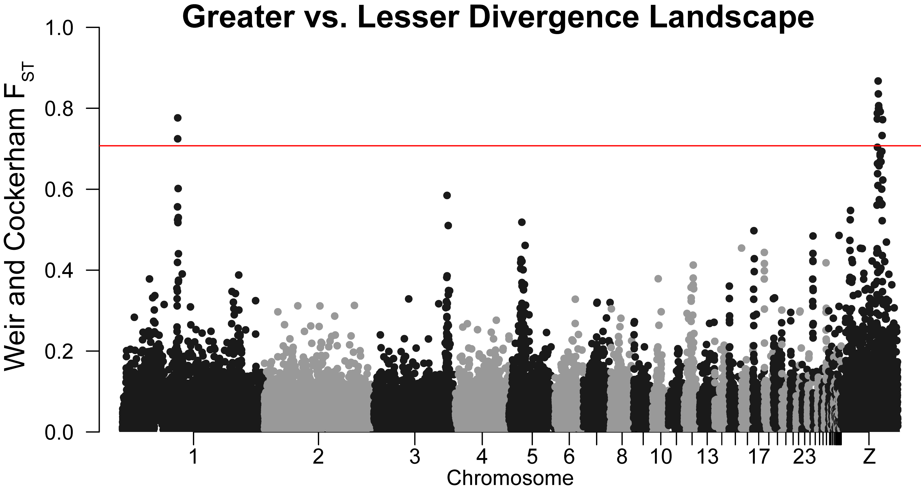
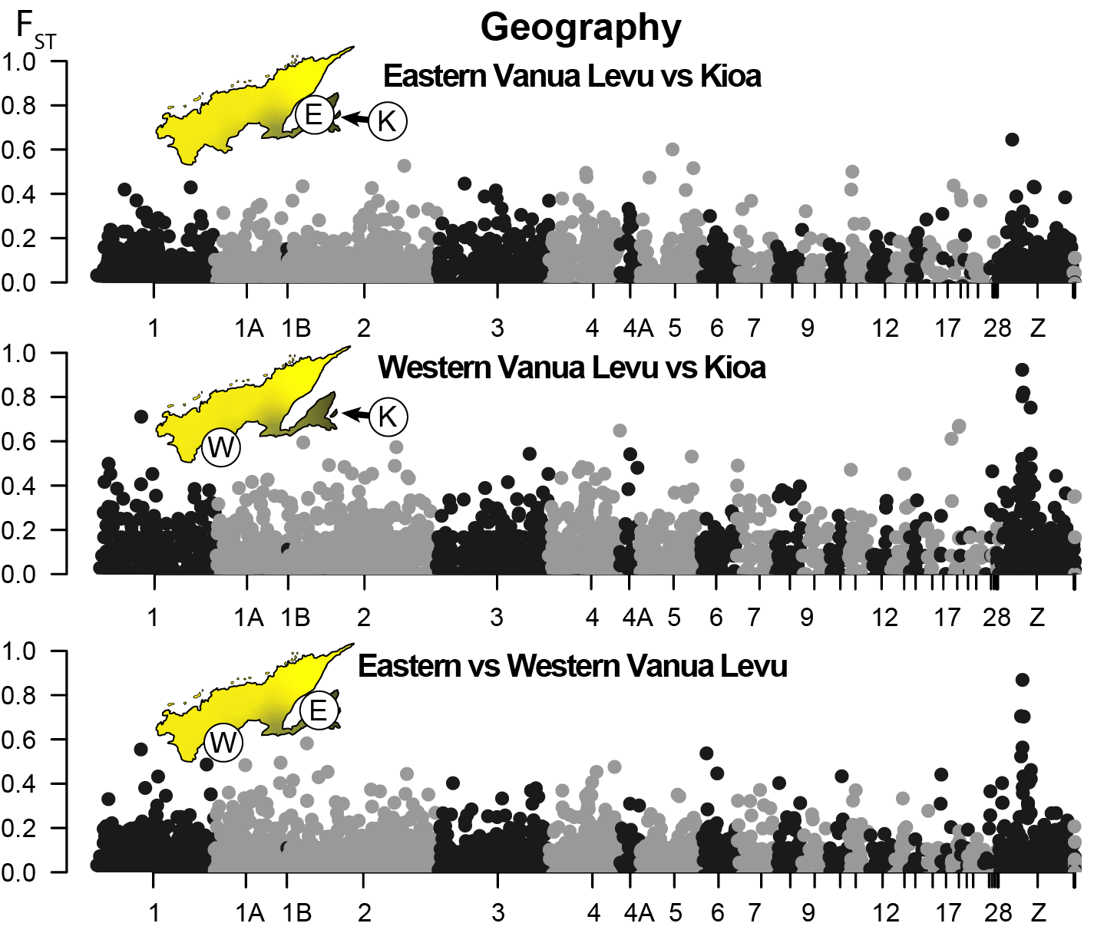
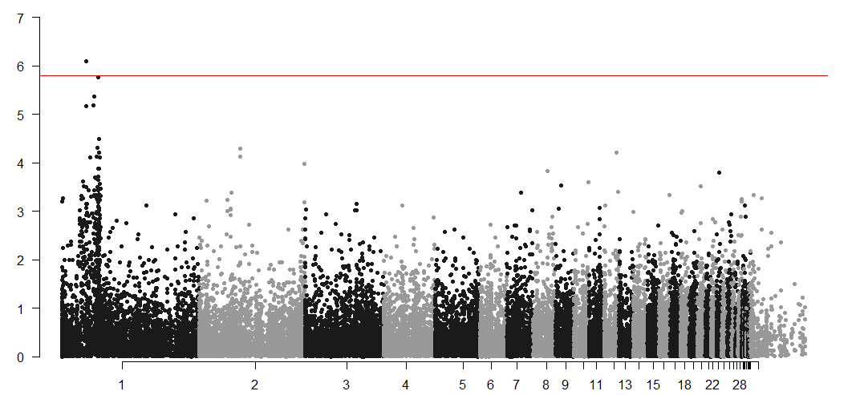
Coarse* genomic landscapes : How is divergence distributed?
Correlation with body size
Position in the genome
Notes:
RADSeq also works surprisingly well in getting broad scale senses of how divergence is distributed across the genome, with these “Manhattan” plots, named after the striking skyline of a US city. In the left example, you can see what the divergence between whistler populations is concentrated in one region on the Z chromosome. Although most RAD datasets are too small for finer scale analyses, certain choices can enable more fine scale analyses, locating fine details of peaks and allowing genome-wide association studies (with some caveats).

Slide 9
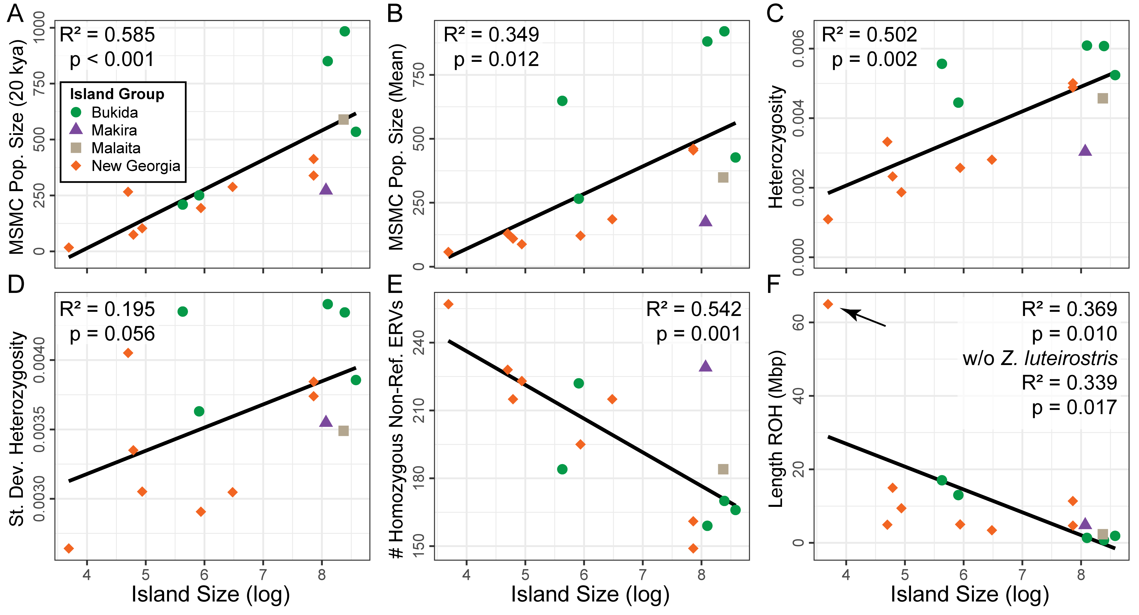
Genetic diversity: How large and stable are populations?
Notes:
Basic metrics of genetic diversity are also easily determined with reduced representation data. Here we looked at how island size shaped a wide array of metrics. Many of these are not accessible to RADseq, but the most fundamental measure is possible with RAD (and whoever chooses the white-eyes will see they get the same results).

Slide 10
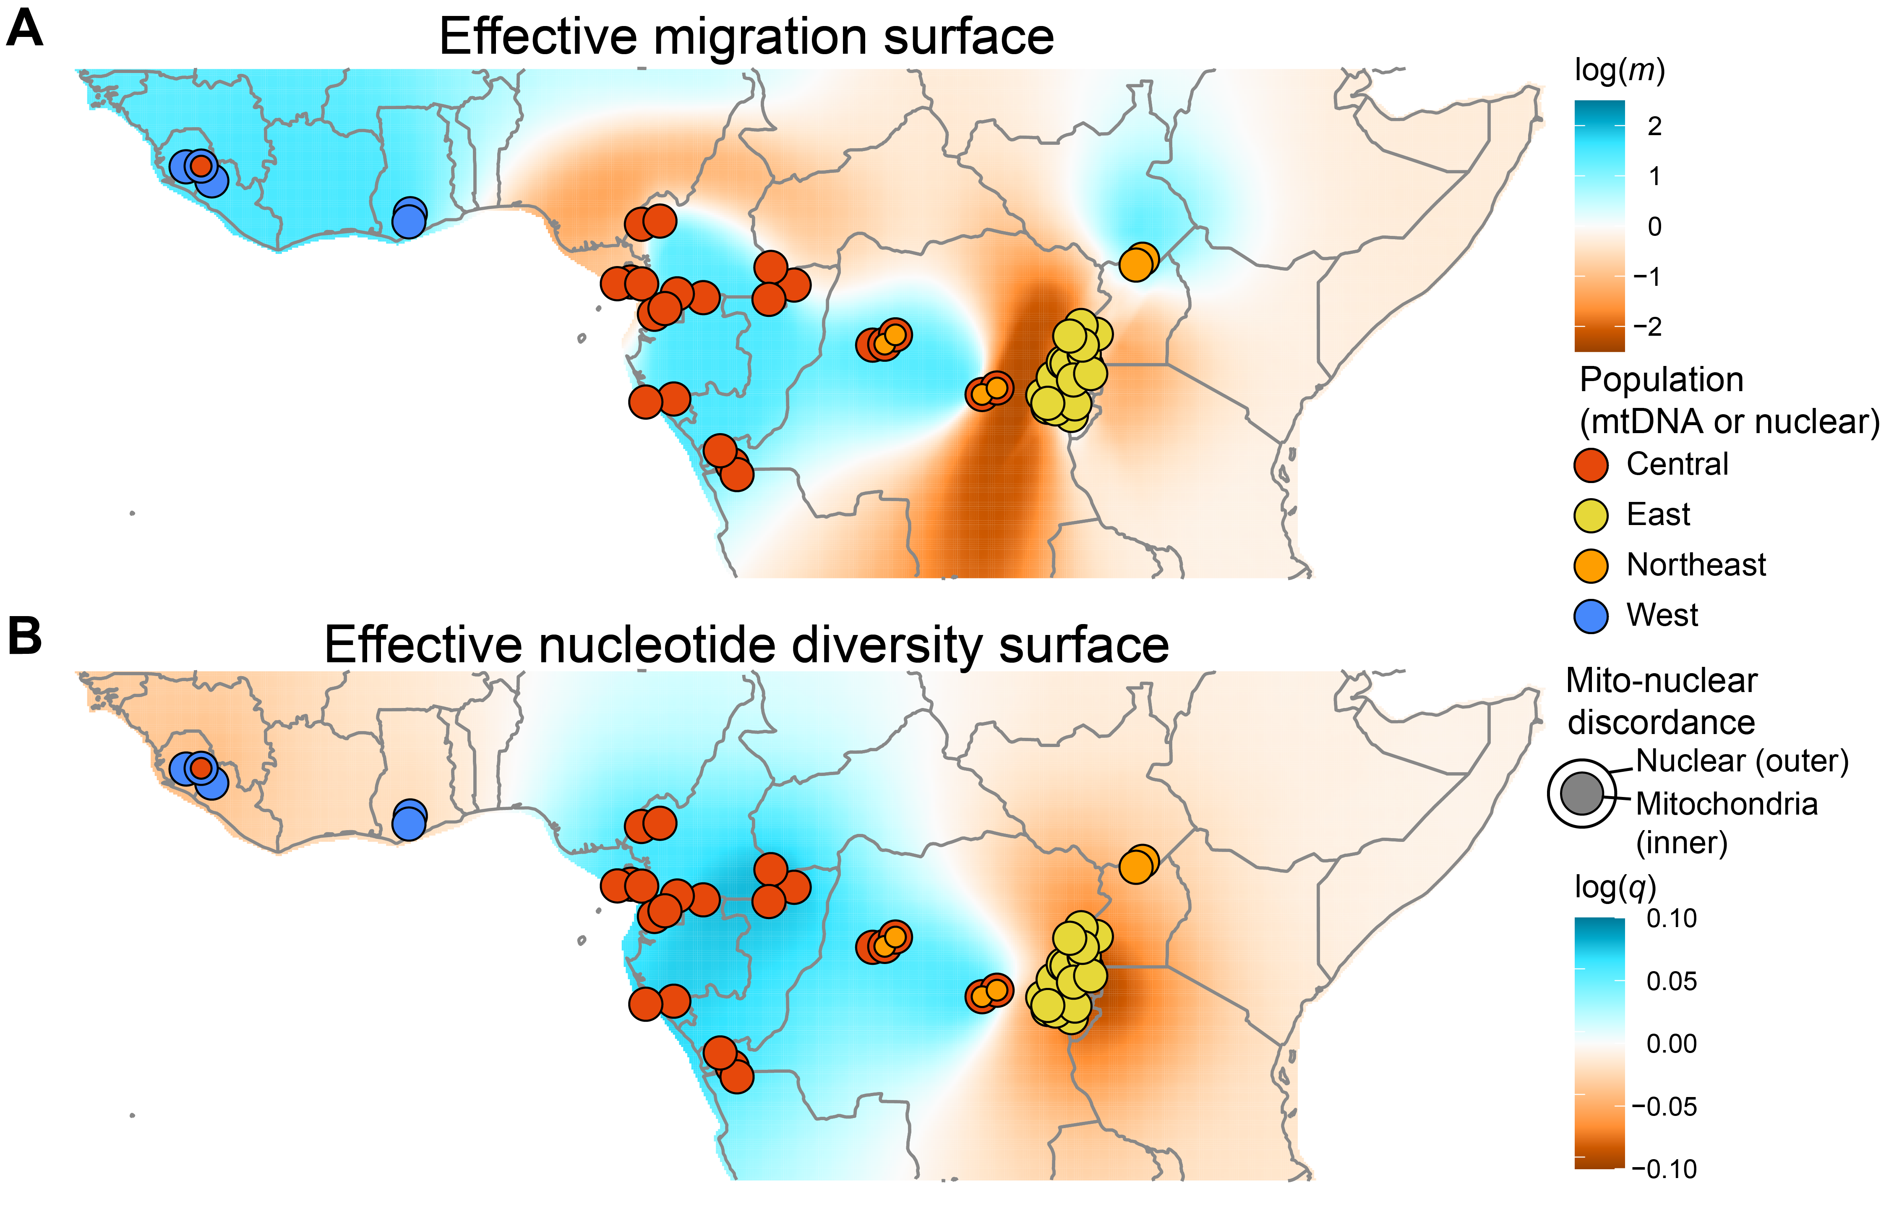
Landscape genetics: How is diversity distributed?
Notes:
Less applicable to island birds (and the one analysis we won’t run here), but landscape genetics describe how diversity and divergence are distributed in a spatially explicit way. You can see here how barriers to gene flow in an African bulbul relate to decreases in genetic diversity. It also highlights that a refugial area harbors the highest diversity.

Slide 11
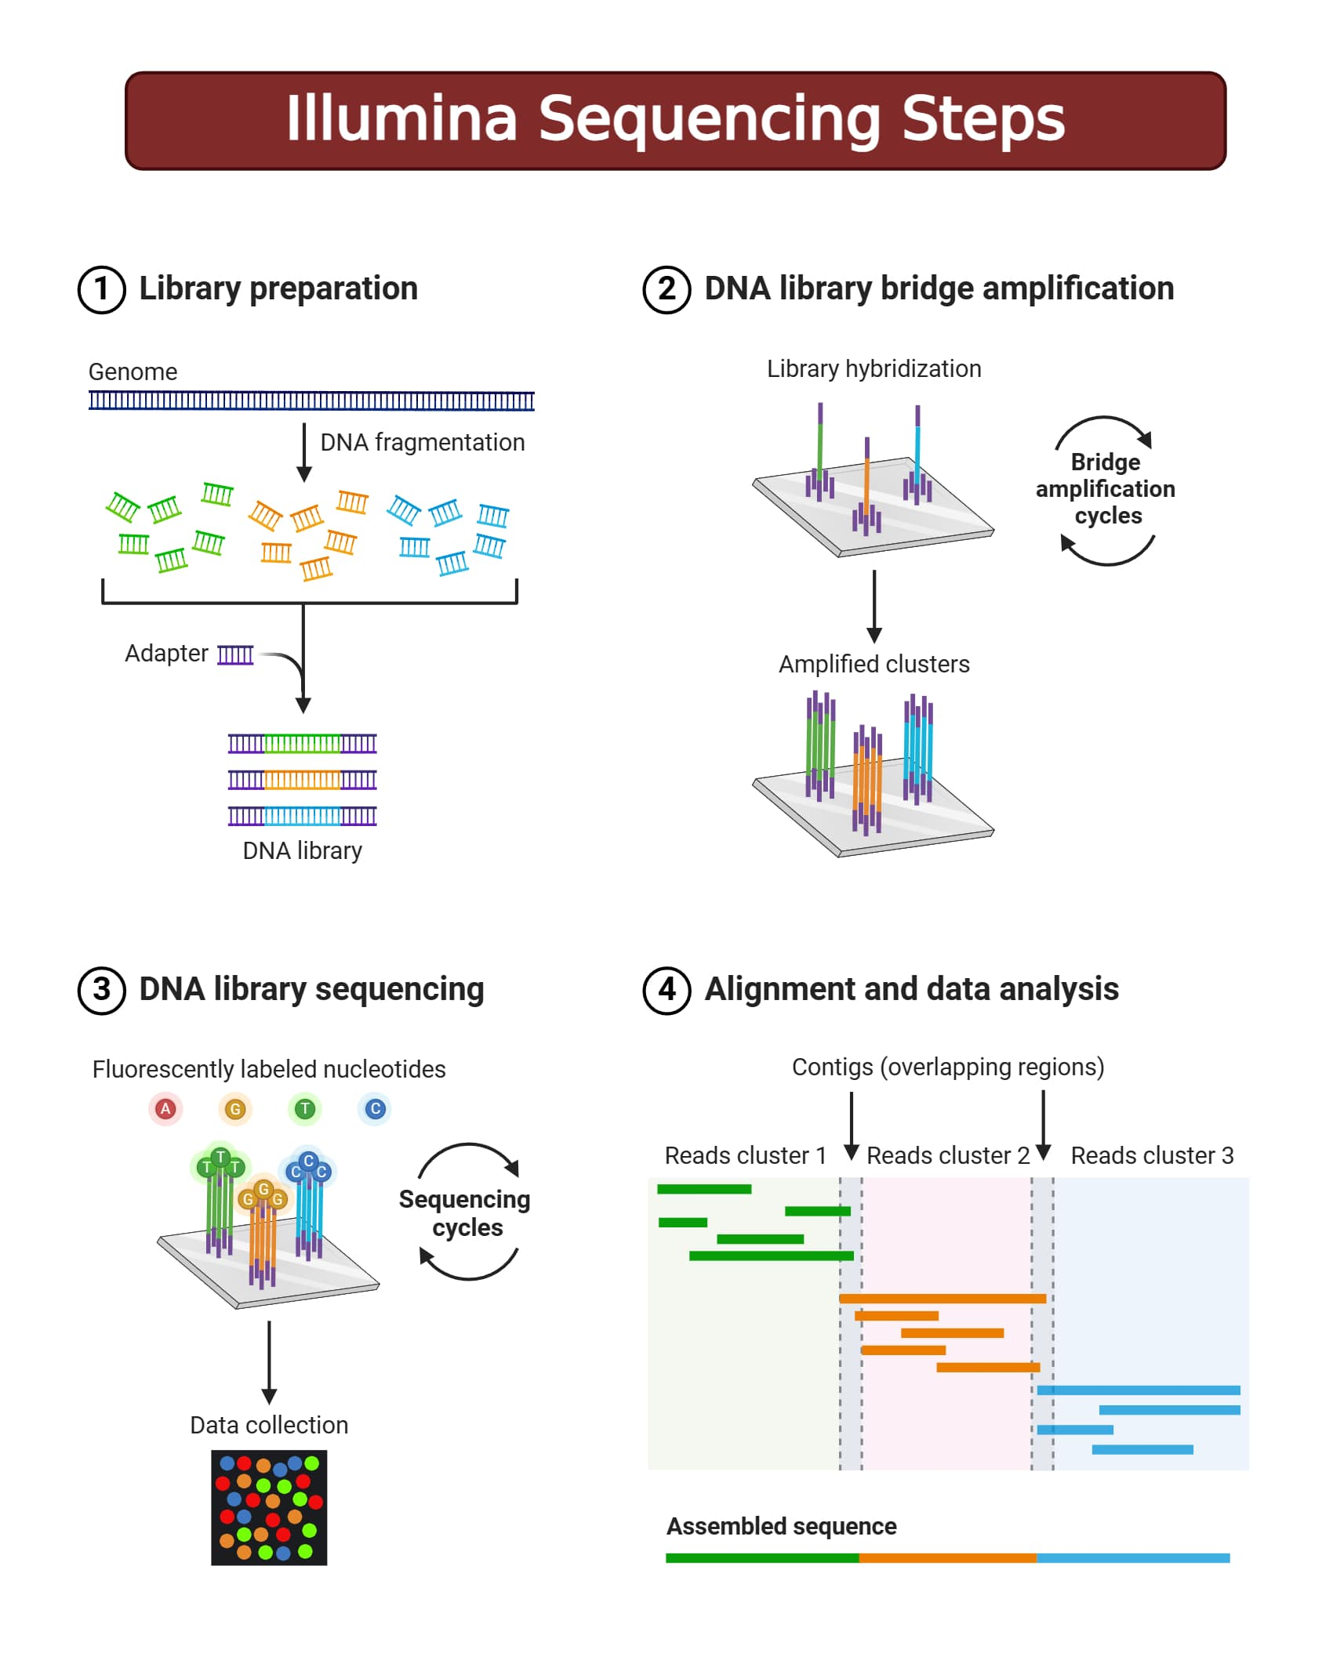
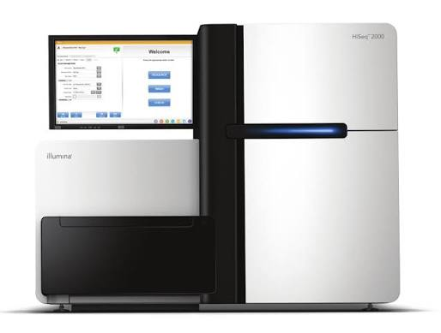
Short read sequencing
Illumina and BGI
Fragment genome, make fragments compatible with sequencer
Attach fragments to sequencer, get signals unique to specific nucleotides
Align or assemble fragments
Assess variation
Analyze variation
Notes:
Short read sequencing is the common technology for many of the analyses we will discuss during this workshop. It always consistent of taking small pieces of the genome, making them readable to a sequencer, aligning or assembling those fragments, determining what variants are real, and analyzing those variants.

Slide 12
Reduced representation
Whole genomes are costly, especially for high coverage
Analysis time consuming for “easy” groups, impossible for “hard” groups
We don’t need all that information!
Regions of the genome closer to each other offer redundant information
Most applications very accurate with 100s or 1000s of variants
How do we consistently sequence the same locations?
Enrich for key regions (target cap.)
Make fewer fragments to sequence
Notes:
Whole genome resequencing is the most single method, randomly fragmenting the genome and aligning it to a known reference. However, it is costly and time intensive to analyze. For many reasons, it also winds up being FAR overkill for many questions (especially the most basic ones!). Restricting that to only important information is what reduced representation is all about. What are some ways to do that? Target capture is one, enriching for the focal regions and minimizing the number of other fragments that don’t many probes designed to match to targets’ genomes. Another way is to make sure you only get a subset of possible fragments.

Slide 13
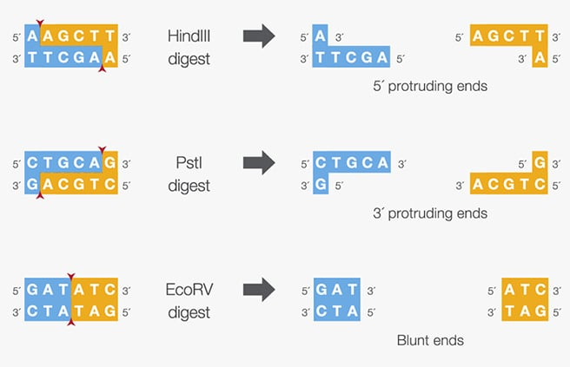
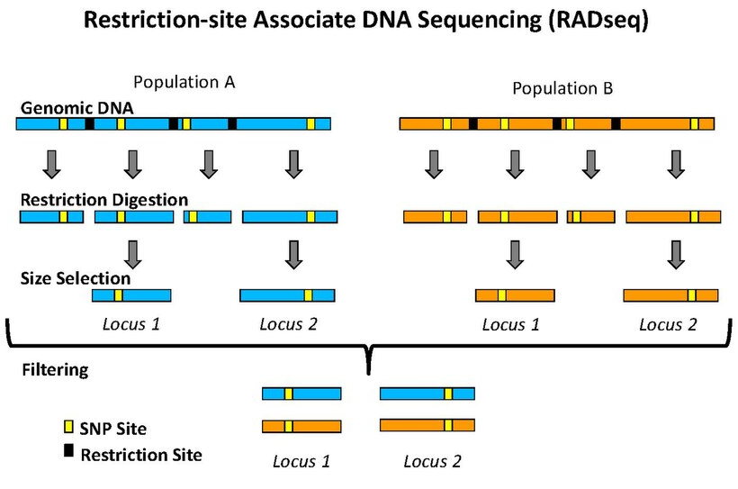
RADSeq
Restriction site associated digest sequencing
Cut genome with enzymes that target specific sequences
Only keep fragments matching size criteria
Notes:
RADseq is the clever way scientists came up with to achieve these goals. It relies on enzymes that cut specific DNA sequences in specific ways, then only selecting fragments of a certain size.

Slide 14
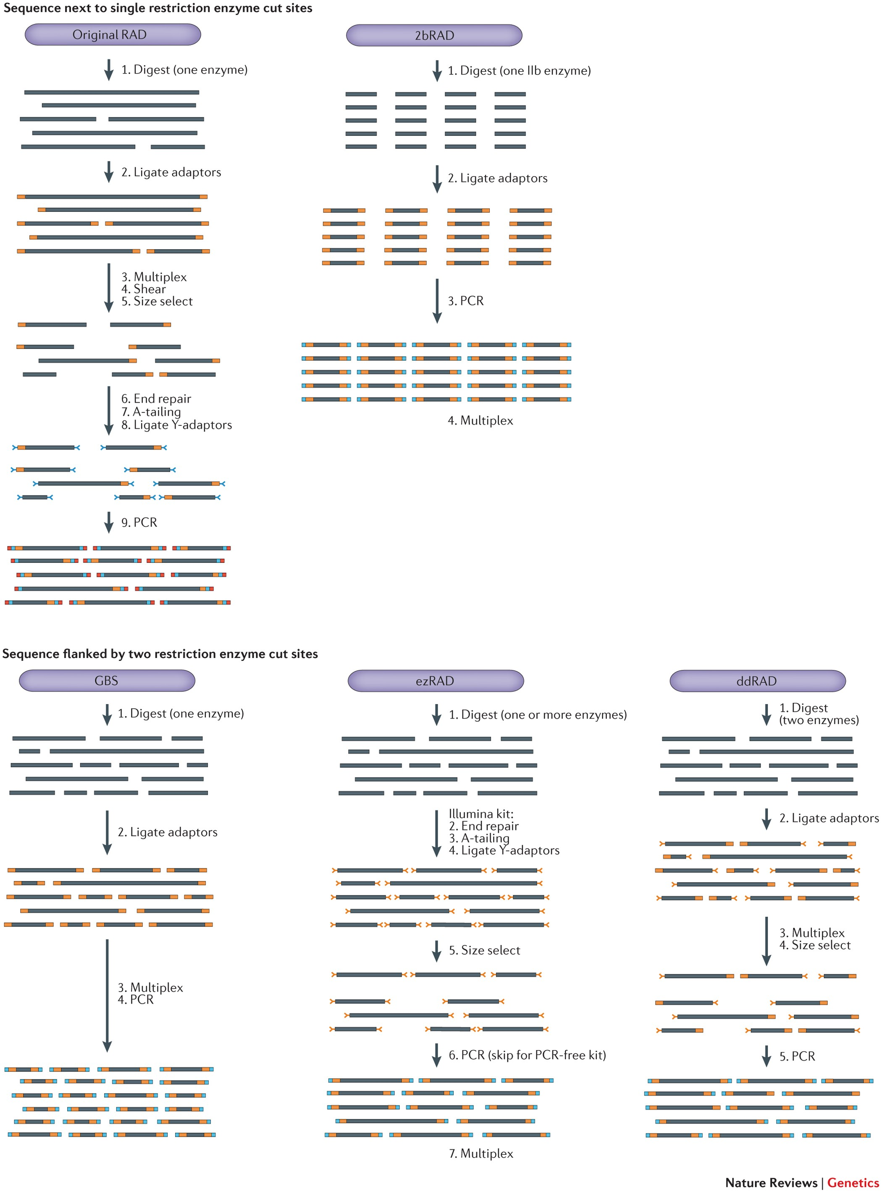
RADSeq
Restriction site associated digest sequencing
Cut genome with enzymes that target specific sequences
Only keep fragments matching size criteria
Only retain reads matching restriction sites in analyses
Notes:
There are many ways of achieving this. Two I’ll focus on are what we are using and a more “modern” version. The protocol we use involves a digest with a single enzyme, then adaptors are attached to the ends of those molecules, which are specific to a given sample. Those samples are then pooled, and all undergo additional shearing and size selection. At the end, those molecules are amplified and sequenced. The other is ddRAD. For that one, two enzymes are used for the digest, and their cut sites are used to attach sample-specific adapters. After those samples are combined, we pick the sizes we are interested in and amplify them.

Slide 15
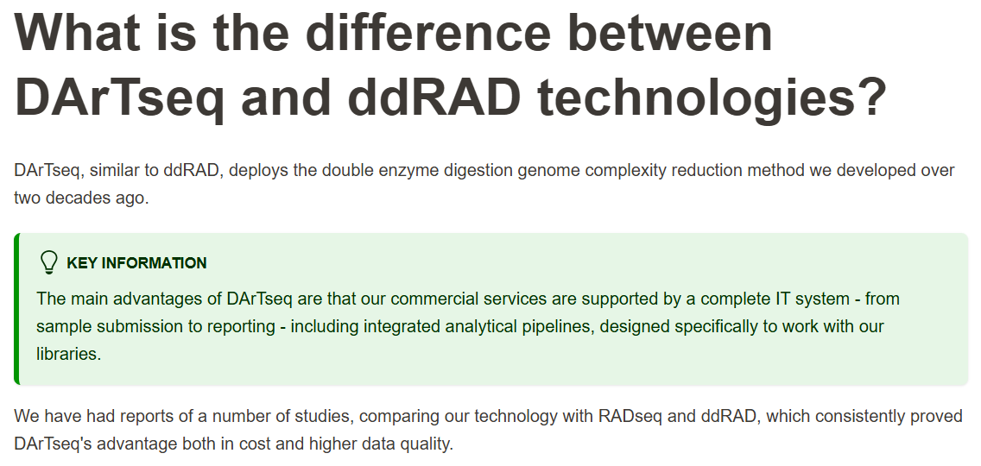
RADseq’s cousin: DArTseq
Notes:
There are many ways of achieving this. Two I’ll focus on are what we are using and a more “modern” version. The protocol we use involves a digest with a single enzyme, then adaptors are attached to the ends of those molecules, which are specific to a given sample. Those samples are then pooled, and all undergo additional shearing and size selection. At the end, those molecules are amplified and sequenced. The other is ddRAD. For that one, two enzymes are used for the digest, and their cut sites are used to attach sample-specific adapters. After those samples are combined, we pick the sizes we are interested in and amplify them.

Slide 16
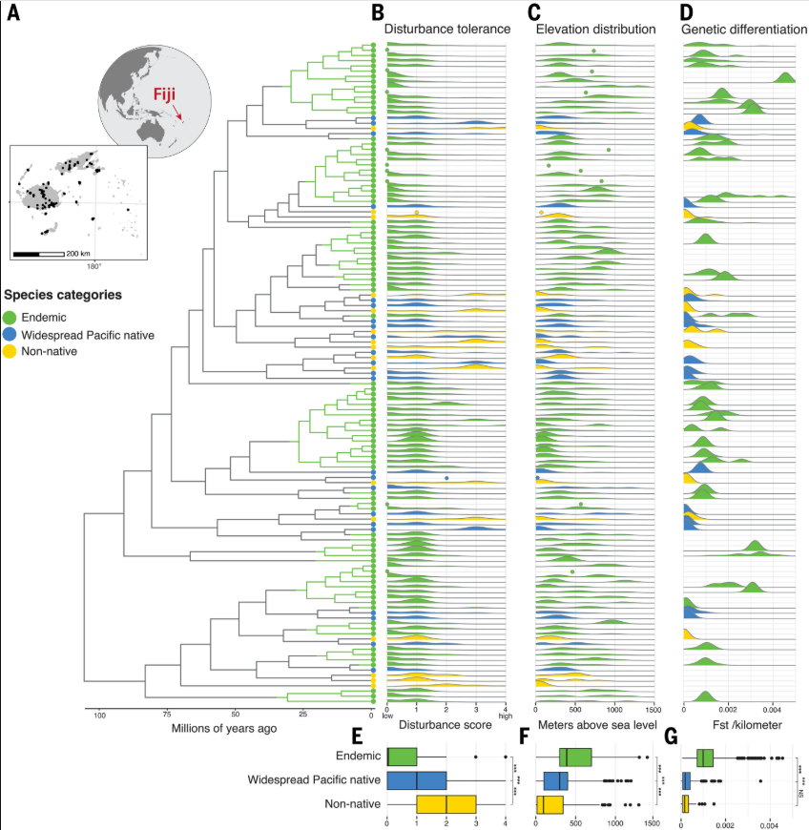
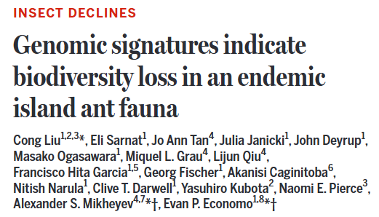
Benefits of RADSeq
High cov., fewer loci
Lower coverage, many loci
Cheap, consistent, high coverage locations
Flexible protocols mean flexible costs based on goals
Allows large comparative datasets
Correlation with body size
Position in the genome
Notes:
RADSeq has a lot of benefits. It is cheap, and can allow very high quality for consistent locations in the genome. Its range of protocols also mean there is a very clear tradeoff between number of loci and number of reads per locus. This allows massive comparative datasets to be assembled. One recent one from Fiji focused on the ants that live here.

Slide 17
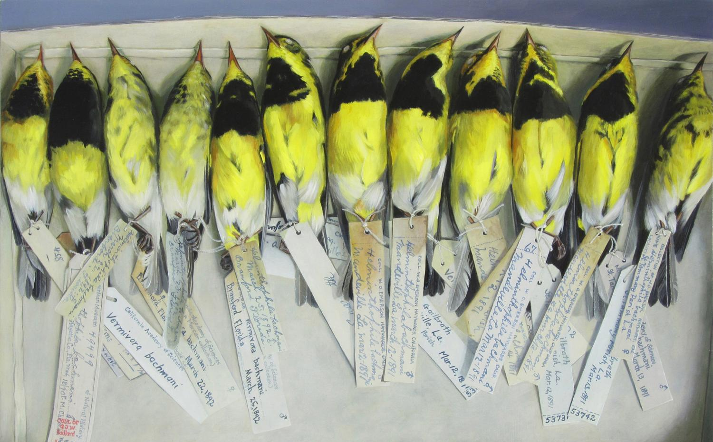
Downsides of RADseq
Bad for historic samples (fragments too small)
BUT, can combine with target capture
Not good at deeper phylogenetic scales
Locus dropout major problem, cut sites can be in one species but not the other, propagates with more species samples
Notes:
RADSeq is not perfect. It cannot be used on samples with degraded quality. Additionally, it struggles at deep tine scales. Even if the regions of interest are in all species, mutations in the cut sites can result in ones being missed in select samples. The broader the taxonomic scope, the worse this problem becomes.

Slide 18
RADSeq analysis has two paths, both similar to other technologies
Clean and demultiplex reads
(find ones with cut sites)
Align to reference genome
Determine variants across samples
Analyze variants
A
T
C
A
T
C
A
G
T
T
G
T
Assemble reads de novo
Align and determine variants
A
T
C
A
T
C
A
G
T
T
G
T

Slide 19
RADSeq and Resequencing
Clean and demultiplex reads
(find ones with cut sites)
Align to reference genome
Determine variants across samples
Analyze variants
A
T
C
A
T
C
A
G
T
T
G
T
A
A
G
T
C
C
T
A
G
T
C
C
T
A
G
G
T
T
T
T
T
G
T
T

Slide 20
RADSeq and Resequencing
Clean and demultiplex reads
(find ones with cut sites)
Align to reference genome
Determine variants across samples
Analyze variants
Stacks
(process_radtags)
PCA
Admixture
FST
Diversity
Inbreeding
Gene flow
Phylogeny
Landscapes
Demography
Stacks
(gstacks, populations)
BWA
(bwa mem)
Genome Analysis Toolkit (GATK)
OR
bcftools mpileup
fastp
trimmomatic

Slide 21
What sequencing types are relevant for you?

Slide 22
Are there any specific genomic analyses you would like to learn about?

Slide 23
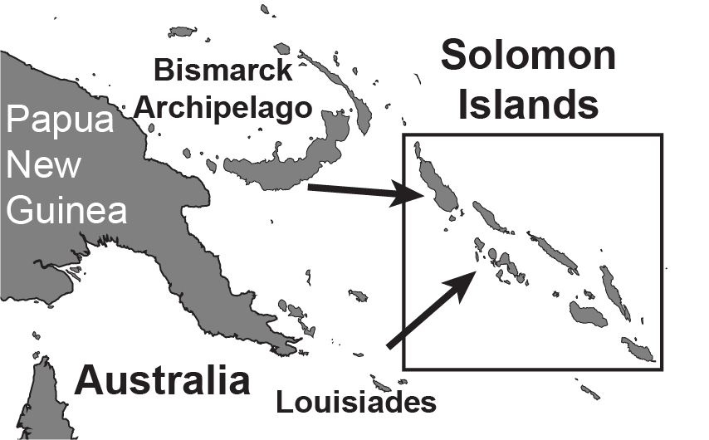
The Solomon Islands
Notes:
We’re going to start in the Solomon Islands, an archipelago east of Australia. It is an idea natural laboratory for studying evolution, in part due to its unique geography. It has these four island groups, denoted by different colors. Some of these groups, like Bukida in green, are made up of current colorful islands, that were connected by land exposed during the last ice age in gray.

Slide 24
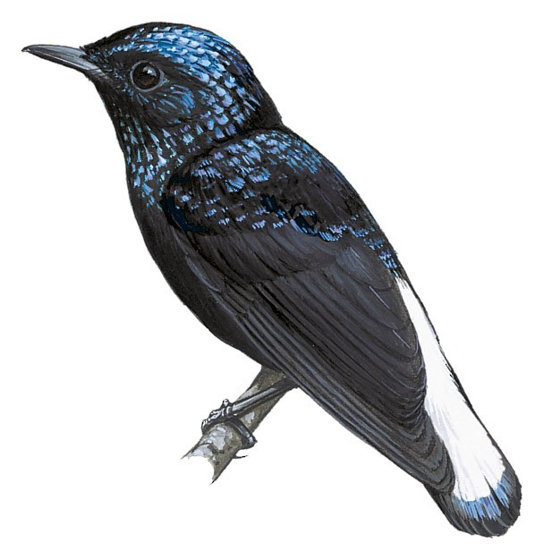
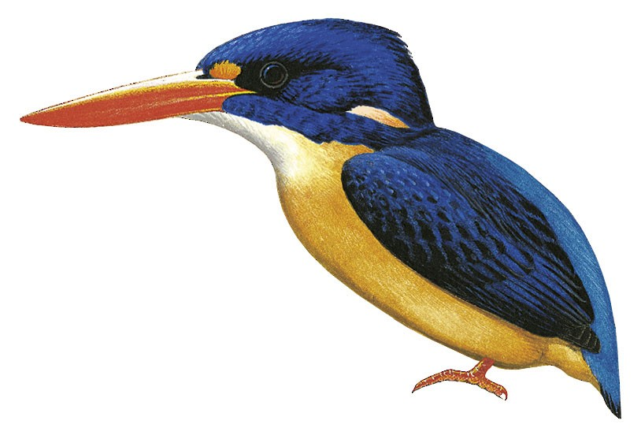
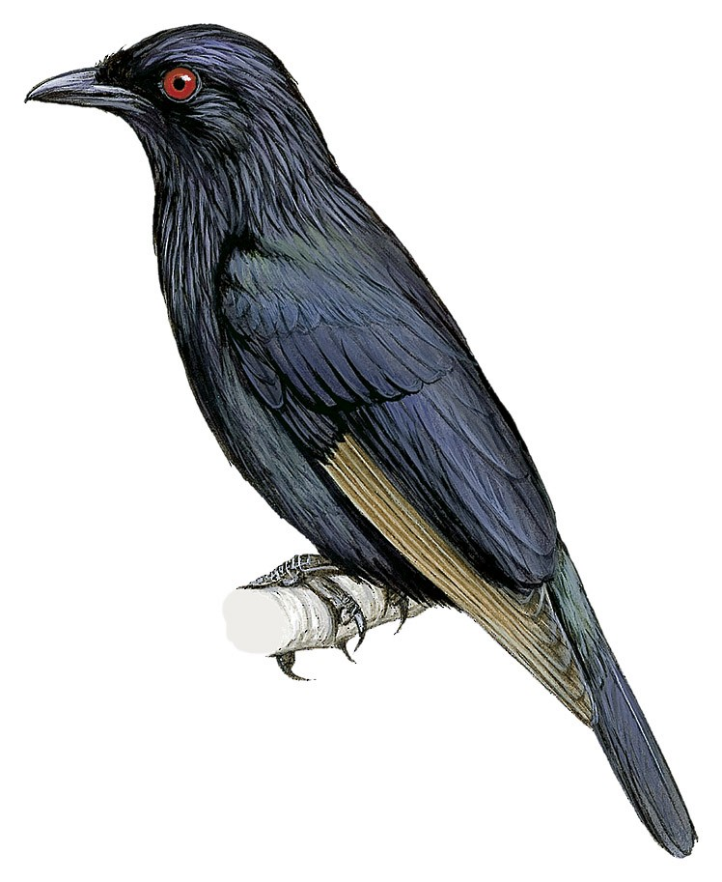
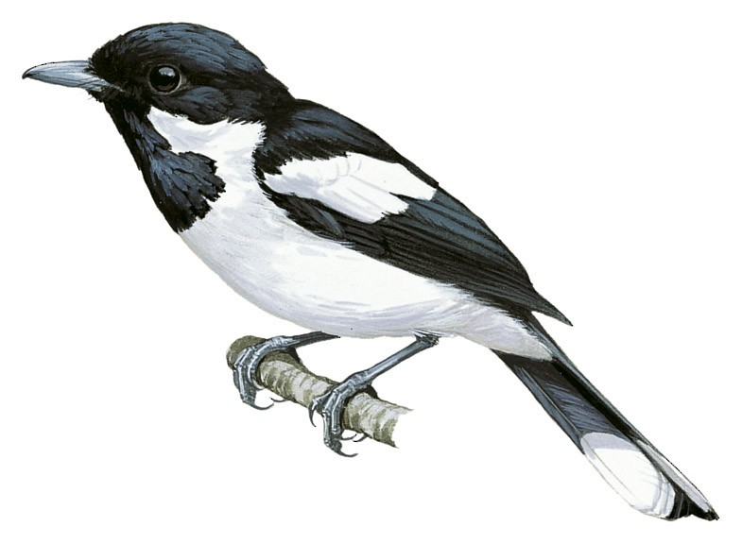
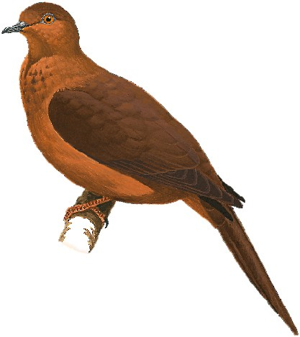
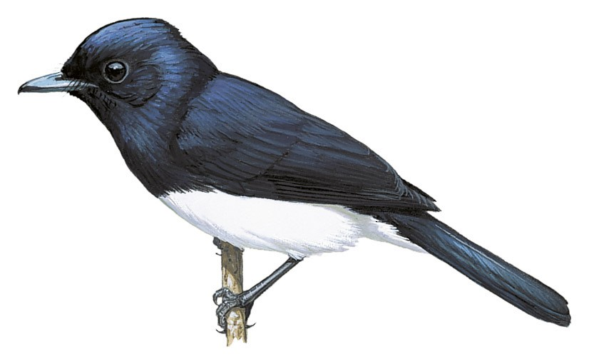
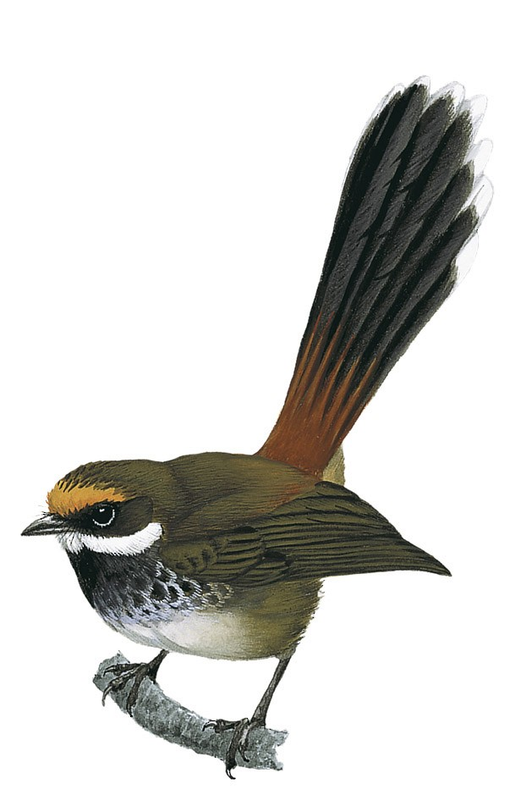
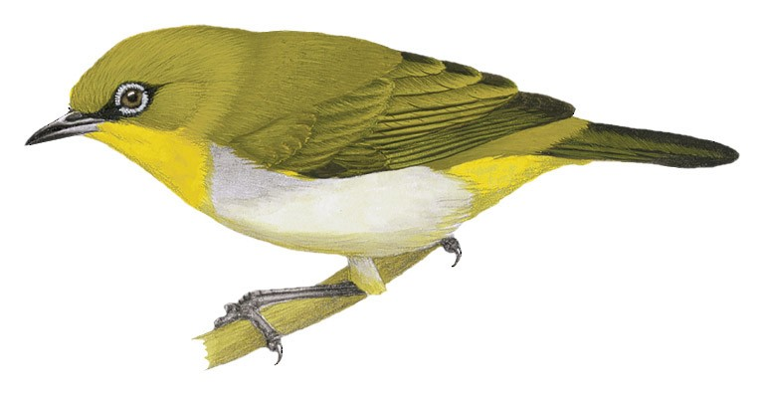
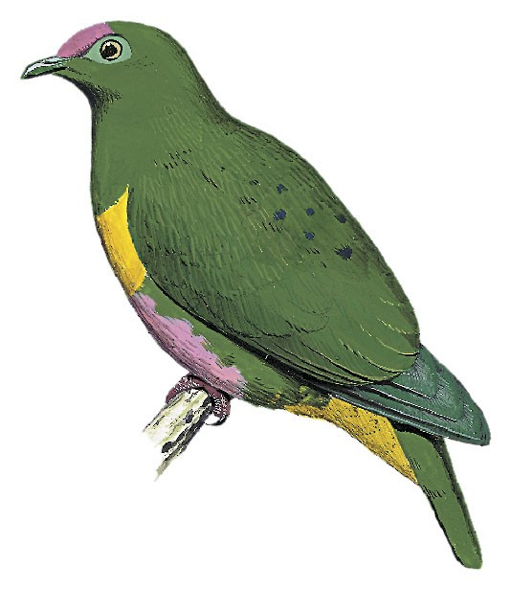
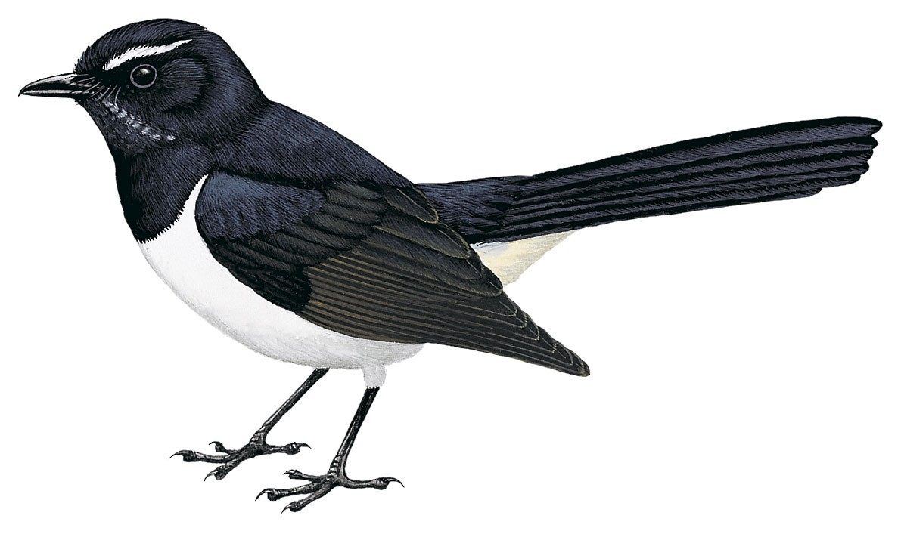
Choosing datasets
Small datasets
Medium datasets
Large datasets
Aplonis metallica
Metallic Starling
Solomons
Ceyx
Dwarf-Kingfishers
Solomons
Lamprolia
Silktails
Fiji
Aplonis grandis
Brown-wing Starlings
Solomons
Symposiachrus
Monarchs
Solomons
Myiagra
Flycatchers
Solomons
Macropygia
Cuckoo-Dove
Solomons
Zosterops
White-eyes
Solomons
Rhipidura rufofronta
Rufous Fantail
Solomons
Ptilinopus
Fruit-Dove
Solomons
Rhipidura leucophrys
Willie-wagtail
Solomons
Pachycephala
Whistlers
Fiji

Slide 25
Choosing datasets
Small datasets
Medium datasets
Large datasets
Aplonis metallica
Metallic Starling
Solomons
Ceyx
Dwarf-Kingfishers
Solomons
Lamprolia
Silktails
Fiji
Aplonis grandis
Brown-wing Starlings
Solomons
Symposiachrus
Monarchs
Solomons
Myiagra
Flycatchers
Solomons
Macropygia
Cuckoo-Dove
Solomons
Zosterops
White-eyes
Solomons
Rhipidura rufofronta
Rufous Fantail
Solomons
Ptilinopus
Fruit-Dove
Solomons
Rhipidura leucophrys
Willie-wagtail
Solomons
Pachycephala
Whistlers
Fiji

