Slide 1
Introduction to command line
USP RADseq Workshop
July 2026

Slide 2
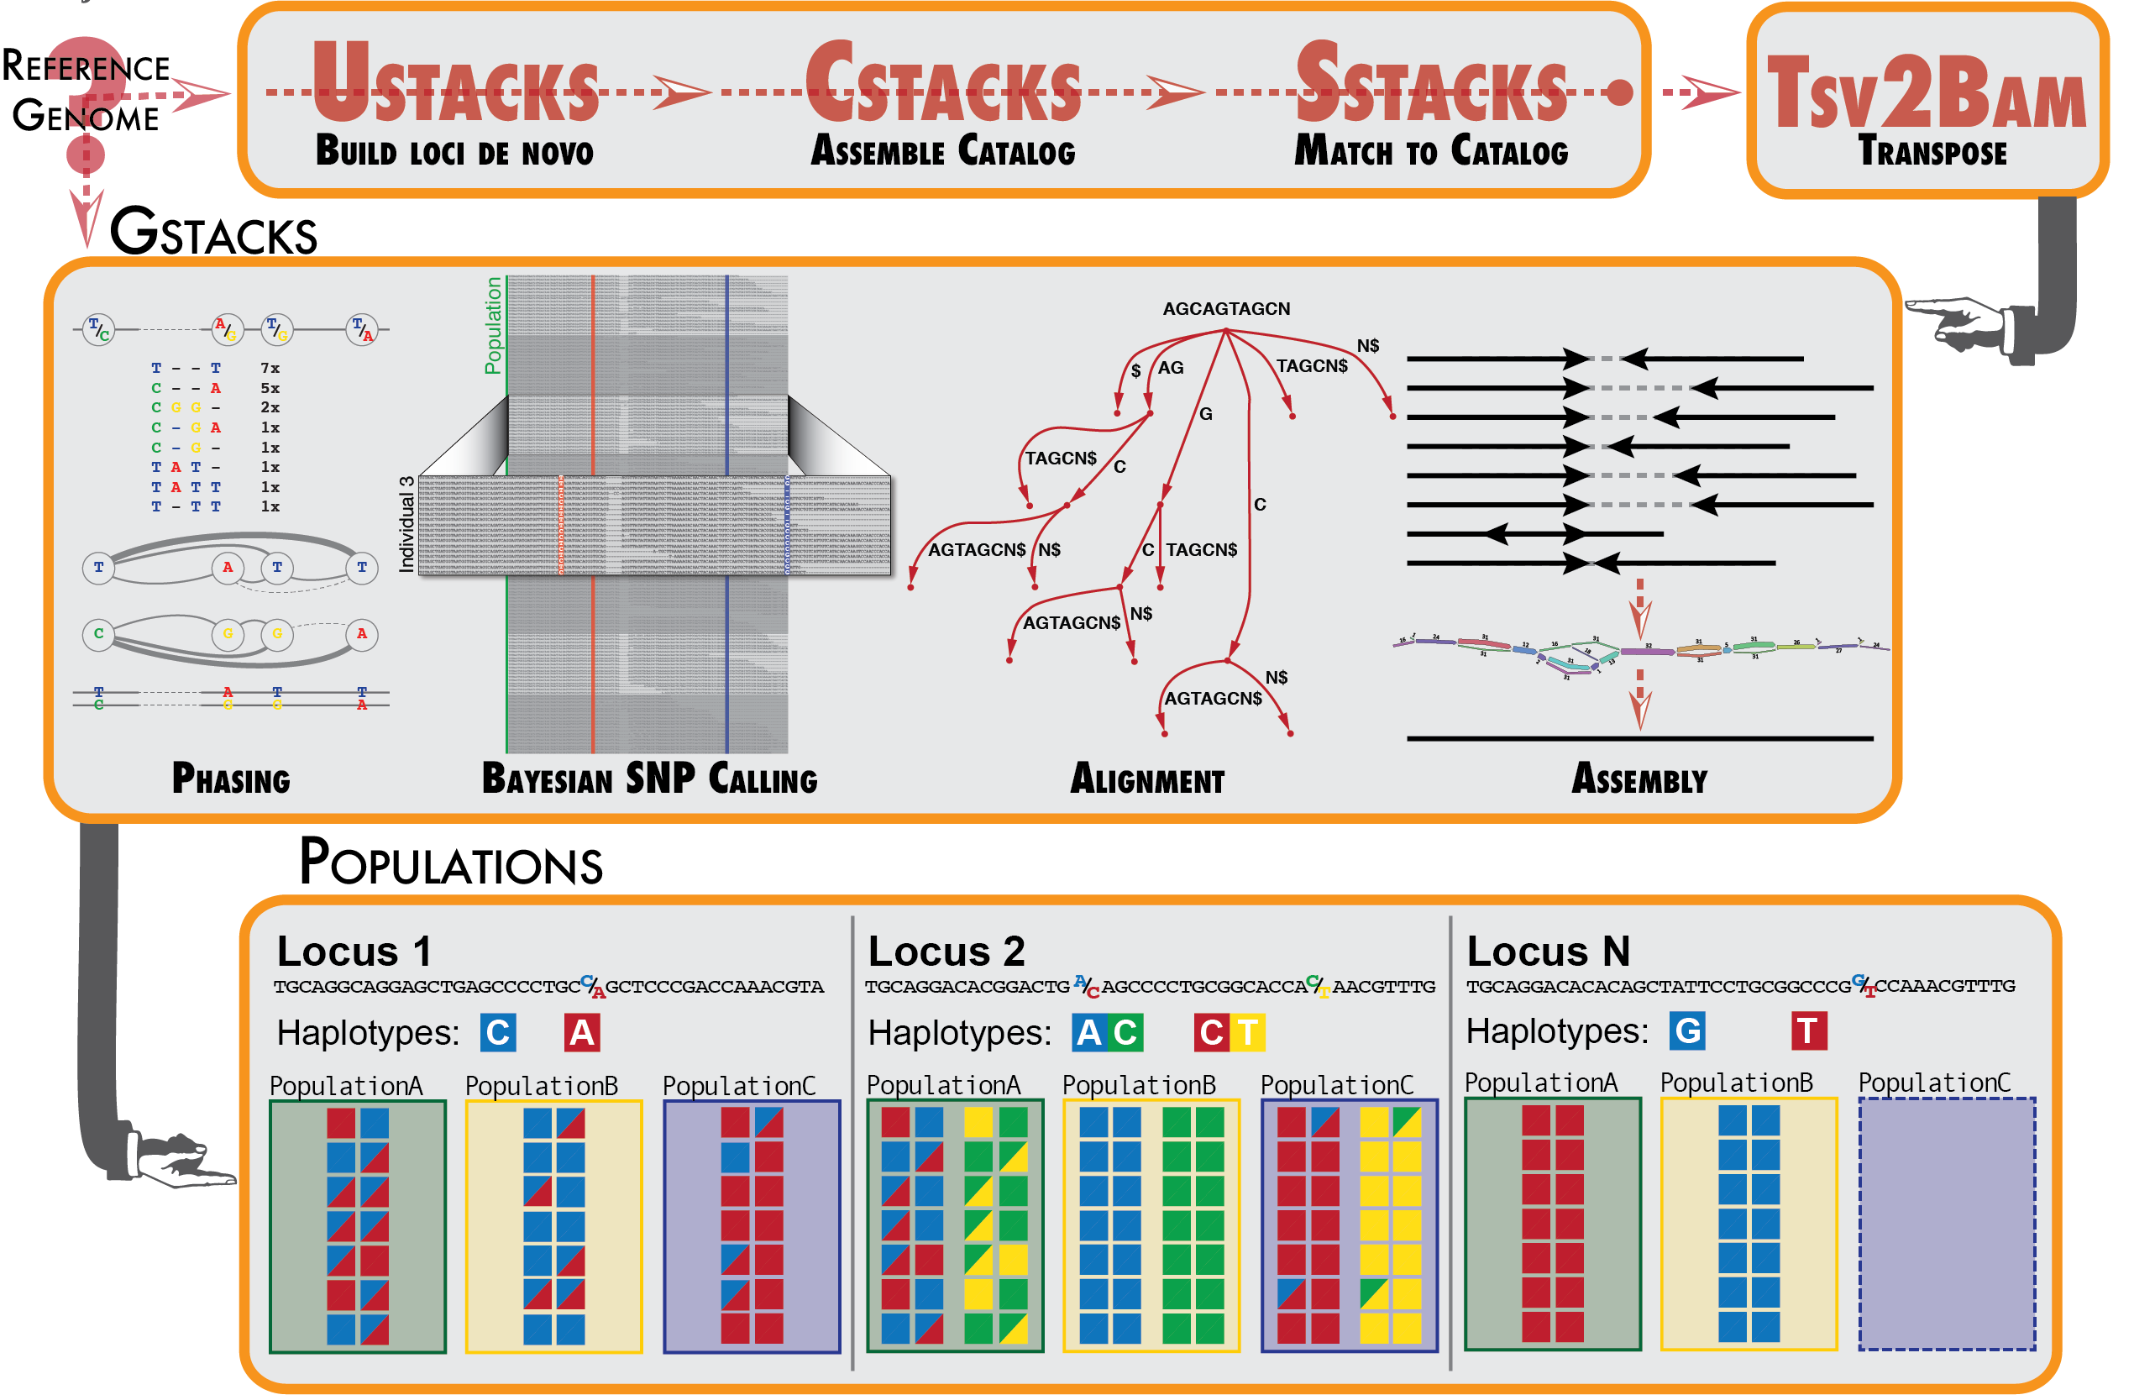
What is a pipeline?
Broadly speaking, pipelines are sets of computational tasks carried out in order
Pipelines can range from fully constructed by user to those pre-built (e.g., Stacks)
Serve as an easy framework for replication and learning new methods

Slide 3
What is Stacks?
Pipeline for analyzing RADseq data
Simplifies much of the SNP calling
Flexible, can accommodate reference-based methods and de novo assembly
Run via command line

Slide 4
What is Stacks?
Stacks has different modules for each step:
Read processing (process_radtags)
Optional assembly (ustacks, cstacks, sstacks)
Alignment (gstacks)
Variant calling (gstacks)
Analysis file generation (populations)

Slide 5
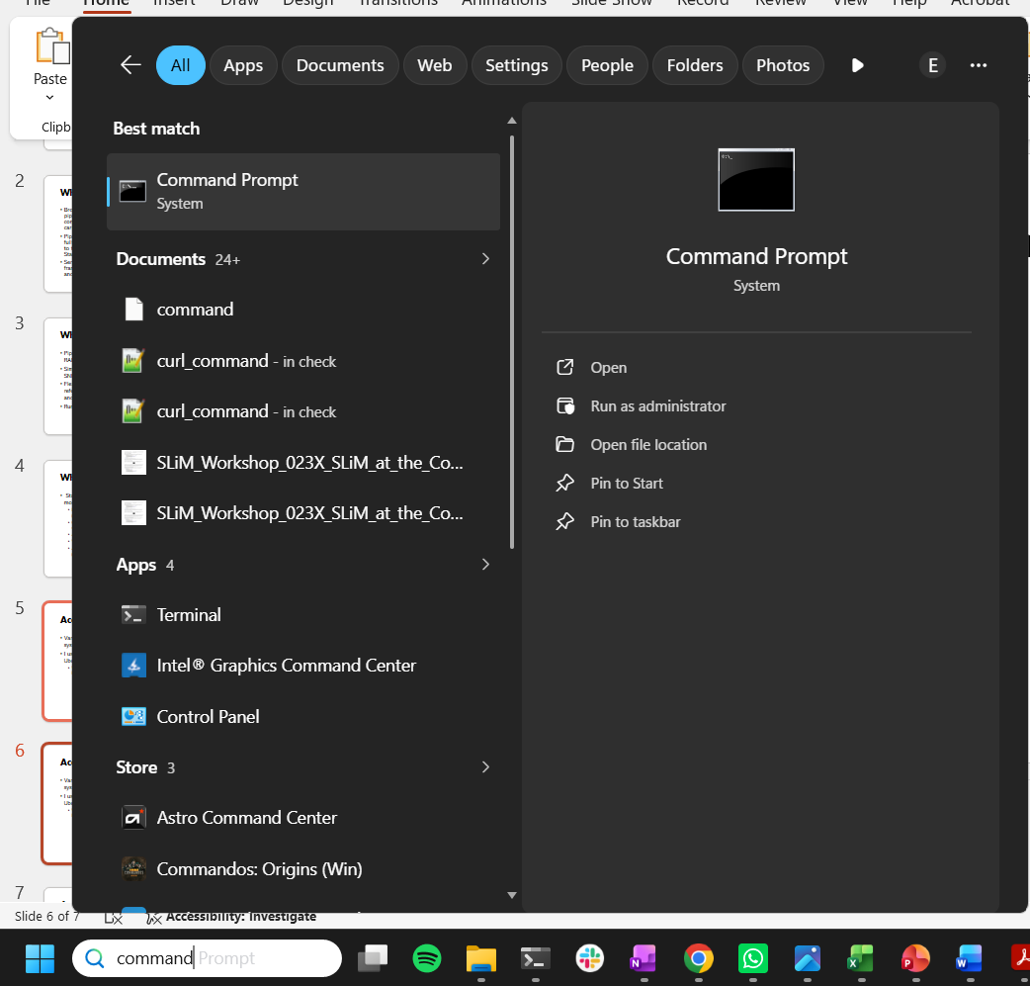
Accessing the command line
Varies across operating systems
I use Window’s native Ubuntu command line
Windows users, you should have this installed unless you are using a server
2
1

Slide 6
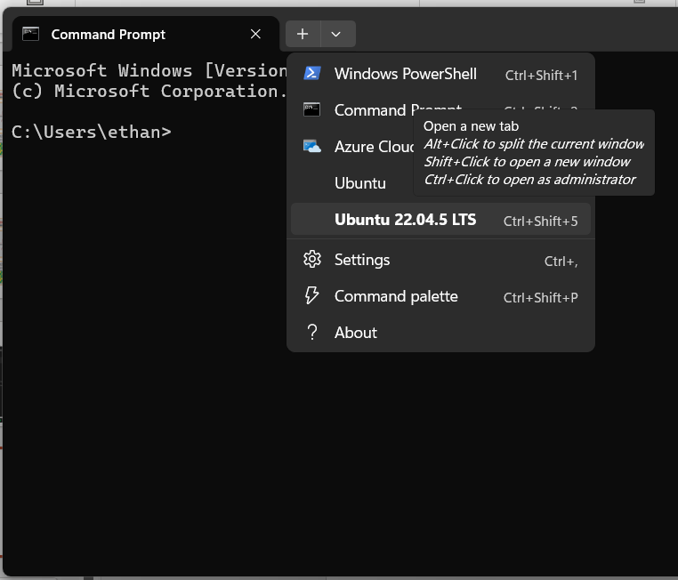
Accessing the command line
1
Varies across operating systems
I use Window’s native Ubuntu command line
Windows users, you should have this installed unless you are using a server
2

Slide 7
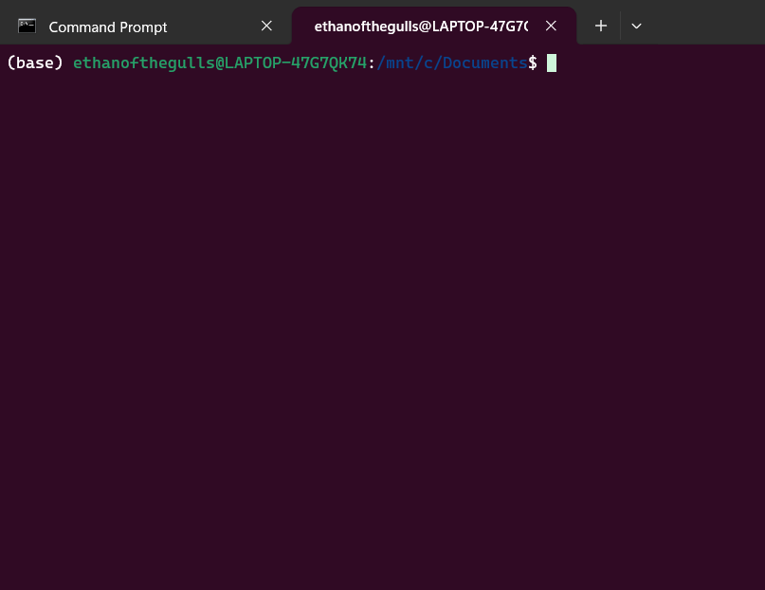
Accessing the command line
Varies across operating systems
I use Window’s native Ubuntu command line
Windows users, you should have this installed unless you are using a server

Slide 8
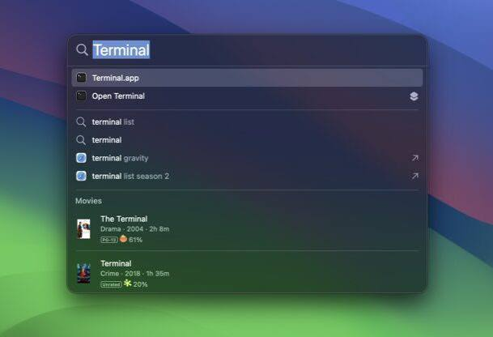
Accessing the command line
Varies across operating systems
I use Window’s native Ubuntu command line
Windows users, you should have this installed unless you are using a server
Powershell has limited capabilities
Mac is Unix by default, access with terminal app

Slide 9
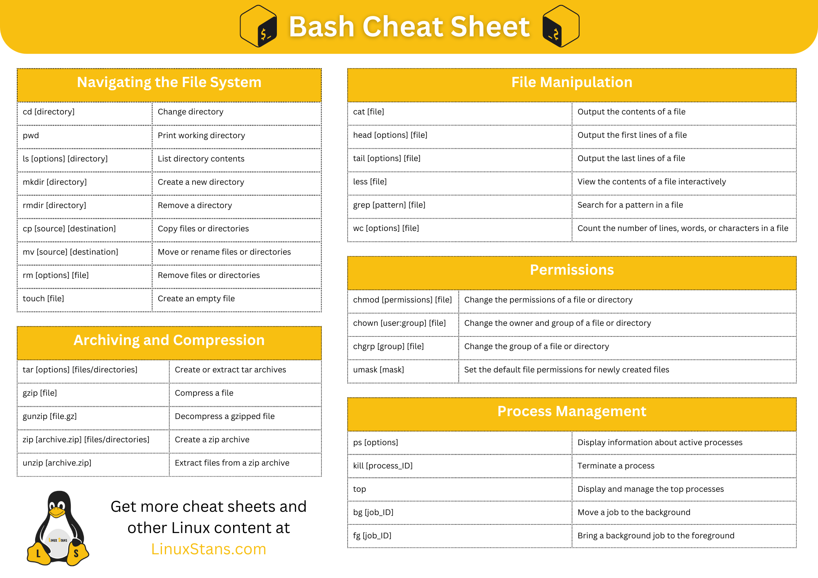
Command line cheatsheats
https://linuxstans.com/bash-cheat-sheet/

Slide 10

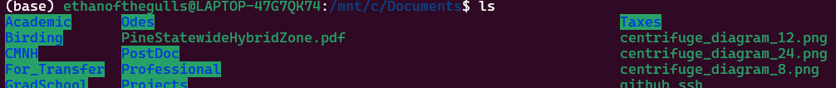
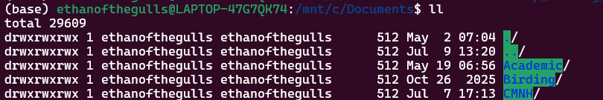
Navigating your computer
pwd stands for print working directory, tells you current location
ls outputs a list of files in a directory, can help you get your bearings
ls -l or ll gives more information

Slide 11
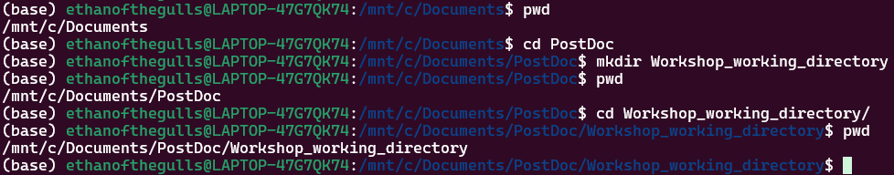
Navigating your computer
cd lets you change your directory, move to a good place to store this workshop output
Make a new directory with mkdir to get a working directory for you to put all the resources for this workshop
Then move into that directory

Slide 12
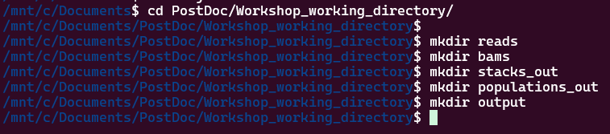
Navigating your computer
Once you make your new directory, we will fill it with sub-directories for your project (bams, stacks_out, populations_out, output)

Slide 13

Installing command line programs
We will install everything that isn’t an R package with conda
Conda is an environment manager, meaning you can install programs and all their dependencies at once (if everything works well)
Miniconda is the simplest version of that

Slide 14
Installing miniconda
Detailed at https://www.anaconda.com/docs/getting-started/miniconda/install/linux-install
curl -O https://repo.anaconda.com/miniconda/Miniconda3-latest-Linux-x86_64.sh
bash ~/Miniconda3-latest-Linux-x86_64.sh
Choose yes
Close and re-open Ubuntu terminal

Slide 15
Installing command line programs
You can install a whole suite of bioinformatic software with one command:
conda create -n rad-workshop-env -c bioconda -c conda-forge bwa stacks vcftools samtools
Wait for it to load, approve the install, and you’re set!
Activate your environment with conda activate rad-workshop-env

Slide 16
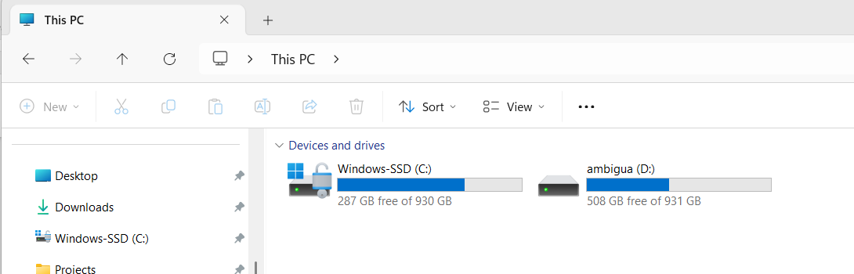
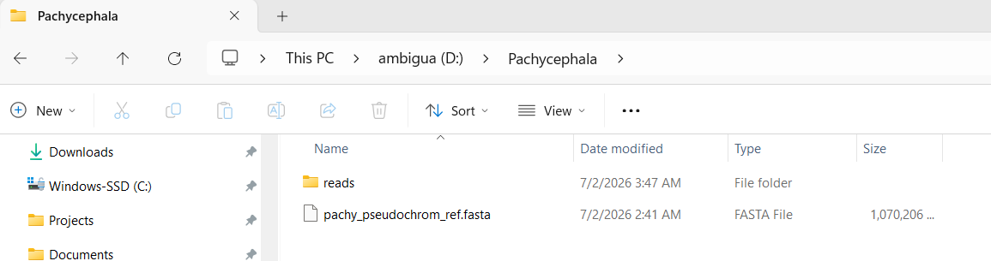
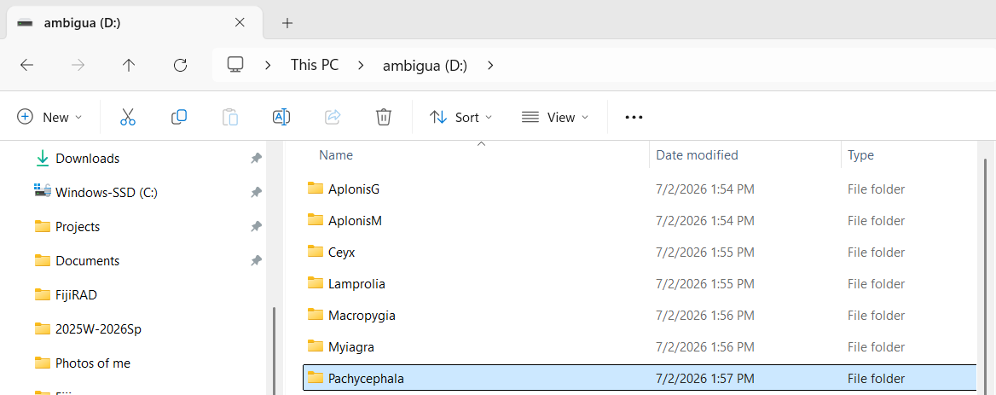
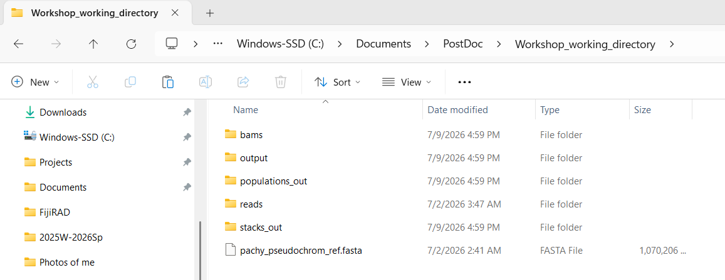
Getting reads, reference, and sample information table
COPY
Paste in working directory

Slide 17
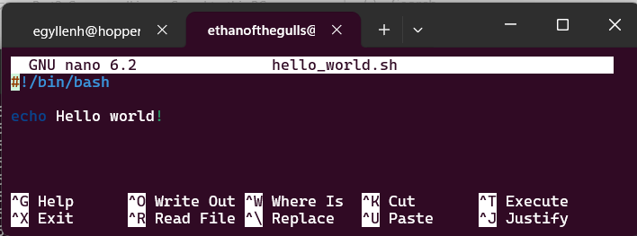

While we download reads – Hello World
Make a new script with touch hello_world.sh
Edit that file with nano
Add a header that tells your computer how to run it
#!/bin/bash
Add a line that prints out a phrase
echo Hello world!
Save (write out) with Control+O then hit enter, exit with Control+X
Run with sh hello_world.sh

Slide 18
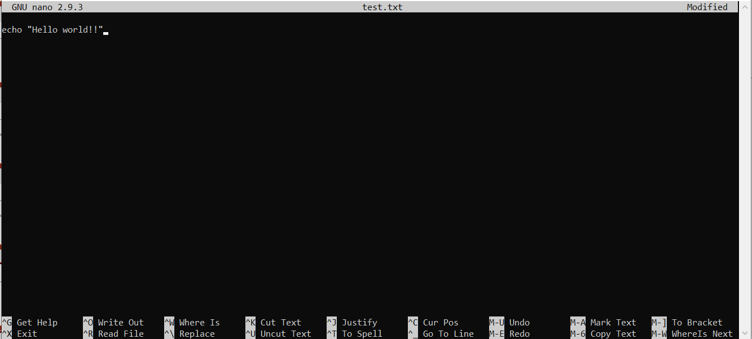
Nano summary
Marker of where you are typing
Ctrl+X to exit the program, may prompt you to save, read the prompt and don’t rush!
Ctrl+O to write out, or save the file

Slide 19
Bash scripts
You just made a bash script! It runs a bunch of commands in order, and is a convenient way to save your work
This is the programming language “bash”, with stands for Bourne Again Shell, which is the same language you used to move around
You can write it in any plain text editor, nano is just an easy one
You will see bash scripts in the github for each section that run relevant commands

Slide 20
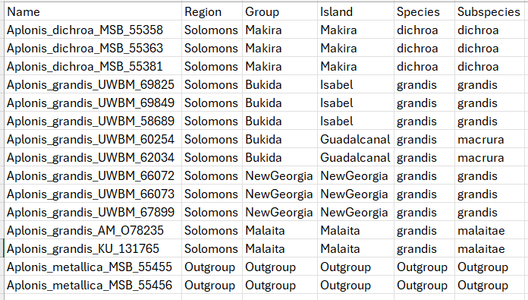
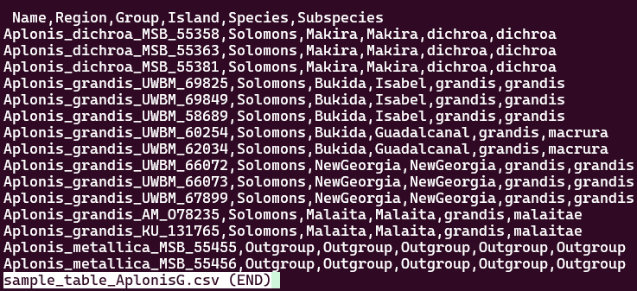
Look at your sample map
You can open in a spreadsheet program or command line (try less)
You can see columns for several levels of organization
All sets have a single designated outgroup for phylogenetics etc
This is a plain text file you can process using Unix commands

Slide 21
Making a sample list
We need a list of samples for our programs to process
We will first subset the file to the sample name column with cut then exclude the first row with tail
cut samples columns from a file based on a delimiter
tail samples rows from a file
We will use the pipe symbol | and output symbol > for the first time
The pipe connect commands together smoothly
The output writes a new plain text file
Try each part individually

Slide 22
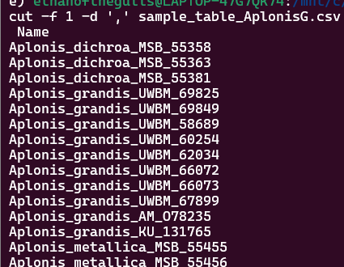
Making a sample list
cut -f 1 -d ',' sample_table_NAME.csv

Slide 23
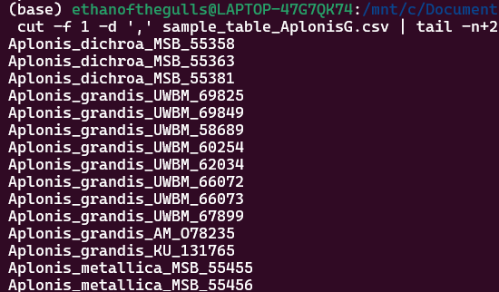
Making a sample list
cut -f 1 -d ',' sample_table_NAME.csv |
tail -n+2

Slide 24
Making a sample list
cut -f 1 -d ',' sample_table_NAME.csv |
tail -n+2 >
sample_list_NAME

Slide 25
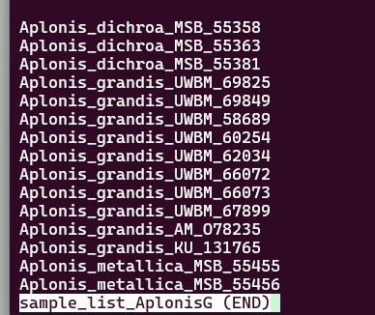
Making a sample list
cut -f 1 -d ',' sample_table_NAME.csv |
tail -n+2 >
sample_list_NAME
less sample_list_NAME

Slide 26
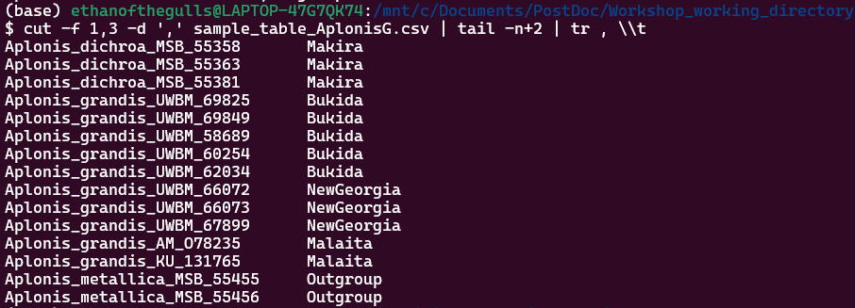
Making a population map
Stacks doesn’t take a sample list on its own, it needs to know how those samples are divided into population
We will combine two columns from our sample table
We need to convert commas to tabs using the translate command
cut -f 1,4 -d ',' sample_table_NAME.csv | tail -n+2 | tr , \\t > popmap_full

Slide 27

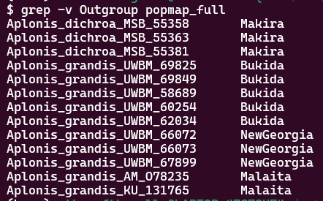
Making a population map
We will make a second map with only the ingroup for some analyses with grep (global regular expression print)
grep tries to match every line in a file with a prompt
grep Outgroup popmap_full
The -v option EXCLUDES anything matching a prompt
grep –v Outgroup popmap_full

Slide 28
Making a population map
We will make a second map with only the ingroup for some analyses with grep (global regular expression print)
grep tries to match every line in a file with a prompt
grep Outgroup popmap_full
The -v option EXCLUDES anything matching a prompt
grep –v Outgroup popmap_full
grep –v Outgroup popmap_full > popmap_ingroup
You can choose what column what you make the popmap with! I suggest starting with island (column 4), but you can re-run this later with e.g. species

