Slide 1
Making and filtering output
USP RADseq Workshop
July 2026

Slide 2
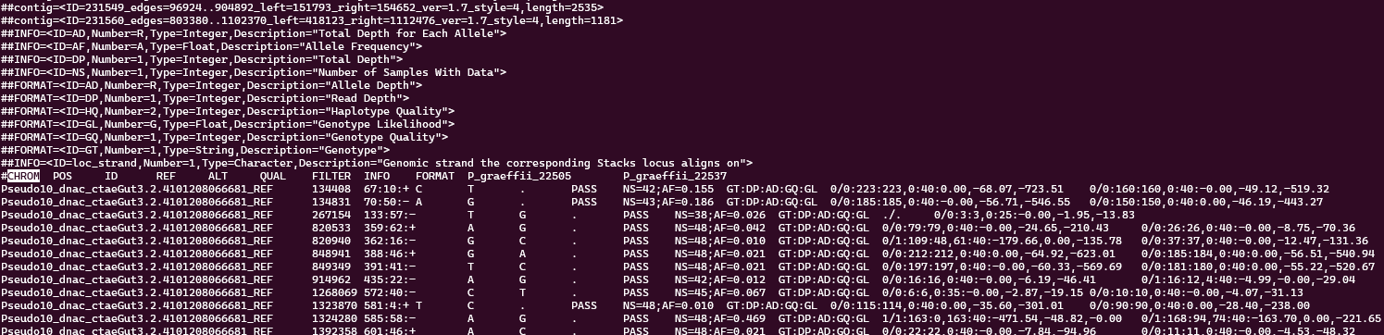
VCF: the baseline for pop gen
Data format that is concise, flexible, and sufficiently data rich it can be used for most programs
We will make a VCF with Stacks’ populations module, then filter it fully with VCFtools

Slide 3
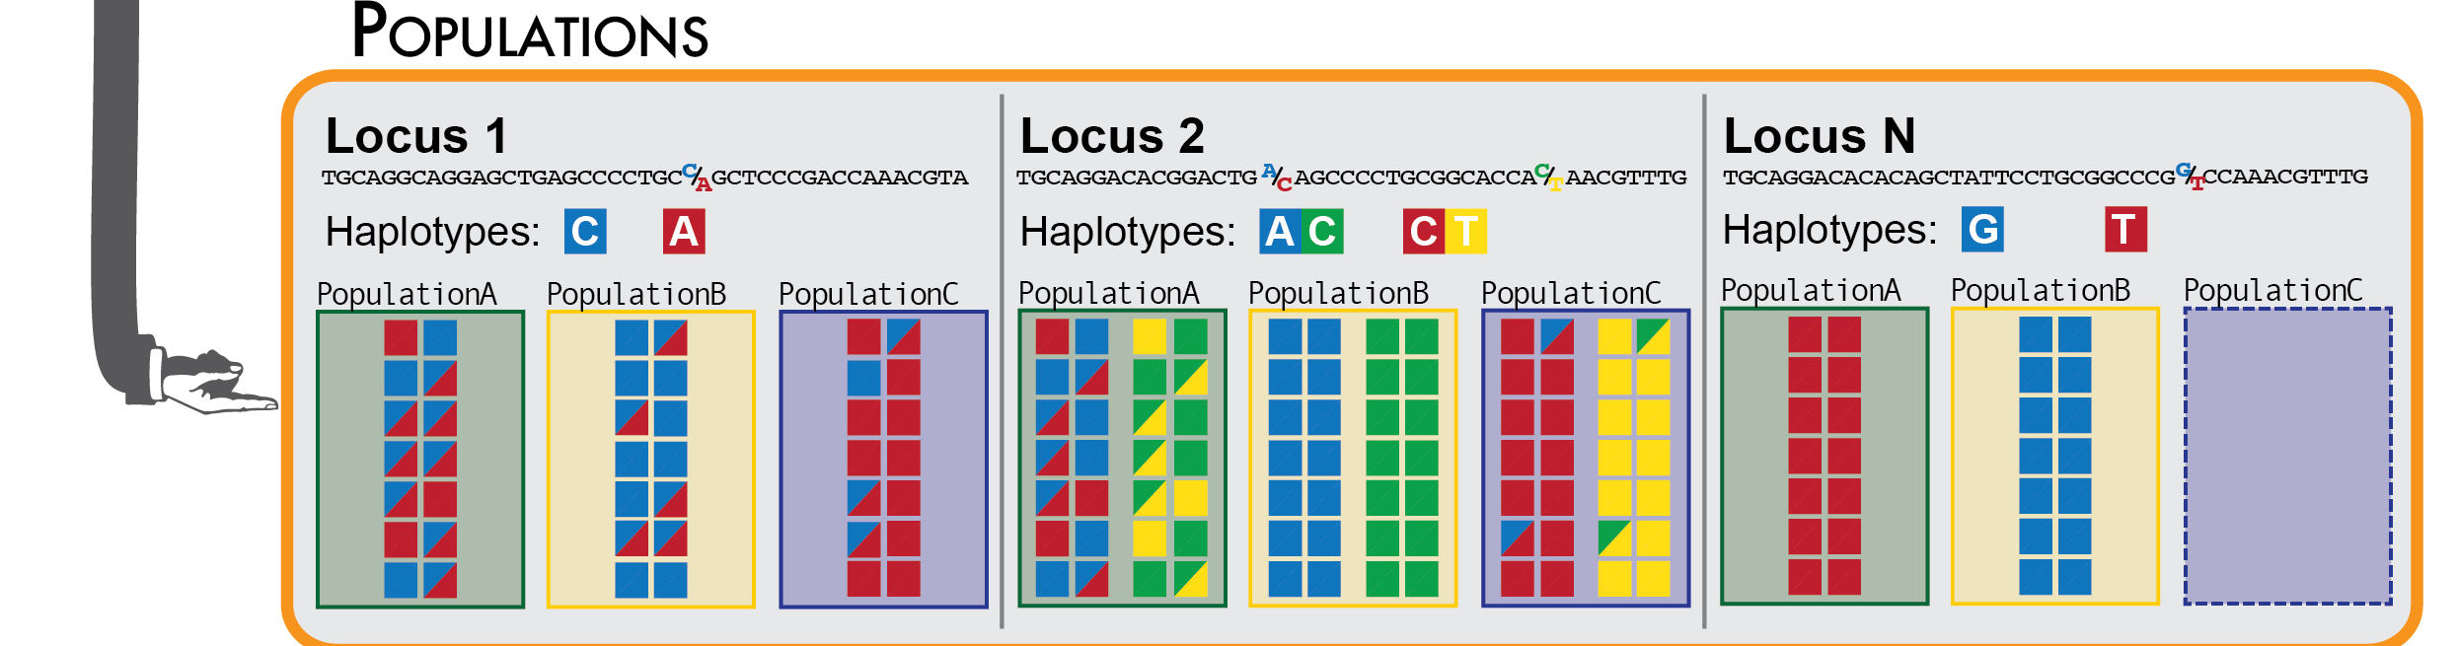
Stacks populations
A nice program with lots of options for output: https://catchenlab.life.illinois.edu/stacks/comp/populations.php
Also will calculate some summary statistics for us!

Slide 4
Common filters
--min-samples-overall (-R): minimum percentage of individuals across pops required to include a locus
--min-maf and --min-mac: minimum minor allele freq and out
--write-random-snp: keep one random SNP per locus
--max-obs-het: maximum cross-population heterozygosity a locus can have (to avoid paralogs)

Slide 5
Common outputs
--vcf: outputs a VCF (main currency for popgen analyses)
--smooth: smooth summary stats (tend to be inaccurate with Stacks)
--phylip-var-all: phylip of all variant and invariant sites per “population”, I run this with a popmap including each individual as a population to get input for phylogenetics, concatenated
--structure, --plink, --treemix: output for running these programs (PLINK is good for ADMIXTURE)

Slide 6
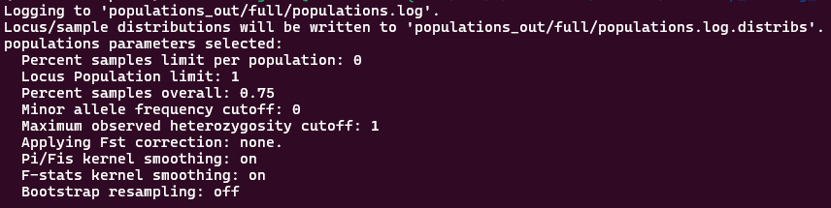
Running populations
Like most of Stacks, very simple, we will run it only one time for now, like below (remember the \ just means the command continues onto the next line)
mkdir populations_out/full
populations --in-path stacks_out/full/ --popmap popmap_full \
--out-path populations_out/full --vcf --min-samples-overall 0.75 \
--write-random-snp --min-mac 2 --smooth --threads 2

Slide 7
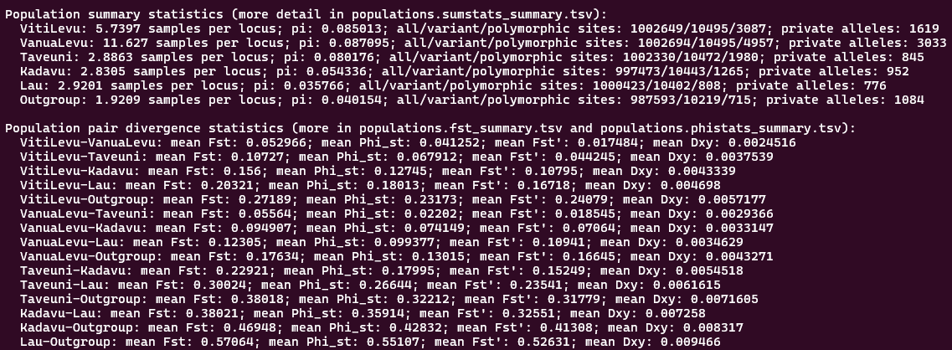
Running populations
Note that it shows the a summary of the population genetic summary statistics results, a nice first pass at the data, but not the most accurate

Slide 8
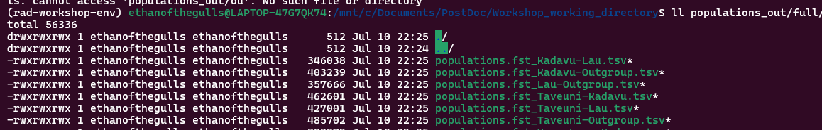
Moving populations output
We will then rename that output and move it somewhere easier to find
We will give it informative names that include the percent completeness and that it was thinned
mv populations_out/ingroup/populations.snps.vcf output/pachycephala_ingroup_75_thinned.vcf
mv populations_out/ingroup/populations.sumstats_summary.tsv output/pachycephala_ingroup_75_thinned_sumstats.tsv

Slide 9
VCFtools
Common tool for subsetting SNP datasets, has several ways of filtering and subsetting loci and samples, a lot like populations
It also runs several analyses, most notably pairwise FST for genome-wide means and Manhattan plots
Full documentation: https://vcftools.github.io/man_latest.html
Installation: we included it in our conda environment!

Slide 10
VCFtools
Basic syntax:
vcftools --vcf samples.vcf {commands} --out path/and/stem_of_output
VCFtools generally only runs one analysis at a time (including “recode” to write a filtered VCF), but can take many options

Slide 11
Common VCFtools SNP filters
--remove-filtered-all: remove sites with a filter tag
--max-missing: proportion of missing data
--chr and --not-chr: include and exclude regions (respectively)
--thin: remove SNPs such that no two sites are closer than X distance
--remove-indels: remove indels
--maf and mac: only include sites with minor allele freq/count >= X
--min-alleles and --max-alleles: max and min number of alleles at a site
Example (outputs filtered vcf like path/to/output_stem.recode.vcf)
vcftools --vcf samples.vcf --recode --max-missing 0.75 --thin 10000 --mac 3 --mix-alleles 2 --max-alleles 2 --not-chrom Z_chrom --out path/to/output_stem

Slide 12
Common VCFtools individual filters
--indv and --remove-indv: keep and remove a given individual (can be used multiple times)
--keep and --remove: keep a list of individuals (a text file of names, like a sample list, NOT a popmap)
Example (outputs filtered vcf like path/to/output_stem.recode.vcf)
vcftools --vcf samples.vcf --recode --keep list_of_indivs --remove-filtered-all --max-missing 0.75 --thin 10000 --mac 3 --mix-alleles 2 --max-alleles 2 --out path/to/output_stem

Slide 13
Common VCFtools outputs
--recode: make a VCF of this filtering scheme
--012: outputs a file with SNPs codes as 0/1/2 for homozygous ref/heterozygous/homozygous alternate
--plink: outputs PLINK format files
--depth: outputs mean depth per individual
--window-pi: outputs mean diversity per window
--weir-fst-pop: most likely to be used here, outputs pairwise FST for a given pair (or more) of populations, input is a list (like --keep), output to command line includes genome-wide mean, output file has site or window based FST
Example: vcftools --vcf samples.vcf --recode --max-missing 0.75 --mix-alleles 2 --max-alleles 2 --weir-fst-pop pop1_list --weir-fast-pop pop2_list --not-chrom Z_chrom --out path/to/output_stem

Slide 14
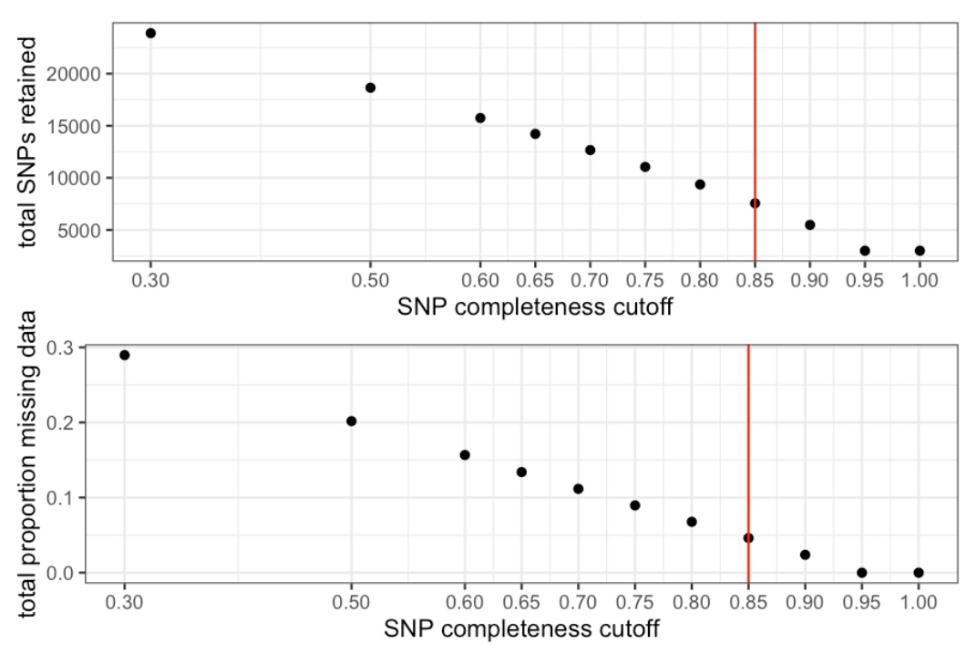
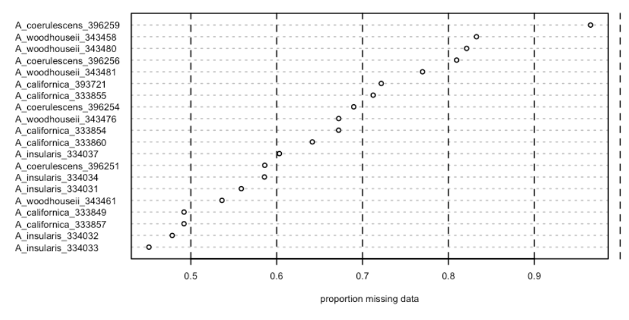
SNPfiltR
A very helpful exploratory tool for filtering, we will not be using it here unless we have time at the end, but I recommend looking into it for exploring your own data (at least for RADseq): https://devonderaad.github.io/SNPfiltR/

