Slide 1
Windowed summary stats
USP RADseq Workshop
July 2026

Slide 2
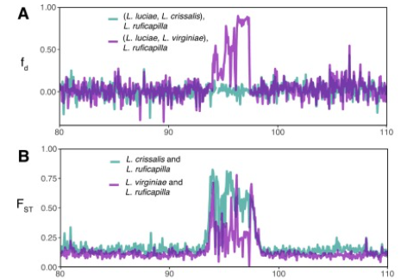
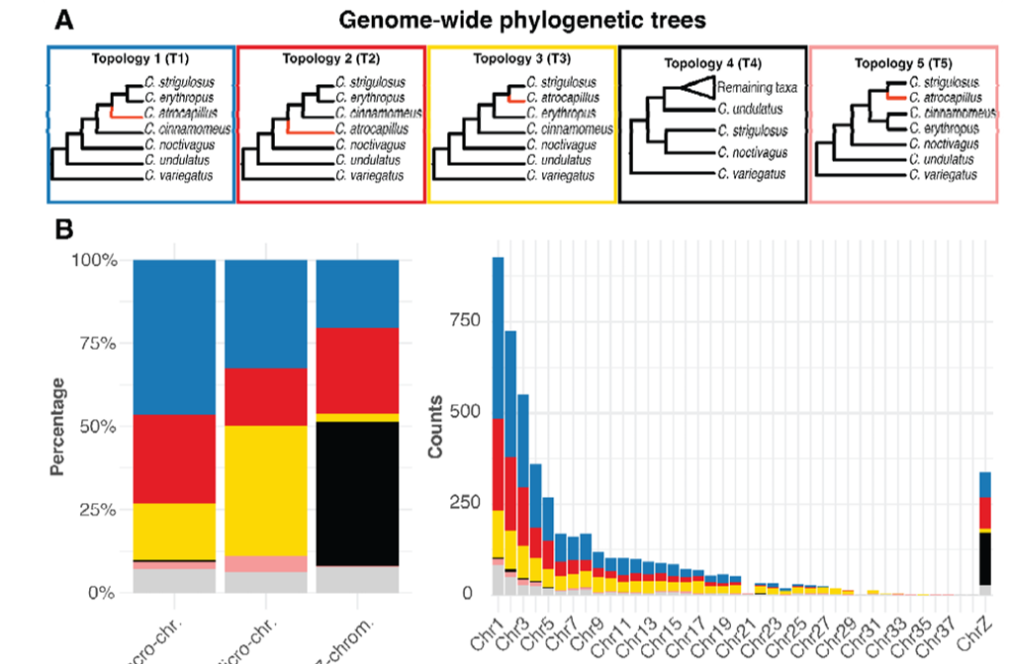
Windowed analyses
Everything we have looked at is heterogenous across the genome! We can use this to learn about what regions relate to differences in our populations AND use knowledge about genomic processes to understand the evolutionary history
Rice et al. 2026 https://doi.org/10.1016/j.ympev.2026.108558
Musher et al. 2026; https://doi.org/10.1101/2025.11.26.690533

Slide 3
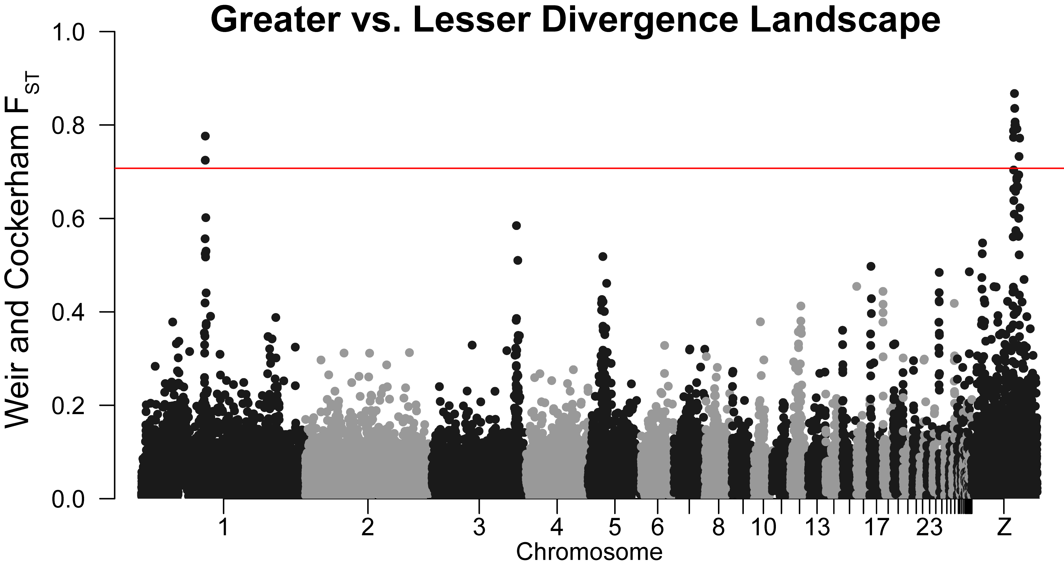
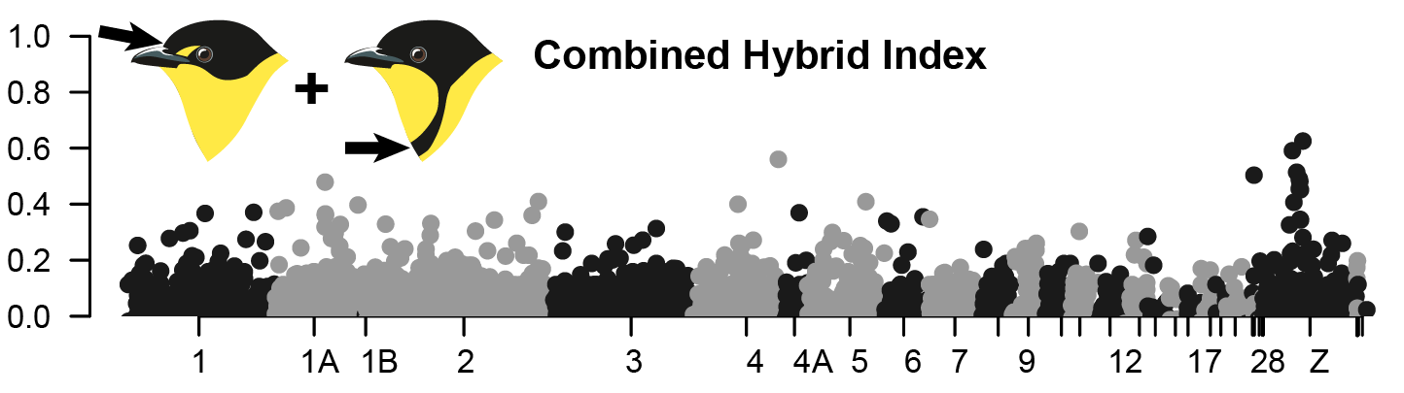
Windowed analyses
We will only focus on FST today, but I recommend looking at pixy for diversity statistics (https://pixy.readthedocs.io/en/latest/) and TWISST for topological variation (https://github.com/simonhmartin/twisst)
We will choose two sets of individuals based on our other analyses
Closely related ones have greater potential for jagged peaks
Ones with phenotypic differences may help narrow down regions of interest (ask Ethan for tips)

Slide 4
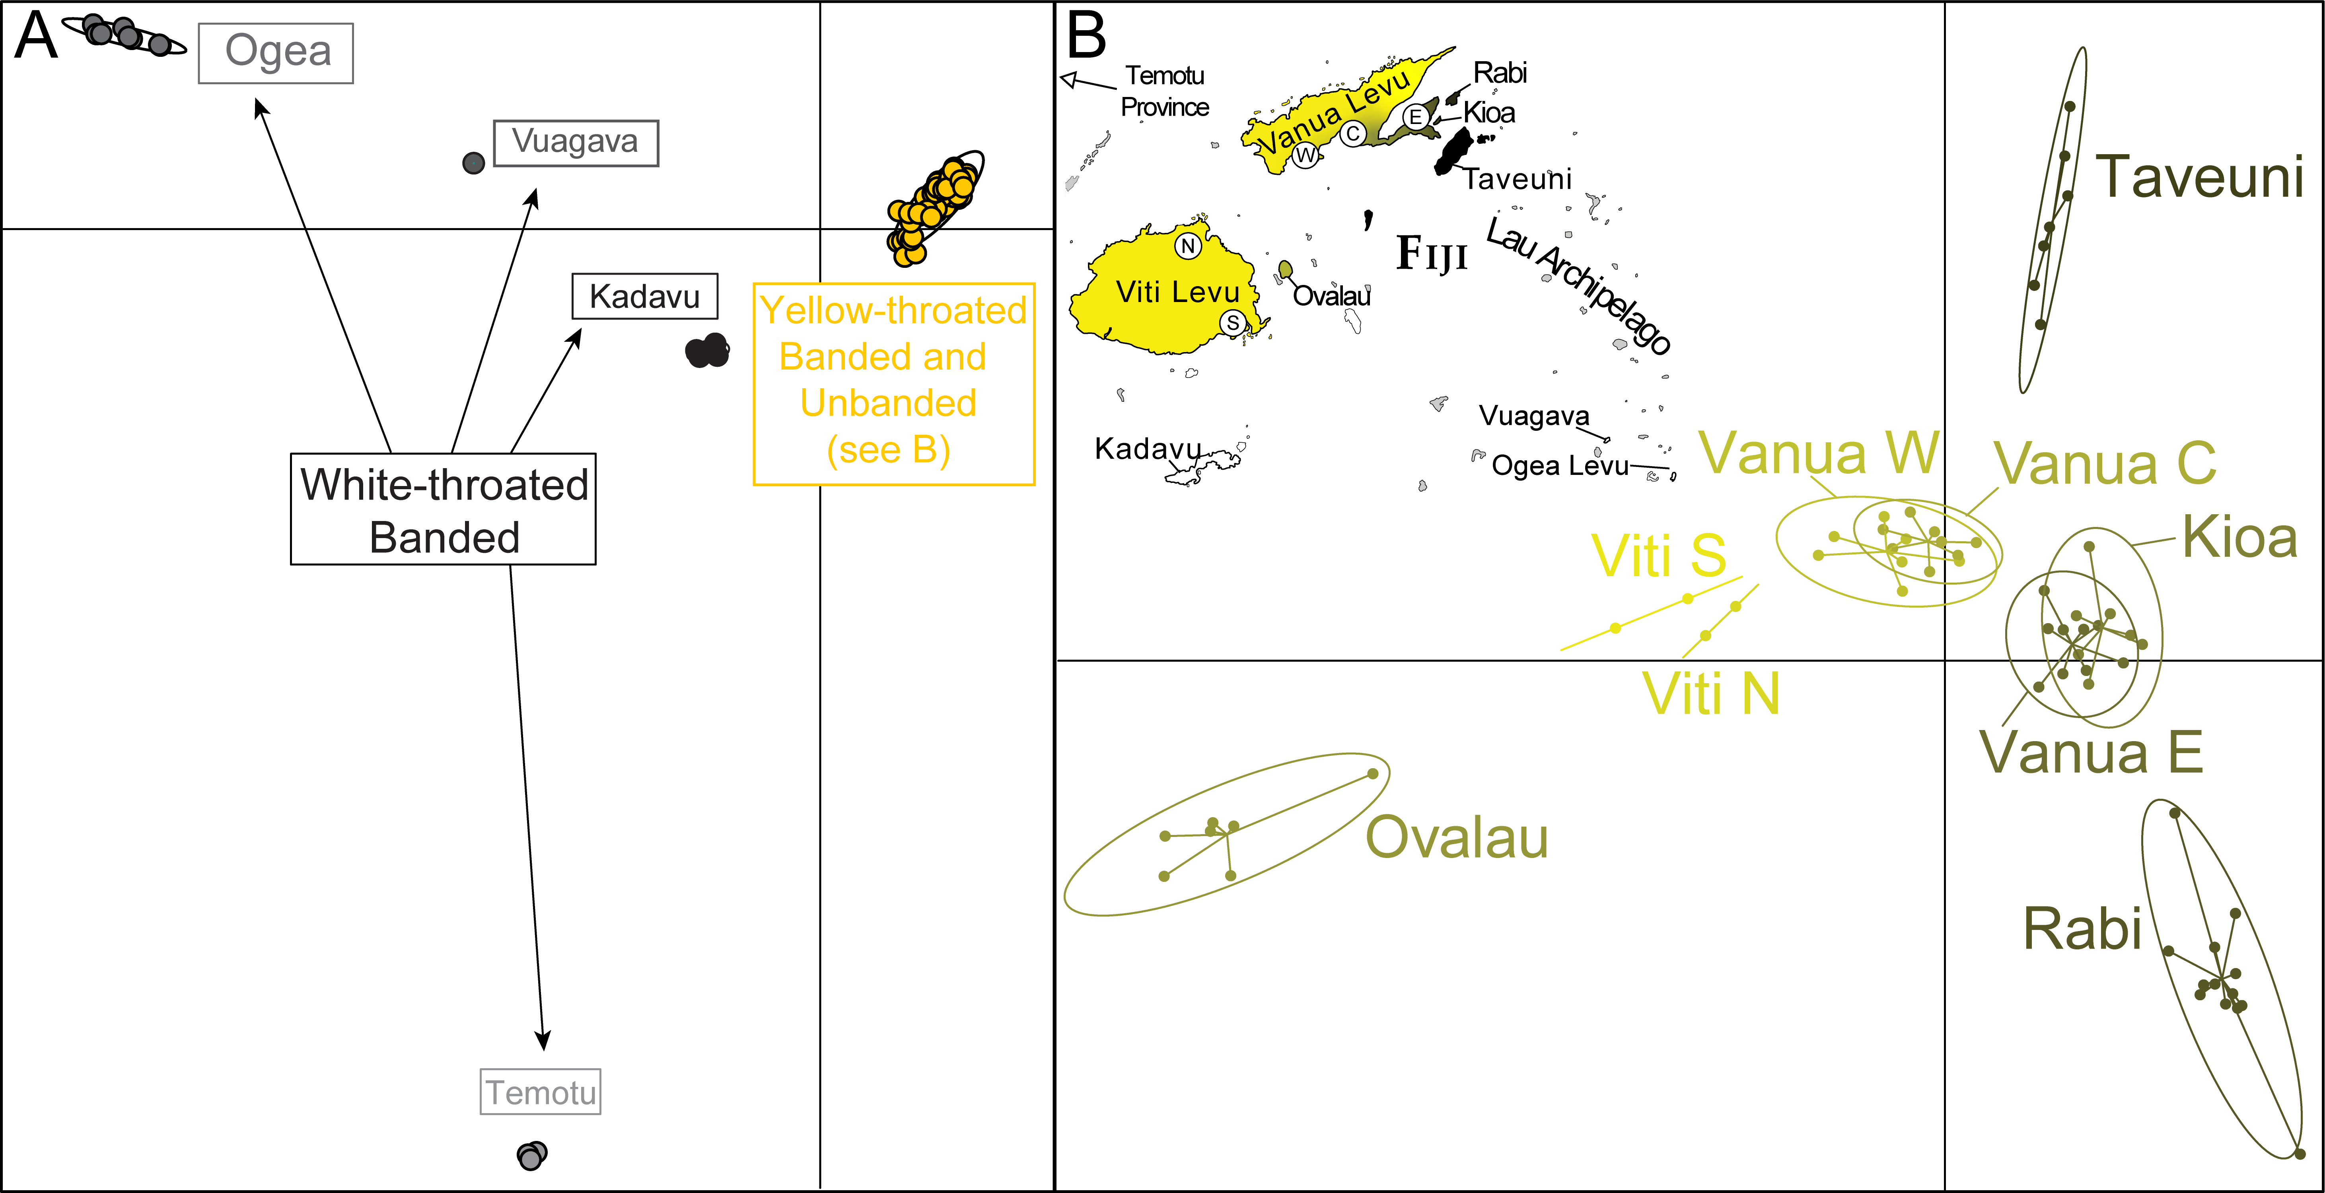

Slide 5
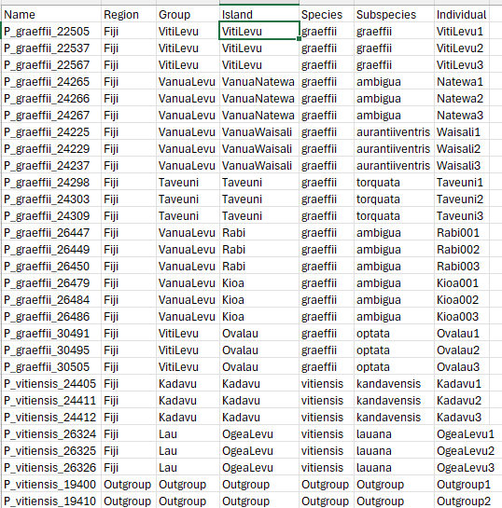
Choosing populations to compare
Put the sample names for each set into a text file that includes a description of what makes that set unique (you can do multiple!)
Viti Levu Group
Vanua Levu Group
nano keep_yellow
nano keep_white
nano keep_vanua
nano keep_viti
Yellow
White

Slide 6
Making new input
We are going to be doing windowed stats, so we don’t actually want to thin, we want all the information in a locus
We also want to apply filters *only* to our focal group
We will re-run populations accordingly
mkdir populations_out/windows
populations --in-path stacks_out/ingroup/ --popmap popmap_ingroup \
--out-path populations_out/windows --vcf
mv populations_out/windows/populations.snps.vcf output/window_input.vcf

Slide 7
Running the windowed FST
We will use VCFtools here (I recommend a script, e.g. nano window.sh)
#!/bin/bash
vcftools --vcf output/window_input.vcf \
--max-missing 0.75 --min-alleles 2 --max-alleles 2 \
--weir-fst-pop keep_white --weir-fst-pop keep_yellow \
--fst-window-size 100000 \
--out output/windowed_fst_white_yellow_75
vcftools --vcf output/window_input.vcf \
--max-missing 0.75 --min-alleles 2 --max-alleles 2 \
--weir-fst-pop keep_viti --weir-fst-pop keep_vanua \
--fst-window-size 100000 \
--out output/windowed_fst_viti_vanua_75

Slide 8
Preparing the output to plot
Unfortunately, the package that makes plotting this data the easiest requires numeric chromosome names
Because of that, we will run a bash script that replaces all chromosome names with numbers
nano rename.sh
#!/bin/bash
grep -v CHROM output/windowed_fst_X_Y_75.windowed.weir.fst | \
cut -f 1 | sort | uniq > chrom_list
track=1
for chrom in $(cat chrom_list); do
sed -i "s/$chrom/$track/g" output/windowed_fst_X_Y_75.windowed.weir.fst
track=$((track+1))
done

Slide 9
Plotting
library(tidyverse)
library(qqman)
setwd('C:/Documents/PostDoc/Workshop_working_directory')
plot_fst <- function(input, title_name="Windowed FST"){
fst <- read.table(input, header=TRUE)
fstsubset <- fst[complete.cases(fst),]
SNP<-c(1:(nrow(fstsubset)))
snp_df<-data.frame(SNP,fstsubset)
manhattan(snp_df,chr="CHROM",bp="BIN_START",p="WEIGHTED_FST",
snp="SNP",logp=FALSE, ylab="Weir and Cockerham Fst",
main=title_name, cex=1.5)
}
plot_fst("output/windowed_fst_viti_vanua_75.windowed.weir.fst",
"Viti Levu vs Vanua Levu Group")
plot_fst("output/windowed_fst_white_yellow_75.windowed.weir.fst",
"White vs Yellow Throat")
We will move back to R for this, using a package called qqman
To make sure we can try out multiple different combinations, we will make another function that can plot any input

Slide 10
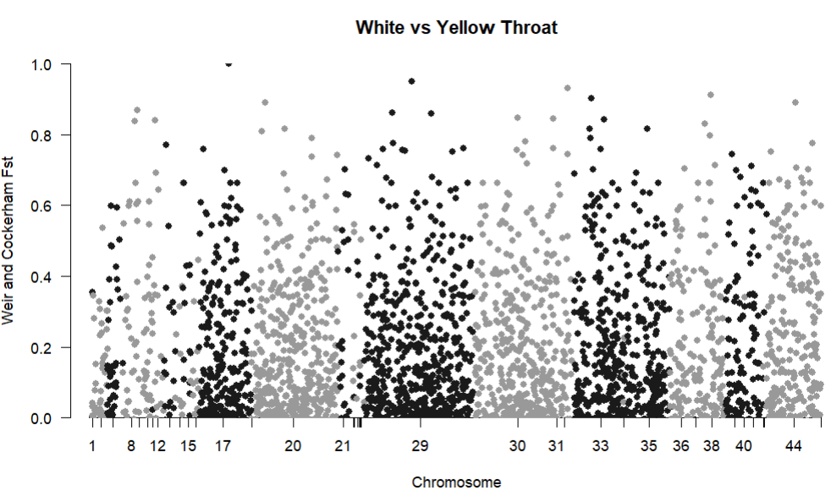
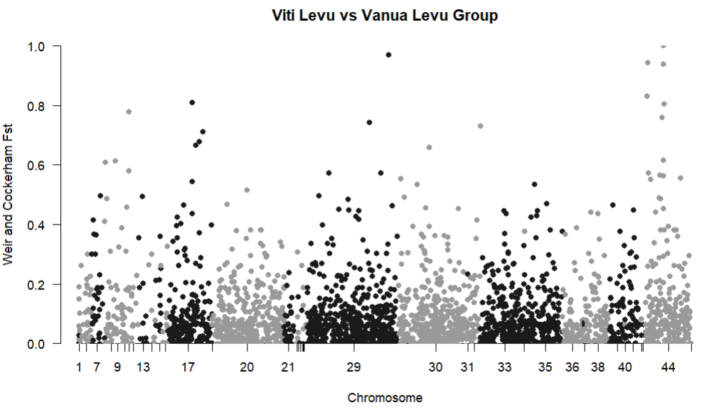
Interpretting the output
You will want to look at the broad characteristics
Is the divergence concentrated in few regions? Or is it random?
Is the overall divergence too high to detect patterns?
Save the plot and your overall impression in your document

Slide 11
Too high to see anything!

Slide 12
Big peak on Z
Other peaks on large autosomes

