Slide 1
Phylogenetics
USP RADseq Workshop
July 2026

Slide 2
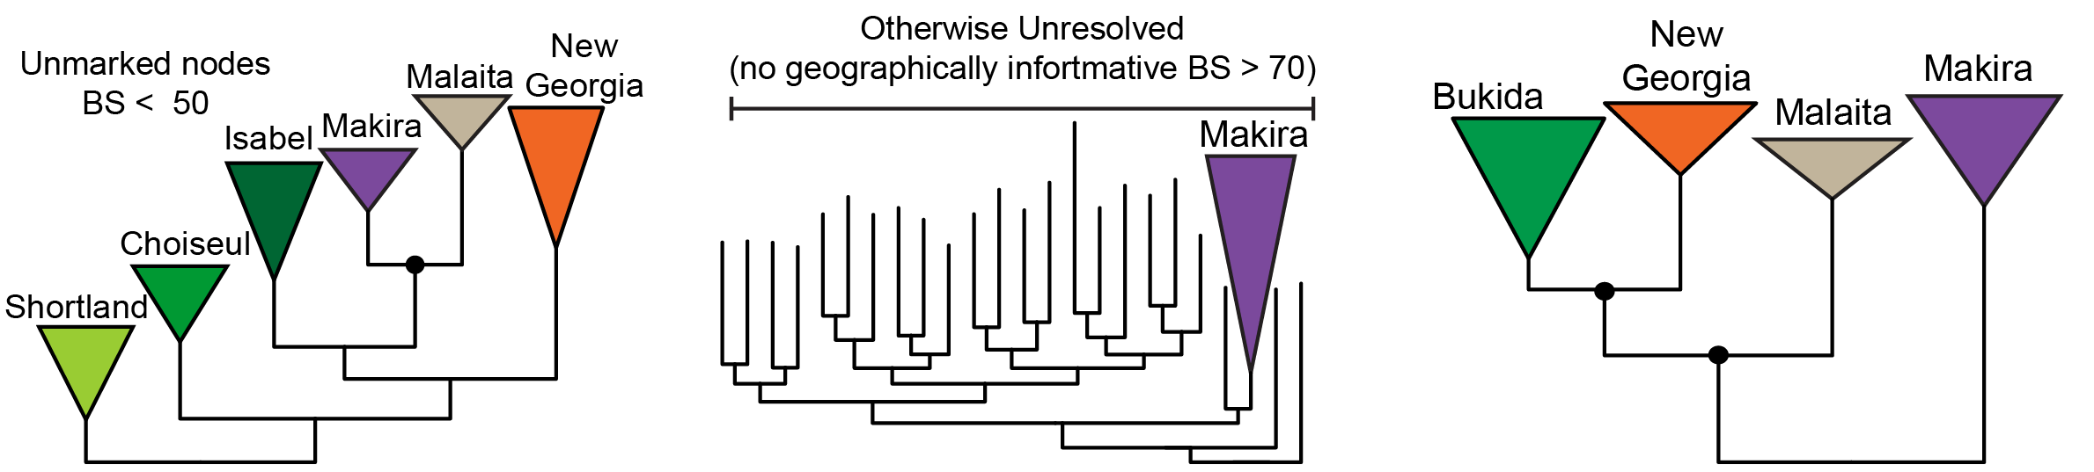
Phylogenies at small scales
Can be a very important aspect of your analysis, but only with sufficient divergence
Also worth noting that they may not tell the true history of divergence, particularly in the Solomon Islands!
Isolated populations can “pull out” and seem to be the first branch in a chain of colonization, could just be the signal of ancient gene flow

Slide 3
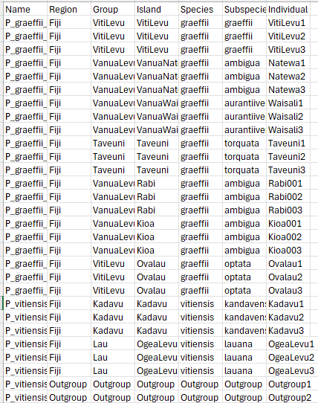
Making the input
One aspect of phylogenetics is that it favors sequences from individuals, something Stacks is obnoxious about
We need to go back to gstacks and populations to “trick it” into outputting sequences for individuals with a new “individual” column in our population table with a max of 6 and min of 10 characters
Then make a popmap like before
cut -f 1,7 -d ',' sample_table_Pachycephala.csv | \
tail -n+2 | \
tr , \\t > popmap_individual

Slide 4
Making the input
Now you will run gstacks and populations again, and once again move the output to your populations folder
As with before, open a file in nano like:
nano stacks_phylo.sh
Then fill it with this to run the program:
#!/bin/bash
gstacks -I bams -M popmap_individual -O stacks_out/individual/
mkdir populations_out/individual
populations --in-path stacks_out/individual/ --popmap popmap_individual \
--out-path populations_out/individual --phylip-var-all \
--min-samples-overall 0.75
grep -v "#" populations_out/individual/populations.all.phylip > output/NAME_75.phylip

Slide 5
Running IQtree
We now need to add a new program to our environment to run everything! With your conda environment loaded, type
conda install -c bioconda -c conda-forge iqtree
Now we will simply run IQTree
iqtree -s output/NAME_75.phylip -m MFP -B 1000 -T 2
This will take a while because we use a full model finding protocol!
We can also add a new and helpful additional bit of information using site concordance factors
iqtree -t output/NAME_75.phylip.treefile \
--scf 5000 -s output/NAME_75.phylip \
--prefix NAME_SCF_75 -T 2

Slide 6
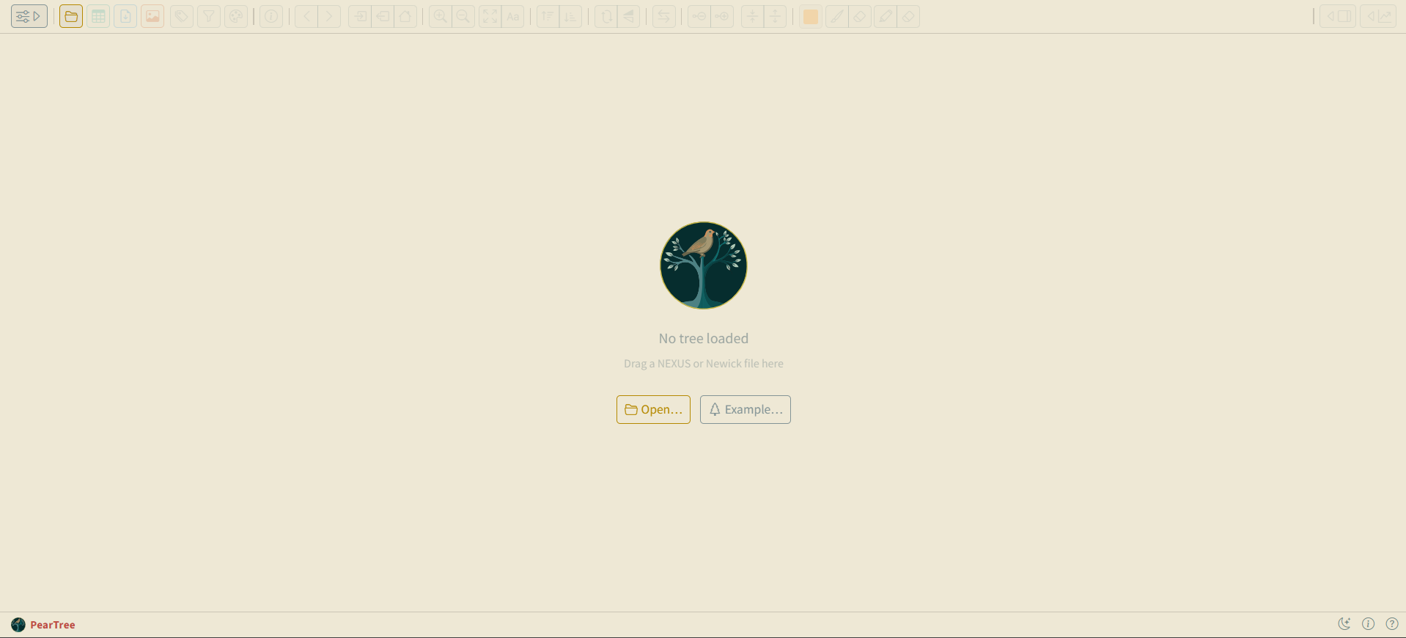
Visualizing our trees
We will view our trees with PearTree (I used to use FigTee): https://peartree.live/

Slide 7
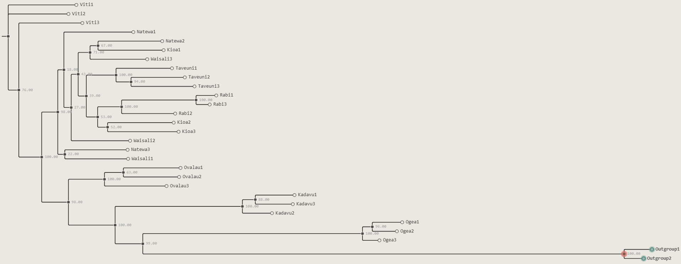
Visualizing our trees
We will view our trees with PearTree (I used to use FigTee): https://peartree.live/
Select outgroup node

Slide 8
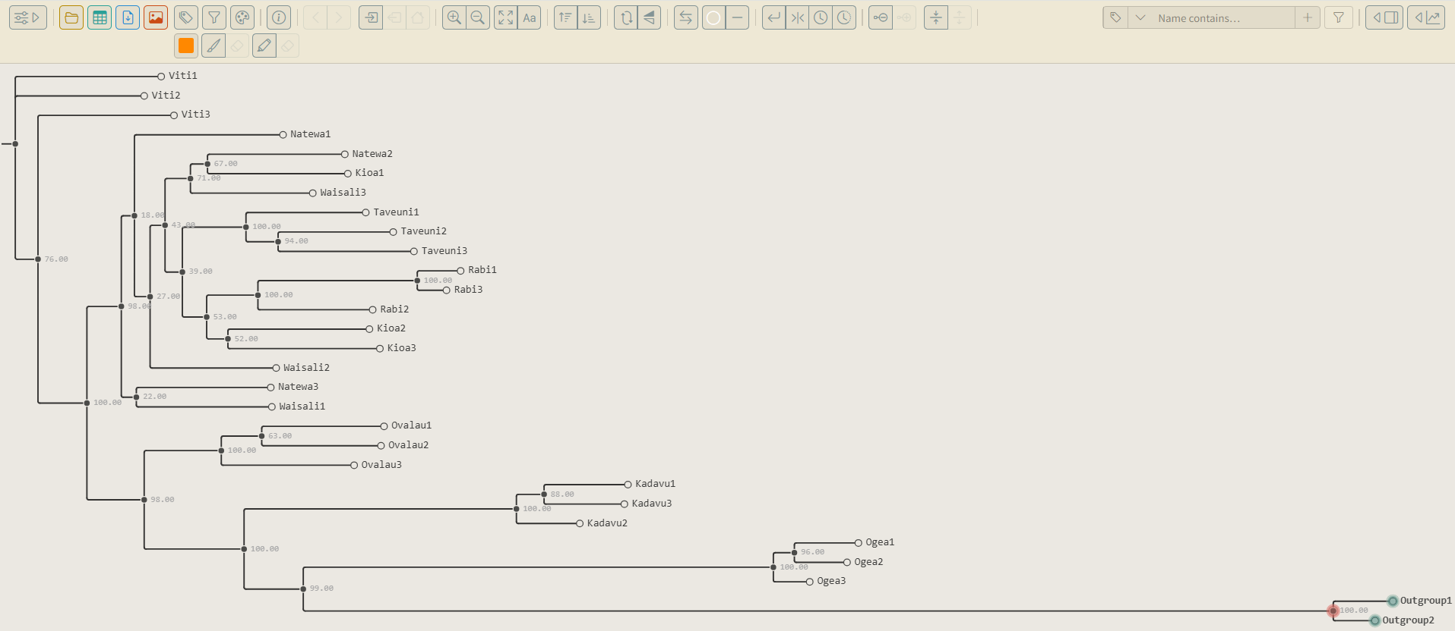
Visualizing our trees
We will view our trees with PearTree (I used to use FigTee): https://peartree.live/
Re-root the tree
Select outgroup node

Slide 9
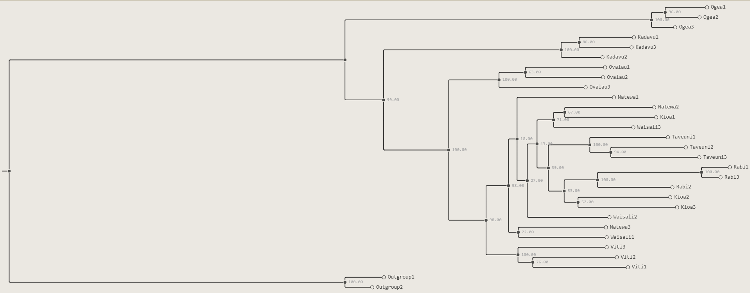
Visualizing our trees
We will view our trees with PearTree (I used to use FigTee): https://peartree.live/

Slide 10
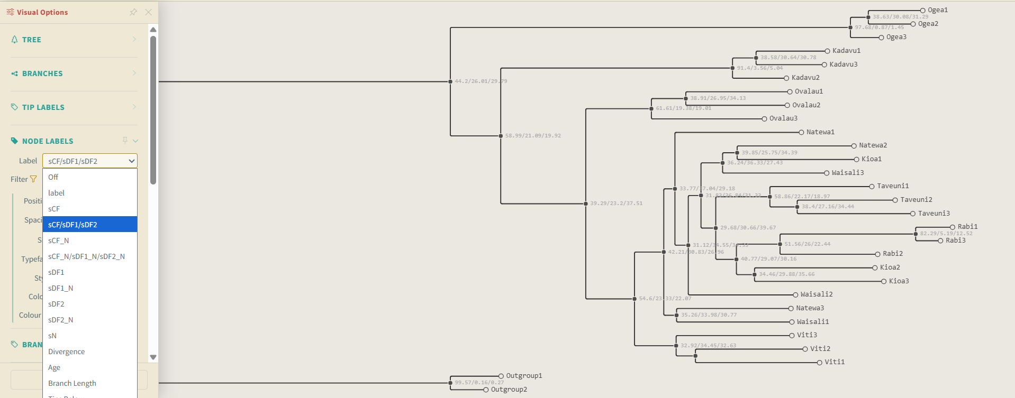
Visualizing our trees
For the SCF, view the nexus file and change the node labels

