Slide 1
Summary Statistics
USP RADseq Workshop
July 2026

Slide 2
Summary statistics
Method of summarizing variants in a set of individuals
Key ones are involved in diversity (pi, heterozygosity), divergence (d_{xy}, F_{ST}), and demography (Tajima’s D)
Populations outputs many of these by default, and you may remember we moved some into our output directory
Easiest to view in spreadsheet form (format they use is not R-friendly
Focus on ones with invariant sites included! This is essential, emulates analyses done with the program pixy (which I highly recommend for genomic data)

Slide 3
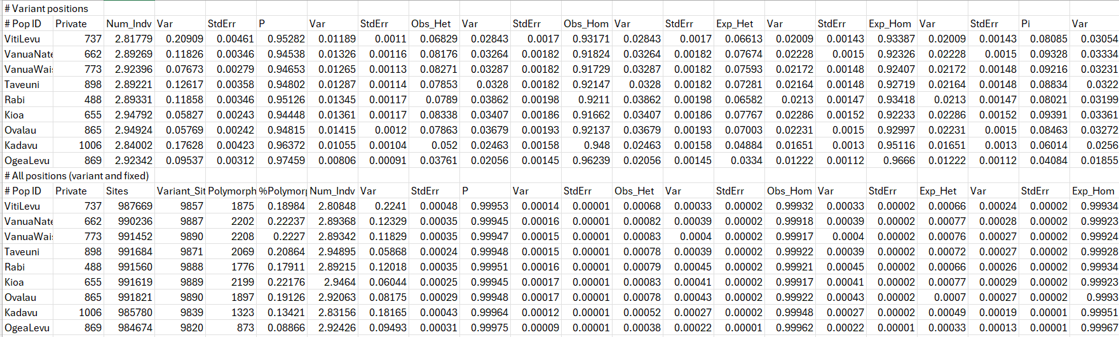
Diversity statistics
Full table is massive, but I want to you make a new tab and first subset it to only the “all positions” section

Slide 4
Diversity statistics
Full table is massive, but I want to you make a new tab and first subset it to only the “all positions” section

Slide 5
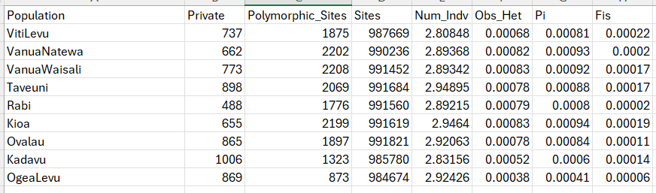
Diversity statistics
Rename first column to relevant taxonomic/geographic level
Delete columns other than “private”, “sites”, “polymorphic_sites”, “obs_het”, “pi”, and “fis”

Slide 6
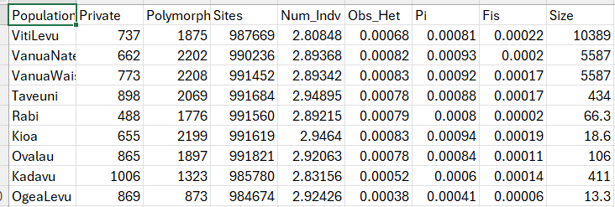
Diversity statistics
Look up sizes of islands you have on google (unless you have a better list handy), add it as a column
Save as a csv

Slide 7
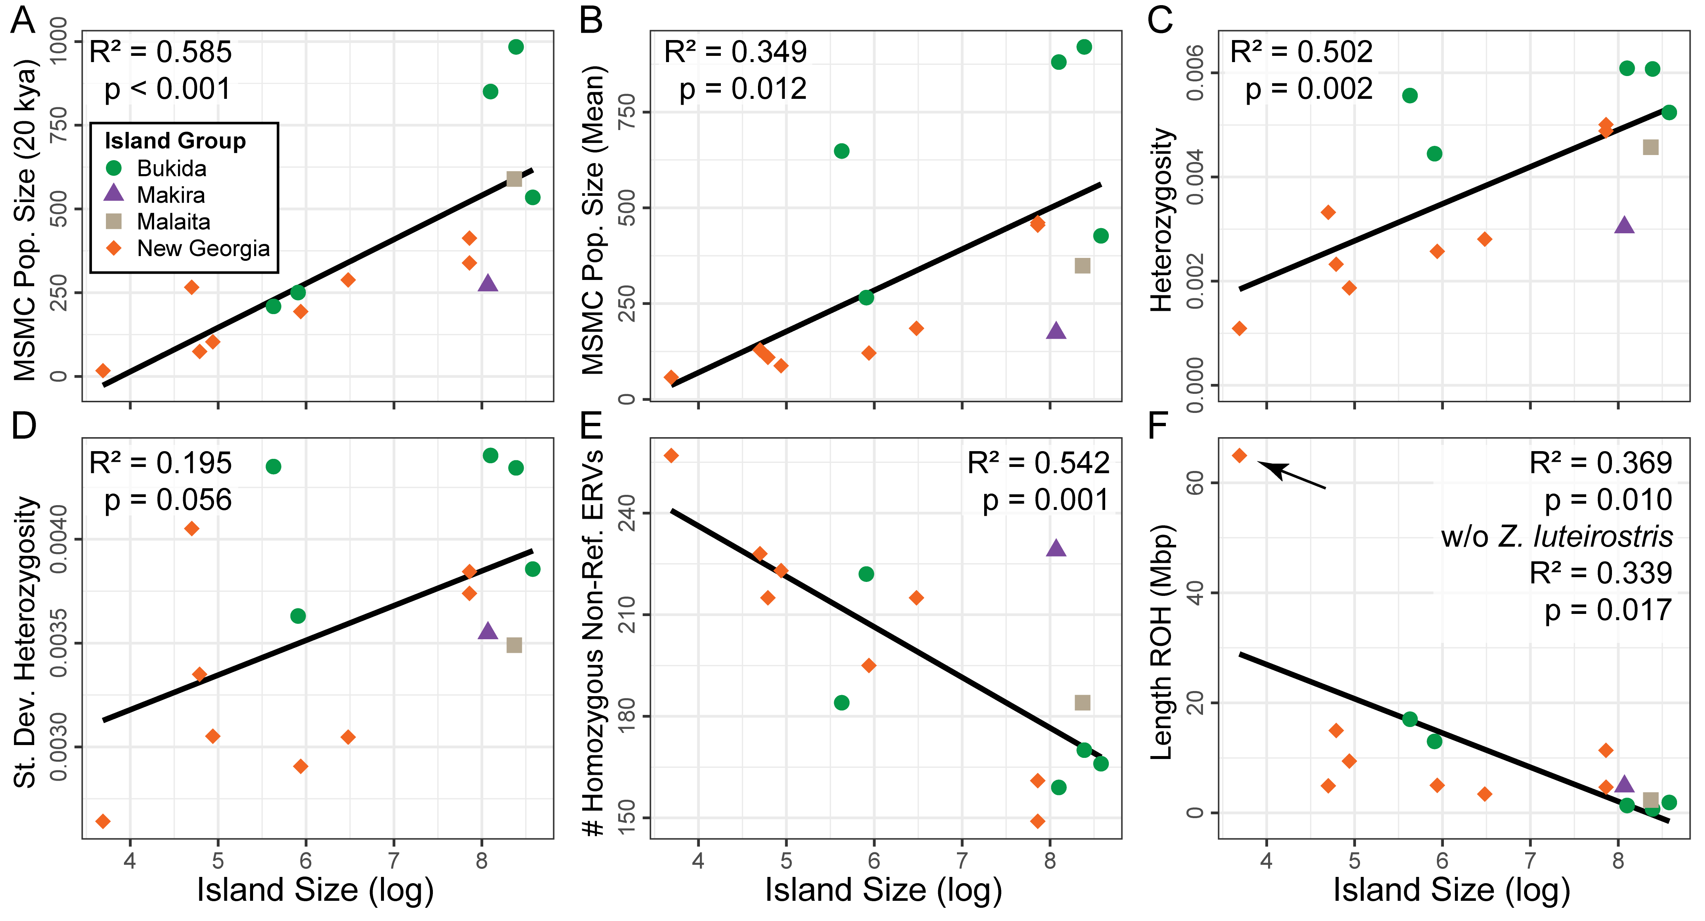

Slide 8
Correlation plot
# we will only need the tidyverse!
library(tidyverse)
library(corrplot)
# change to working directory
setwd('C:/Documents/PostDoc/Workshop_working_directory')
# read in the file
sumstats <- read.csv("summary_stats.csv")
# make a correlation matrix, removing the Population column
corr_matrix <- cor(select(sumstats, !Population))
# look at a correlation plot of all values
corrplot(corr_matrix)
# more complex
corrplot.mixed(corr_matrix, order = 'AOE', tl.cex=0.8, tl.pos="lt“,
lower="ellipse", # lower corner is a visual depiction
upper="number“) # upper is the correlation coefficient
Read csv into R
Load tidyverse and corrplot
Make a correlation matrix
Plot with corrplot
Plot a more complex version

Slide 9
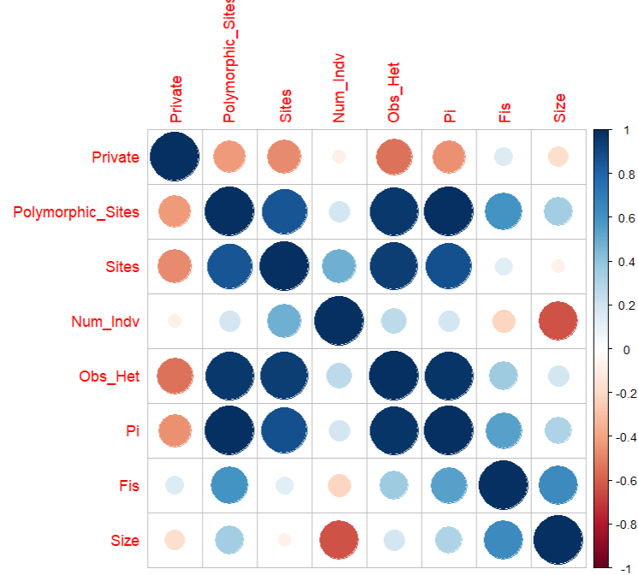
Correlation plot
Read csv into R
Load tidyverse and corrplot
Make a correlation matrix
Plot with corrplot
Plot a more complex version

Slide 10
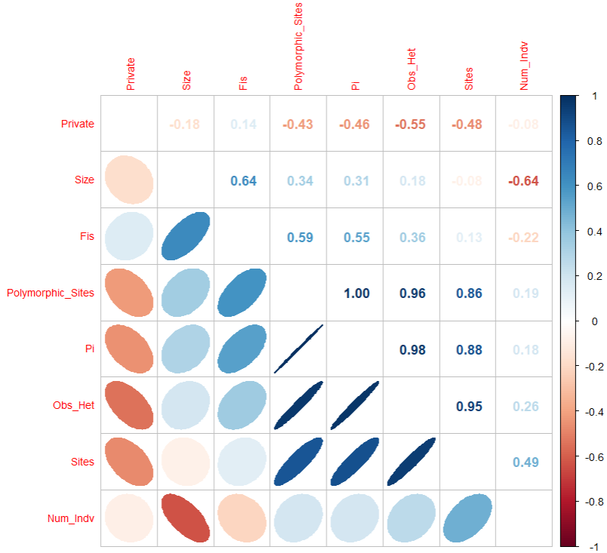
Correlation plot
Read csv into R
Load tidyverse and corrplot
Make a correlation matrix
Plot with corrplot
Plot a more complex version

Slide 11
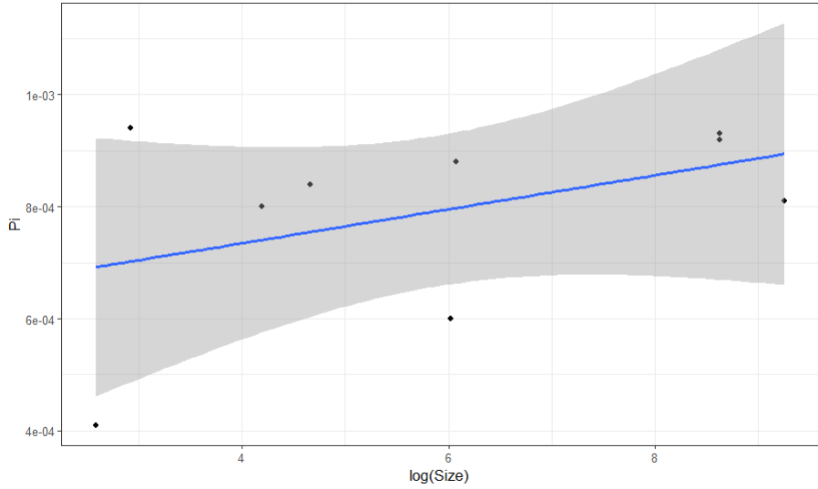
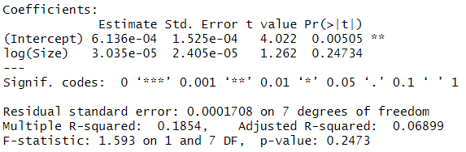
Island size vs diversity
Choose a diversity stat and plot vs log island size
ggplot(data=sumstats, aes(x=log(Size), y=Pi)) +
geom_point() +
geom_smooth(method="lm") +
theme_bw()
How strong is your correlation? Let’s look at a linear model
model = lm(data=sumstats, Pi~log(Size))
summary(model)

Slide 12
Looking closer
Kioa admixed, very close to Vanua Levu
Ovalau admixed, higher div than Viti!
Viti Levu recent
colonization
Kadavu large but isolated

Slide 13
Intermission: simulations

Slide 14
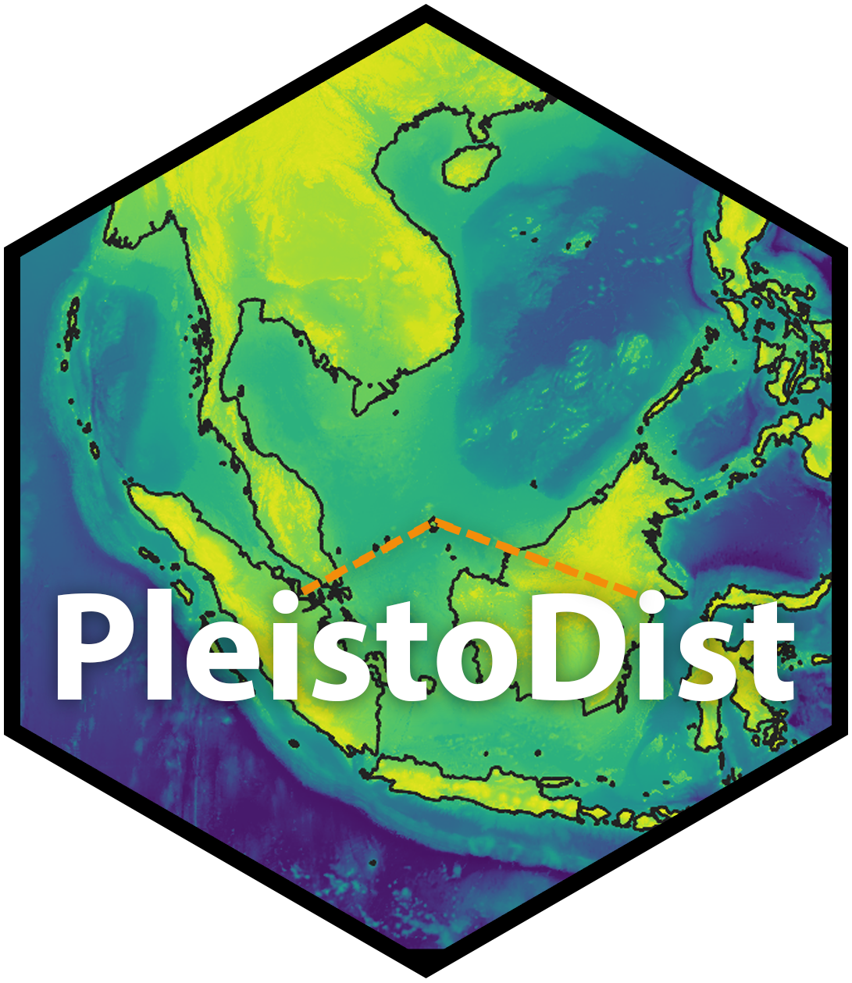
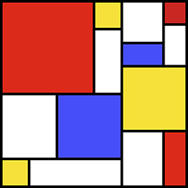
Simulation study: What makes an island size-diversity relationship
Simulated island colonization and divergence with SLiM
One synthetic glacial cycle (122 ka, reduced to 24,400 ticks)
150,000 to 300,000 individuals
50 starting individuals
Starting diversity based on empirical AFS
Variables
Overwater dispersal frequency
Dropoff in dispersal frequency
Output diversity at given islands periodically for linear models in R
Natural dispersal
(5,000 ticks)
Variable decline
in dispersal (19,400 ticks)

Slide 15
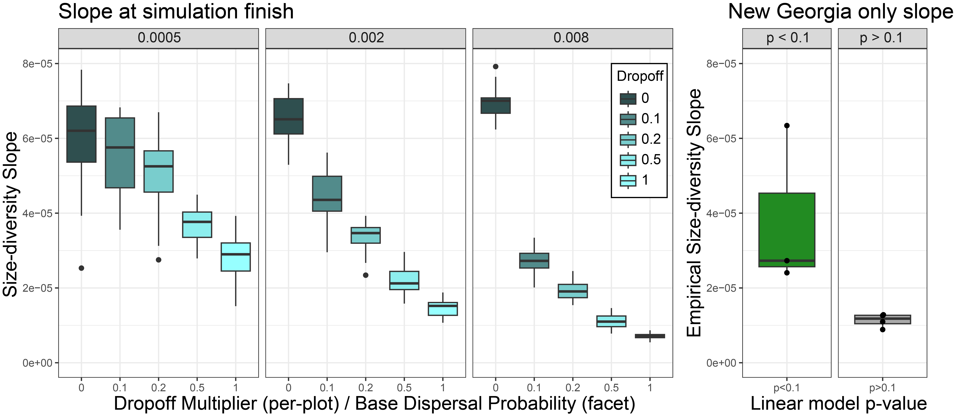
Simulation study: recent dispersal key for strength of relationship

Slide 16
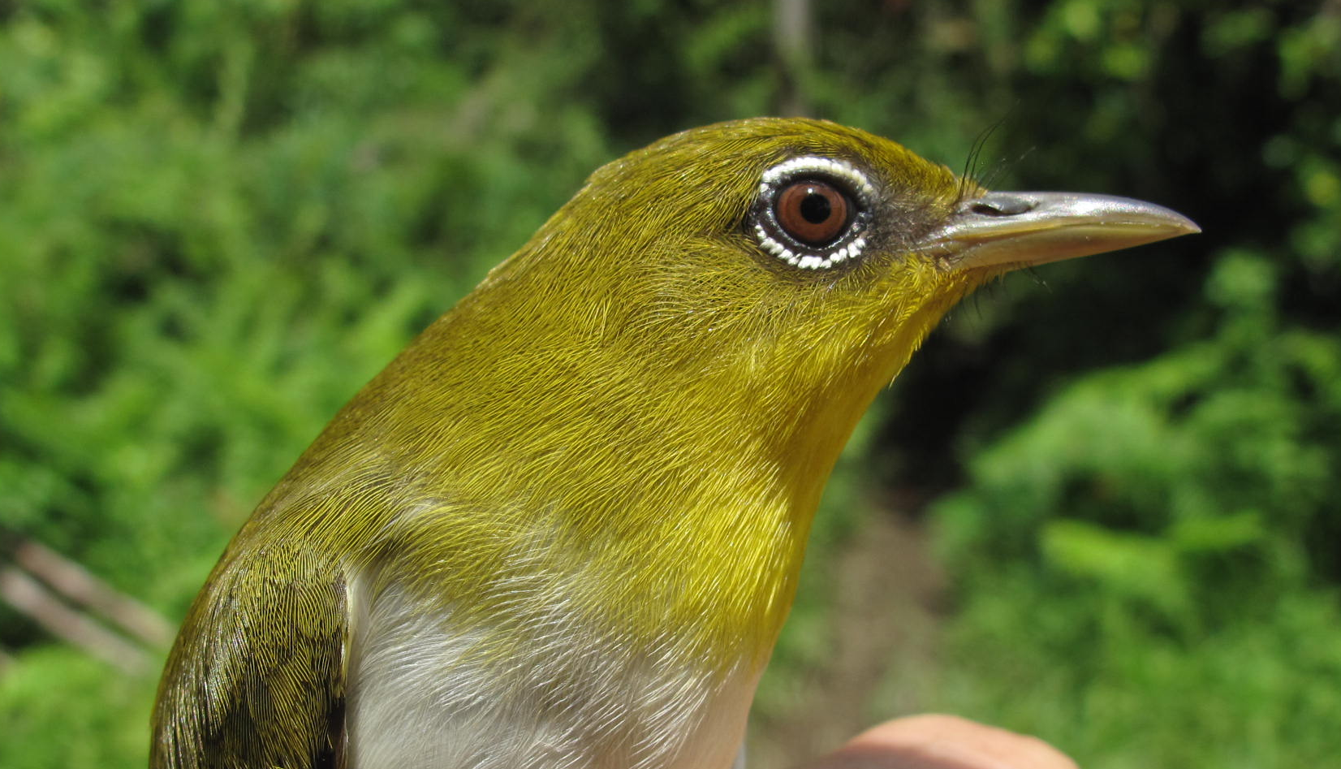
Simulation study: recent dispersal key for strength of relationship
THAT’S ME!

Slide 17

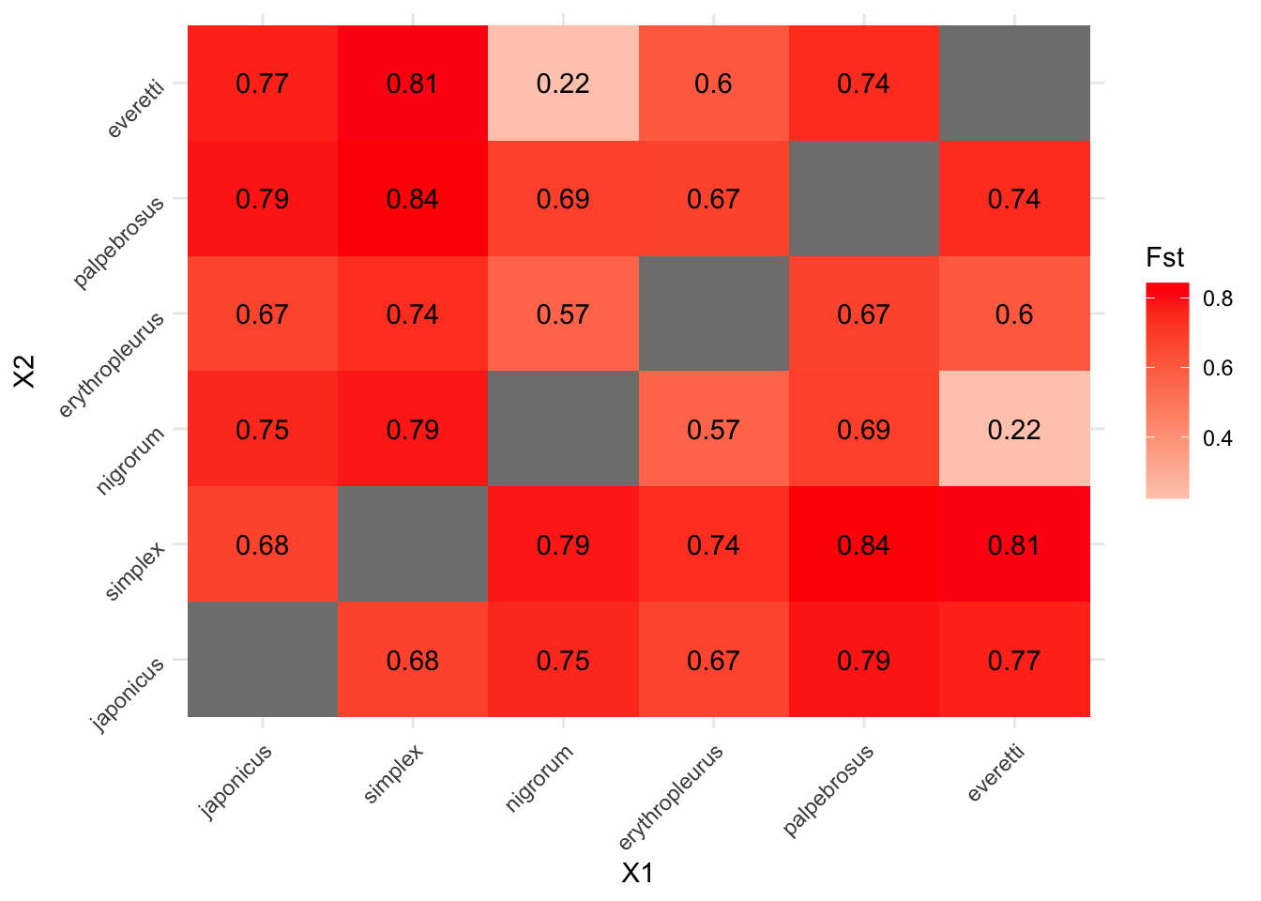
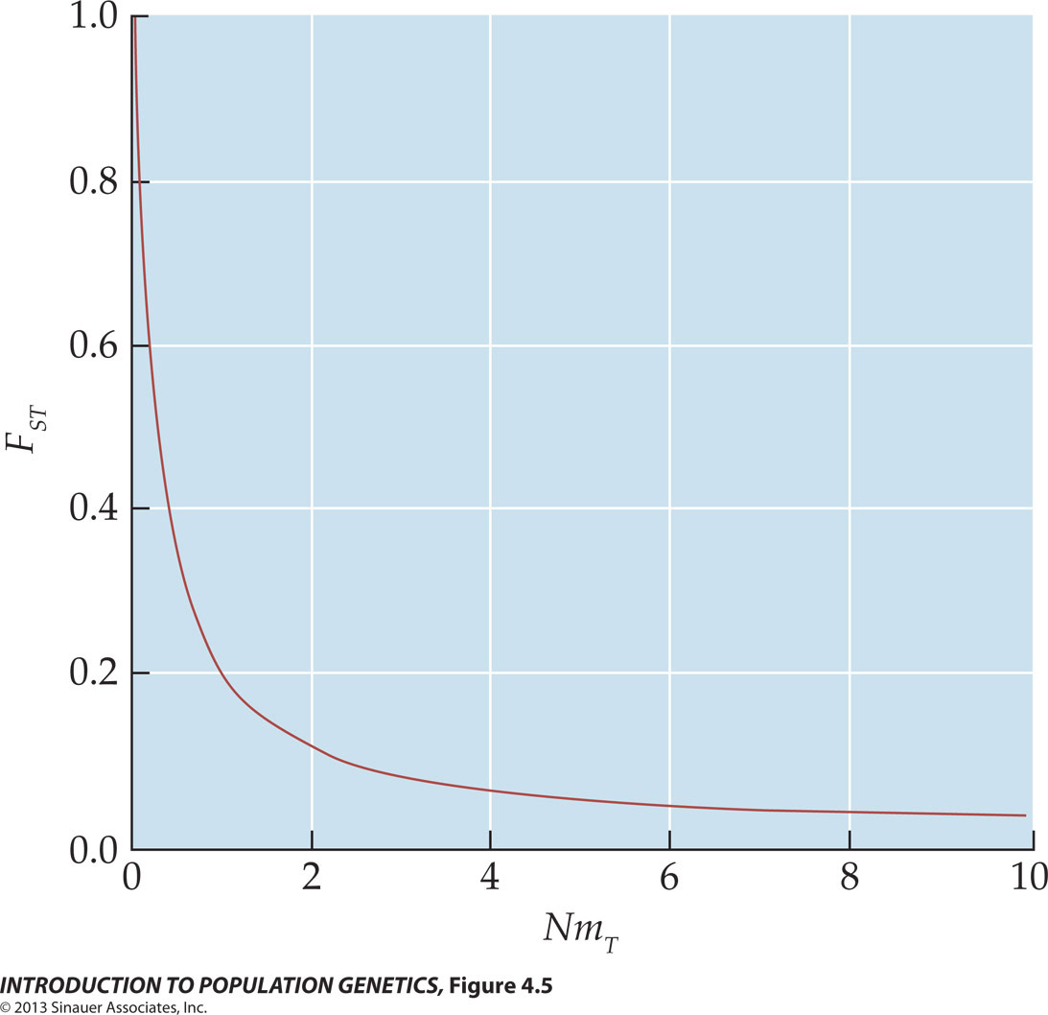
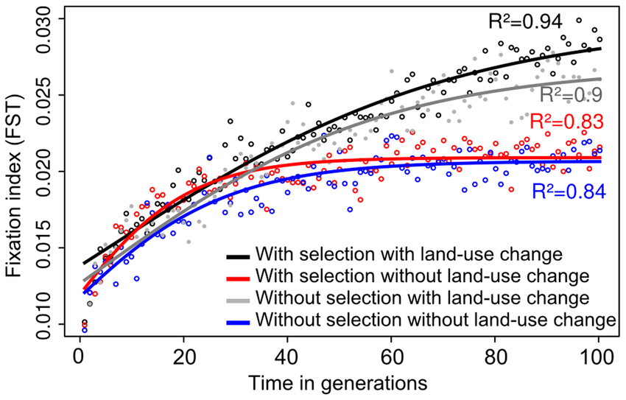
Quantifying divergence with F_{ST}
Devon DeRaad
I normally do this with VCFtools, e.g. https://github.com/ethangyllenhaal/FijiPachyRad/tree/main/04_pairwise_Fst
I wanted to try something new here that past attendees liked, loosely following this: https://devonderaad.github.io/zosterops.rad/zosterops.pairwise.fst.html
Output is a nice heatmap with values, easy to compare to expectations

Slide 18
# load packages for FST
library(vcfR)
library(adegenet)
library(StAMPP)
library(reshape)
# read in VCF
ingroup_vcf <- read.vcfR("output/pachycephala_ingroup_75_thinned.vcf")
# read in sample table
samples <- filter(read.csv("sample_table_pachycephala.csv", sep=","), # read in the CSV
Island!="Outgroup") # remove outgroup
# make genlight and set population like PCA
ingroup_genlight <- vcfR2genlight(ingroup_vcf)
ingroup_genlight@pop <- as.factor(samples$Island)
# calculate FST
pairwise_fst <- stamppFst(ingroup_genlight)
# convert to matrix, fill in both columns
fst_matrix <- pairwise_fst$Fsts
fst_matrix[upper.tri(fst_matrix)] <- t(fst_matrix)[upper.tri(fst_matrix)]
# melt to make proper heatmap input
heat_input <- reshape::melt(fst_matrix)

Slide 19
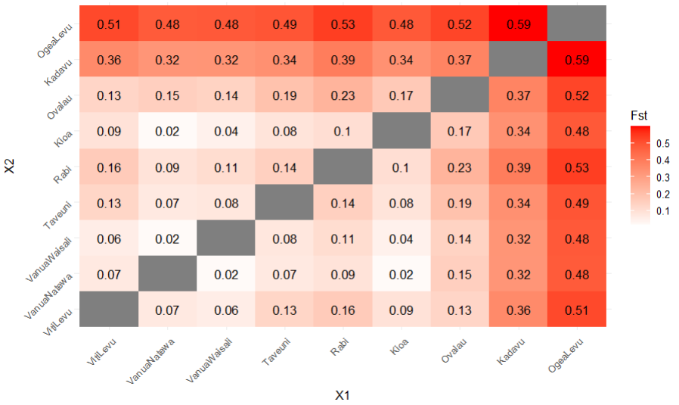
Plotting and interpreting F_{ST}
# plot with ggplot
ggplot(data = heat_input, aes(x=X1, y=X2, fill=value)) +
geom_tile() + # tile plot
geom_text(data=heat_input,aes(label=round(value, 2))) + # add values
theme_minimal() + # remove labels
scale_fill_gradient2(low = "white", high = "red", space = "Lab", name="Fst") +
theme(axis.text.x = element_text(angle = 45, hjust = 1), # axis labels
axis.text.y = element_text(angle = 45, hjust = 1))
F_{ST} is very powerful, but several caveats
Takes longer to increase in larger, more diverse populations
Can help you determine an UPPER BOUND on number of effective migrants

Slide 20
Likely <<0.5
mig/gen
to Kadavu
Ovalau
admixed
with ghost
Rabi relatively
small
Viti Levu
founder
effect

