Slide 1
Population Structure
USP RADseq Workshop
July 2026

Slide 2
Report document
We will be doing a series of analyses on your dataset, so let’s keep track of everything
You can treat this however you would like as we go, but if everything goes to plan everyone will do a 3-5 minute presentation on their system, so this will be a helpful place to store output
The core goals will include determining which populations are genetically distinct, and if you determine any lineages are evolutionarily distinct

Slide 3
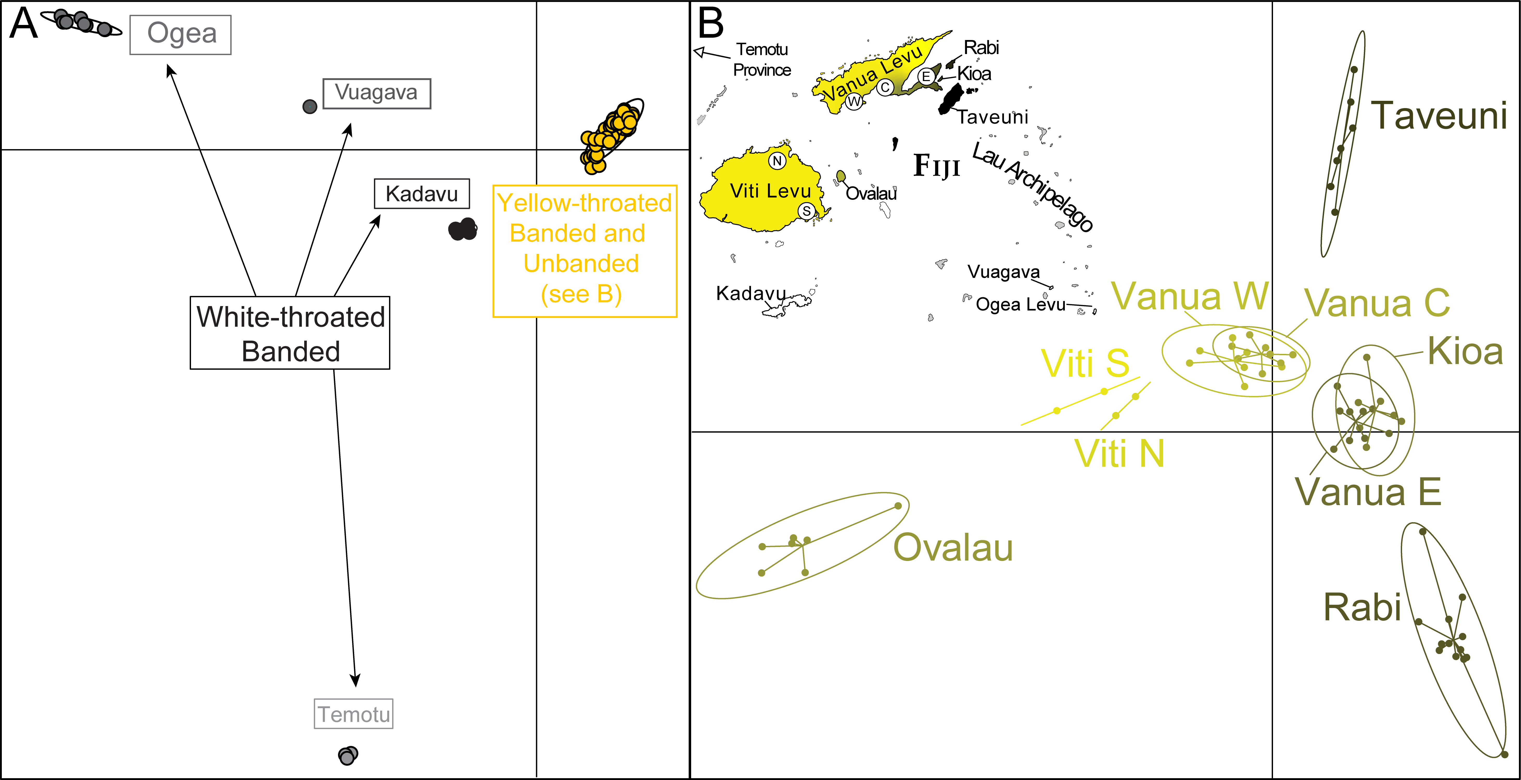
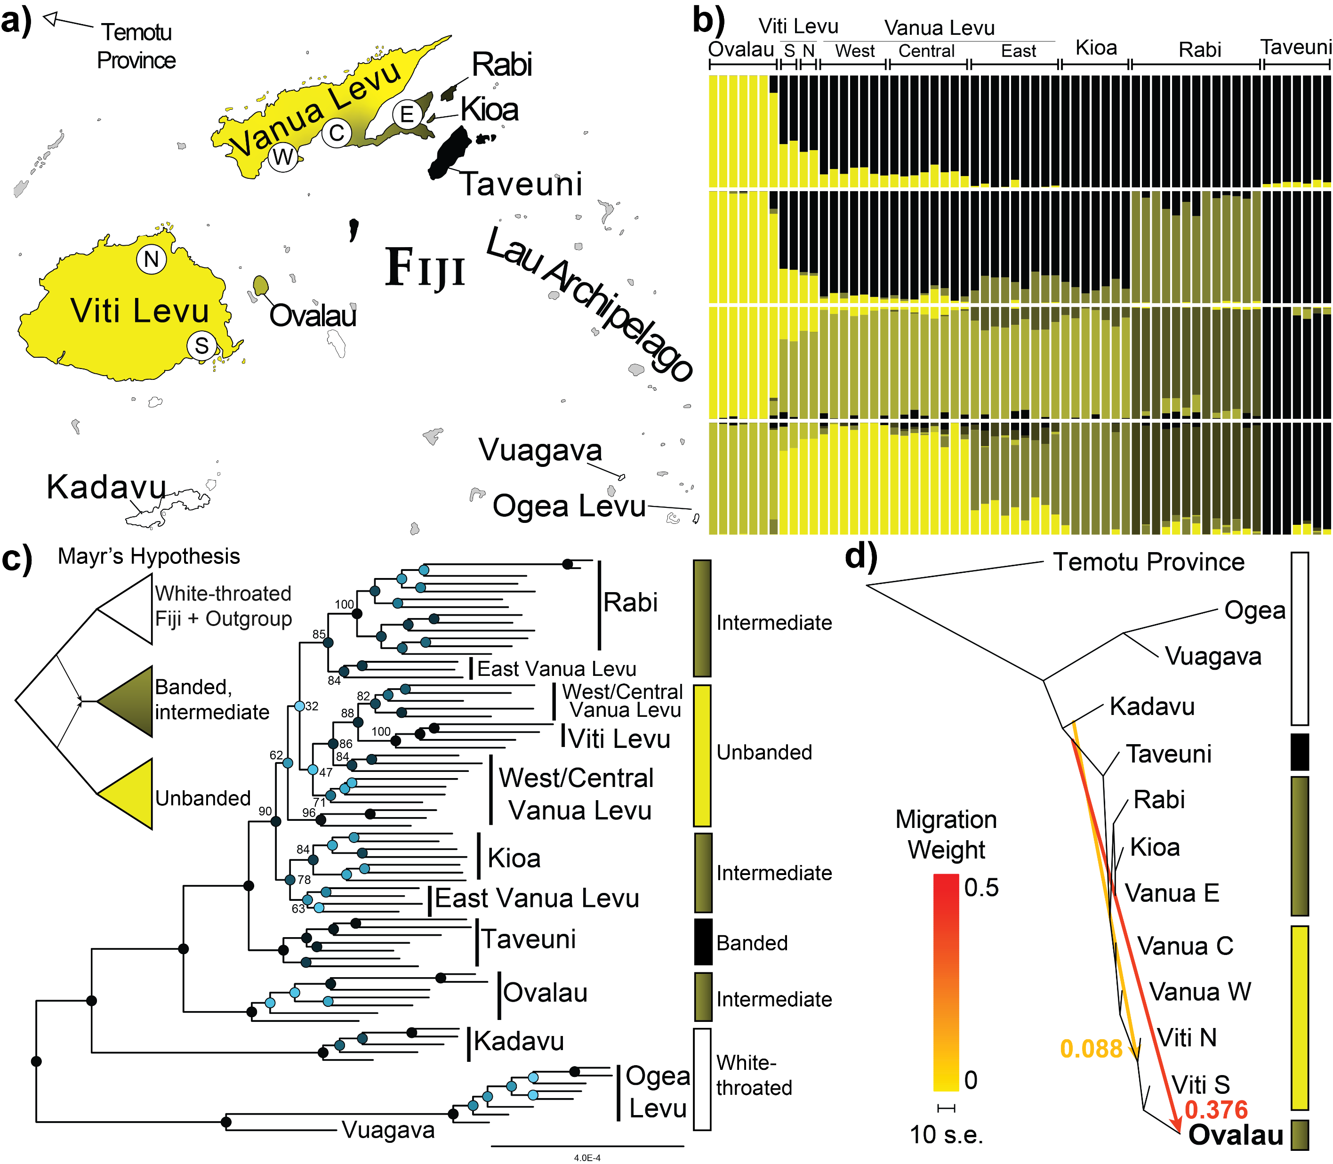
What does population structure tell us?
I view population structure as the most basic assessment of how genetic diversity is distributed across the range of a species
Shows things that phylogenetic analyses can miss

Slide 6
Genomic data and R
R is a very powerful and flexible data visualization tool
The same applies to genomic data, and it has tools for many of the core genomic analyses, we will be covering a select few
Many programs have their built-in plotters and dataframes that can be fed into the “tidyverse”, a VERY powerful suite of packages
Many steps start with vcfR, a program that reads VCFs into an R-friendly format

Slide 7
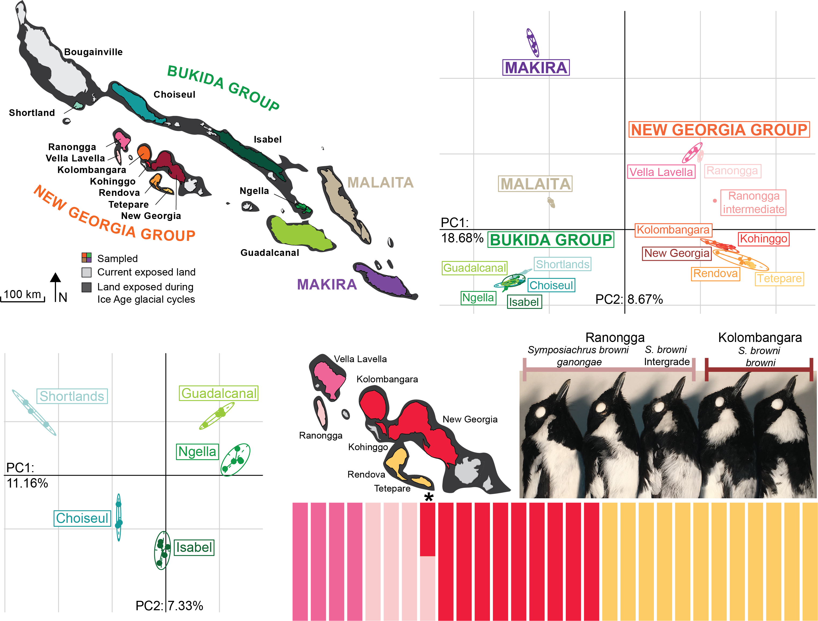
Genomic PCAs
To me, the most fundamental figure in descriptive analyses with population genomic data, with PC loadings quantitative
Highlights how populations group together, can suggest hybrids
Often reflects phylogeny but finer scale

Slide 8
Genomic PCA sensitivity
Sample size is key, high sampling of weak structure can “pull out” more strongly than low sampling of high structure
If you include everything together, strong divergence can mask fine-scale structure
Small populations can pull out dramatically due to drift, even if they are very recently diverged

Slide 9
Loading your libraries
We need several libraries
adegenet
ade4
vcfR
parallel
tidyverse
viridis
# install relevant packages
install.packages(c("adegenet", "ade4", "vcfR",
"parallel", "viridis", "tidyverse"))
# load packages
library("adegenet")
library("ade4")
library("vcfR")
library("parallel")
library("tidyverse")
library("viridis")

Slide 10
Running the PCA
Several small steps, mostly file conversion
I recommend copying the code from the GitHub (also right), then we will walk through it
Set your working directory to something with your sample table
# set working directory
setwd('C:/Documents/PostDoc/Workshop_working_directory')
# read the VCF in as a vcfR object
ingroup_vcf <- read.vcfR("output/ NAME _ingroup_75_thinned.vcf")
# convert the VCF to a genlight file
ingroup_genlight <- vcfR2genlight(ingroup_vcf)
# assign populations to the genlight based population table
pop(ingroup_genlight) <- filter(read.csv("sample_table_NAME.csv"),
Island!="Outgroup")$Island
# run the PCA using 2 cores of your PC, and keep 4 PCs
ingroup_pca <- glPca(ingroup_genlight, n.cores=2, nf=4)

Slide 11
Plotting the PCA
# make a plot using the s.class program
s.class(ingroup_pca$scores[,c(1,2)],
pop(ingroup_genlight), col=magma(10, begin=.8, end=0),
clab=1, cstar=1, cell=2.5)
# Let's try it again with PC 3 and 4, then 1 and 3
s.class(ingroup_pca$scores[,c(3,4)],
pop(ingroup_genlight), col=magma(10, begin=.8, end=0),
clab=1, cstar=1, cell=2.5)
s.class(ingroup_pca$scores[,c(1,3)],
pop(ingroup_genlight), col=magma(10, begin=.8, end=0),
clab=1, cstar=1, cell=2.5)
# barplot of the eigenvalues to tell you the percent of variance each PC explains
barplot(ingroup_pca$eig/sum(ingroup_pca$eig),
main="Variance explained per PC",
col=heat.colors(length(ingroup_pca$eig)))
Many ways to do it, this one is simple and effective
We should also get the loadings of PC1 and 2, and look at PCs beyond 2 for hidden structure
PCA bar plot helpful for finding additional PCs to examine
Fundamental: highlight geographically informative variation

Slide 12
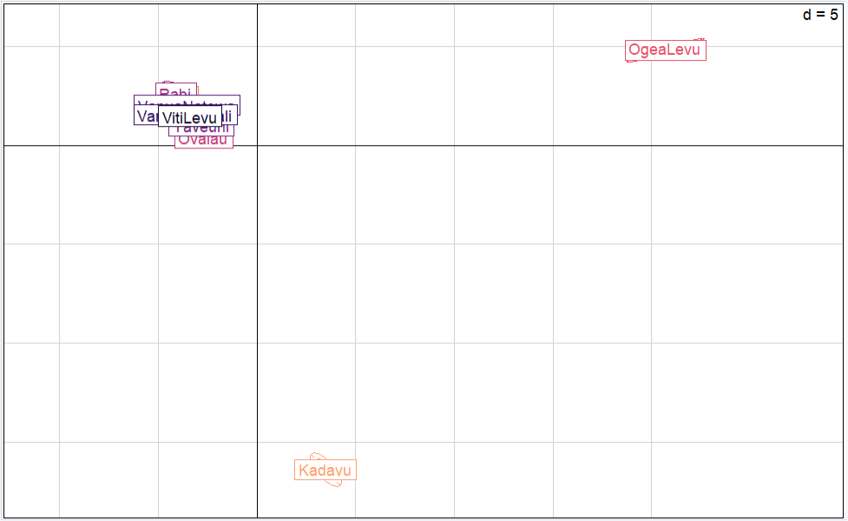
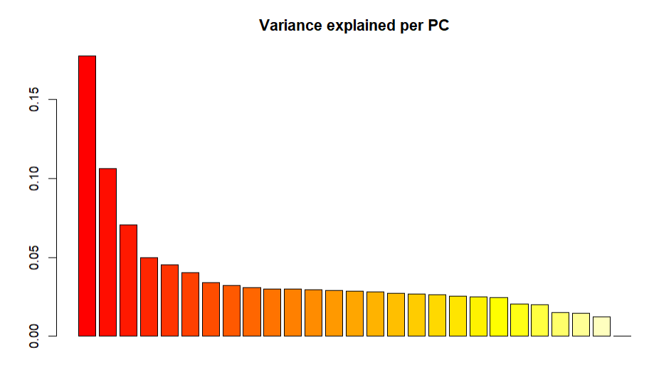
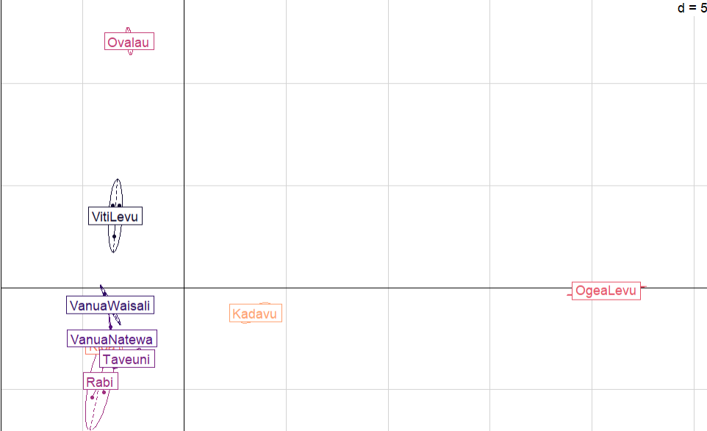
Plotting the PCA
# make a plot using the s.class program
s.class(ingroup_pca$scores[,c(1,2)],
pop(ingroup_genlight), col=magma(10, begin=.8, end=0),
clab=1, cstar=1, cell=2.5)
# Let's try it again with PC 3 and 4, then 1 and 3
s.class(ingroup_pca$scores[,c(3,4)],
pop(ingroup_genlight), col=magma(10, begin=.8, end=0),
clab=1, cstar=1, cell=2.5)
s.class(ingroup_pca$scores[,c(1,3)],
pop(ingroup_genlight), col=magma(10, begin=.8, end=0),
clab=1, cstar=1, cell=2.5)
# barplot of the eigenvalues to tell you the percent of variance each PC explains
barplot(ingroup_pca$eig/sum(ingroup_pca$eig),
main="Variance explained per PC",
col=heat.colors(length(ingroup_pca$eig)))

Slide 13
ADMIXTURE-style analyses
Structure is perhaps most well known
In my opinion, much less useful than alternatives, sample size biases even stronger than PCAs, and “hallucinates” hybrids for low sample size groups

Slide 14
sNMF
# install LEA
if (!require("BiocManager", quietly = TRUE))
install.packages("BiocManager")
BiocManager::install("LEA")
# Load in additional tools for sNMF
source("http://membres-timc.imag.fr/Olivier.Francois/Conversion.R")
source("http://membres-timc.imag.fr/Olivier.Francois/POPSutilities.R")
# Load main library, LEA, and a color scheme
library(LEA)
library(RColorBrewer)
# set working directory
setwd('C:/Documents/PostDoc/Workshop_working_directory')
# vcf2geno function from LEA make a geno file in a specified directory
vcf2geno("output/NAME_ingroup_75_thinned.vcf", # input path
output = "output/ NAME _ingroup_75_thinned.geno") # output path
# run sNMF for 1-7 pops, 20 reps per pop, modest admixture punish (alpha)
ingroup_snmf = snmf("output/pachycephala_ingroup_75_thinned.geno", ploidy=2,
K = 1:7, alpha = 100, project = "new", entropy = T, repetitions = 20)
# plot to decide optimal K, helpful but not absolute
plot(ingroup_snmf, cex = 1.2, col = "lightblue", pch = 19)
sNMF is fast, resource light, and relatively robust to violations
Uses the LEA package
Assigns populations and has way of testing fit of different pop numbers

Slide 15
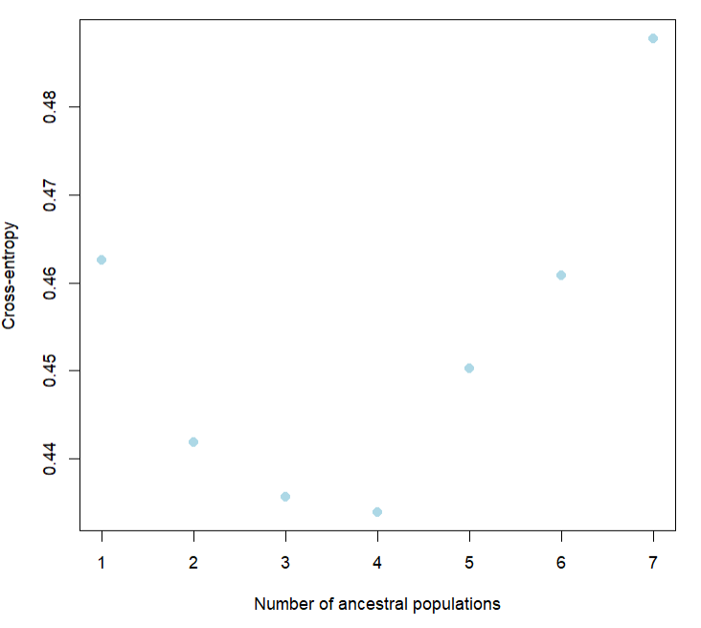
sNMF
# install LEA
if (!require("BiocManager", quietly = TRUE))
install.packages("BiocManager")
BiocManager::install("LEA")
# Load in additional tools for sNMF
source("http://membres-timc.imag.fr/Olivier.Francois/Conversion.R")
source("http://membres-timc.imag.fr/Olivier.Francois/POPSutilities.R")
# Load main library, LEA, and a color scheme
library(LEA)
library(RColorBrewer)
# set working directory
setwd('C:/Documents/PostDoc/Workshop_working_directory')
# vcf2geno function from LEA make a geno file in a specified directory
vcf2geno("output/NAME_ingroup_75_thinned.vcf", # input path
output = "output/ NAME _ingroup_75_thinned.geno") # output path
# run sNMF for 1-7 pops, 20 reps per pop, modest admixture punish (alpha)
ingroup_snmf = snmf("output/pachycephala_ingroup_75_thinned.geno", ploidy=2,
K = 1:7, alpha = 100, project = "new", entropy = T, repetitions = 20)
# plot to decide optimal K, helpful but not absolute
plot(ingroup_snmf, cex = 1.2, col = "lightblue", pch = 19)
sNMF is fast, resource light, and relatively robust to violations
Uses the LEA package
Assigns populations and has way of testing fit of different pop numbers

Slide 16
Plotting sNMF
# make a color palette
BlackYellow <- colorRampPalette(c("yellow", "black"))
# make function for plotting admixture output
plot_sNMF <- function(input, k_val, colors = BlackYellow(k_val+1)){
# picks best run best on cross entropy
best_run <- which.min(cross.entropy(input, K = k_val))
# makes q matrix of ancestry coeffs
q_matrix <- Q(input, K = k_val, run = best_run)
# plots the output, space makes blank between indivs
barplot(t(q_matrix), col = colors, border = NA, space = 0.25, xlab = "Individuals", ylab = "Admixture coefficients", horiz=FALSE)
}
# plotting parameters, note the number in mfrow should be your k
par(mfrow=c(7,1), mar=c(0,2,0,0), oma=c(1,2,1,0))
# plot sNMF for each K
plot_sNMF(ingroup_snmf, 1)
plot_sNMF(ingroup_snmf, 2)
plot_sNMF(ingroup_snmf, 3)
plot_sNMF(ingroup_snmf, 4)
plot_sNMF(ingroup_snmf, 5)
plot_sNMF(ingroup_snmf, 6)
plot_sNMF(ingroup_snmf, 7)
Need to make a plotting function
You can use a range of color palettes, I like using a gradient
Then you plot a range of K values to explore

Slide 17
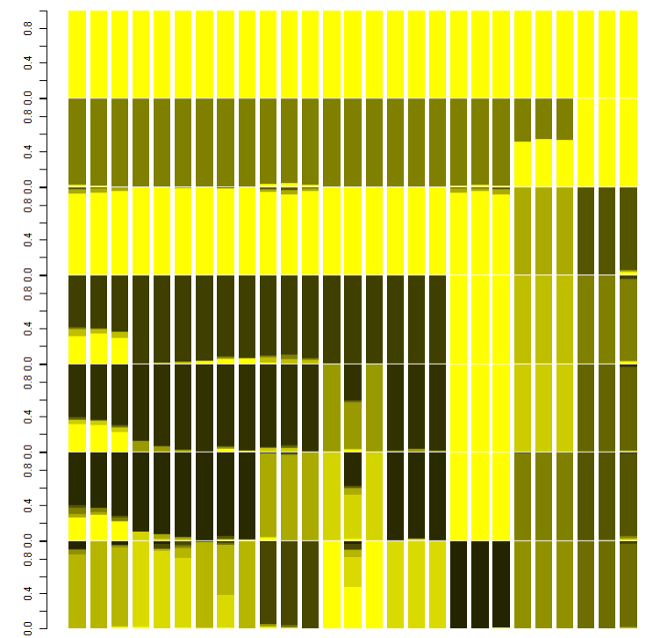
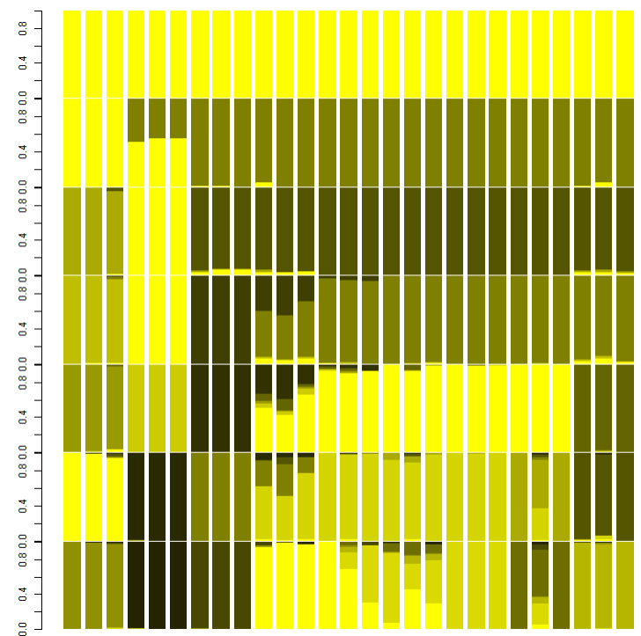
Interpreting sNMF

Slide 18
sNMF issue: ordering
You don’t need to do this, but for reference, to change the order follow these steps
Make sure bcftools is installed (it should be in your env)
Compress vcf: bgzip in.vcf
Index vcf: tabix in.vcf.gz
Order vcf: bcftools view -S sorted_list in.vcf.gz > out.vcf
Decompress vcf: gunzip in.vcf.gz

