Slide 1

Auditory Training

Slide 2
Auditory training
Auditory training (AT) is a process of teaching the child with HL to take full advantage of available auditory cues.
AT uses everyday activities to foster the development of listening skills.
Listening is a learned behavior and can be improved with practice!
The better a child’s parents/care providers understand her listening abilities, the more natural and spontaneous activities can become.
Notes:
Auditory training is most often used with children who are pre- and perilingually deaf.

Slide 3
Auditory training cont.
Utilizes residual hearing
Emphasizing that the primary goal is training the mind to be aware of, attend to, and use sound.
To help integrate listening into one’s development of communication and social skills
Key component of AR for CI recipients, those with prelingual HL, and those with severe to profound losses

Slide 4
Learning to Listen
A child must learn to listen using their amplification devices (hearing aids, cochlear implants).
Merely providing hearing instruments does not mean the sounds will automatically be perceived or interpreted by the child.
By learning to detect and interpret the sounds, the child's capacity for spoken language is maximized.

Slide 5
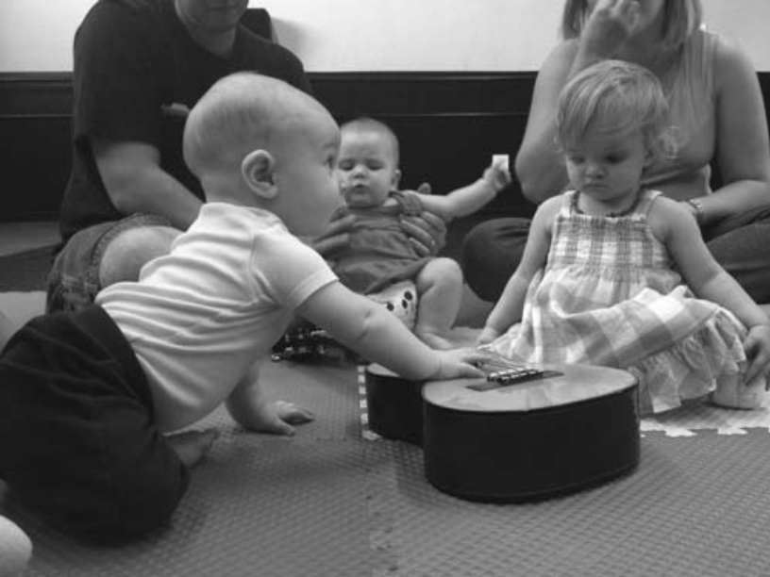
Early-intervention program
Ideally begins as soon as the permanent hearing loss is confirmed.
Families may receive a list of all of the available programs in the geographic area and/or be referred to a nation-wide early-intervention system
Types of Programs
  Center-Based Program: children attend weekly therapy for a set number of hours
  Home-Based Program: early-intervention specialist visits the infant’s home and provides instruction to the parents and child

Slide 6
Assessment of Auditory skills
Determine if training is warranted
Provide a basis for post-therapy assessment
Identify specific areas of auditory training to concentrate on.

Slide 7
Nature of testing depends on:
Age of child
His or her Language skills
Type and degree of hearing loss

Slide 8
Assessing young children
Both amount and difficulty of testing appropriate for young children are limited by their physical and cognitive development
Informal testing and observations are relied on heavily for this age group
Initial goal for auditory training of infant may not center on speech perception. Rather the focus is on if hearing is working appropriately as well as identifying if auditory skills have emerged (gross discrimination and localization of a variety of stimuli)
Parent questionnaires (ex IT-MAIS, PEACH, FAPI) help provide framework for how hearing technology is working and whether programming changes are needed

Slide 9
FAPI
Document on Moodle
The Functional Auditory Performance Indicators (FÁPI) assesses the functional auditory skills of children with hearing loss. It can be used by parents, therapists, early interventionists, and teachers. The profile lists auditory skills in an integrated hierarchical order in 7 categories.

Slide 10
Formal assessments for children:
*WIPI
*NU-CHIPS
Ling 10 Sound Test
Early Speech Perception Test (ESP)
Glendonald Auditory Screen Procedure (GASP)
Developmental Approach to Successful Listening (DASL)
*Additional word recognition assessment information available on MOODLE

Slide 11
WIPI
Word Intelligibility by Picture Identification
Includes only vocabulary appropriate for children with hearing loss
4 lists, 25 monosyllabic words each
Child provides picture pointing response in a closed set format
Suitable for use with children with hearing loss and limited receptive and expressive language abilities

Slide 12
Nu-CHIPS
Northwestern University Children’s Perception of Speech
50 monosyllabic nouns scrambled to form four individual tests
Response format requires child to point to the one picture from several options that best represent the test item
Basic vocabulary; nonverbal response format

Slide 13
Ling 10 Sounds
A behavioral listening check
The sounds indicate a child’s ability to detect all aspects of speech as they encompass the frequency range of all phonemes.
This check can be used to determine what sounds the student is able to detect, discriminate, and identify

Slide 14
Ling 10 continued
Should begin sitting next to the child, move to 3 feet then to 6 feet.
By including the absence of a sound it teaches the child to indicate when they don’t hear anything.
A child with normal hearing can hear all of these sounds at twenty feet.
Remember to present these in varying order.

Slide 15
ESP: Early speech perception test
Assess pattern and word perception using a closed-set format
Results allow for placement into 4 speech perception categories:
  No pattern perception
  Pattern perception
  Some word identification
  Consistent word identification

Slide 16
Gasp – Glendonald auditory screen procedure
Based on Erber’s model
3 subtests of speech perception:
  Phoneme detection
  Word identification
  Sentence comprehension
  Results from GASP can aid in planning auditory training because the child’s performance on the subtests is predictive of other related auditory tasks

Slide 17
DASL II: Developmental Approach to Successful Listening
Comprehensive test of auditory skills that evaluates:
Sound awareness
Phonetic listening
Auditory comprehension
Ages 3 and up
Some normative information available for children with varying degrees of hearing loss

Slide 18
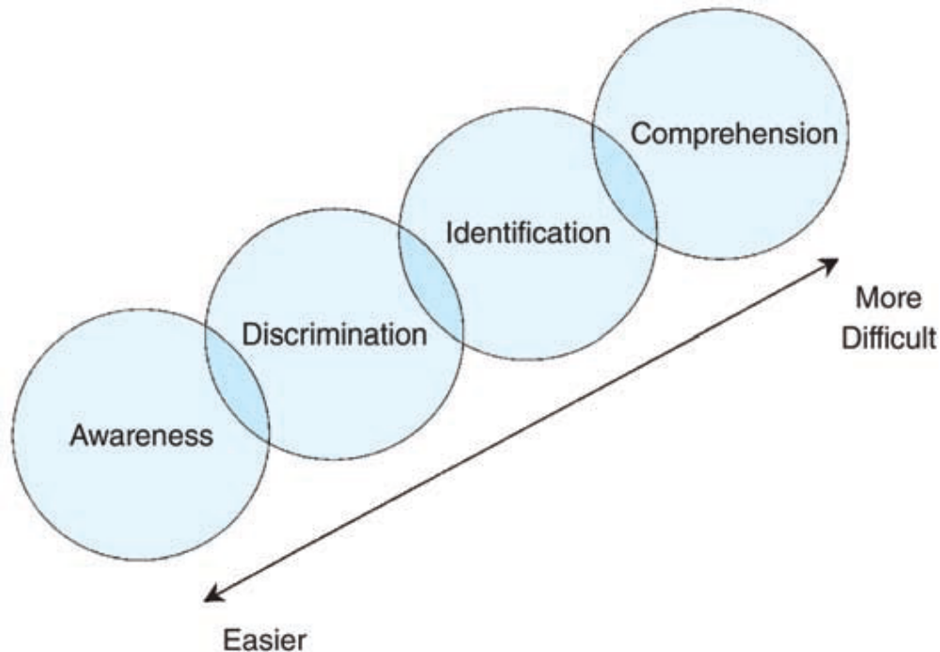
Auditory training for infants and toddlers

Slide 19

Basic Stages of Auditory Development
Hierarchy of Listening Skills/Levels of Perception Model (Erber)
Comprehension
Identification
Discrimination
Detection

Slide 20
Detection of sounds (Sound Awareness)
Ability to determine the presence or absence of sound (audition-only).
“Sound Conditioning”
Taken from: Sandie Bass-Ringdahl, University of Iowa
Notes:
indicates when an ongoing environmental sound stops (e.g., music)
indicates when a continuous speech syllable stops (e.g., sustained /ba/).
To develop sound awareness, a conditioned response is needed.
Conditioned response. Child listens and responds in a defined way each time he/she hears a sound.
To establish a conditioned response:
signal “listen”
pause and establish eye contact
cover mouth, be careful not to muffle the sound
pause (vary length to avoid over anticipation)
provide the sound
expect child to respond (may have to guide the child at first)
You may choose to use a listening hoop to avoid muffling the sound during listening activities. A listening hoop is an embroidery hoop covered with two layers of special speaker cloth.
Detection means noticing that a sound is present or absent. It does not establish that the child can distinguish sounds or understand speech. Source: Schow & Nerbonne, 8th ed., pp.118-119.

Slide 21
Detection cont.
To develop sound awareness, a conditioned response is needed.
  Conditioned response. Child listens and responds in a defined way each time he/she hears a sound.
  To establish a conditioned response:
    signal “listen”
    pause and establish eye contact
    cover mouth, be careful not to muffle the sound
    pause (vary length to avoid over anticipation)
    provide the sound
    expect child to respond (may have to guide the child at first)
    Taken from: Sandie Bass-Ringdahl, University of Iowa

Slide 22
Examples of detection Tasks
  responds to loud, low frequency environmental sound (e.g., drum)
  responds to presence of a speech syllable (e.g., /ba/)
  responds to variety of environmental sounds (e.g., whistle, horn, knock on the table)
  indicates when an ongoing environmental sound stops (e.g., music)
  indicates when a continuous speech syllable stops (e.g., sustained /ba/).

Slide 23
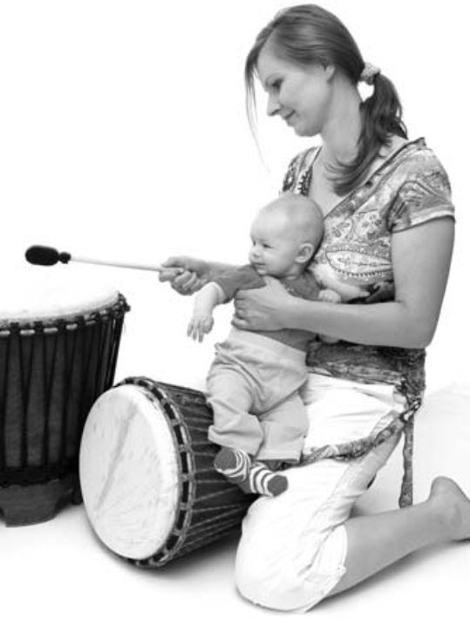
Detection/Sound awareness activities
Play peek-a-boo
Play musical chairs
March to the beat of a drum
Push the toy care whenever the clinician says “Vrrrrm”

Slide 24
Example: Detection objective
Detects strong and/or low-frequency voice 1-3 feet from CI microphone.
Attends to 3 loud toy or environmental sounds from 4-6 feet from FM microphone.
Detects 3 moderate intensity environmental sounds (e.g., baby swing music, microwave beep to indicate bottle is ready, running water for a bath).
Taken from: Parent-Infant Communication

Slide 25
Discrimination
Discrimination of sounds refers to the ability to perceive similarities and differences between two or more sounds (including speech stimuli).
Can include suprasegmental and segmental contrasts
(duration / intensity / pitch )
Taken from: Sandie Bass-Ringdahl, University of Iowa

Slide 26
Examples of discrimination tasks
  repeats the correct number of syllables heard
  discriminates between loud and soft sounds and durations.
  discriminates between repeated syllables using a fast rate versus a slow rate
  discriminates between high- and low-pitched sounds (whisper / quiet / loud speech)
  discriminates between sound continuously varying from high to low, and low to high pitch
  repeats vowel sounds

Slide 27
Discrimination activities
Play a game with toy animals (“The cow says ‘moo’; the sheep says
‘baaa’ ”)
Respond to commands (“Clap your hands”; “Jump!”)
Play a Same or Different game (“car car”; “car star”) using pairs of picture cards where the child has to point to the correct illustration
Repeat what you hear (“Mamma,” “Papa”)

Slide 28
Example: Discrimination objective
Discriminates voice from primary caregiver from other voices (e.g., smiles when mom speaks).
Discriminates angry voice from happy voice (e.g., baby cries when angry voice speaks and smiles with happy voice).
Discriminates two vocalizations (e.g., baby imitates mom’s “mm”, but does not vocalize at mom’s “babababa”).
Taken from: Parent-Infant Communication

Slide 29
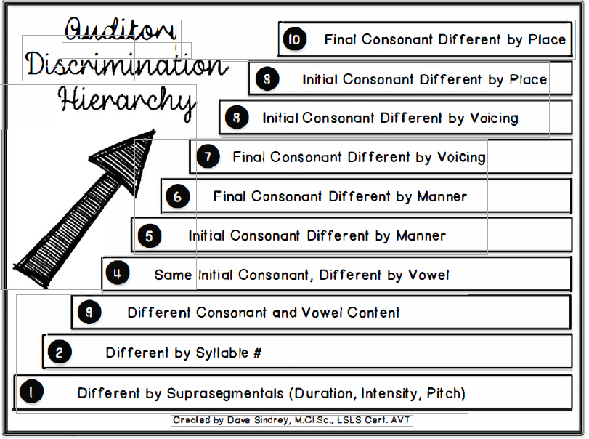
Auditory Discrimination Hierarchy

Slide 30
Identification
Ability to repeat, point to, or write the speech stimulus heard
Taken from: Sandie Bass-Ringdahl, University of Iowa
Notes:
repeating, pointing to, or writing the speech stimulus heard.
words with identical vowels and consonants differing only in manner
seat vs. cheat
words with identical vowels and consonants differing only in voicing
van vs. fan
Identification may be shown by repeating, pointing, or writing; spoken repetition is not the only response. In the slide 31 dog/fog example, /d/ and /f/ differ in place, manner, and voicing. Compare a voiced alveolar stop with a voiceless labiodental fricative. Sources: original slide 30 notes; slide 29; textbook p.116, Table 4-3.

Slide 31
Examples of Identification Tasks
  words varying in number of syllables
    hat vs. ice cream cone
  one syllable words varying in vowels and consonants.
    bat vs. fish
  stereotypic messages (familiar expressions and directions)
  words with identical consonants and different vowels
    book vs. bear
  words with identical vowels and consonants differing in place, manner, and/or voicing
    dog vs. fog

Slide 32
Example: Identification objective
Recognizes an adult-produced animal sound and associates sound with toy animal.
Identifies 3 loud instrument sounds: drum, guitar, and bells.
Recognizes 10 words that label common objects (e.g. bottle, diaper, ball).
Taken from: Parent-Infant Communication

Slide 33
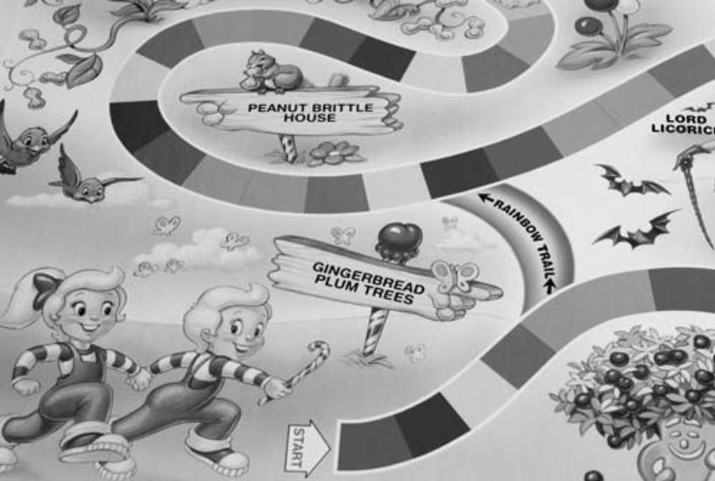
Identification
Play the game Candy Land and listen for the names of the colors
Play with sets of postcards or stickers (“Show me the cat”)
Play Go Fish with cards (“Give me your sevens”; “Give me your twos”)

Slide 34
Comprehension
Comprehension of sounds refers to the ability to understand the meaning of speech by answering questions, following directions, or participating in a conversation.
  The child’s response must be qualitatively different than the stimuli presented!
  This level requires that the person have a certain degree of syntactic and semantic language development
Taken from: Sandie Bass-Ringdahl, University of Iowa
Notes:
Auditory sequencing
familiar expressions
follow single directions
follow classroom directions
follow multi-element directions
Structured listening set
recall details of a story
understand the main idea of a lesson or complex story
Conversation
answer questions requiring comprehension of the main idea
paraphrase remarks of another
offer spontaneous relevant remarks
Comprehension requires understanding the message. Following a direction or answering a question shows something different from merely repeating the words. Sources: slides 34-36 and existing notes; textbook p.119.

Slide 35
Examples of Comprehension Tasks
  Auditory sequencing
    familiar expressions
    follow single directions
    follow classroom directions
    follow multi-element directions
  Structured listening set
    recall details of a story
    understand the main idea of a lesson or complex story
  Conversation
    answer questions requiring comprehension of the main idea
    paraphrase remarks of another
    offer spontaneous relevant remarks
Taken from: Sandie Bass-Ringdahl, University of Iowa

Slide 36
Example: Comprehension objective
Demonstrates comprehension of 2 phrases through audition alone (e.g., Do you want up?).
Comprehends increasingly complex requests (e.g., bring me your socks and shoes).
Comprehends and responds appropriately to sentences in which possessive nouns or pronouns are contrasted (e.g., Where are you eyes? vs. Where are mommy’s eyes?).
Comprehends the meaning of 3, loud environmental sounds (e.g., smoke alarm, doorbell, car horn).
Taken from: Parent-Infant Communication

Slide 37
Illustrative formal auditory training lesson plan
Title: Snake and Ice Cream Game
Goal: Discrimination
Objective: The student will discriminate a nasal consonant versus non-nasal unvoiced consonant that differs in place of production.
Materials:
  a picture of a snake to represent the /s/ sound
  a picture of a boy about to eat an ice cream sundae to represent the /m/ sound
  a stack of 26 pennies for reinforcements
Procedures:
Introduce the picture of the snake by pointing to it and saying “ssssssssss . . .” Ask the child to imitate your production. Similarly, introduce the picture of the sundae, and say “mmmmmm . . .” Ask the child to imitate your production.
Say each sound with your face visible. After each utterance, ask the child to point to the corresponding picture.
Place 13 pennies on each picture. Cover your mouth. Randomly say one sound after another. After each production, the child may pick up a penny from one of the two pictures. If the child removes a penny from the correct picture, he or she can keep it. If incorrect, the penny must be placed back on the picture.
Continue until all pennies are spent.

Slide 38
Auditory training approaches in 4 categories:
Analytic
Synthetic
Pragmatic
Eclectic

Slide 39
Analytic Auditory Approach
Break speech into smaller components
(same - different) Bottom-up approach
Vowels vs consonants

Slide 40
Analytic Therapy Objectives
Will discriminate vowels that differ in first formant information Will discriminate vowels that differ in second formant information
Will discriminate words that have vowels with similar first and second formant information
Will identify words with different vowels, using a four-item response set
Will identify words with different vowels, from an open set of vocabulary

Slide 41
synthetic
Emphasizes use of clues derived from syntax and context
Use of meaningful stimuli
(Sentence perception) Top-down approach

Slide 42
Synthetic Therapy Objectives
Will discriminate between a declarative and interrogative sentence
Will carry on a conversation
Can follow the instructions of simple commands

Slide 43
Pragmatic
Training listener to control communication variables
Level of speech
Signal-to-noise ratio (SNR)
Context or complexity of message
Table 4.8 QUEST?AR

Slide 44
Eclectic:
Combines most or all of the strategies

Slide 45
Goals of Auditory Training
There are many factors that can be manipulated to make a task easier or harder
Regardless, the goal is always to make the listening task challenging without being frustrating.
The most useful learning events are those that take place in a meaningful context for that child specifically.
Notes:
Adjust set size, stimulus length/similarity, context, structure, and listening conditions to keep practice challenging but manageable. Use the child’s baseline and specify response, cuing, and success criteria. Sources: slides 46-48; Writing Goals handout.

Slide 46
Four Design Principles
Auditory Skill
  Awareness, detection
  Discrimination
  Identification
  Comprehension
Stimuli
  Phonetic level
  Sentence level
Activity Type
  Formal
  Informal
Difficulty Level
  Response type
    Closed, limited, open
  Stimulus unit
    Words, phrases, sentences
  Stimulus similarity
  Contextual support
  Task structure
    Highly structured, spontaneous
  Listening conditions

Slide 47
3. Activity Type
Informal
  Occurs as part of the daily routine
  Often incorporated into other activities
Formal
  Highly structured
  Usually one-on-one training

Slide 48
Difficulty Level
easy hard
Stimulus set---------------
Stimulus unit-------------
Stimulus similarity------
Contextual support----
Task structure-----------
Listening conditions (SNR)
closed limited open
phoneme syllable word sentence
dissimilar similar
high low
structured spontaneous
good poor

Slide 49
Formal Auditory training programs
There are a number of formal, commercially available auditory training programs available for use.
  SPICE (Speech Perception Instructional Curriculum Evaluation)
  Learn To Talk Around The Clock
  Cottage Acquisition Scales For Listening, Language, and Speech
  Developmental Approach to Successful Listening (DASL)
  SKI-HI
Notes:
SPICE is a curriculum kit for developing speech/listening skills/processing skills in children who use either cochlear implants or hearing aids. The kit includes a manual, a set of accompanying toys and picture cards, and a demonstration video. The program provides a sequence of lesson objectives and suggests a variety of activities for each objective. The activities are designed for children ages 3 through 12 and can be adapted to a variety of language levels. Goals for the curriculum are listed in four categories: detection, supra-segmental perception, vowels and consonants, and connected speech.
This oral, early intervention program is designed for professionals who work with families of children who are deaf or hard of hearing. It focuses on language learning in the child's home environment. It provides a toolbox for professionals to maximize the caregiver's language development techniques by encouraging interactions during everyday activities. The premise is that providing opportunities for interaction in everyday life provides the groundwork for auditory and language development. The curriculum includes a toolbox and VHS cassette.
A product to help assess, select objectives, and plan instruction to document and facilitate language acquisition in children with hearing loss. It is based on many of the language development beliefs of researcher Christie Yoshinaga-Itano (Language assessment of infants and toddlers with significant hearing loss, Seminars in Hearing, 1994) It includes a set of scales (pre-verbal, pre-sentence, simple sentence, complex sentence, sounds and speech) that follow the development of language, listening, cognition, and speech. The assessment component is based on language sampling. It also provides suggestions for using the tool to promote instruction in the addressed areas.

Slide 50
DASL II
Developmental Approach to Successful Listening II​
Consists of hierarchy of listening skills worked on in brief, individualized sessions​
Main use is with preschool and school age using hearing aids/cochlear implants​
Emphasizes 3 areas of auditory skill development: Sound Awareness, Phonetic Listening and Auditory comprehension​

Slide 51
SPICE
Speech Perception Instructional Curriculum and Evaluation ​
Used for evaluating and developing auditory skills in children with severe to profound hearing loss​
Contains goals and objectives associated with 4 levels of speech perception: Detection, Suprasegmental, Vowel and Consonant Perception, and Connected Speech ​

Slide 52
SKI HI
Sensory [Kids] Impaired Home Intervention​
Comprehensive identification and home intervention curriculum for infants with hearing loss and their families​
Developmentally based auditory stimulation training program​
Used in conjunction with language-speech stimulation and consists of four phases and eleven general skills​
Table 4.10 ​

Slide 53
Cottage Acquisition Scales For Listening, Language, and Speech
Age range: Birth-8 years ​
Integrated approach to language intervention by providing a single set of instruments for following the development of language, listening, cognition and speech in children with hearing loss. ​
Skills addressed include: Sound Awareness, Phonetic Listening, Suprasegmental Speech Duration, Vowels and Consonants, Vocalization & Phonetic Level Speech, Phonological Level Speech ​

Slide 54
Auditory Training Programs
Choose the AT program that best meets the child’s and the family’s needs.
All of the programs are structured using the same basic principles—the hierarchy of listening skills- Erber’s levels of perception
Notes:
The shared listening skills are detection, discrimination, identification, and comprehension. Erber also supports integrating auditory work into conversation and daily activities rather than treating the sequence as a rigid schedule. Source: textbook p.134; slide 19.

Slide 55
Goals

Slide 56
Resources
John Tracey Clinic
Central Institute for the Deaf (creators of the SPICE curriculum)
BRIDGE Program (Med EL)
The Listening Room (Advanced Bionics)
Sound Foundations (Cochlear Americas)
AG Bell
The SKI-HI Institute

