Slide 1
Simulating Quantization, MAC Units with VSQ and Testbench
4/22 Progress Report
Presenter: I-An Hou

Slide 2
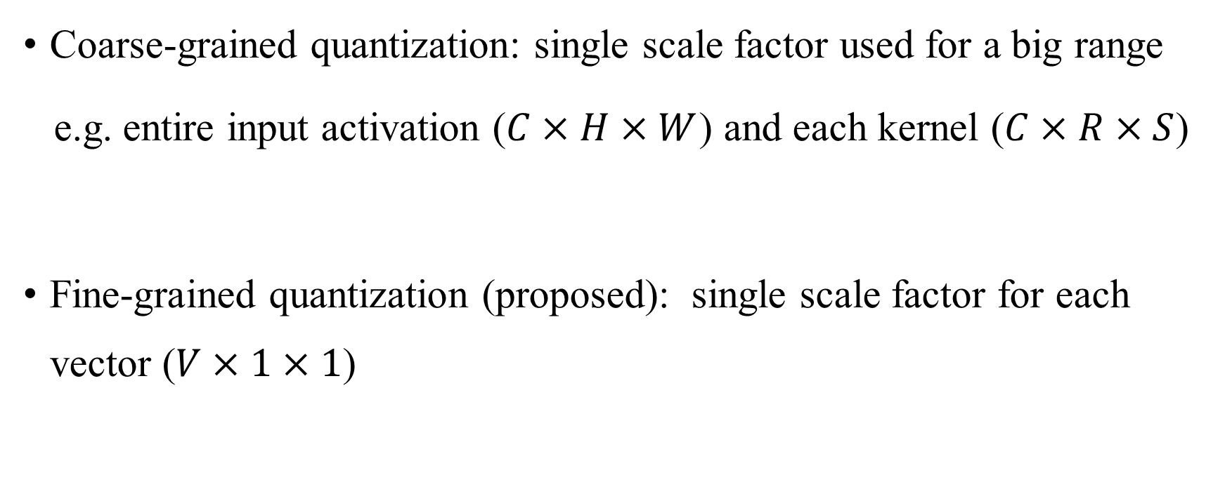
Reference
Coarse-grained quantization: single scale factor used for a big range
e.g. entire input activation ($C×H×W$) and each kernel ($C×R×S$)
Fine-grained quantization (proposed): single scale factor for each vector ($V×1×1$)

Slide 3
Reference
Pros for fined-grained quantization:
1. Smaller range to be represented, lower quantization error.
2. Synergy with hardware (a single MAC unit)

Slide 4


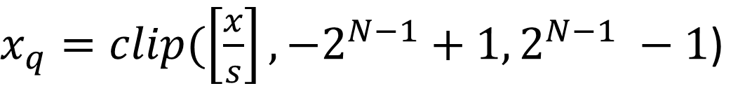
Quantization Fundamentals
Mapping data (x) to the desired range [$−2^{N−1}+1, 2^{N−1} −1$]
Assume symmetric quantization
$$s=\frac{α}{2^{N−1}−1}$$
$x_{q}=clip(\left[\frac{x}{s}\right], −2^{N−1}+1, 2^{N−1} −1$)

Slide 5

Quantization Fundamentals
To avoid vanishing gradient, the simulated quantization is used during training.
$$x_{q}^{s}=s×x_{q}$$

Slide 6
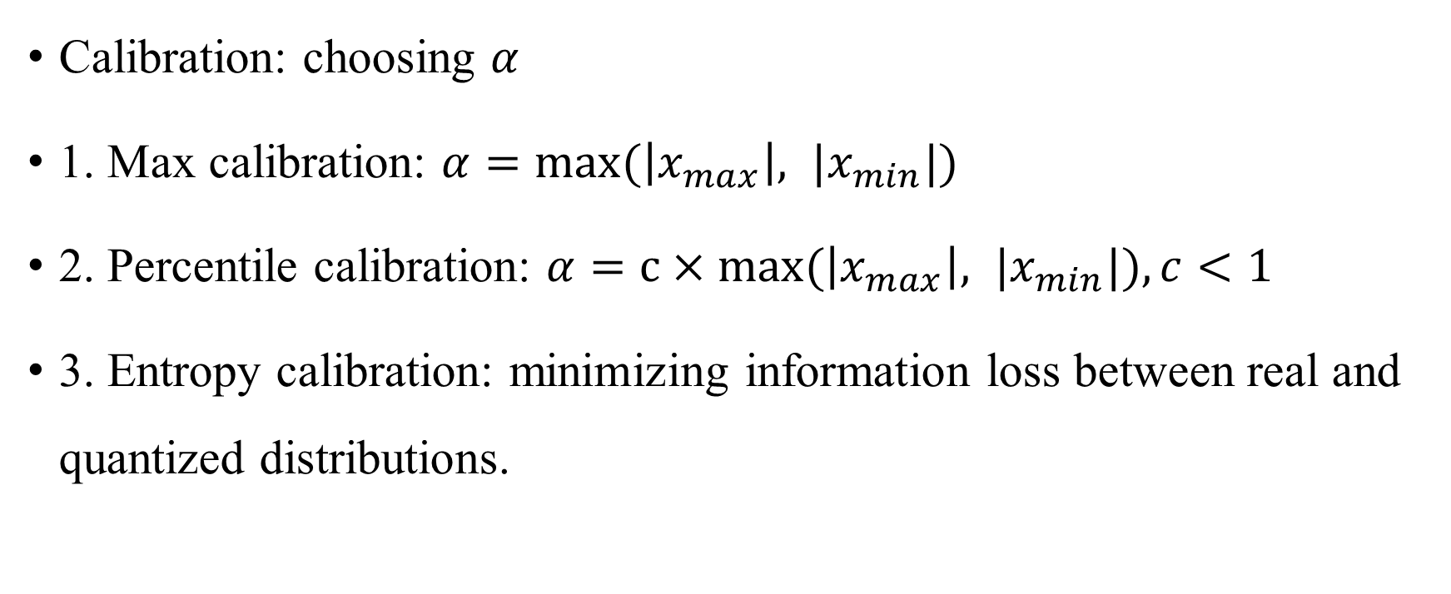
Quantization Fundamentals
Calibration: choosing $α$
1. Max calibration: $α=max⁡(\left|x_{max}\right|, {|x}_{min}|)$
2. Percentile calibration: $α=c×max⁡(\left|x_{max}\right|, {|x}_{min}|), c<1$
3. Entropy calibration: minimizing information loss between real and quantized distributions.

Slide 7


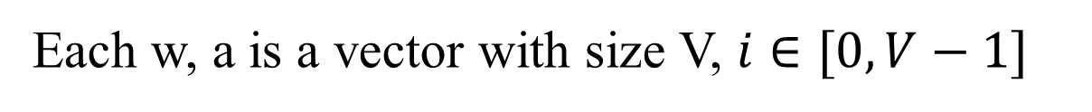
Mapping to Hardware
Normal MAC unit
$$y\left(j\right)= \sum_{i=0}^{V−1}{w\left(j\right)\left(i\right)×a(j)(i)}$$
With VS-Quant
$$y_{q}^{s}\left(j\right)= \sum_{i=0}^{V−1}{w_{q}\left(j\right)\left(i\right)×a_{q}\left(j\right)\left(i\right)}$$
$$×s_{w}\left(j\right)s_{a}(j)$$
Each w, a is a vector with size V, $i∈[0, V−1]$

Slide 8
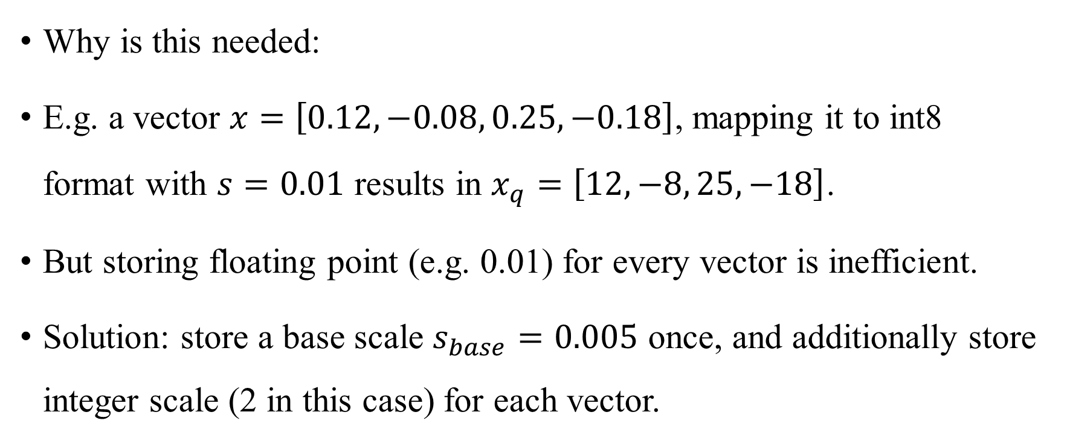
Two-level Quantization
Why is this needed:
E.g. a vector $x=\left[0.12, −0.08, 0.25, −0.18\right]$, mapping it to int8 format with $s=0.01$ results in $x_{q}=\left[12, −8, 25, −18\right]$.
But storing floating point (e.g. 0.01) for every vector is inefficient.
Solution: store a base scale $s_{base}=0.005$ once, and additionally store integer scale (2 in this case) for each vector.

Slide 9


Two-level Quantization
Solution: store a base scale $γ$ once, and additionally store integer scale $s_{q}$for each vector.
$$x_{q}^{s}=s_{q}×γ×x_{q}$$

Slide 10
Two-level Quantization
Solution: store a base scale $γ$ once, and additionally store integer scale $s_{q}$for each vector.
Integer per-vector scale factor
$$x_{q}^{s}=s_{q}×γ×x_{q}$$
Floating-point coarse-grained scale factor

Slide 11

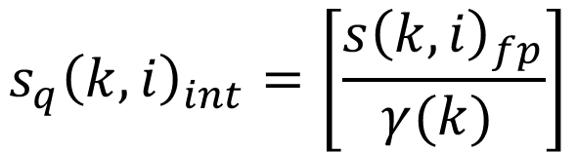

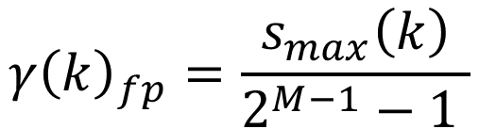

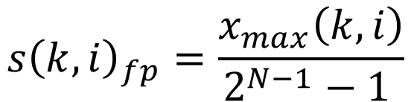
Two-level Quantization
Obtaining $s_{q}$and$γ$:
$$x_{max}{\left(k, i\right)}_{fp}=max⁡|x(k, j, i)|$$
$$s_{max}{\left(k\right)}_{fp}=max⁡(s{\left(k, i\right)}_{fp})$$
$$s{\left(k, i\right)}_{fp}=\frac{x_{max}\left(k, i\right)}{2^{N−1}−1 }$$
$$γ{\left(k\right)}_{fp}=\frac{s_{max}\left(k\right)}{2^{M−1}−1 }$$
$$s_{q}{\left(k, i\right)}_{int}=\left[\frac{s{\left(k, i\right)}_{fp}}{γ(k) }\right]$$

Slide 12
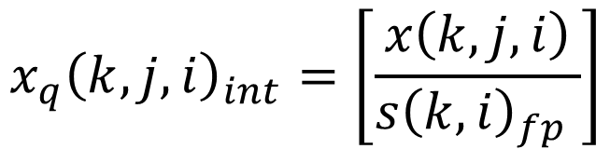

Two-level Quantization
Obtaining $x_{q}^{s}$:
$$x_{q}{\left(k, j, i\right)}_{int}=\left[\frac{x\left(k, j, i\right)}{s{\left(k, i\right)}_{fp} }\right]$$
$x_{q}^{s}{\left(k, j, i\right)}_{fp}=$ $x_{q}{\left(k, j, i\right)}_{int}{×s}_{q}{\left(k, i\right)}_{int}×γ(k)$

Slide 13
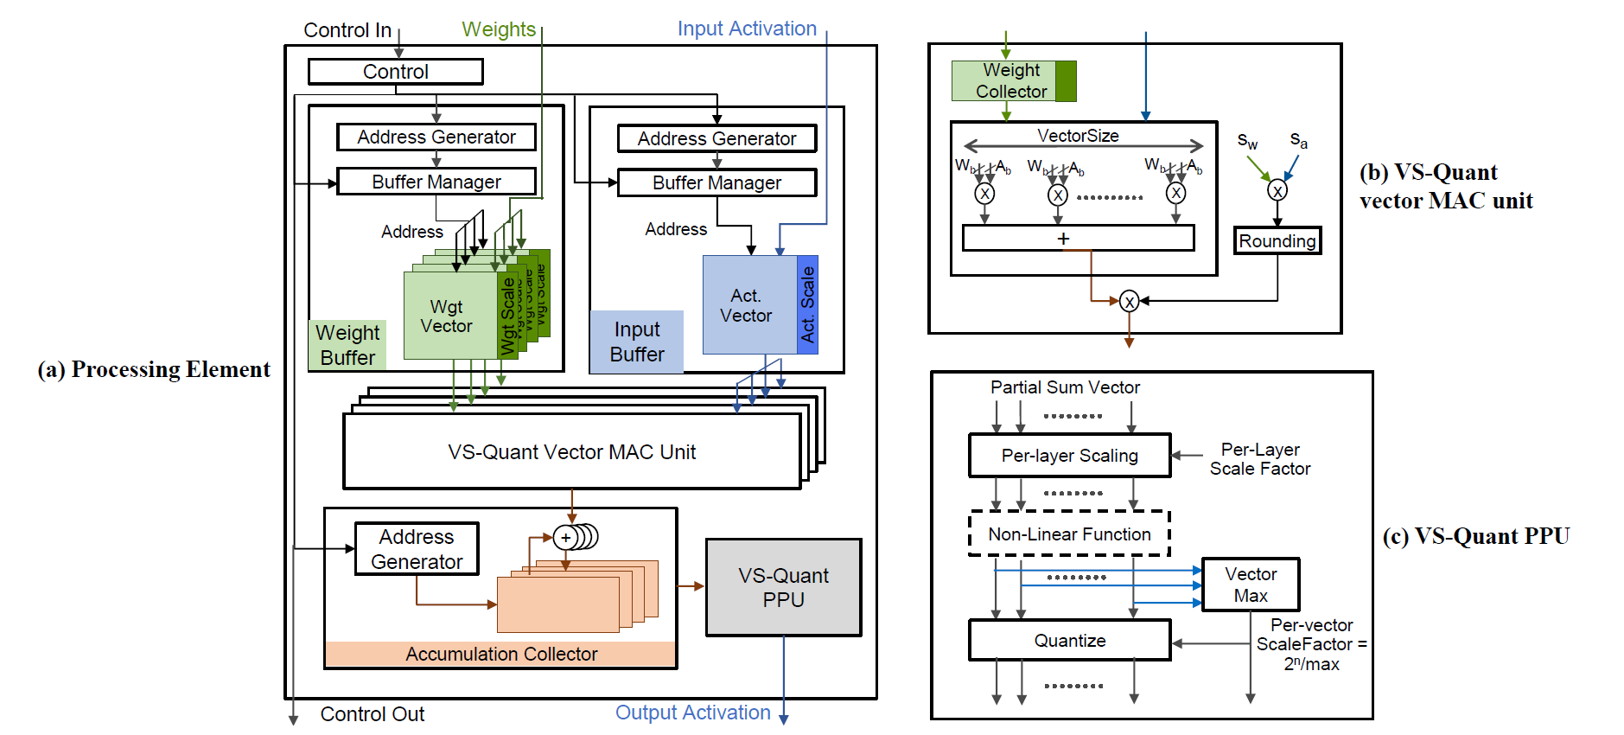
Hardware Design

Slide 14


Hardware Design
$$x_{q}{\left(k, j, i\right)}_{int}{×s}_{q}{\left(k, i\right)}_{int}×γ(k)$$
$$x_{q}{\left(k, j, i\right)}_{int}{×s}_{q}{\left(k, i\right)}_{int}$$

Slide 15
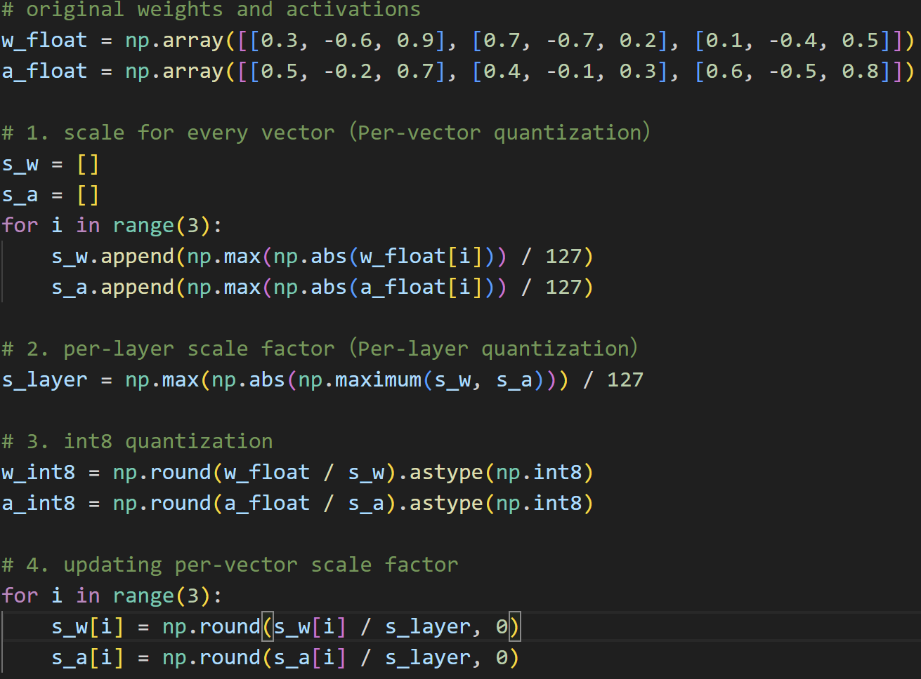
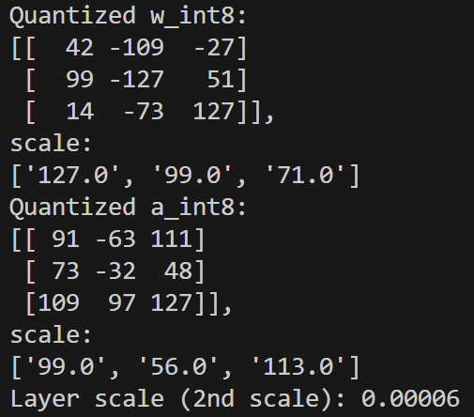
Python Code

Slide 16
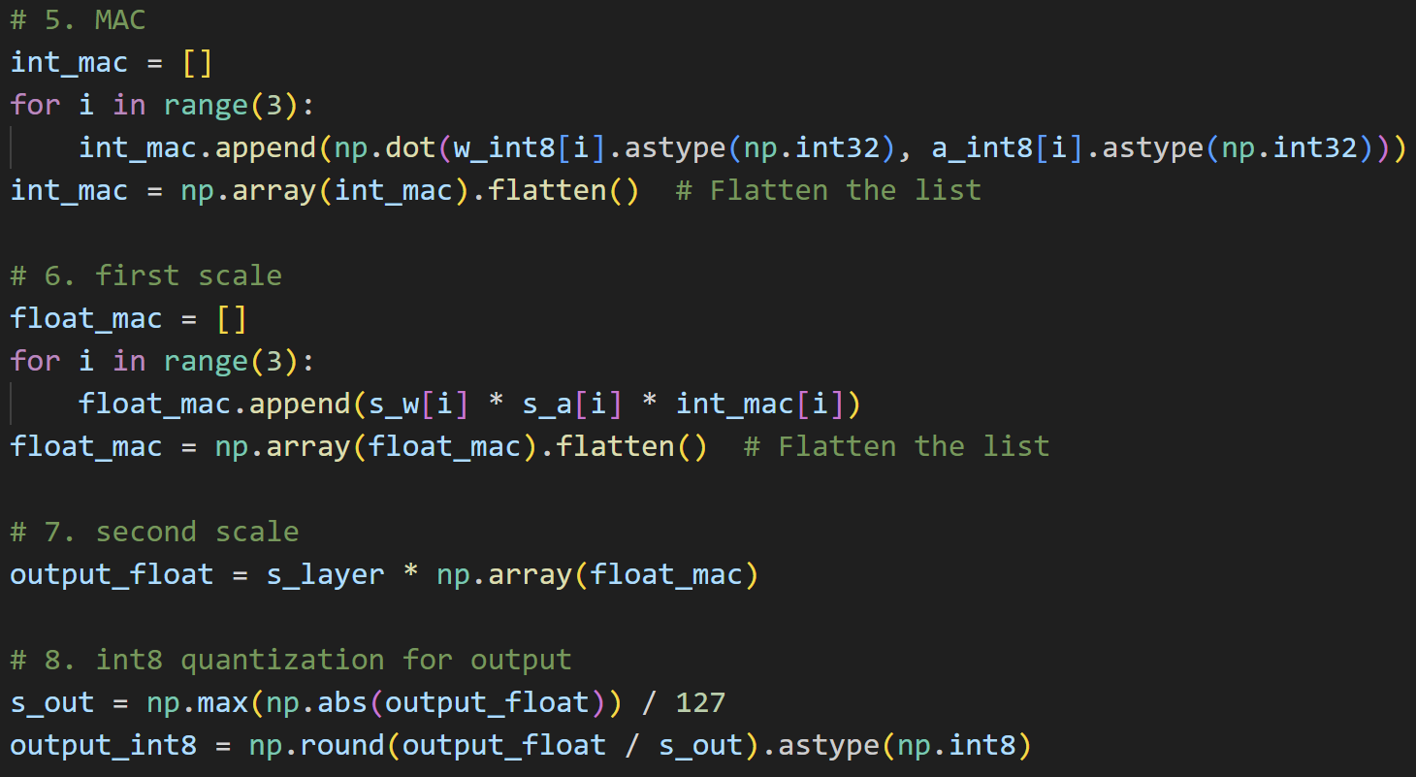
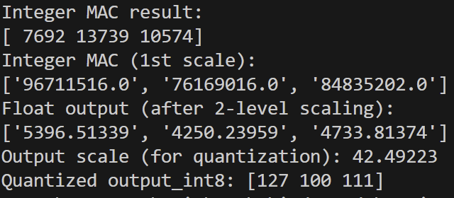
Python Code

Slide 17
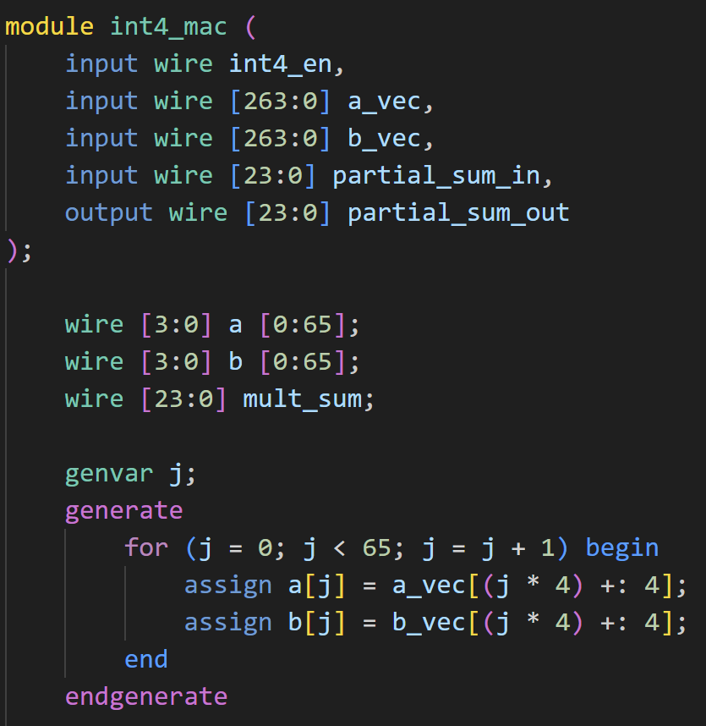
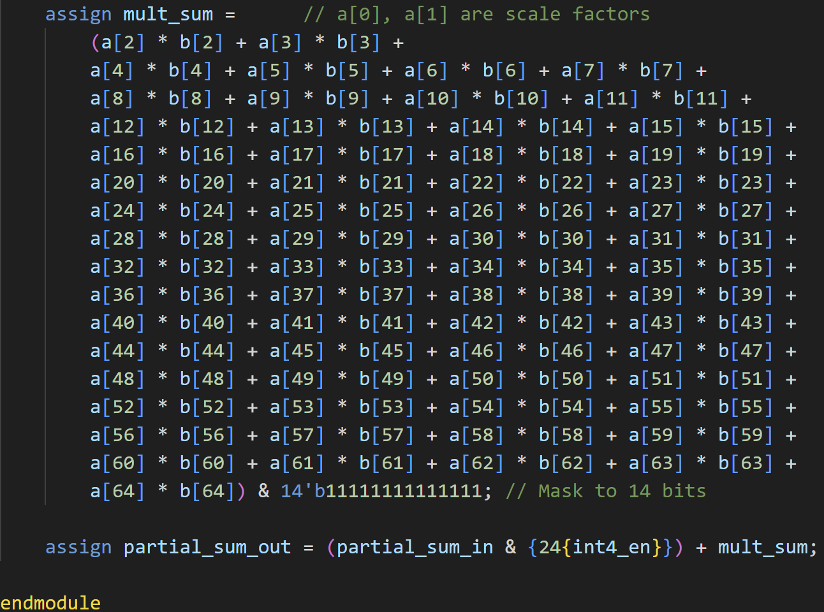
Verilog Code for Int4 MAC

Slide 18
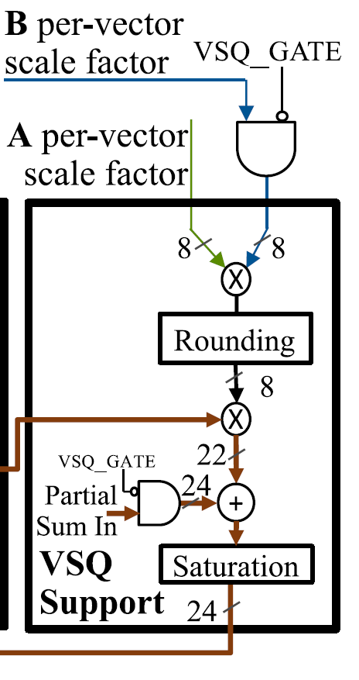
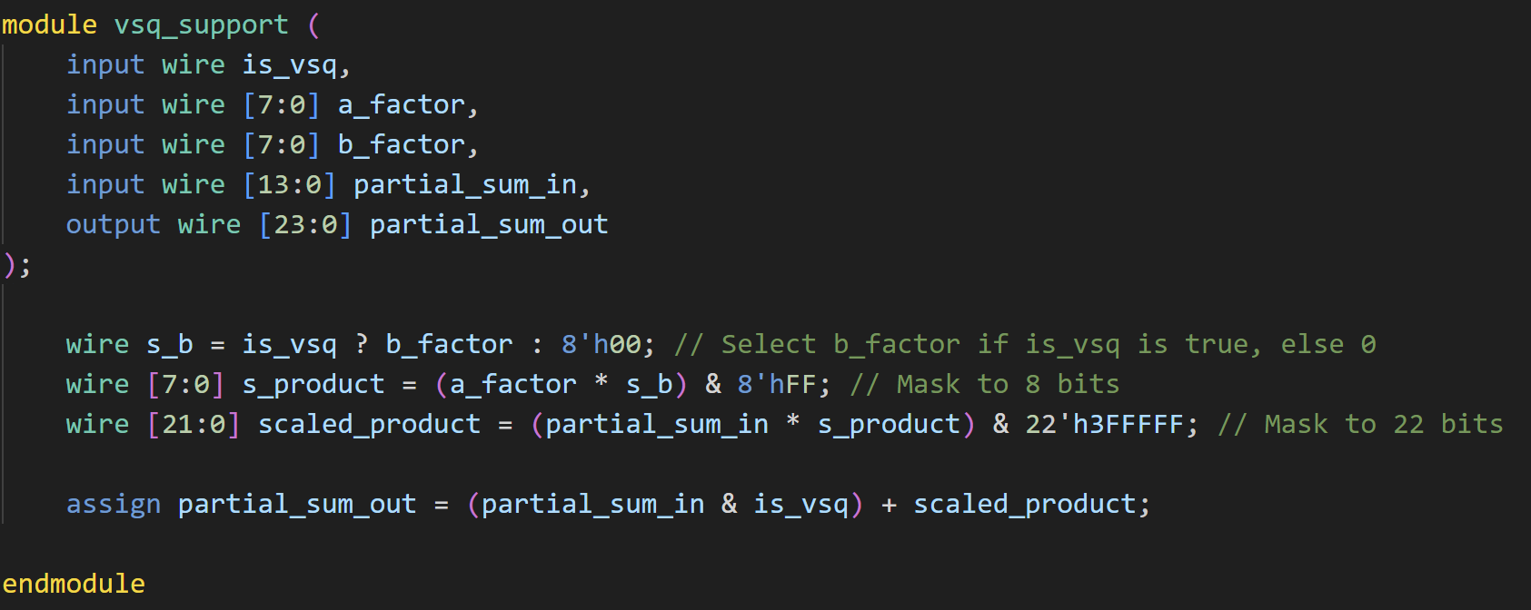
Verilog Code for VSQ-Support

Slide 19
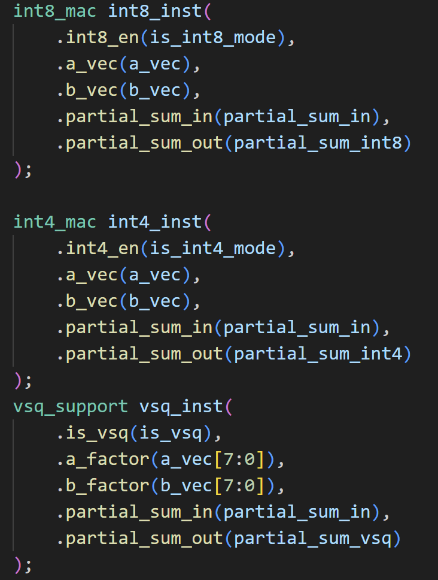
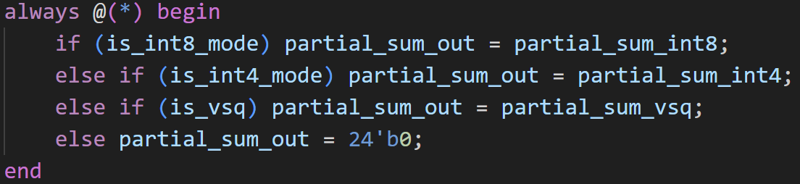
Verilog Code for a single MAC datapath

Slide 20
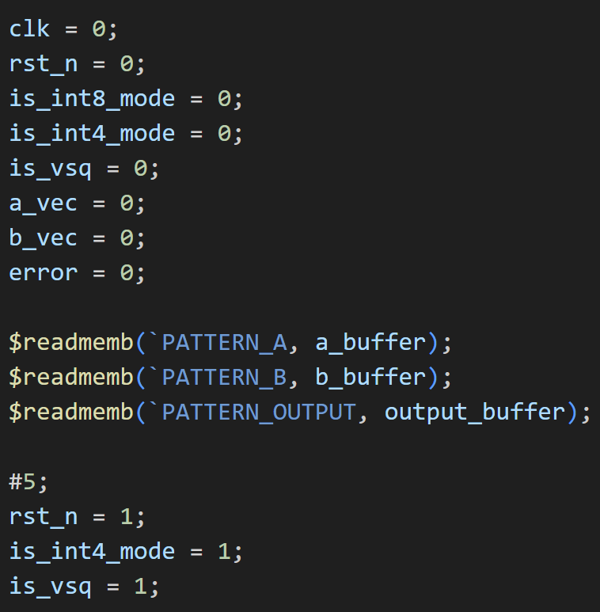
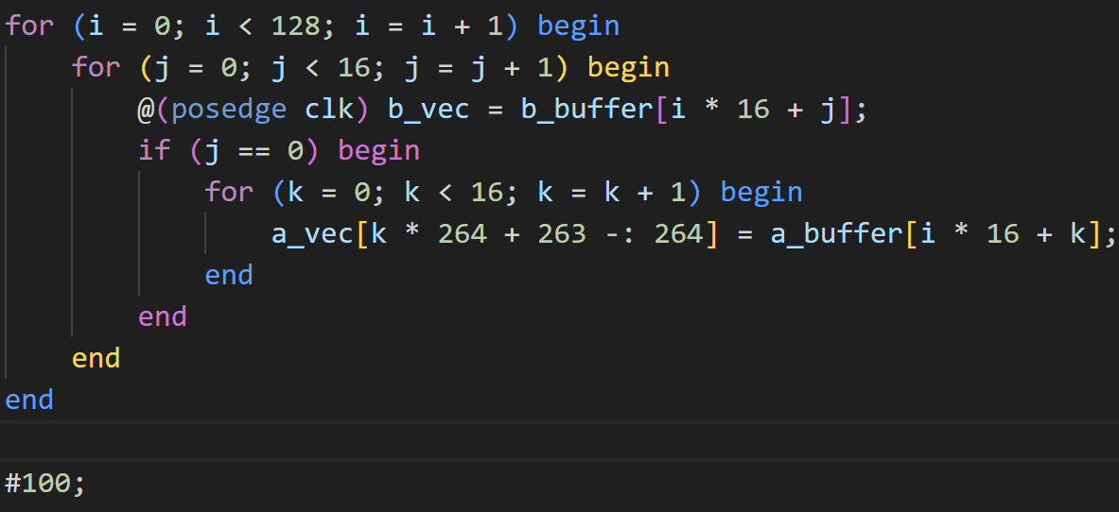
Testbench

Slide 21
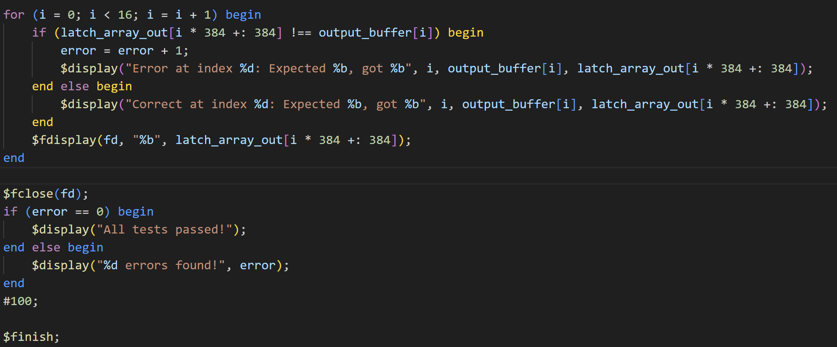
Testbench

Slide 22
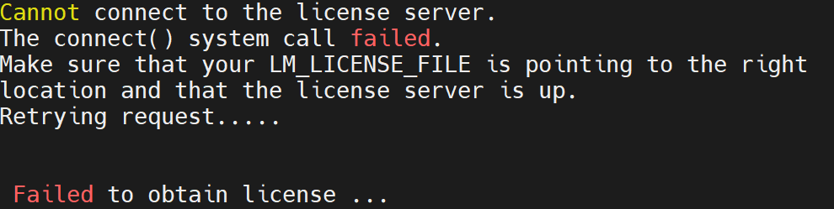
Simulation Result
Testbench simulation pass (no screenshot due to current issues on the workstation. )

