Slide 1
PPU with Approx. Softmax and Testbench
5/20 Progress Report
Presenter: I-An Hou

Slide 2
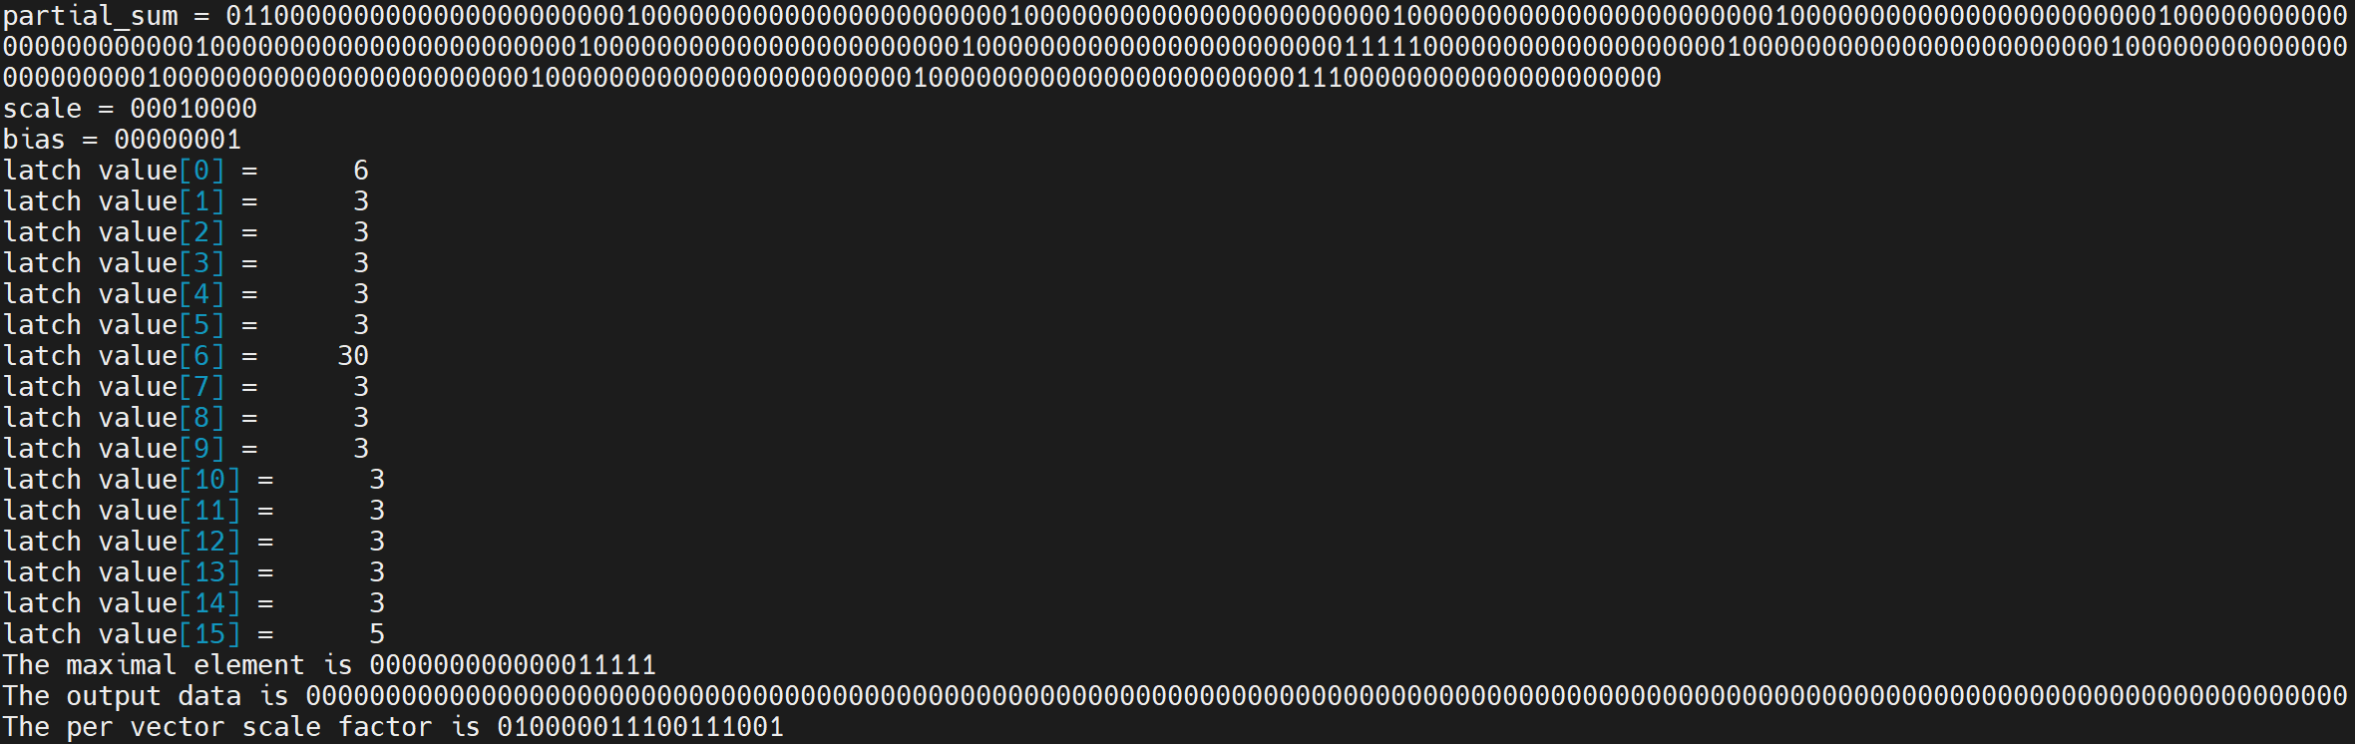
Modification
Error occur in quantization part, other parts function normally.

Slide 3
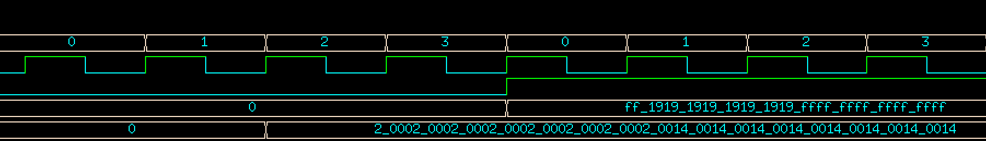
Modification
It was simply a problem about matching output clock cycles together.
Latch array output datas
Processing
Output

Slide 4
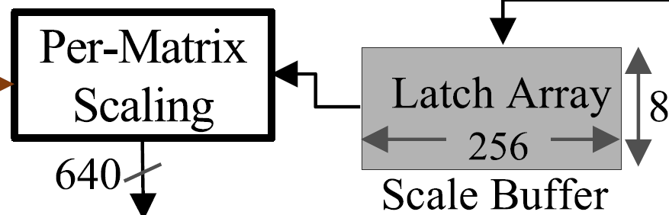
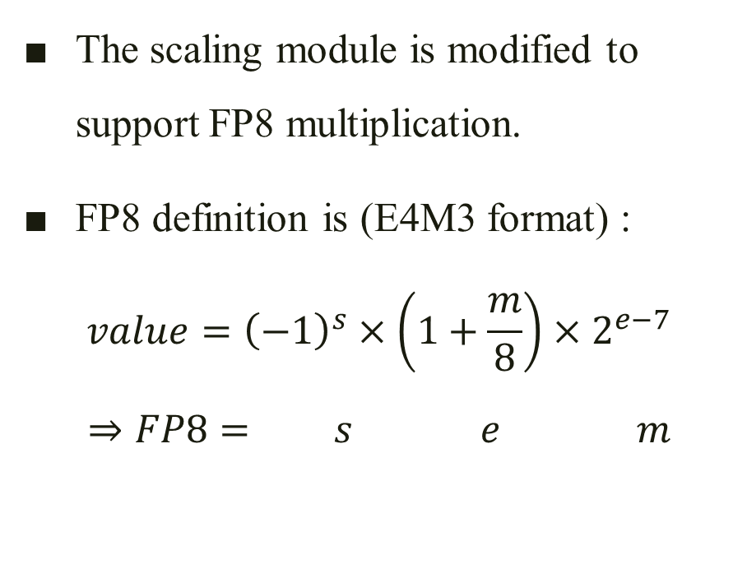
Modification
The scaling module is modified to support FP8 multiplication.
FP8 definition is (E4M3 format) :
$$value={\left(−1\right)}^{s}×\left(1+\frac{m}{8}\right)×2^{e−7}$$
$$⇒FP8= s e m$$
1 bit
4 bit
3 bit

Slide 5
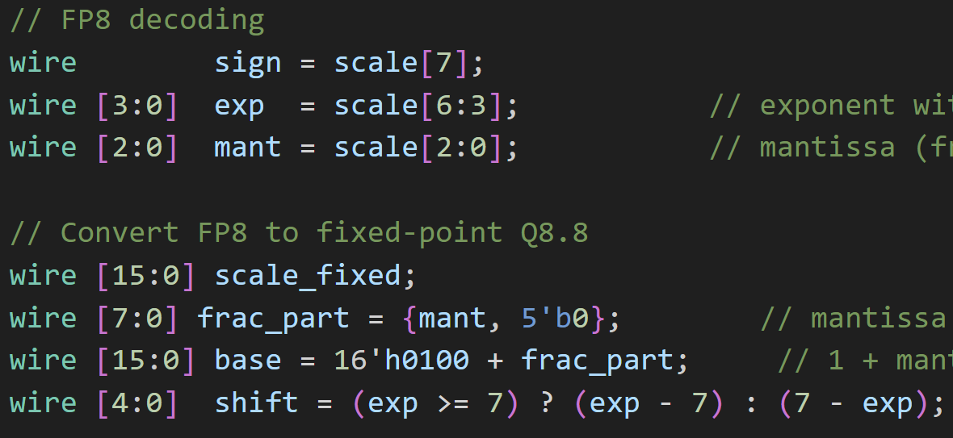
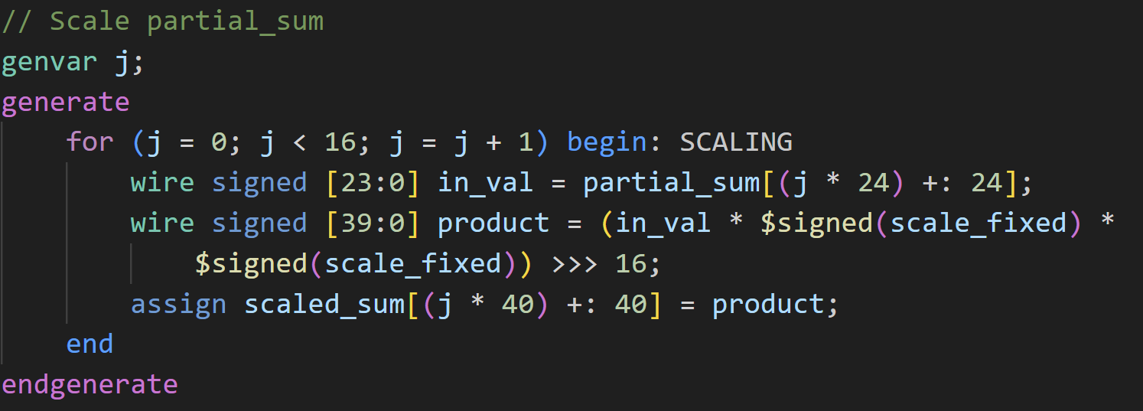
Modification
First part is decoding FP8 format.
Then transferring it to Q8.8 fixed point number. But why Q8.8 ?
The output bit width for each mac is 40 bits, which is 40 – 24 = 16 bits wider. Since Q8.8 is 16 bits wide, the result is 24 + 16 + 16 – 16 = 40.

Slide 6
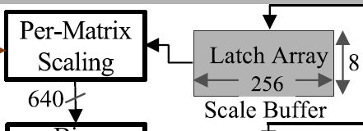
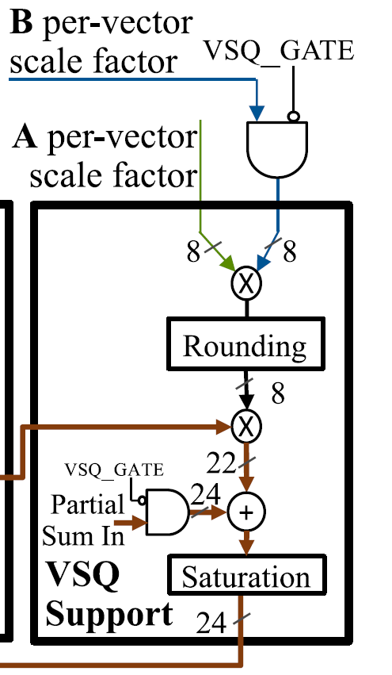
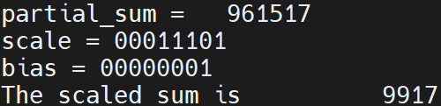
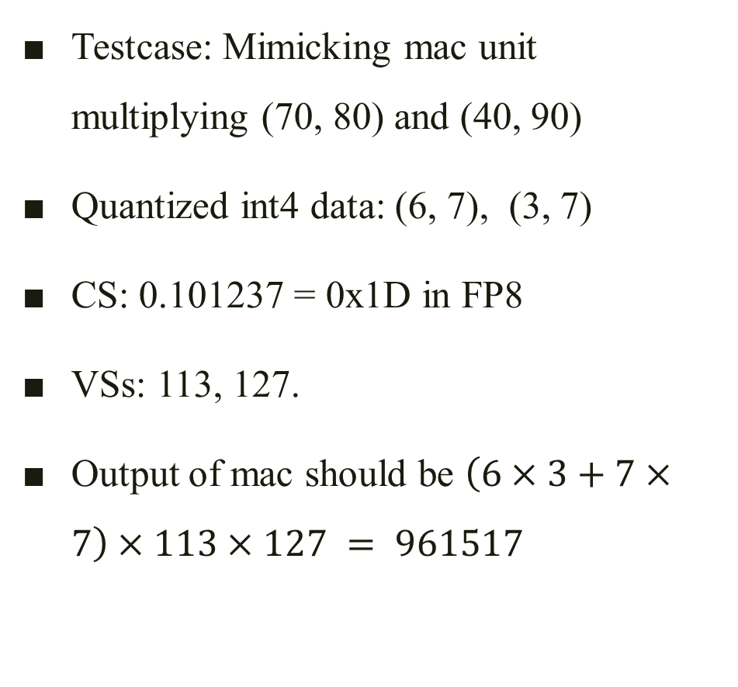
Modification
Testcase: Mimicking mac unit multiplying (70, 80) and (40, 90)
Quantized int4 data: (6, 7), (3, 7)
CS: 0.101237 = 0x1D in FP8
VSs: 113, 127.
Output of mac should be $\left(6×3+7×7\right)×113×127 = 961517$
*CS = coarse-grain scale factor
VSs = per vector scale factors
*Theoretical output = 2800 + 7200 = 10000

Slide 7
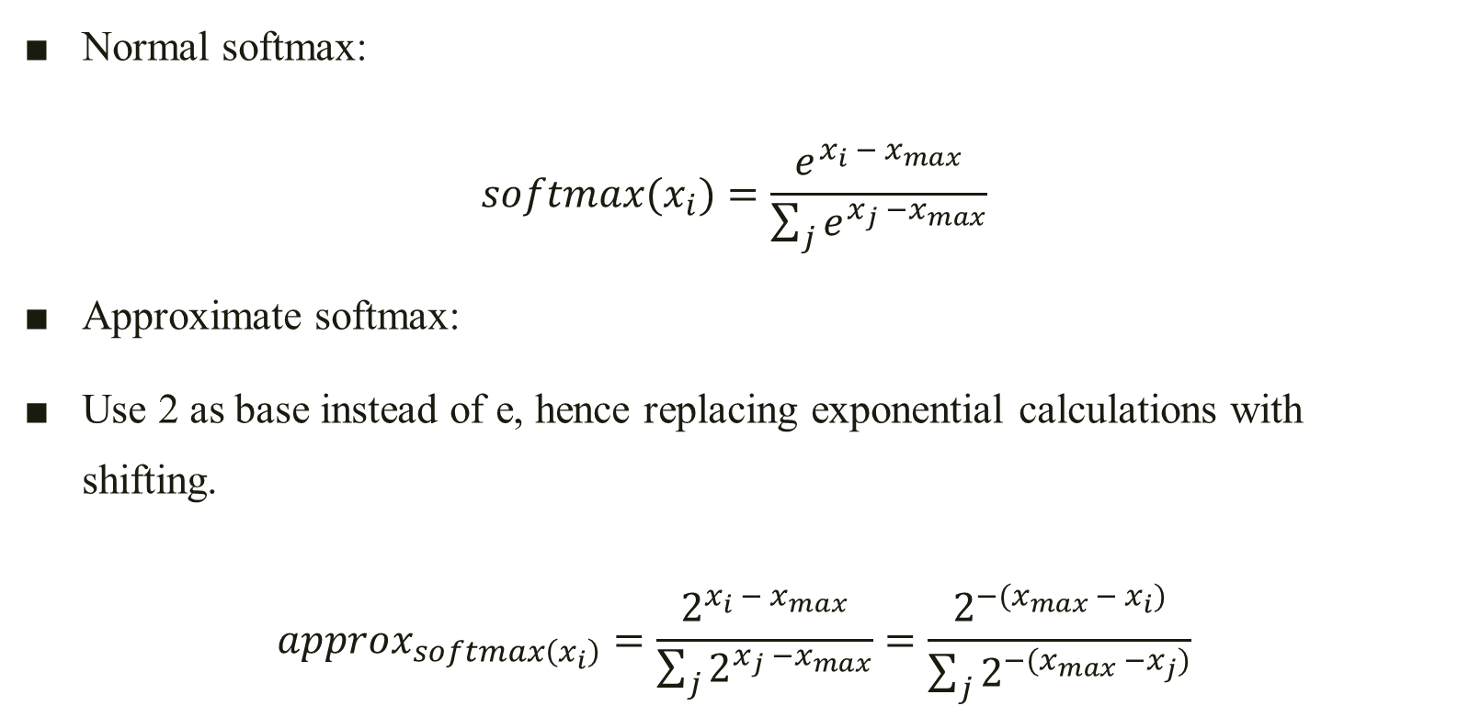
Approx. Softmax
Normal softmax:
$$softmax(x_{i})=\frac{e^{x_{i} − x_{max}}}{\sum_{j}{e^{x_{j} −x_{max}}}}$$
Approximate softmax:
Use 2 as base instead of e, hence replacing exponential calculations with shifting.
$$approx_{softmax\left(x_{i}\right)}=\frac{2^{x_{i} − x_{max}}}{\sum_{j}{2^{x_{j} −x_{max}}}}=\frac{2^{−(x_{max} − x_{i})}}{\sum_{j}{2^{−(x_{max} −x_{j})}}}$$

Slide 8
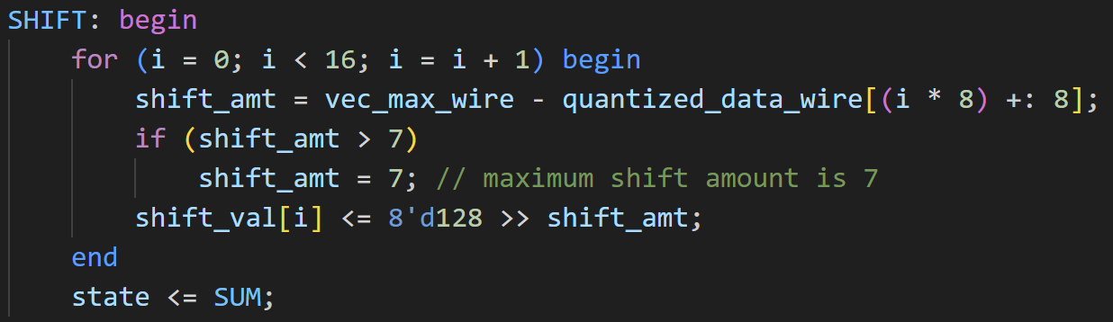
Approx. Softmax
The reference didn’t specify the bit width after approx. softmax, so I assume it to be 8 (common).
So the maximum shift amount is set to be 7.

Slide 9
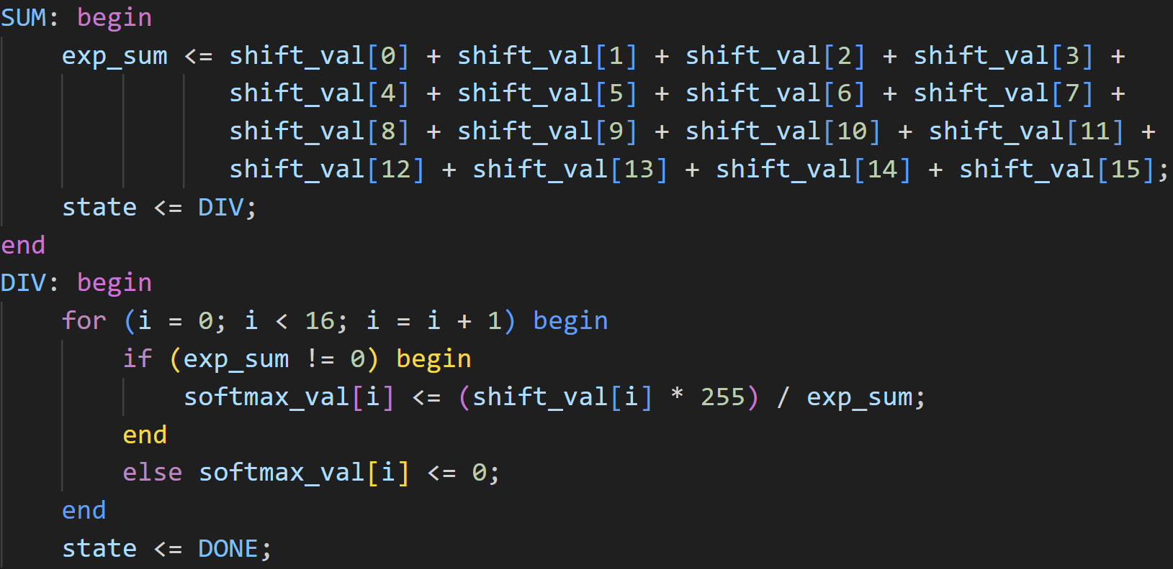
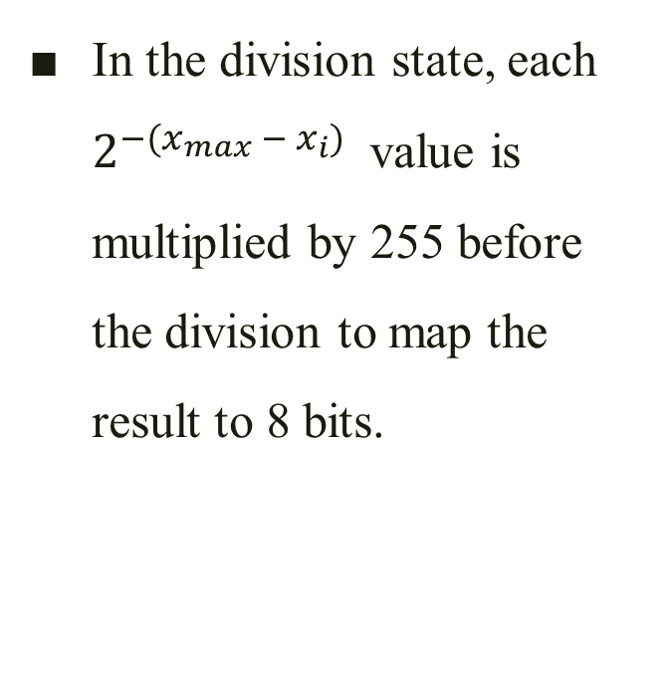
Approx. Softmax
In the division state, each $2^{−(x_{max} − x_{i})}$ value is multiplied by 255 before the division to map the result to 8 bits.

Slide 10
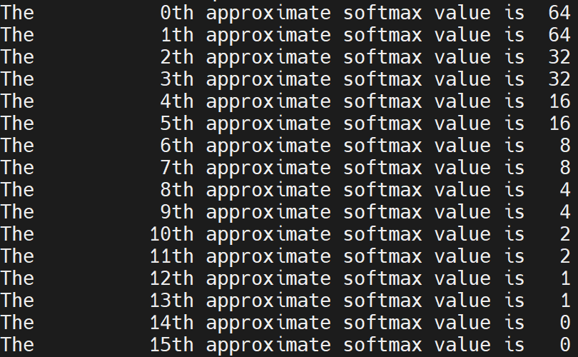
Testing Correctness
The test case is (120, 120, 121, 121, … , 127, 127), the theoretical output is
The Verilog code output is
Correct.

Slide 11
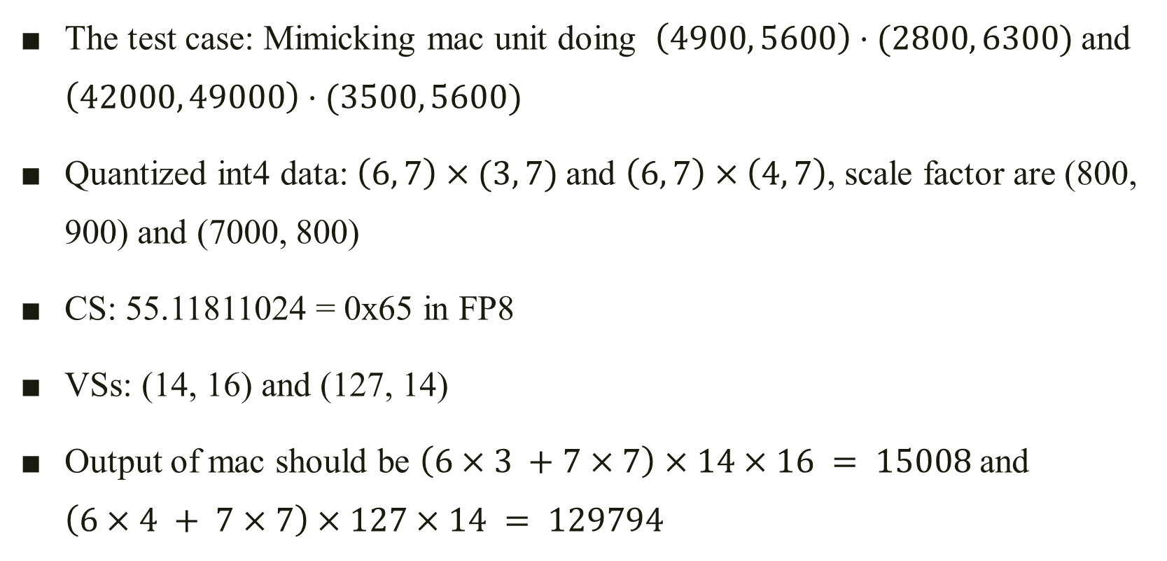
Testing Overall Correctness of PPU
The test case: Mimicking mac unit doing $\left(4900, 5600\right)⋅(2800, 6300)$and $\left(42000, 49000\right)⋅(3500, 5600)$
Quantized int4 data: $\left(6, 7\right)×(3, 7)$and $\left(6, 7\right)×\left(4, 7\right)$, scale factor are (800, 900) and (7000, 800)
CS: 55.11811024 = 0x65 in FP8
VSs: (14, 16) and (127, 14)
Output of mac should be $\left(6×3 +7×7\right)×14×16 = 15008$and $\left(6×4 + 7×7\right)×127×14 = 129794$

Slide 12
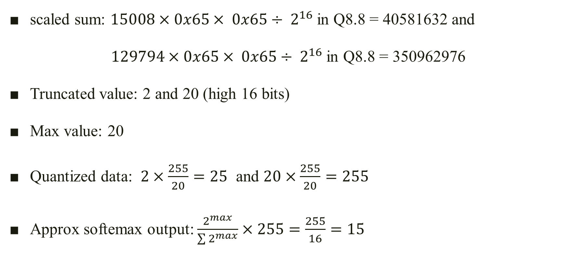
Theoretical Output of PPU
scaled sum: $15008×0x65× 0x65÷ 2^{16}$in Q8.8 = 40581632 and
$129794×0x65× 0x65÷ 2^{16}$in Q8.8 = 350962976
Truncated value: 2 and 20 (high 16 bits)
Max value: 20
Quantized data: $2×\frac{255}{20}=25$ and $20×\frac{255}{20}=255$
Approx softemax output: $\frac{2^{max}}{\sum{2^{max}}}×255=\frac{255}{16}=15$

Slide 13
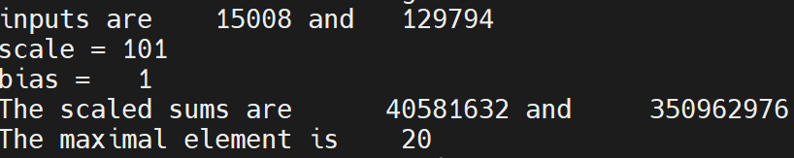

Comparing Output of PPU
scaled sum: $15008×0x65× 0x65÷ 2^{16}$in Q8.8 = 40581632 and
$129794×0x65× 0x65÷ 2^{16}$in Q8.8 = 350962976
Truncated value: 2 and 20 (high 16 bits)
Max value: 20

Slide 14
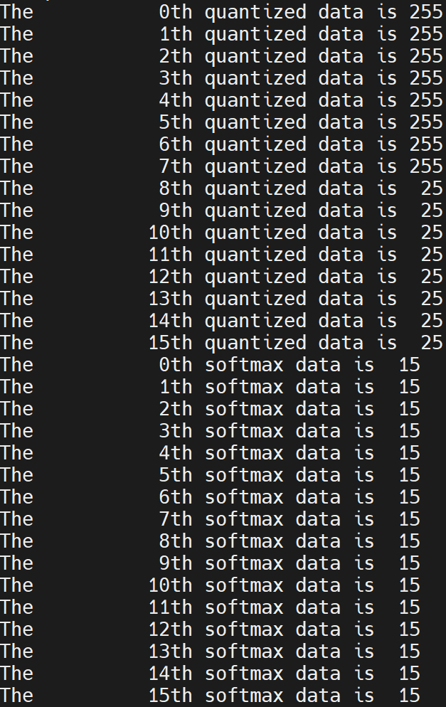
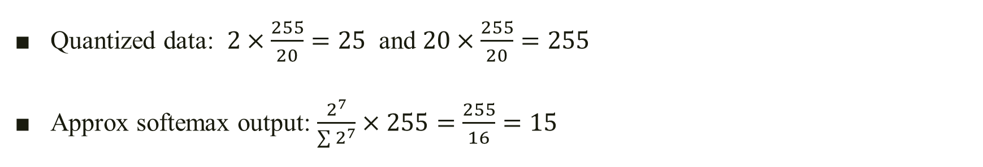
Comparing Output of PPU
Quantized data: $2×\frac{255}{20}=25$ and $20×\frac{255}{20}=255$
Approx softemax output: $\frac{2^{7}}{\sum{2^{7}}}×255=\frac{255}{16}=15$

