Slide 1
Overall Modification, Layout and Post Sims
5/27 Progress Report
Presenter: I-An Hou

Slide 2
Progress Report
Put MAC, ACC collector, and PPU together successfully
Currently working on synthesis

Slide 3
Block Diagram
The whole accelerator is consist of MAC units, accumulation collector, and a PPU.
valid_ppu
a_vec, b_vec, mode
valid_ppu
quantized_data
MAC UNITS
PPU
Partial_sum_out
Partial_sum_in
softmax_data
ACC COLLECTOR
to_ppu

Slide 4
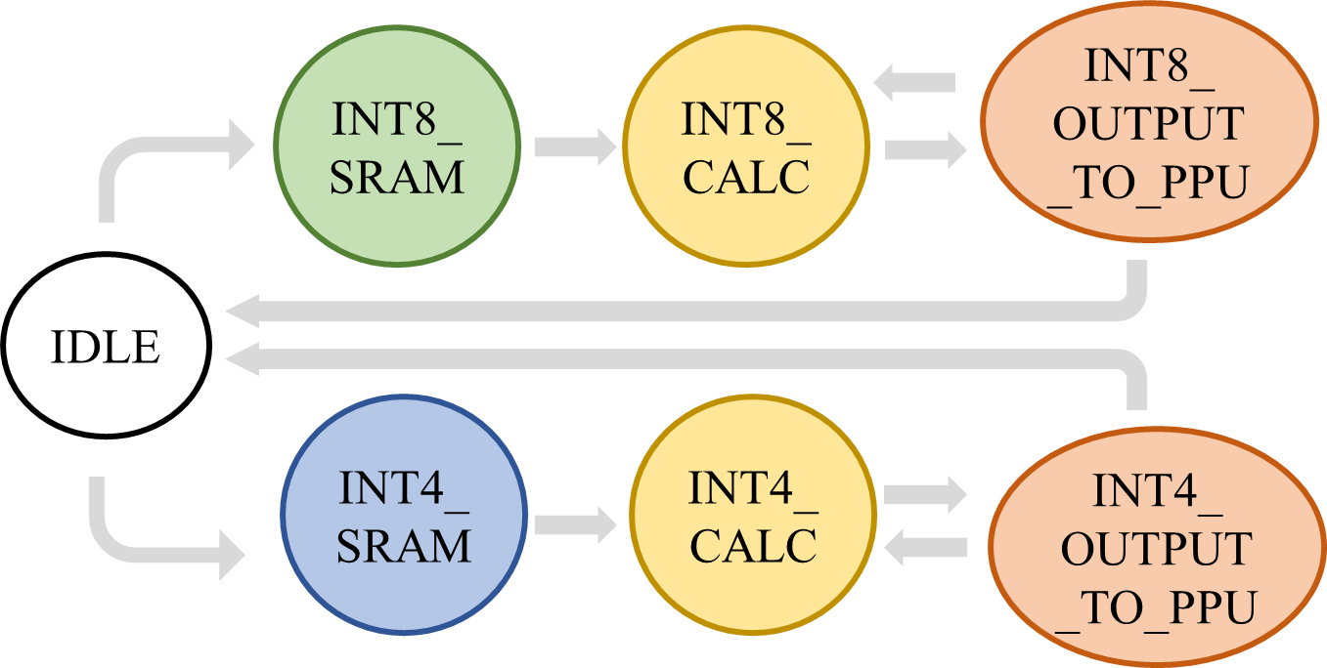
Modification
Old design: large FSM in control unit

Slide 5
Modification
Modified: simplified FSM in MAC and accumulation collector
IDLE
valid
start
addr == 15
(output complete)
IDLE
CALC
MAC
PPU
calc_count == calc_max
ppu
MAC
ACC

Slide 6
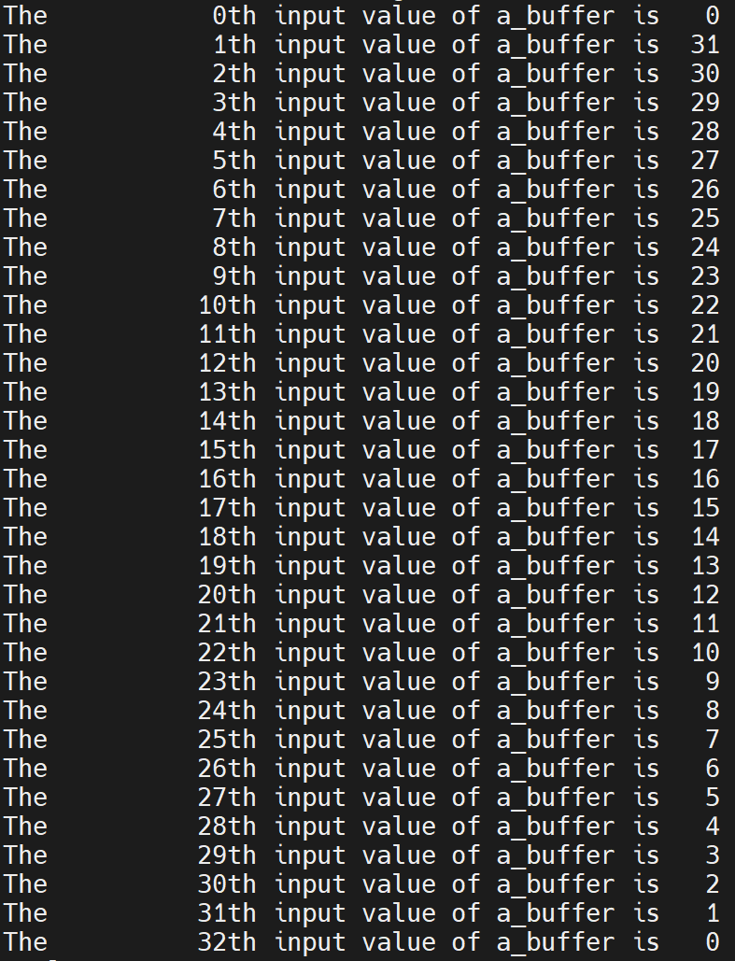
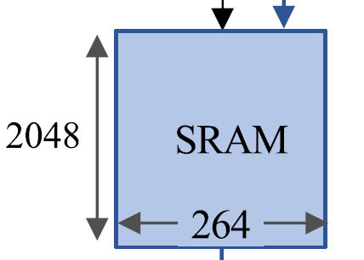
Testbench
Testcase: (0, 1, 2, 3, … , 31) + scale (scale = 0 in int8 mode)
Total number of input = 32
One of the input is modified to be much smaller
Scale = 0x65, bias = 1
32

Slide 7
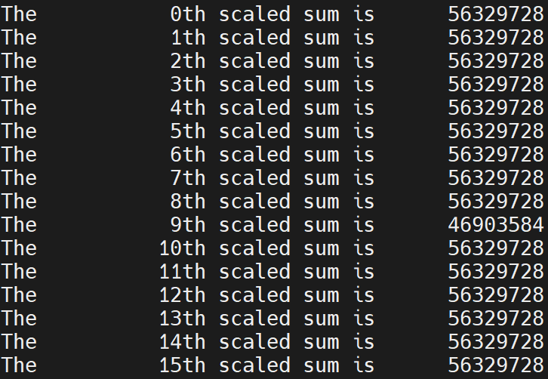
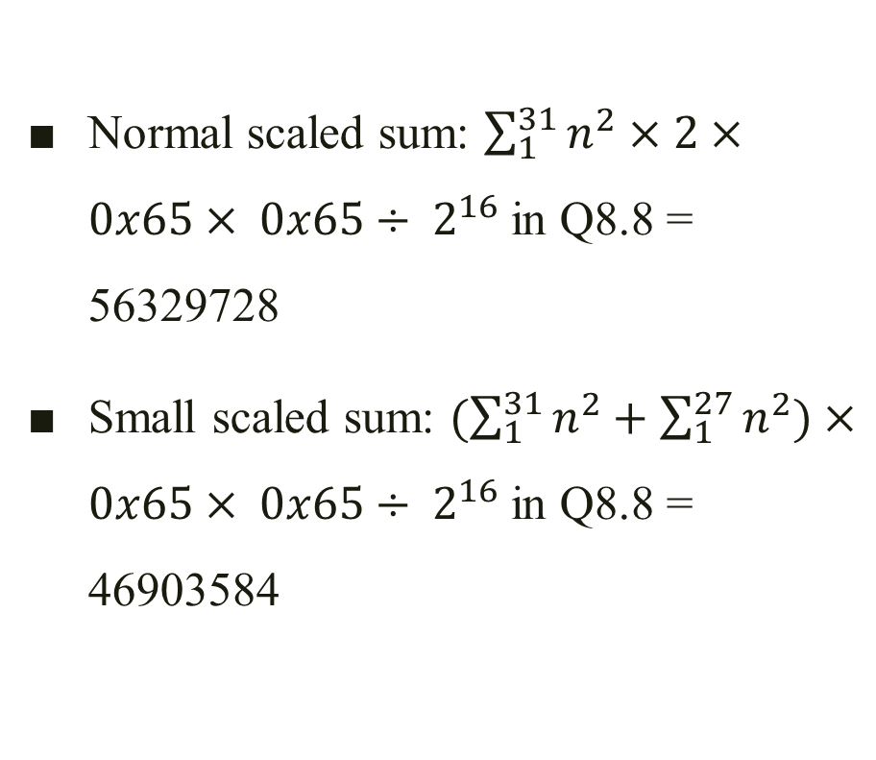
Testbench
Normal scaled sum: $\sum_{1}^{31}{n^{2}}×2×0x65× 0x65÷ 2^{16}$in Q8.8 = 56329728
Small scaled sum: $(\sum_{1}^{31}{n^{2}}+\sum_{1}^{27}{n^{2}})×0x65× 0x65÷ 2^{16}$in Q8.8 = 46903584

Slide 8
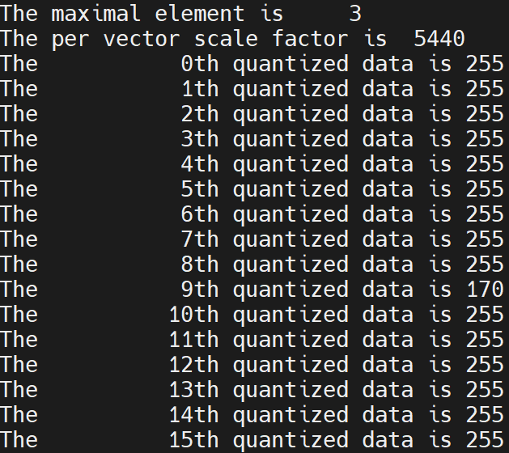
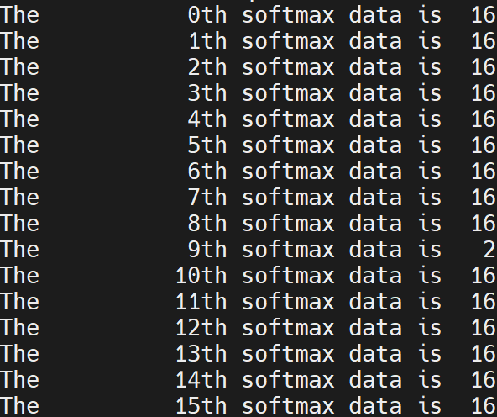

Testbench
Max = 56329728 $÷ 2^{24}$=3, reciprocal = 255 << 6 / 3 = 5440

Slide 9
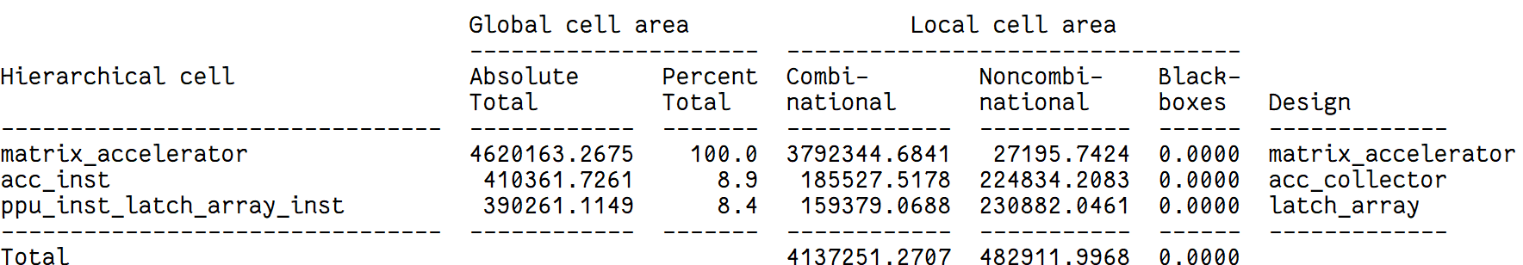
Synthesis
.tcl, .sdc, .setup files: from DSD lecture
Library used: /home/raid7_2/course/cvsd/CBDK_IC_Contest/CIC/SynopsysDC/db/typical.db
The area is huge, still optimizing it.

Slide 10
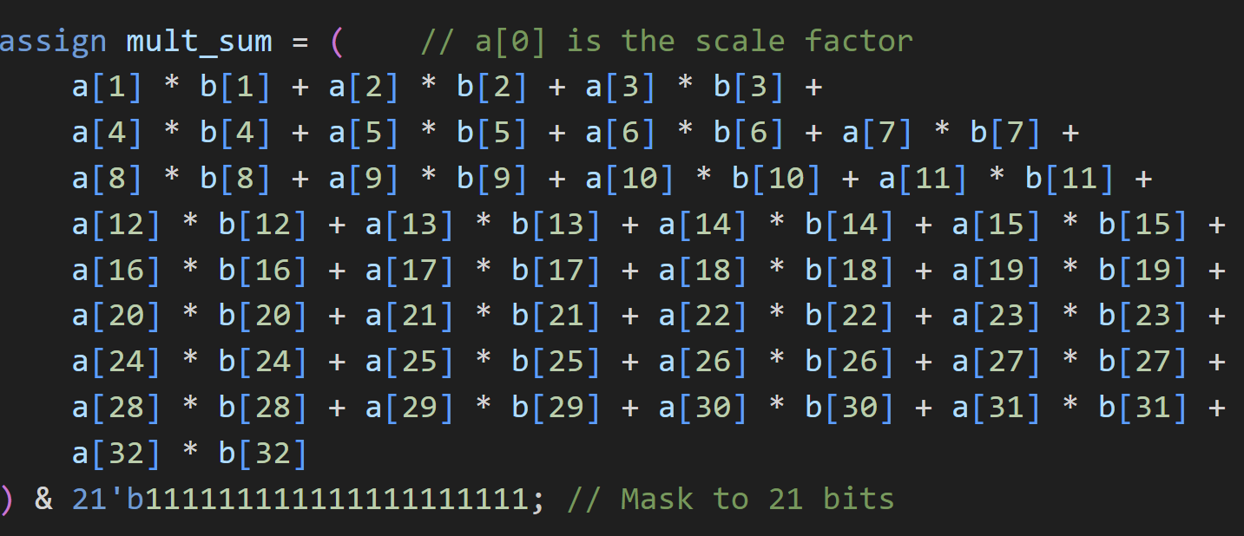
Synthesis
Optimizing each MAC: adder tree

Slide 11
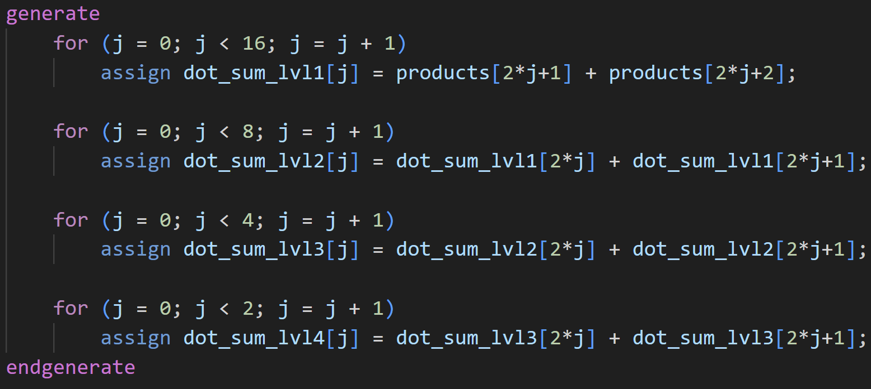
Synthesis
Optimizing each MAC: adder tree

