Slide 1
A 95.6-TOPS/W Deep Learning Inference Accelerator With Per-Vector Scaled 4-bit Quantization
Presenter: I-An Hou

Slide 2
Accuracy/Energy Trade-Off
Errors after propagation is catastrophic
High accuracy results in huge energy cost
Low energy cost results in high accuracy loss
eg. BERT-Large: INT8 with only 1.5% accuracy loss, but INT4 results in an accuracy loss of 84%

Slide 3
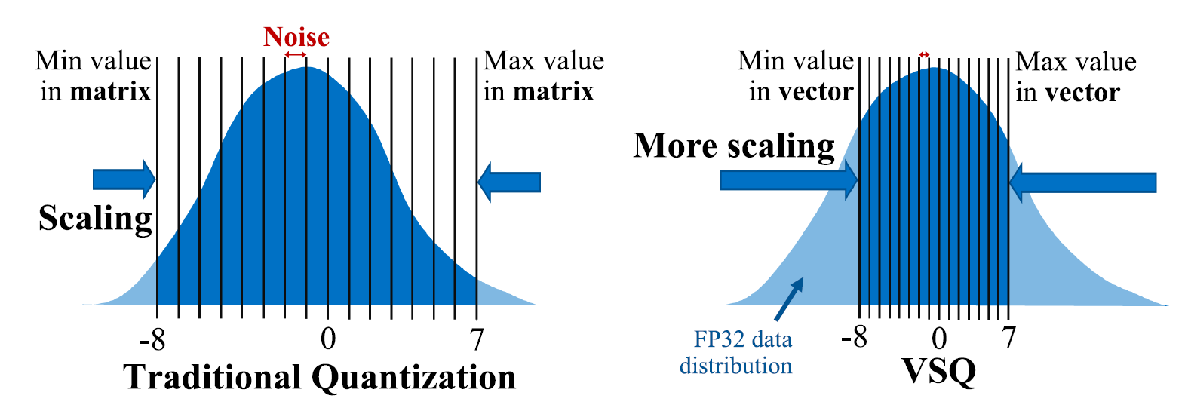
Per-Vector Scaled Quantization

Slide 4
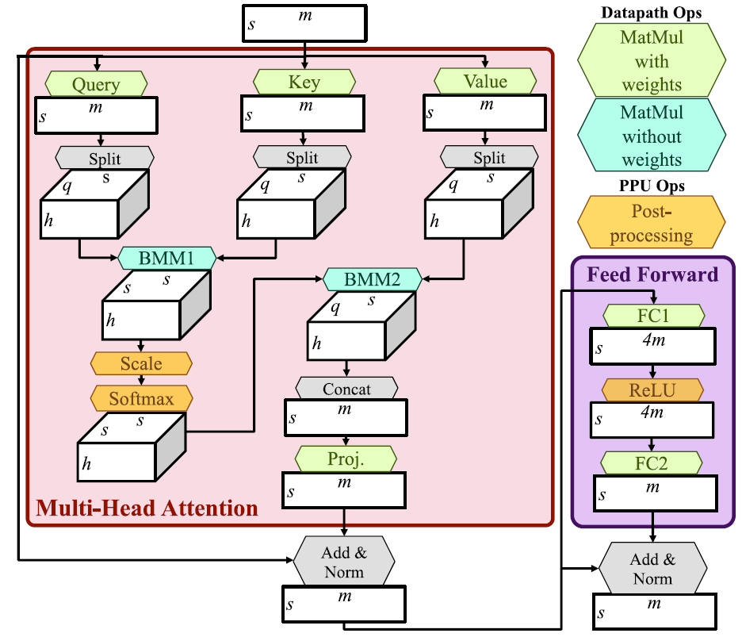
Transformer Network

Slide 5
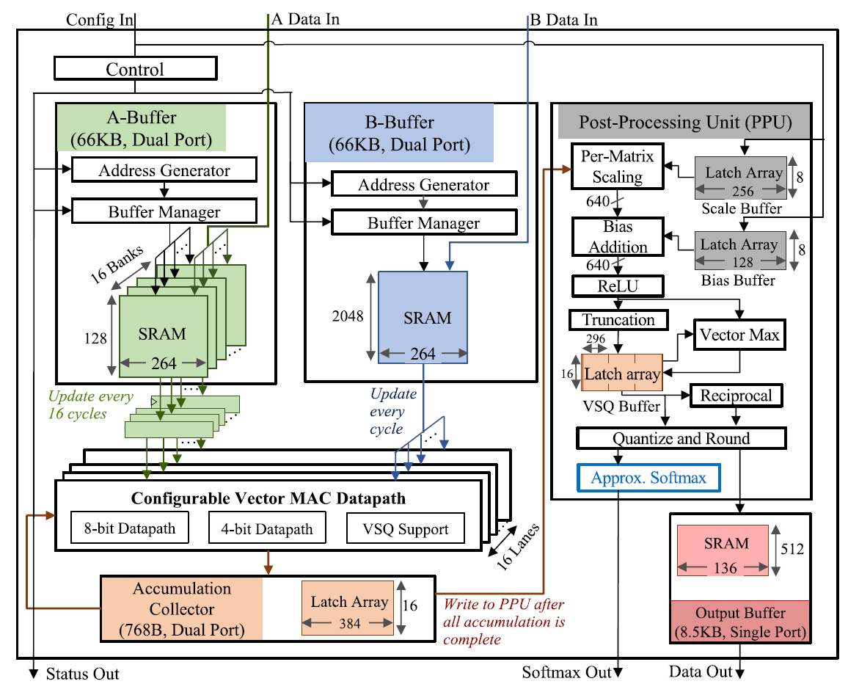
Accelerator Design

Slide 6
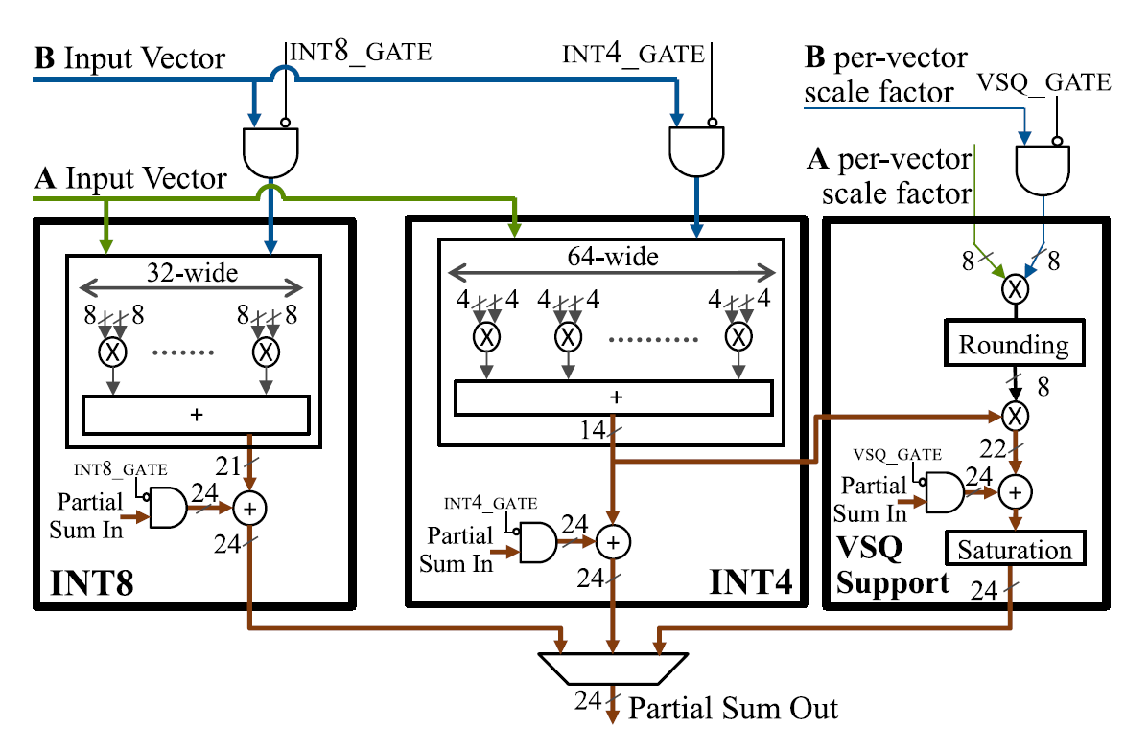
Reconfigurable Datapath Design

Slide 7
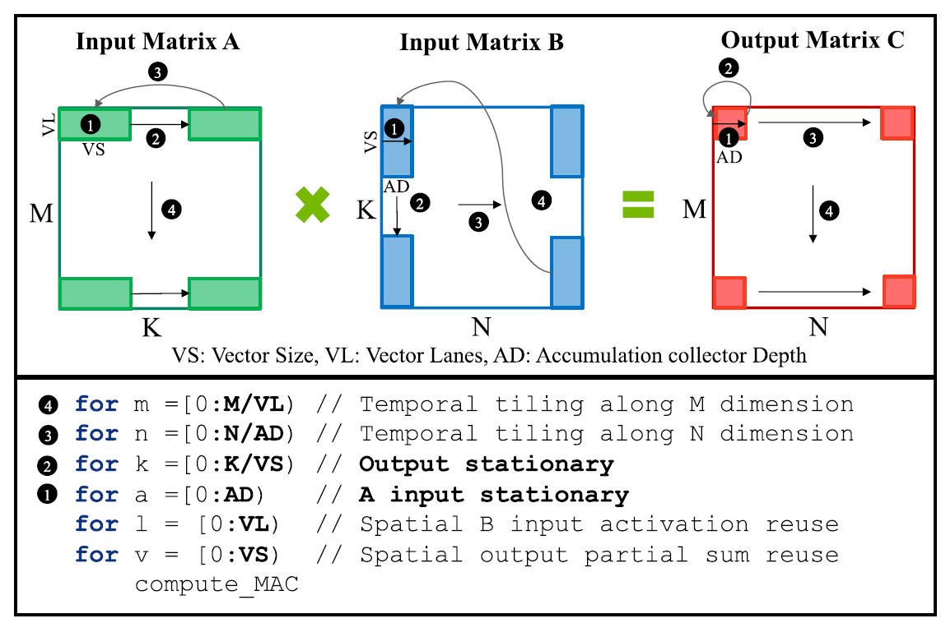
Mapping MAC to Accelerator

Slide 8
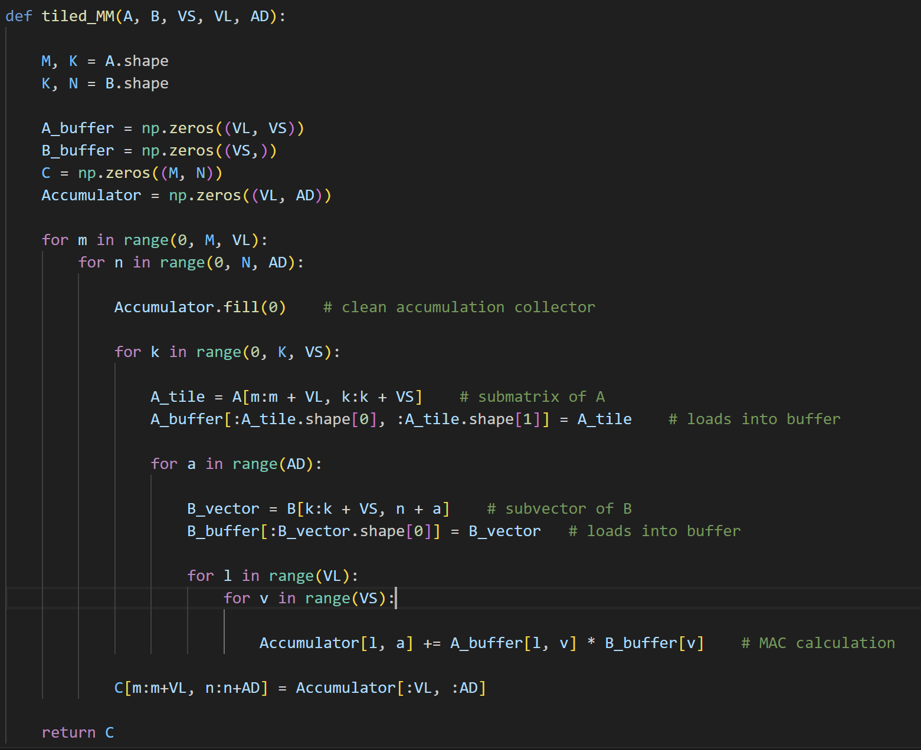

Slide 9
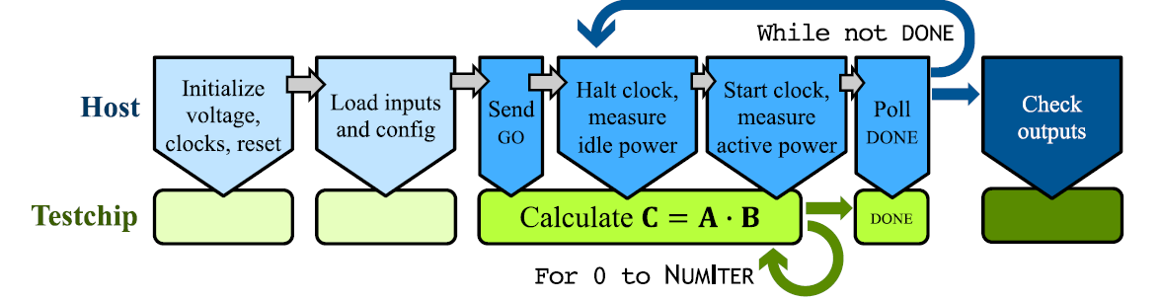
Measurement Workflow

