Slide 1
Implementing MAC Units and Testbench
3/25 Progress Report
Presenter: I-An Hou

Slide 2
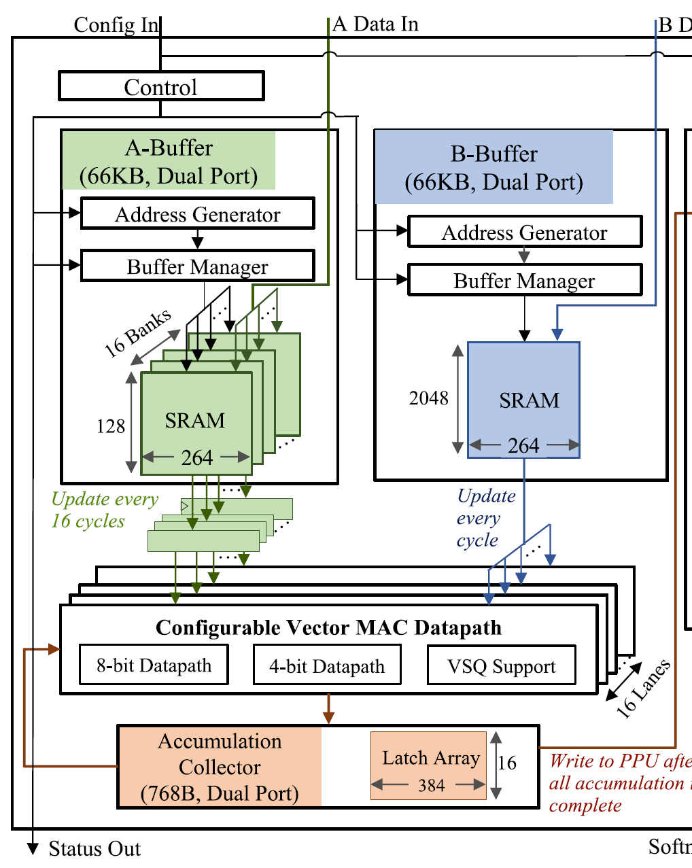
Recall

Slide 3
Overall Structure
Data_out
Data_A
MAC
Acc Collector
A_SRAM
A_SRAM writer
Config_in
Control Unit
B_SRAM
B_SRAM writer
Data_B
3

Slide 4
Control Unit
Rst_n
Control Unit
Int8_sram_start
Config_in
Int4_sram_start
Clk
MAC_mode
to_MAC
to_PPU
from_MAC

Slide 5
Control Unit
Rst_n
To every other parts
The rst_n reset signal is transmitted to all parts to delete stored data if necessary.
Control Unit

Slide 6
Control Unit
To SRAM writers
Control unit will figure out which mode is currently needed by reading config_in.
Give corresponding signals to sram_writers for differen types of address generation.
Int8_sram_start
Control Unit
Int4_sram_start

Slide 7
Control Unit
Count how many cycles have passed for a certain calculation, and will give signals to transmit data to different parts.
to_MAC: data from SRAM to MAC
Control Unit
to_MAC
To SRAMs

Slide 8
Control Unit
Count how many cycles have passed for a certain calculation, and will give signals to transmit data to different parts.
from_MAC: data from MAC to ACC
to_PPU: data from ACC to PPU
Control Unit
to_PPU
from_MAC
To accumulation collector

Slide 9
Control Unit
Control unit will figure out which mode is currently needed by reading config_in.
MAC_mode is sent to MAC datapath and determine which kind of MAC will be used.
Control Unit
MAC_mode
To MAC datapath

Slide 10
Control Unit
Design a finite state machine
INT8_
OUTPUT_TO_PPU
INT8_SRAM
INT8_CALC
IDLE
INT4_SRAM
INT4_CALC
INT4_
OUTPUT_TO_PPU

Slide 11
A_SRAM writer
Data_A
Int8_sram_start
A_SRAM writer
Sliced matrix A data
Int4_sram_start
Write_en
Addr_a
Clk
Rst_n

Slide 12
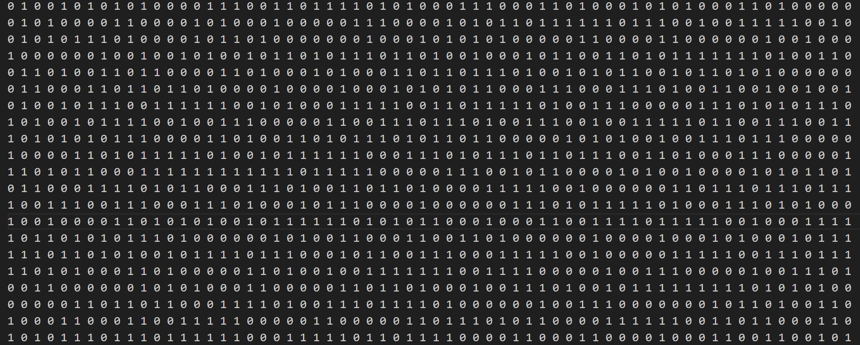
A_SRAM writer

Slide 13
A_SRAM writer

Slide 14
A_SRAM writer

Slide 15
A_SRAM writer
Turn in to int8, and are sent to A_SRAM, filling in Addr_a.

Slide 16
B_SRAM writer
Data_B
Int8_sram_start
A_SRAM writer
Matrix B data
Int4_sram_start
Write_en
Addr_b
Clk
Rst_n

Slide 17
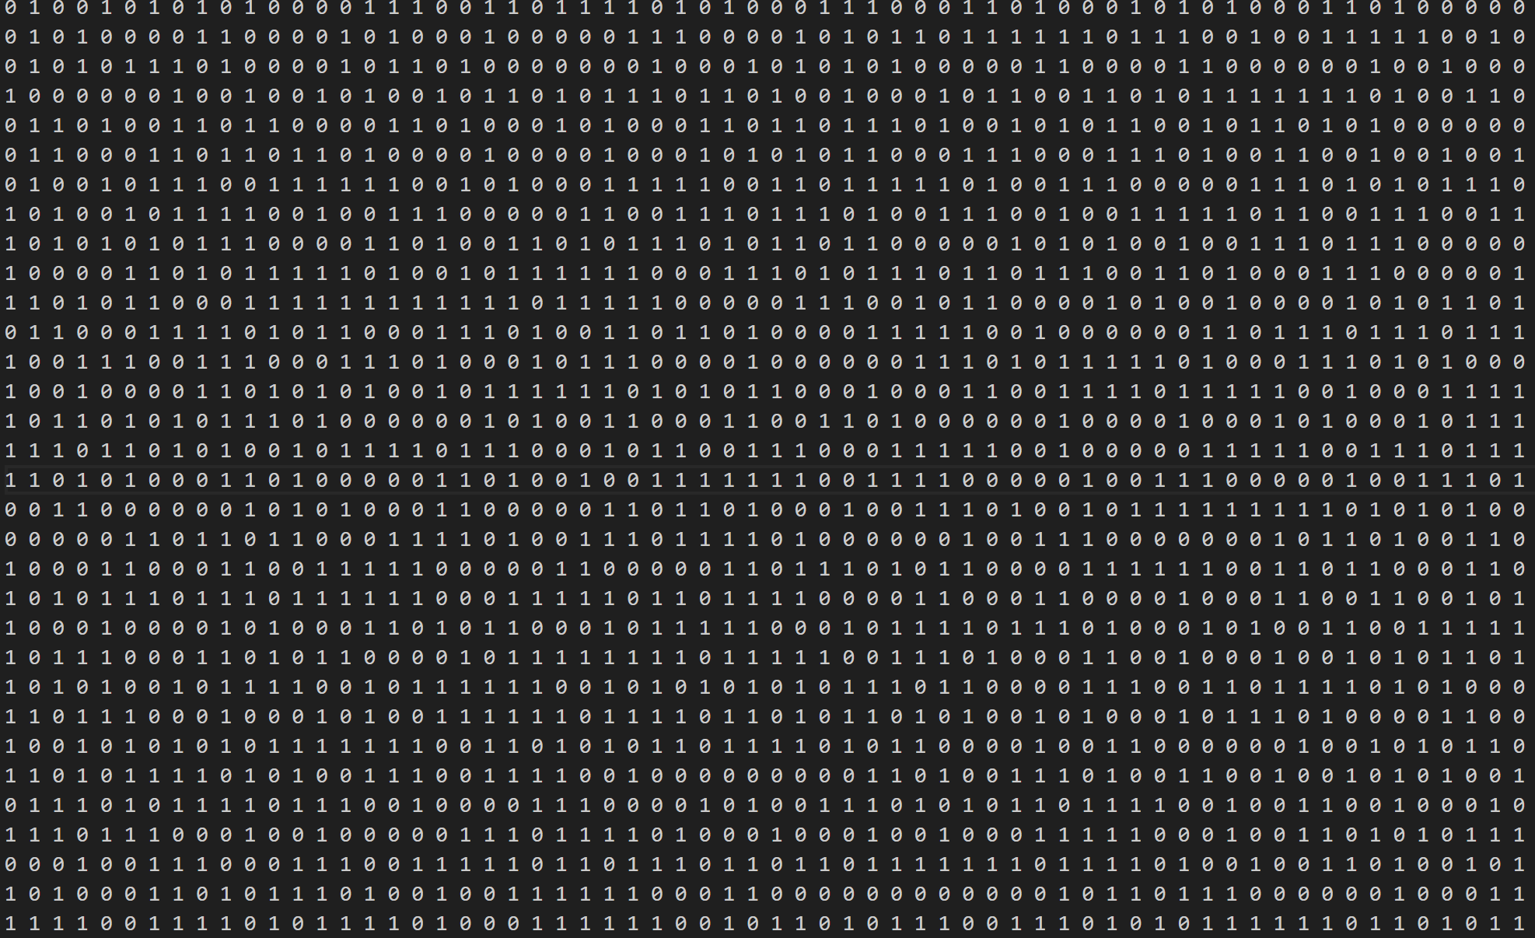
B_SRAM writer
Data_B
Int8_sram_start
A_SRAM writer
Matrix B data
Int4_sram_start
Write_en
Addr_b
Rst_n

Slide 18
Turn in to int8, and are sent to B_SRAM, filling in addr_b, addr_b + 1, addr_b + 2, addr_b + 3 respectively.

Slide 19
A SRAM
A_SRAM
Sliced matrix A data
Sliced matrix A data
Addr_a
Write_en
Clk
Rst_n
to_MAC

Slide 20
B SRAM
B_SRAM
matrix B data
matrix B data
Addr_b
Write_en
Clk
Rst_n
to_MAC

Slide 21
MAC
Sliced matrix A data
MAC
Partial sum out
matrix B data
Clk
Rst_n
Partial sum in

Slide 22
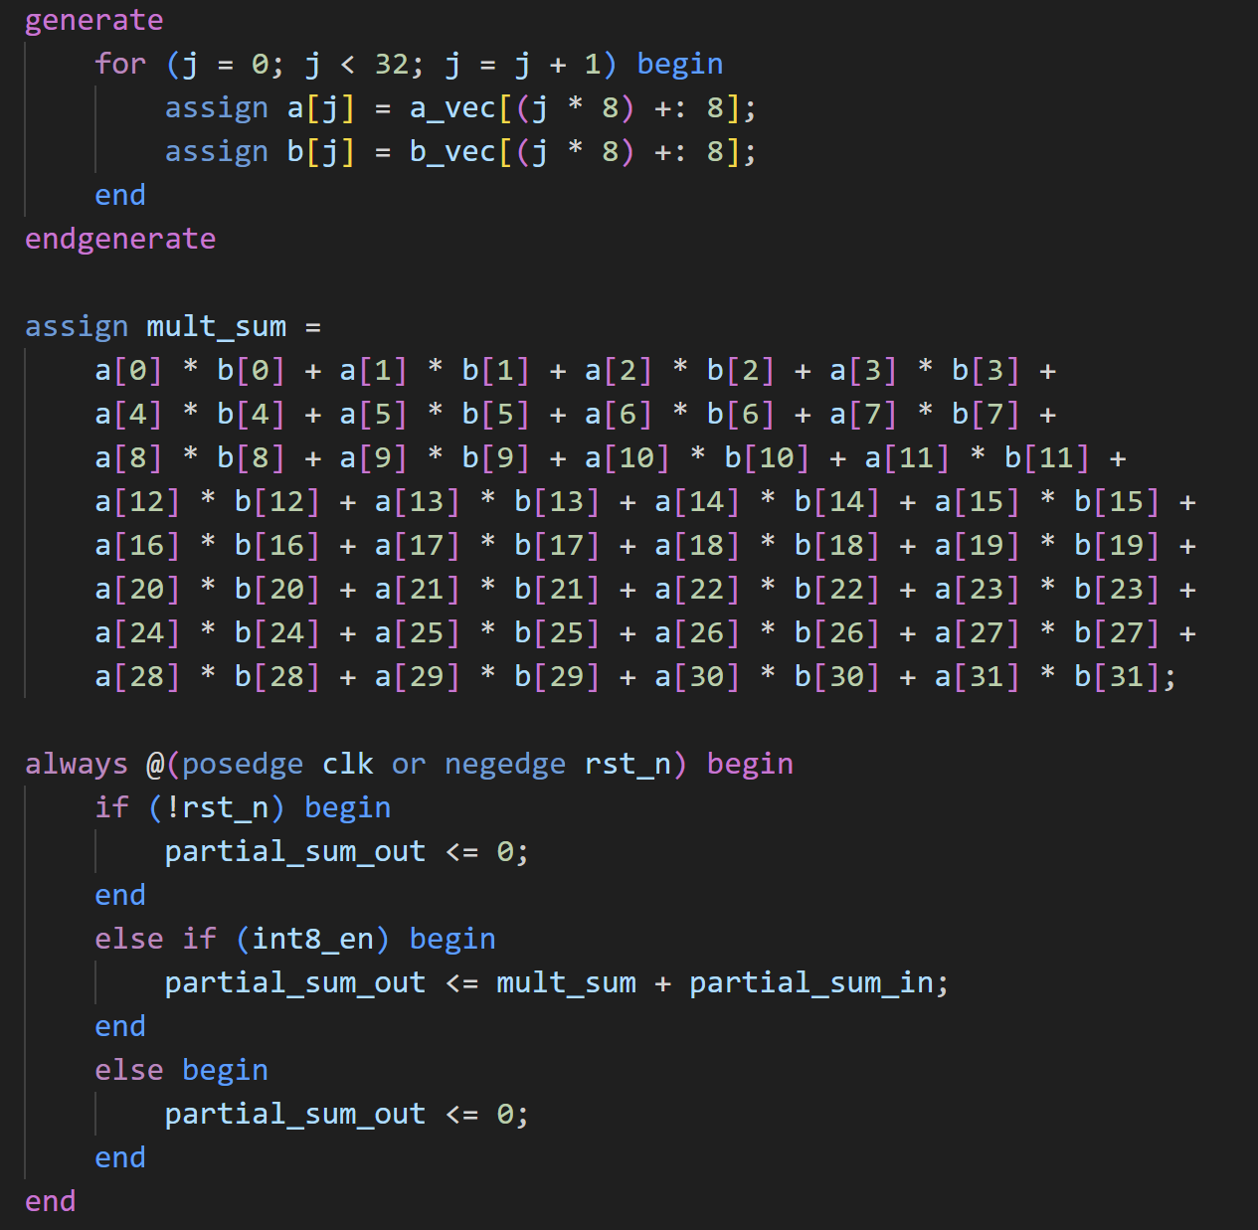
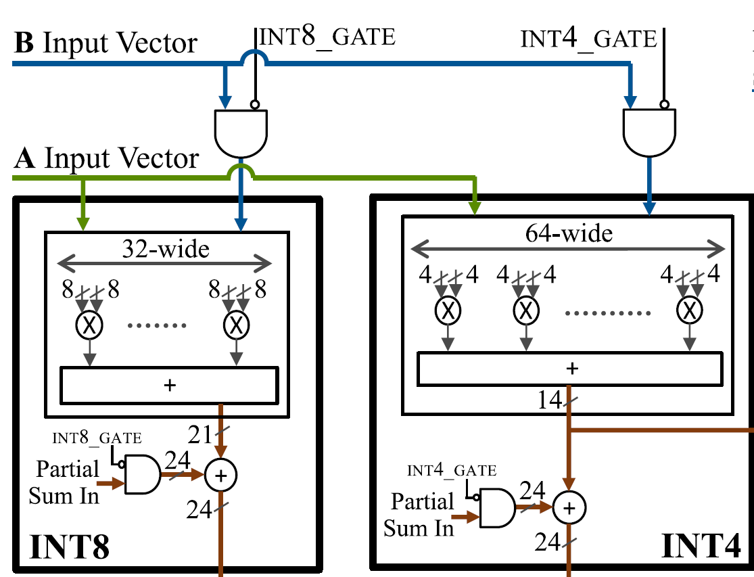
MAC

Slide 23
Accumulation Collector
to_MAC
to_PPU
Partial sum in
Acc Collector
Partial sum out
Data_out
Clk
Rst_n

Slide 24
Current Progress
MAC: int8, int4 type mac are implemented and tested (by testbench).
Other parts: all written but not tested yet.
Eg. int4 mac datapath

