Slide 1
PPU and Testbench
5/6 Progress Report
Presenter: I-An Hou

Slide 2
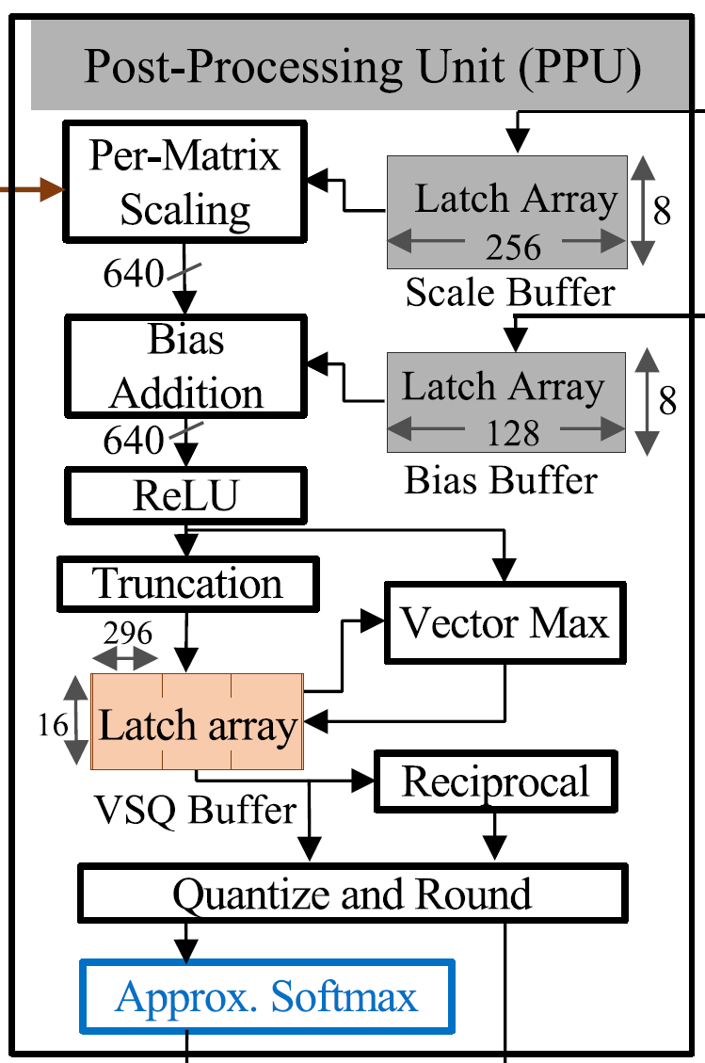
Recall
Scaling, biasing
ReLU
Truncation
Max, reciprocal
Quantization

Slide 3
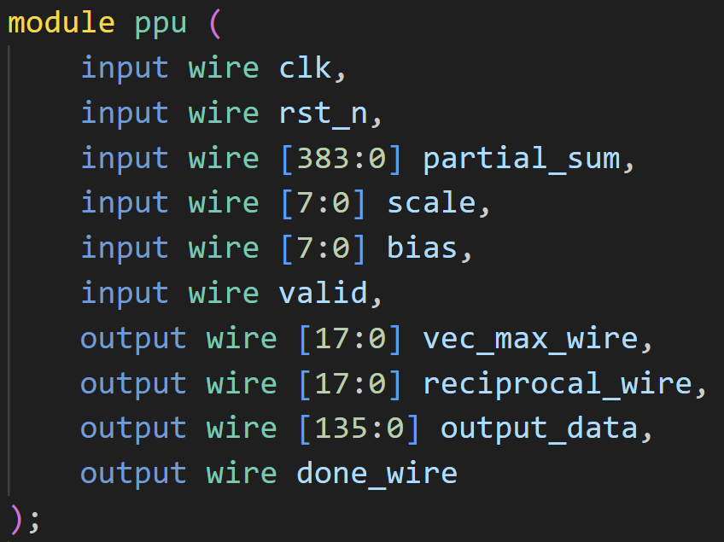
Input, Output Ports
vec_max_wire and reciprocal_wire are for debug

Slide 4
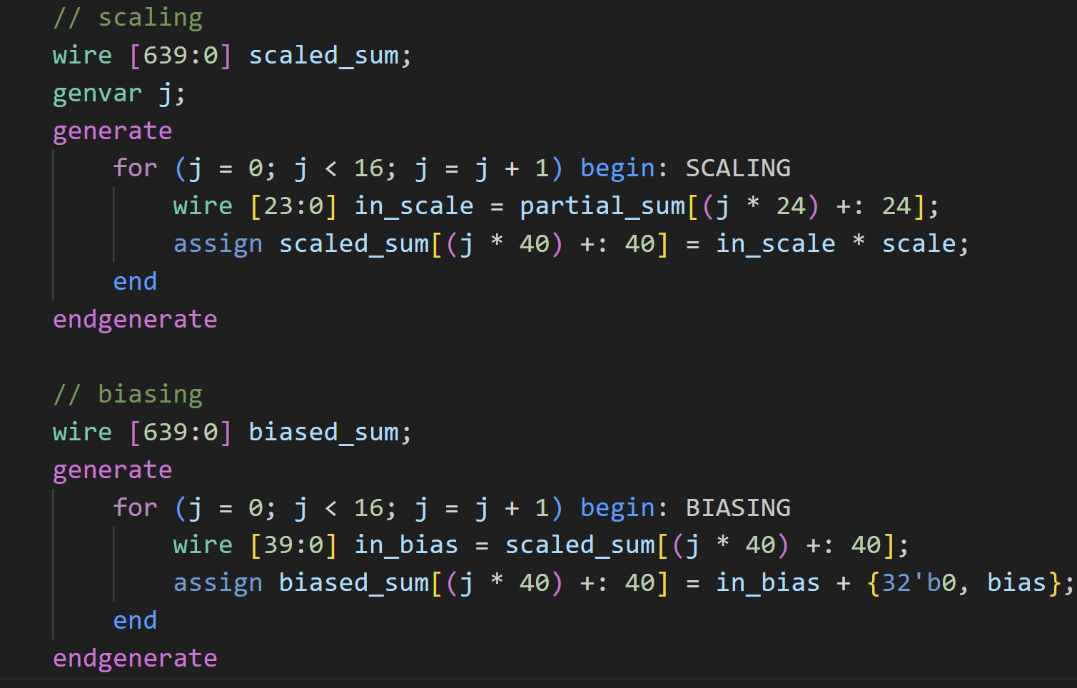
Scaling and Biasing
Each result of MAC times scale and padding to 40 bits. (40 * 16 banks = 640 bits as mentioned in the paper)

Slide 5
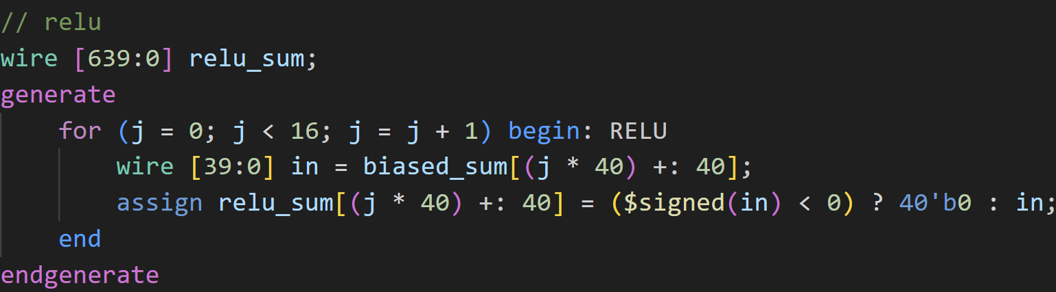
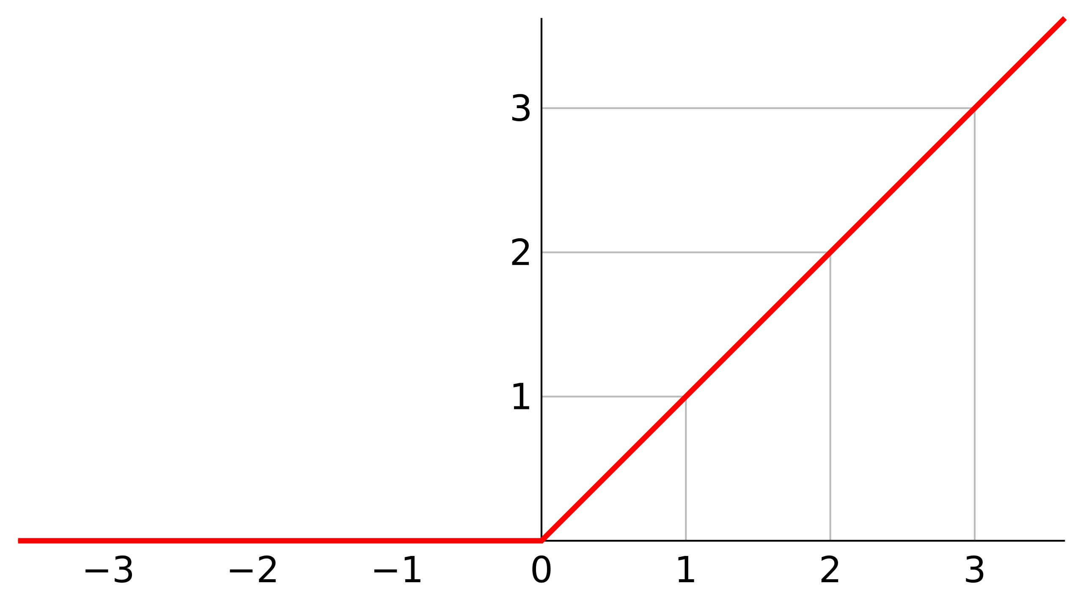
ReLU
If the scaled and biased result is negative, cover it with 0.

Slide 6
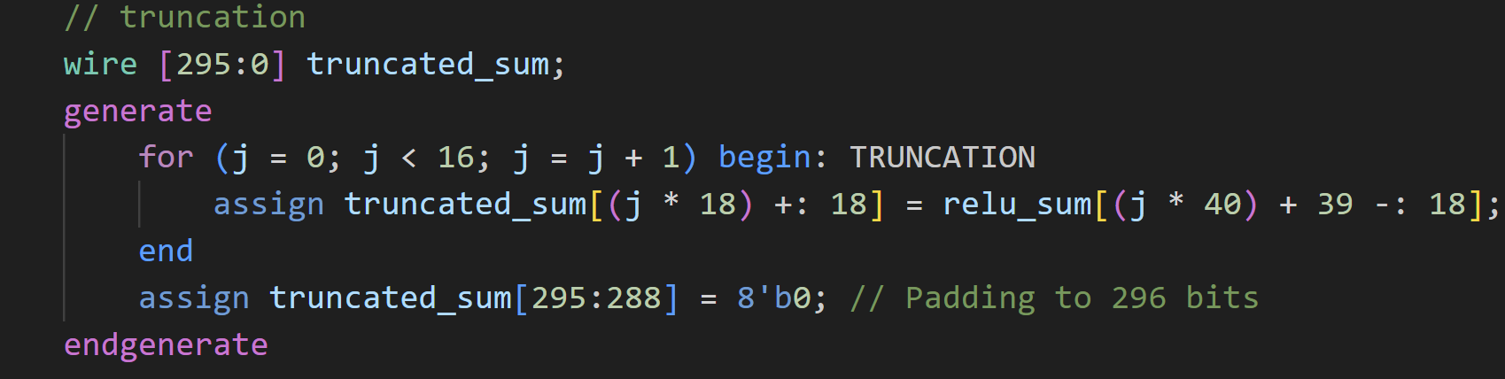
Truncation
Pick the high 18 bits to be the truncated result, and add 8 bits to reach 296 bits as mentioned in the paper.

Slide 7
Truncation
Pick the high 18 bits to be the truncated result, and add 8 bits to reach 296 bits as mentioned in the paper.

Slide 8
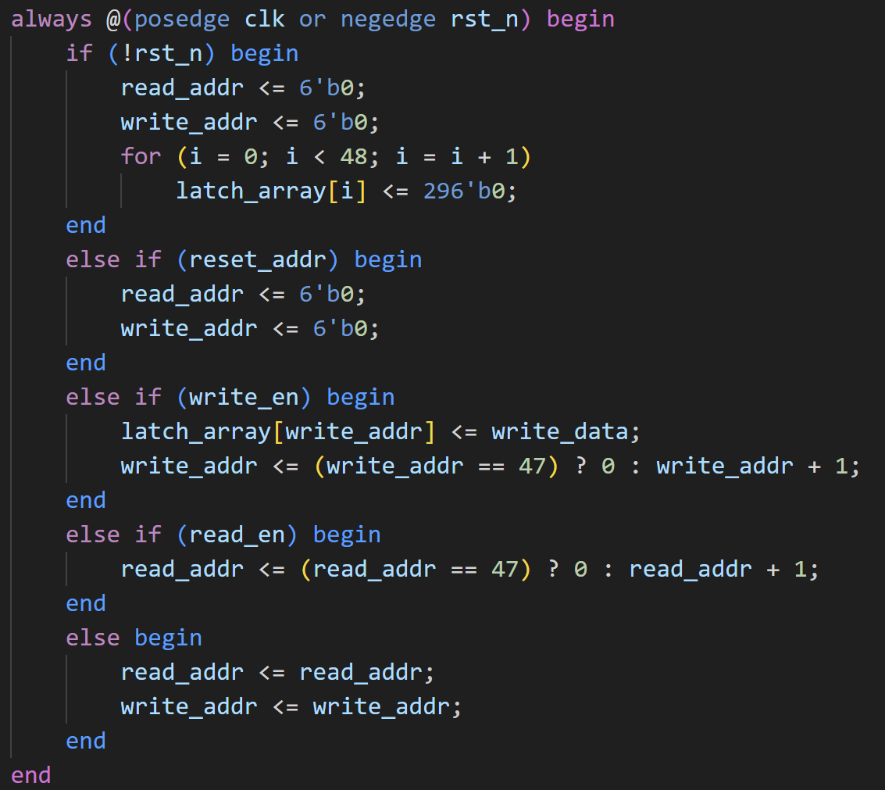
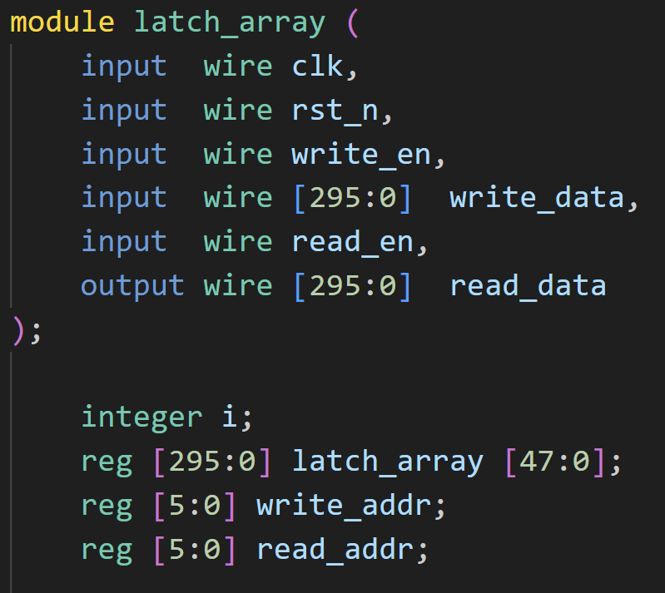
Latch Array

Slide 9
Finite State Machine of Latch Array
IDLE
INPUT
OUTPUT
Doing nothing, all registers store their values.
Writing latch array with data after ReLU.
Reading datas in latch array.

Slide 10
Finite State Machine of Latch Array
Done or reset
IDLE
INPUT
OUTPUT
Reset
When Quantizing

Slide 11
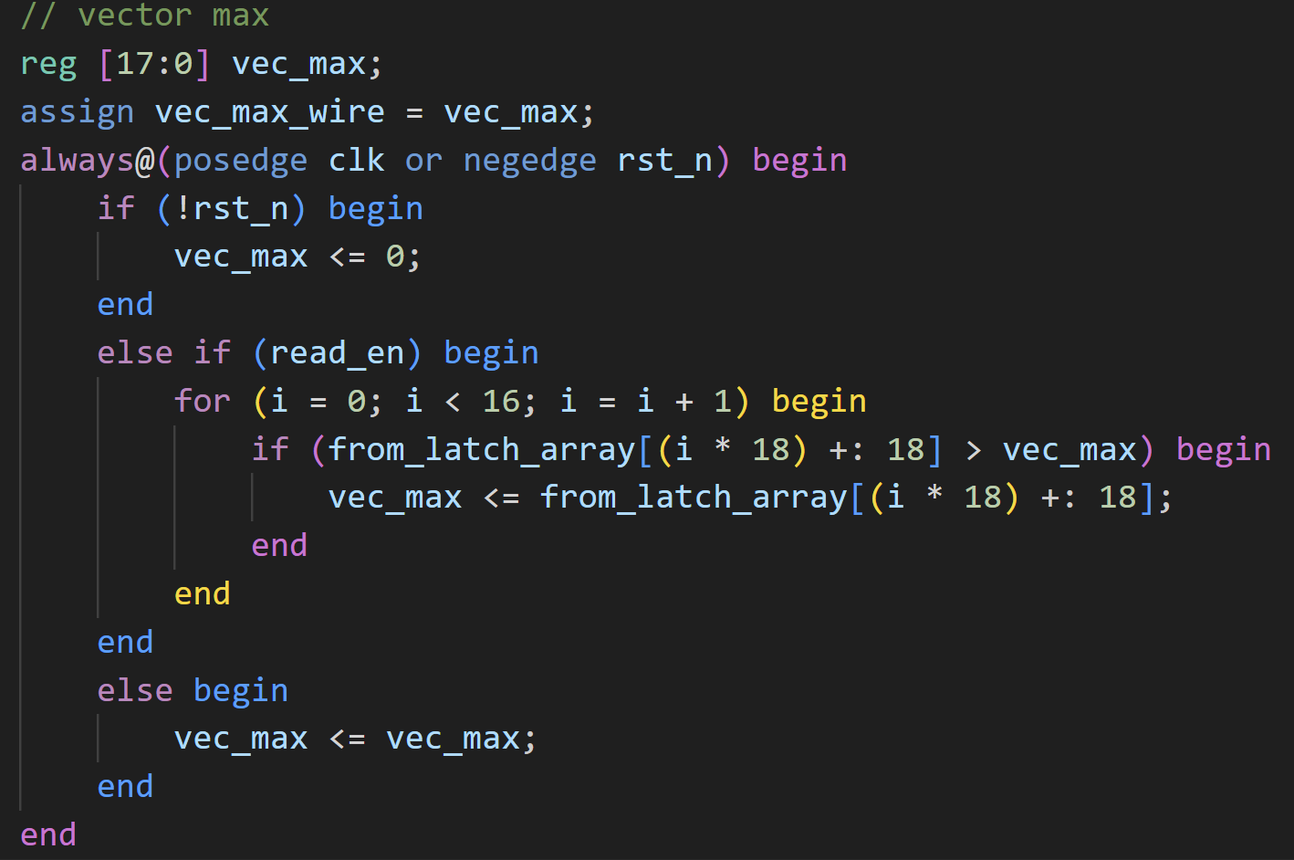
Vector Max
When in “OUTPUT” mode, find the max value in latch array.

Slide 12
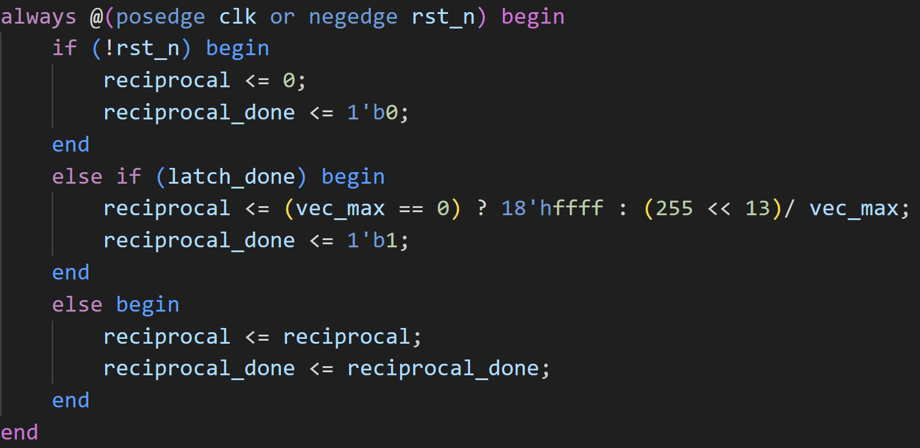
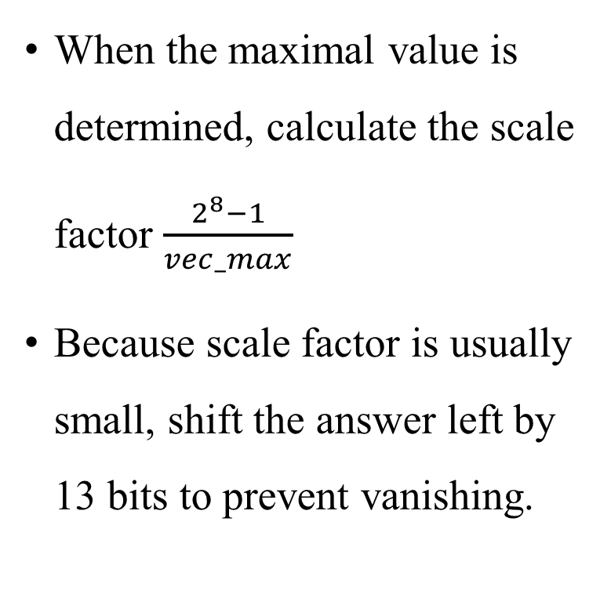
Reciprocal
When the maximal value is determined, calculate the scale factor $\frac{2^{8}−1}{vec_max}$
Because scale factor is usually small, shift the answer left by 13 bits to prevent vanishing.

Slide 13
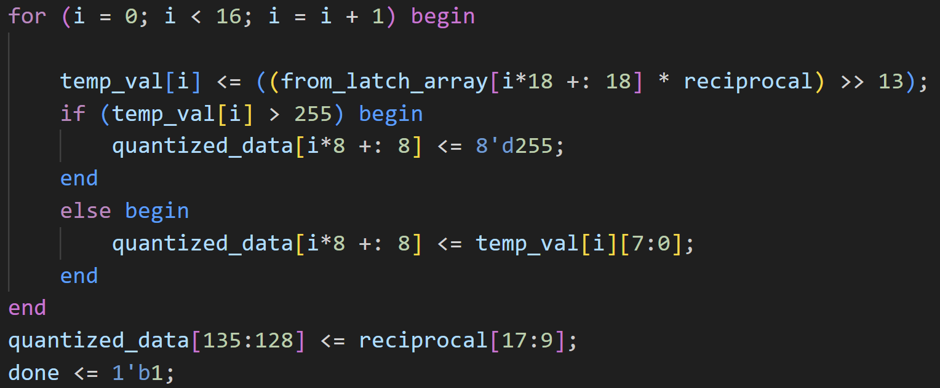
Quantization and Rounding
After switching to OUTPUT mode, quantize each data in latch array and store the result in a buffer implemented in testbench. (Remember to >> 13)

Slide 14
Testbench
Partial sum for the input is
{0110000…0, 8{0100000…0}, 0111110…0, 5{0100000…0}, 0111000…0}
Scale = 16, Bias = 1

Slide 15
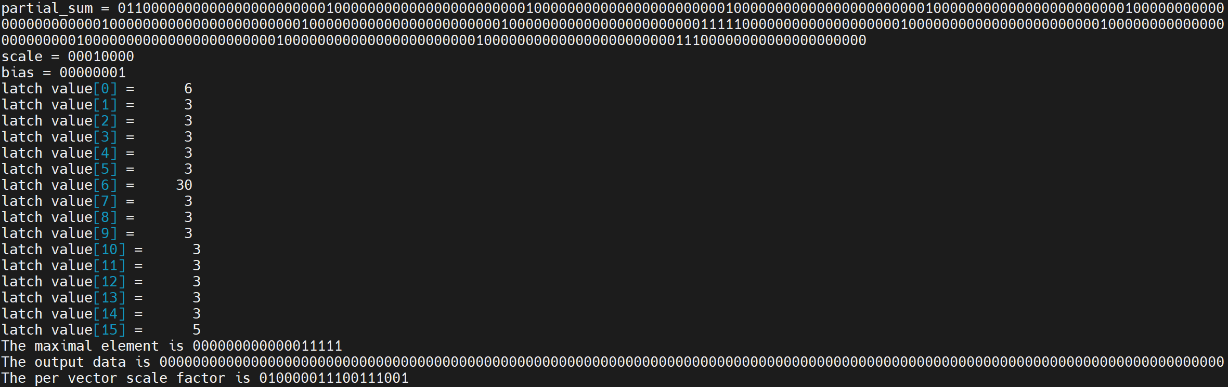
Current Progress
Error occur in quantization part, other parts function normally.

