Slide 1
CloakMe
Proactive Digital Protection for High-Profile Individuals
Founder: Mandar Satam
Website: www.clokame.com
Email: mandar.satam@gmail.com

Slide 2
The Problem
Executives, celebrities, and high-net-worth individuals are increasingly targeted by:
- Social media impersonation
- Doxxing and personal info leaks
- Deepfake attacks and data exposure
- Uncontrolled reputational damage
Traditional cybersecurity tools don’t protect individuals' digital identities.

Slide 3
The Solution
CloakMe is a unified digital exposure monitoring platform that:
- Scans dark web, paste sites, forums for leaks
- Detects impersonated/cloned social media accounts
- Flags risky content and deepfakes in real-time
- Delivers exposure scores and alerting systems

Slide 4
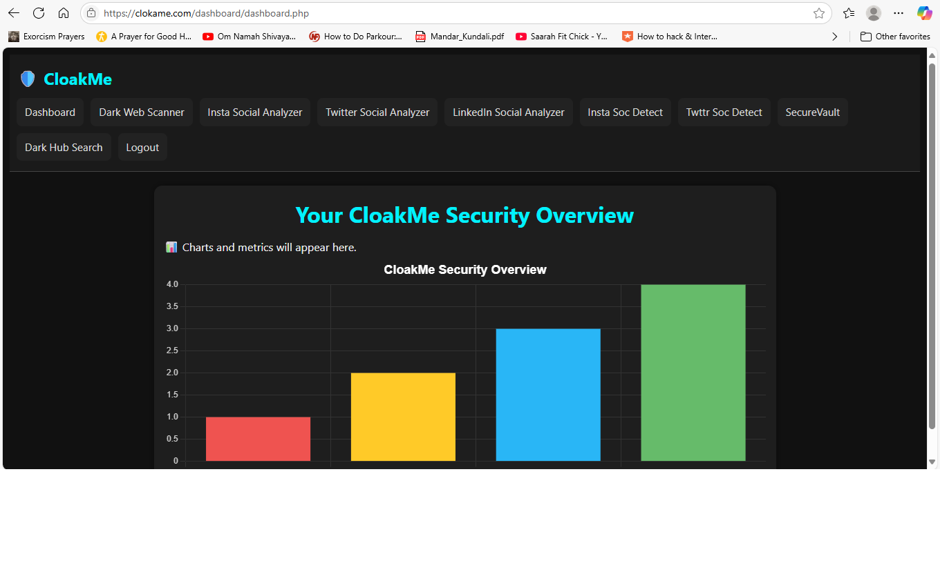
Product Features Overview
CloakMe Dashboard - User exposure visualization

Slide 5
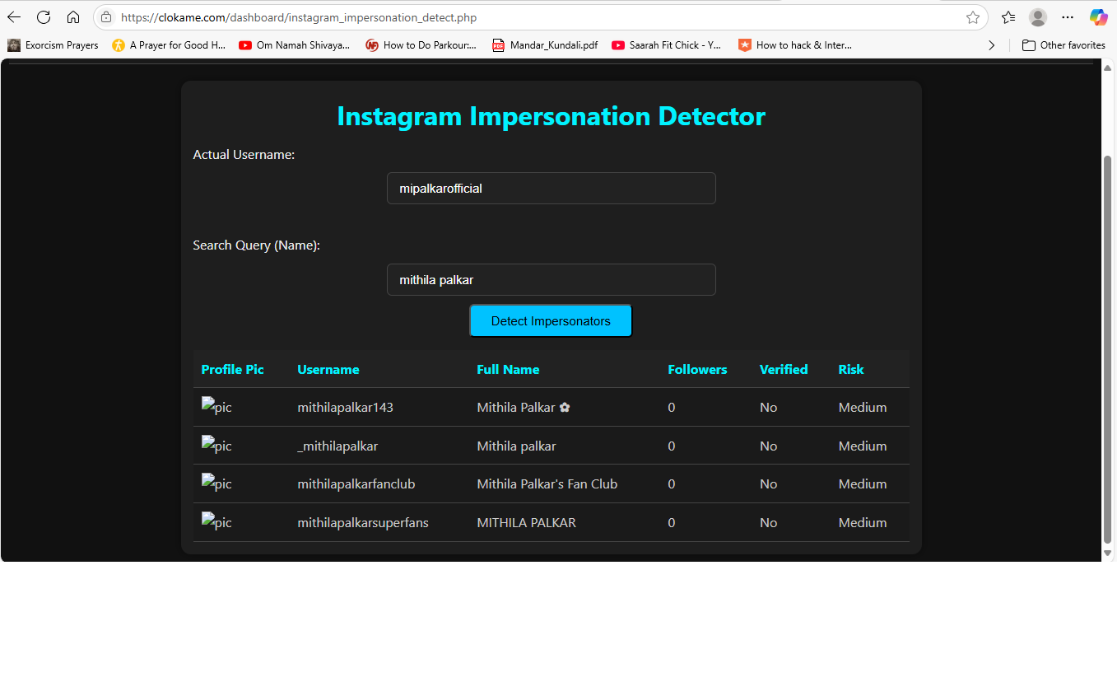
Instagram Impersonation Detector
Live impersonator detection with risk scoring

Slide 6
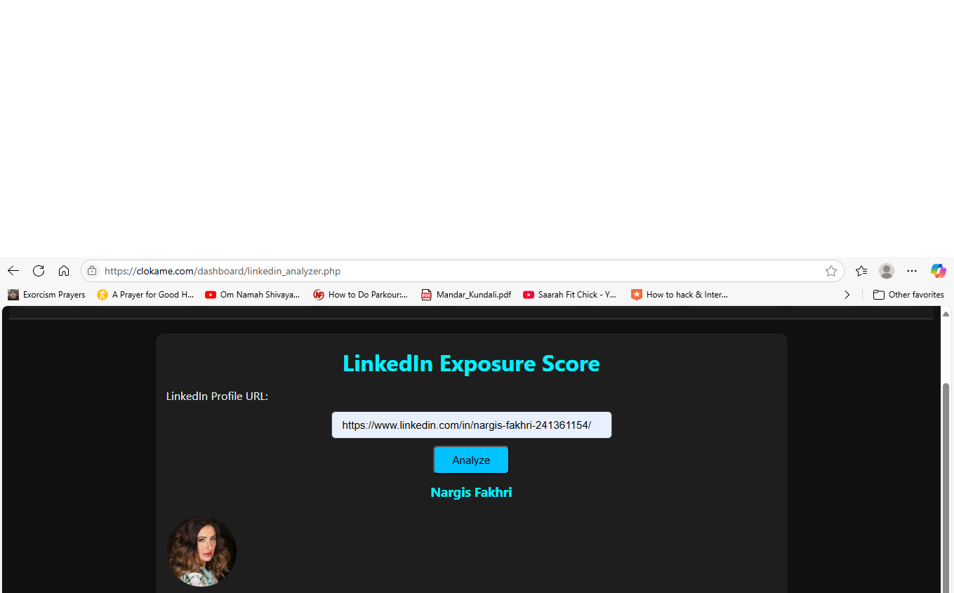
LinkedIn Exposure Analyzer
Checks for public overexposure in LinkedIn profiles

Slide 7
Market Opportunity
- $2B+ market for personal cybersecurity and digital identity protection
- Rapidly growing interest in VIP protection & brand monitoring
- Opportunity in proactive, continuous monitoring

Slide 8
Competitive Advantage
- Multi-source dark web scanning
- Modular scoring for social content and metadata
- Real-time alerts for impersonation or leaks
- Built with mobile-first, privacy-first design

Slide 9
Business Model
- SaaS subscription model
- Tiered pricing: individual, family, enterprise
- Freemium alerts; paid includes impersonation takedowns & vault access

Slide 10
Traction
- MVP complete and live at www.clokame.com
- Modules: Social Analyzer, Impersonation Detector, Secure Vault, Dark Web Hub
- 1 real registered user, 2 subscribers, 150+ outreach attempts

Slide 11
Team
Mandar Satam – Founder & CEO
- 15+ years in cybersecurity (Red Team, SCADA, IoT)
- CVE discoverer, author, SANS certified (GPEN, GXPN, GAWN)
- Former AppSec lead at US healthcare & fintech orgs

Slide 12
Ask & Use of Funds
Seeking $250K–$300K in pre-seed capital
- $80K: Engineering & UX
- $50K: Cloud infrastructure + security
- $40K: Marketing & outreach
- $30K: Mobile app development
- $50K: Legal, compliance, and runway

Slide 13
Contact
Mandar Satam
Founder & CEO, CloakMe
Email: mandar.satam@gmail.com
Website: www.clokame.com

