Slide 1
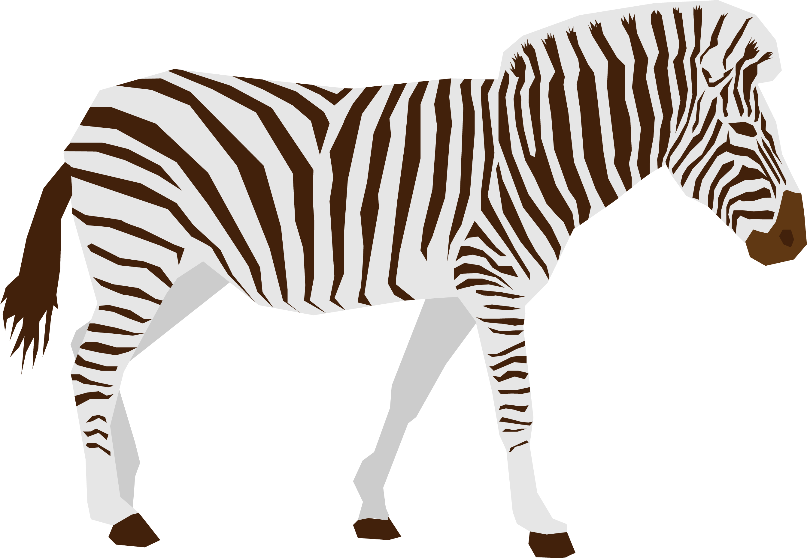
Cool Animal
<-- duplicated
Cool Animal
Cool Animal
<-- copy and pasted

