Slide 1
Online Community Identities:
https://uchicago.box.com/s/vp0ciemgmvof0id5nejgnfhojfwmjquz
An analysis of Adoption-related subreddits
By Ethan Kozlowski

Slide 2
Research Question
- How do the conversational dynamics and post sentiments within online adoption communities differ between general-purpose adoption subreddits like r/Adoption and adoptee-exclusive spaces like r/Adopted?
- Do adoptees and non adoptees differ in their sentiment towards adoption within these different spaces?
Supplementary Questions:
- Are the topics discussed in r/Adoption and r/Adopted distinctly different from one another?
- Are the posts from adoptees distinctly different from posts not made by adoptees in r/Adopted and r/Adoption?

Slide 3
Research Question
- How do the conversational dynamics and post sentiments within online adoption communities differ between general-purpose adoption subreddits like r/Adoption and adoptee-exclusive spaces like r/Adopted?
- Do adoptees and non adoptees differ in their sentiment towards adoption within these different spaces?
Supplementary Questions:
- Are the topics discussed in r/Adoption and r/Adopted distinctly different from one another?
- Are the posts from adoptees distinctly different from posts not made by adoptees in r/Adopted and r/Adoption?

Slide 4
Research Question
- How do the conversational dynamics and post sentiments within online adoption communities differ between general-purpose adoption subreddits like r/Adoption and adoptee-exclusive spaces like r/Adopted?
- Do adoptees and non adoptees differ in their sentiment towards adoption within these different spaces?
Supplementary Questions:
- Are the topics discussed in r/Adoption and r/Adopted distinctly different from one another?
- Are the posts from adoptees distinctly different from posts not made by adoptees in r/Adopted and r/Adoption?

Slide 5
Quick Data Overview
- Data collection method:
scraping old.reddit.com
(non dynamic) and reddit archive: the-eye.eu
- Reddits of interest:
r/Adopted
r/Adoption
these are the single two largest subreddits related to topic of adoption

Slide 6
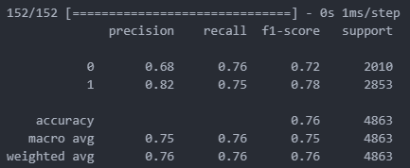
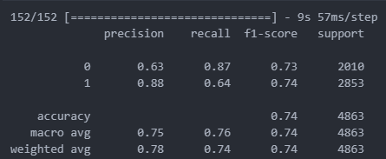
ML: DNN and biLSTM NN
Along with other more traditional ML classifiers (decision trees and logistic regression)
I attempted to classify reddit posts into those made by adoptees and those not made by adoptees.
The neural networks performed well but not incredibly so.
DNN
biLSTM NN

Slide 7
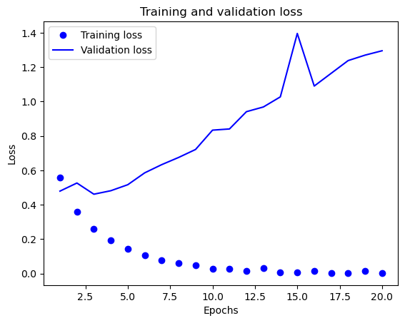
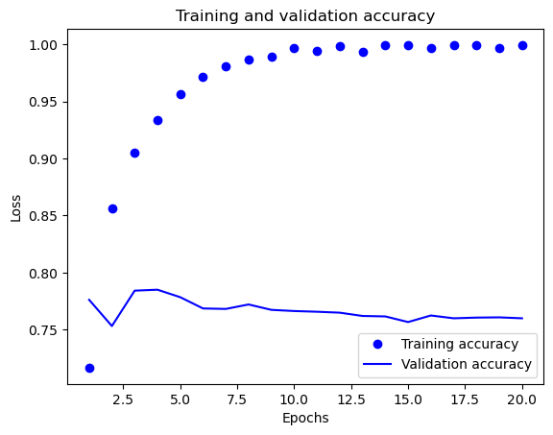
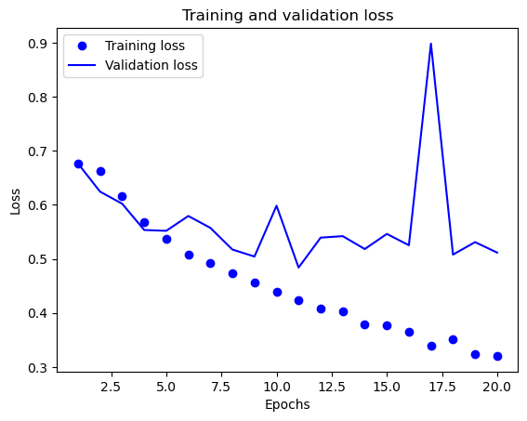
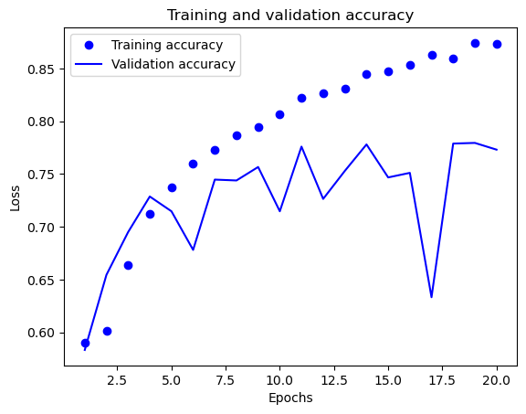
ML: DNN and biLSTM NN
Along with other more traditional ML classifiers (decision trees and logistic regression)
I attempted to classify reddit posts into those made by adoptees and those not made by adoptees.
The neural networks performed well but not incredibly so.
DNN
biLSTM NN

Slide 8
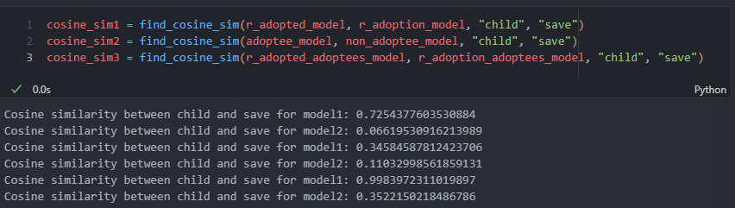
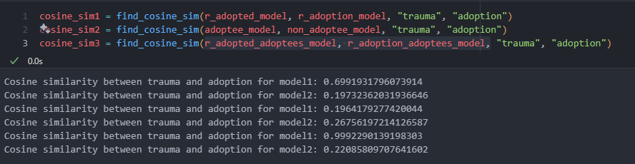
Word Embeddings (word2vec)

Slide 9
Word Embeddings (word2vec)

Slide 10
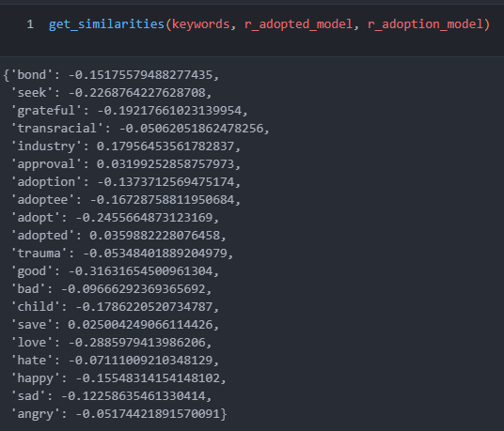
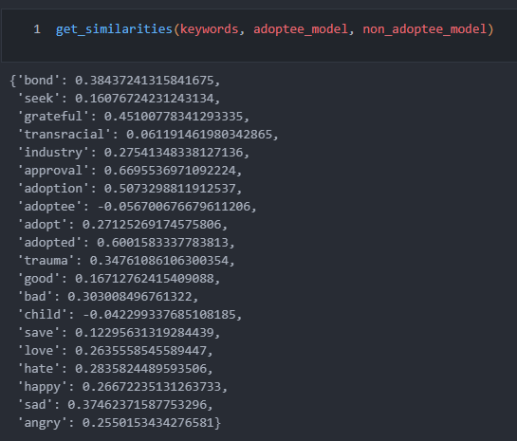
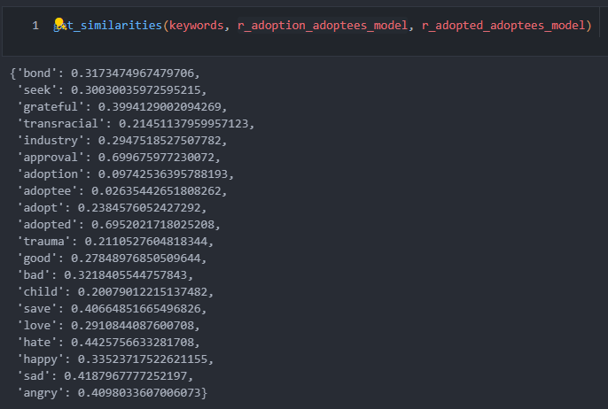
Word Embeddings (word2vec)

Slide 11
Word Embeddings (word2vec)

Slide 12
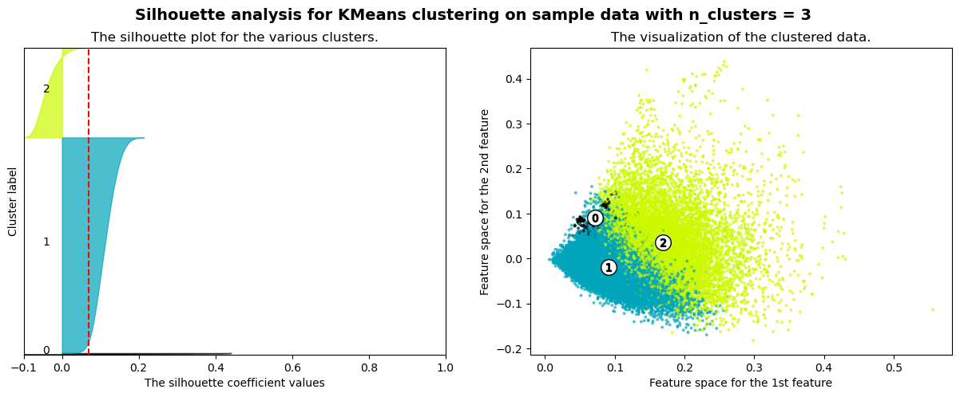
Clustering and Topic Modeling
The average silhouette_score is : 0.069

Slide 13
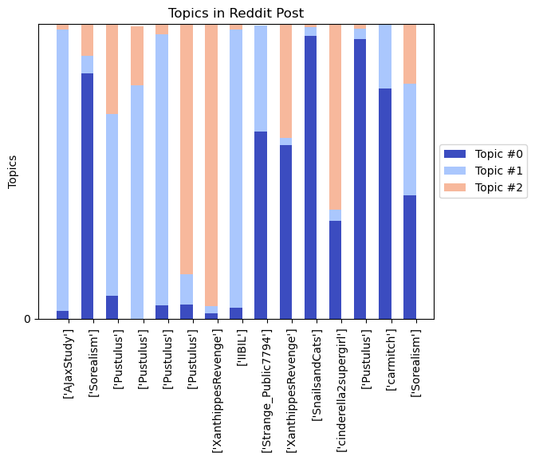
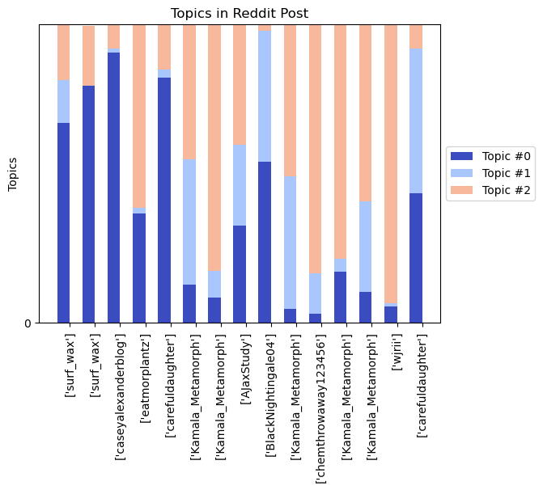
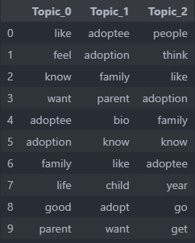
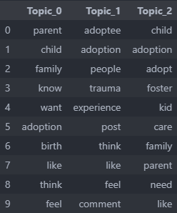
r/Adopted
r/Adoption

Slide 14
r/Adopted
r/Adoption

Slide 15
Sentiment Analysis:
No data was prelabeled for sentiment: therefore used VADER to rate the compound sentiment score for all texts.
VADER is specifically made for social media data and generally performs well (F1: 0.96)
Adoptee Sentiment: 0.39165695604488315
Non-adoptee sentiment: 0.4558886840314298
Running a t-test for sample means we see that means are statistically significantly different from one another at the α = .05 significance level

Slide 16
Sentiment Analysis: 2 way ANOVA
 | sum_sq | Degrees of Freedom | F-stat | PR(>F)
is_adoptee | 13.540146 | 1.0 | 36.756788 | 1.350233e-09
subreddit | 121.939295 | 1.0 | 331.022779 | 1.144487e-73
is_adoptee * subreddit | 0.000014 | 1.0 | 0.000038 | 9.950871e-01
Residual | 14685.122317 | 39865.0 | NAN | NAN

Slide 17
Sentiment Analysis: 2 way ANOVA
 | sum_sq | Degrees of Freedom | F-stat | PR(>F)
is_adoptee | 13.540146 | 1.0 | 36.756788 | 1.350233e-09
subreddit | 121.939295 | 1.0 | 331.022779 | 1.144487e-73
is_adoptee * subreddit | 0.000014 | 1.0 | 0.000038 | 9.950871e-01
Residual | 14685.122317 | 39865.0 | NAN | NAN

Slide 18
Sentiment Analysis: 2 way ANOVA
 | sum_sq | Degrees of Freedom | F-stat | PR(>F)
is_adoptee | 13.540146 | 1.0 | 36.756788 | 1.350233e-09
subreddit | 121.939295 | 1.0 | 331.022779 | 1.144487e-73
is_adoptee * subreddit | 0.000014 | 1.0 | 0.000038 | 9.950871e-01
Residual | 14685.122317 | 39865.0 | NAN | NAN

Slide 19
Conclusions
We see there are measurable differences between the posts written by adoptees and written by non adoptees.
With ML we see that we can predict whether or not someone is an adoptee based off of their post text alone.
Through Topic Modeling we see that r/Adopted has this topic of shared bonding and empathy where r/Adoption has an exclusive topic related to prospective adoptive parents
Through Embedding we see the relationship between specific words varies by subreddit and by adoptee status
We also see that status as adoptee and non adoptee and subreddit are both independently significant predictors of a post sentiment.

Slide 20
Conclusions
We see there are measurable differences between the posts written by adoptees and written by non adoptees.
With ML we see that we can predict whether or not someone is an adoptee based off of their post text alone.
Through Topic Modeling we see that r/Adopted has this topic of shared bonding and empathy where r/Adoption has an exclusive topic related to prospective adoptive parents
Through Embedding we see the relationship between specific words varies by subreddit and by adoptee status
We also see that status as adoptee and non adoptee and subreddit are both independently significant predictors of a post sentiment.

