Slide 1
Online Discussions on Adoption
By Ethan Kozlowski

Slide 2
Social Science Relevance
Online Formation of Identity
Expression of Adoptive Identity in salient spaces
Novel approach to studying topic (adoption)

Slide 3
Why Large scale computing?
Enhance the speed of serial processing for data wrangling:
Tokenization
Normalization
POS tagging
PySpark ML pipelines on EMR cluster
scalable for larger NLP work
test/train handling through pipeline

Slide 4
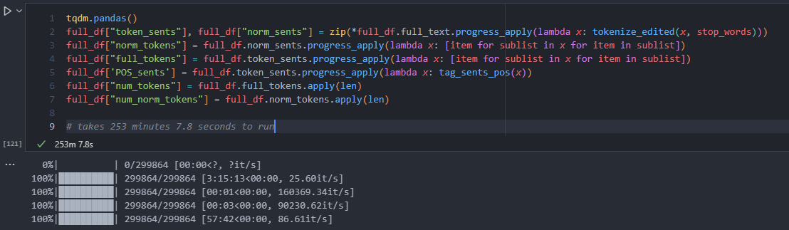
Serial Code
Takes hours to run!

Slide 5
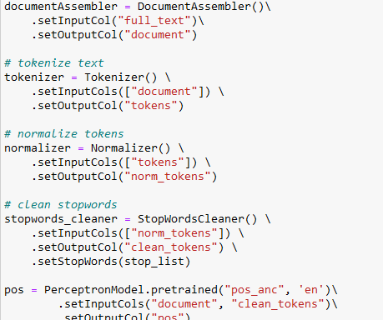
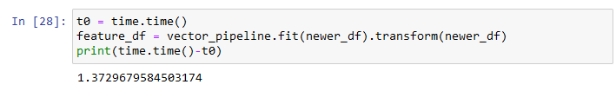
PySpark code
Takes seconds to run ☺

Slide 6
Data Collection
Data collection was previously done for another class:
consisted of collecting links and passing them through PRAW
limited by API limits, chose not to parallelize this process, but theoretically could

Slide 7
Predicting Authorship
Utilizes EMR clusters and Pyspark
Pipeline
Assembler
LR or RF
Grid Search

Slide 8
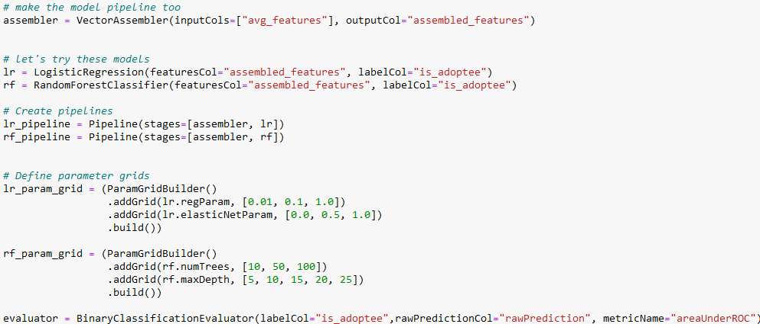

Slide 9
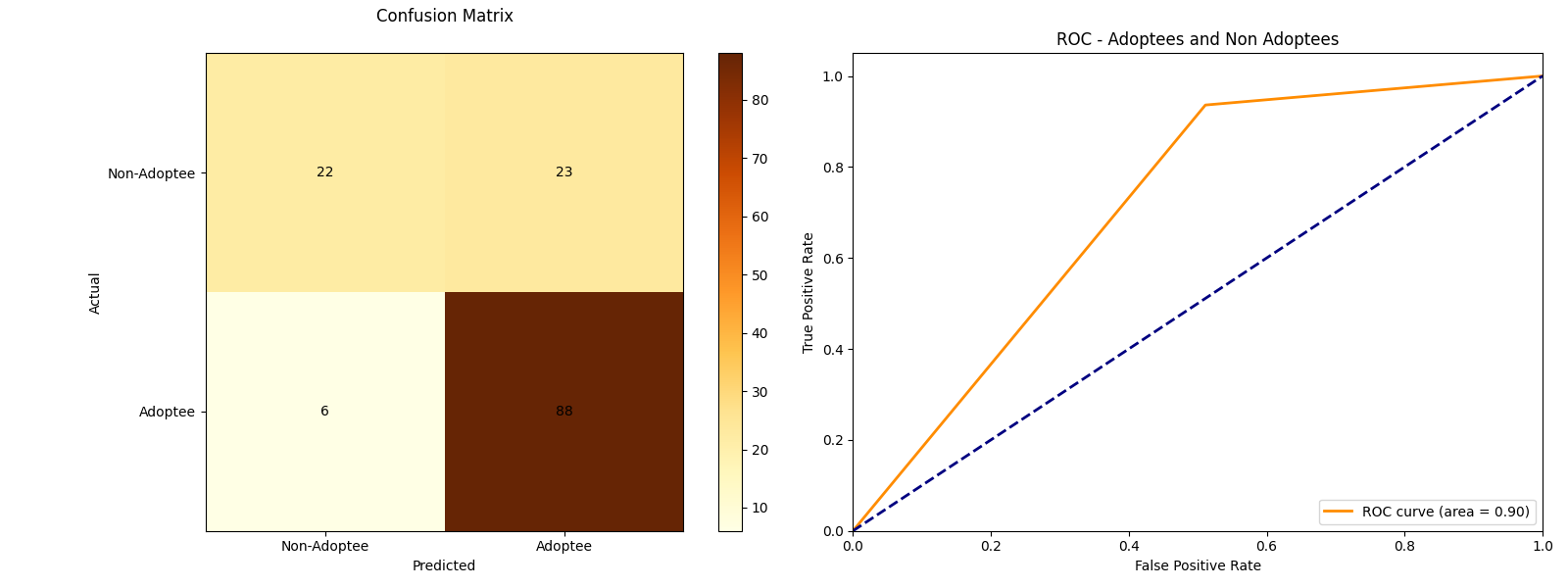
BEST 5-FOLD CV RF

Slide 10
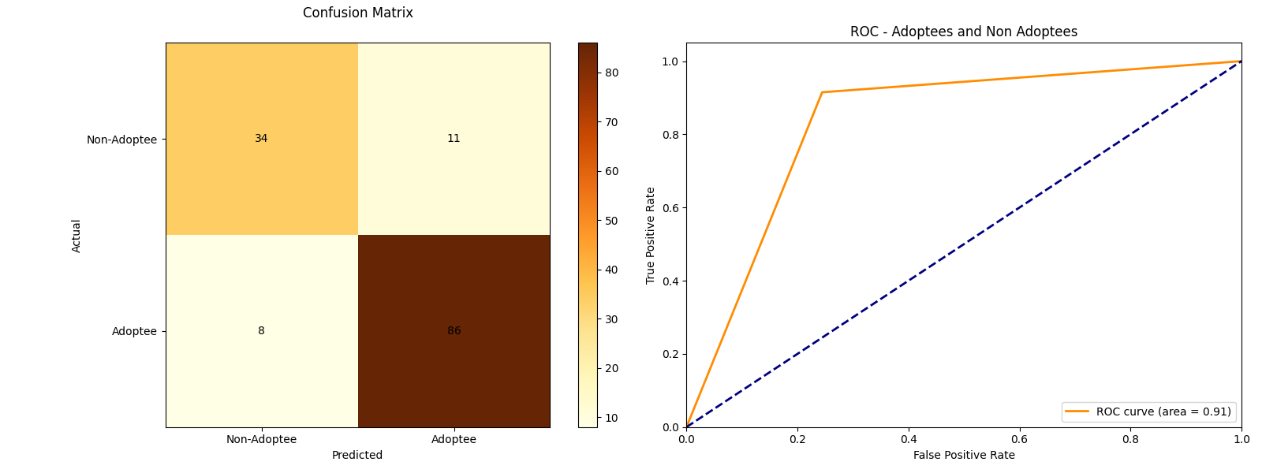
BEST 5-FOLD CV LR

Slide 11
Discussion and Takeaways
Py Spark significantly speeds up part of the process
ML pipeline is scalable
classifier does pretty well
adoptee posts are distinct from non adoptee posts

