Slide 1
Lab 9

Slide 2
Logistics- IMPORTANT!
If you have a question about lab or homework, including coding problems, ask either prof. Molnar or me via piazza, email or office hour ahead of the due date. If you have a question during the week, ask on piazza or by email instead of waiting for office hour.
If you have an unusual and particular reason (e.g. exam, illness, etc.) to believe you won’t be able to finish a lab/homework on time, get in touch with prof. Molnar to see if you can arrange an extension.

Slide 3
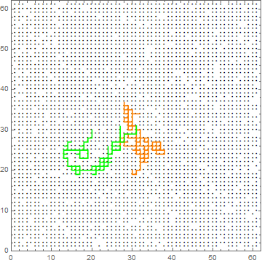
Personal Project
You have an optional opportunity to perform an investigation of your own to replace one of the homework grades.
The topic may be ANY computational project from/related to any domain of physics.
Some topic examples include comparison of particular computational methods (e.g. pseudo-random number generation, numerical integration etc.) simulation and analysis of some complex random process, quantum systems, time dependent/relativistic E&M, fluid dynamics etc.
If you already have an idea, contact prof. Molnar to arrange the details. If you’re interested but not really sure what to do, email me or come to the office hour to discuss.

Slide 4
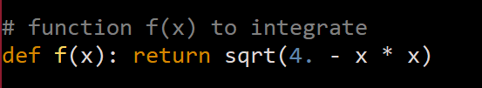
Part 1
The default code has the following function (line 17-18): Run the code for different value of N (= product of two numbers) and observe how the average error changes.
Next, modify line 18 to implement the two different integrands shown in the manual. The x1, x2 on line 25 are the bounds of your integration. Think about how you need to set them to prevent them from blowing up to infinity. The upper bound for the integral could just be set as an arbitrarily large number, but if you want to be smart about it, consider the order of magnitude of integrand as you increase x.

Slide 5
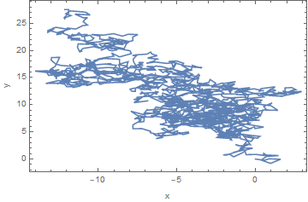
Part 2
You are given a sample code of lattice random walk. First, test it out to see what it does.
Next, modify the code so that you have a continuous 2D random walk. This means, instead of picking one of four direction, you have to choose an angle from a continuous interval (either –pi to pi or 0 to 2pi) and calculate the projection of a step in the cartesian coordinates.
Analyze the mean-squared displacement at Nth step, as well as the standard deviation, and compare the order of magnitude of the two.

Slide 6
Part 3
You are also given a sample code for a 2-D lattice self-avoiding walk. Run it to simulate self-avoiding walks on square lattice, and estimate the Flory exponent between mean-squared displacement and number of steps.
Remark on how the algorithm is able to avoid crossing the trajectory without changing the statistical property of the ensemble.

