Slide 1
Lab 12

Slide 2
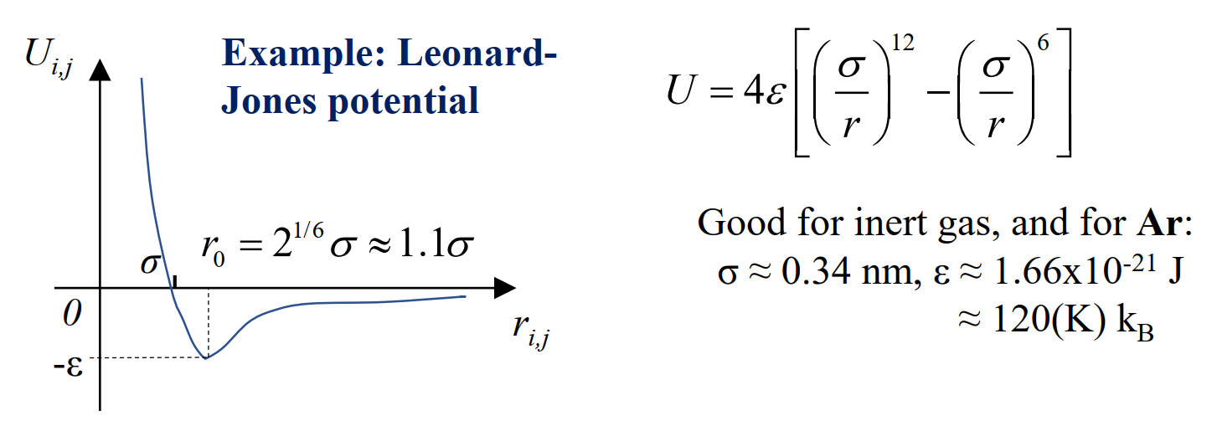
Leonard-Jones potential
In this simulation, we have an attractive force outside some radius r_0, and repulsive force within. Note that the repulsive force diverges to infinity.

Slide 3
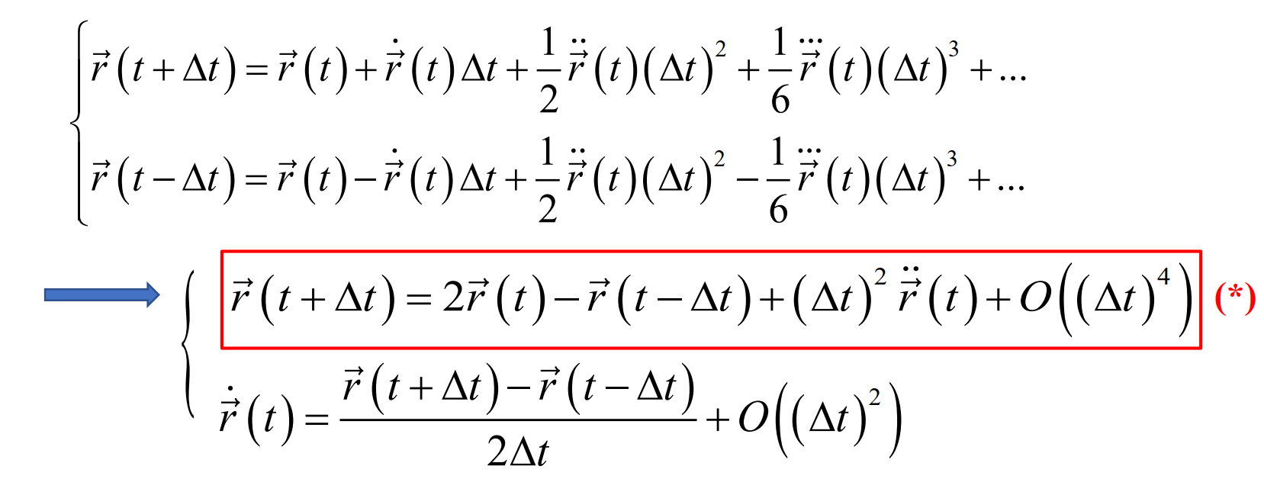
Verlet approximation
In this approximation, the change in position is given as a series expansion in derivatives.
This is appropriate for our problem, because we can calculate the interaction force using the equation for central potential, so we can obtain the 2nd order time derivative without actually taking derivatives!

Slide 4
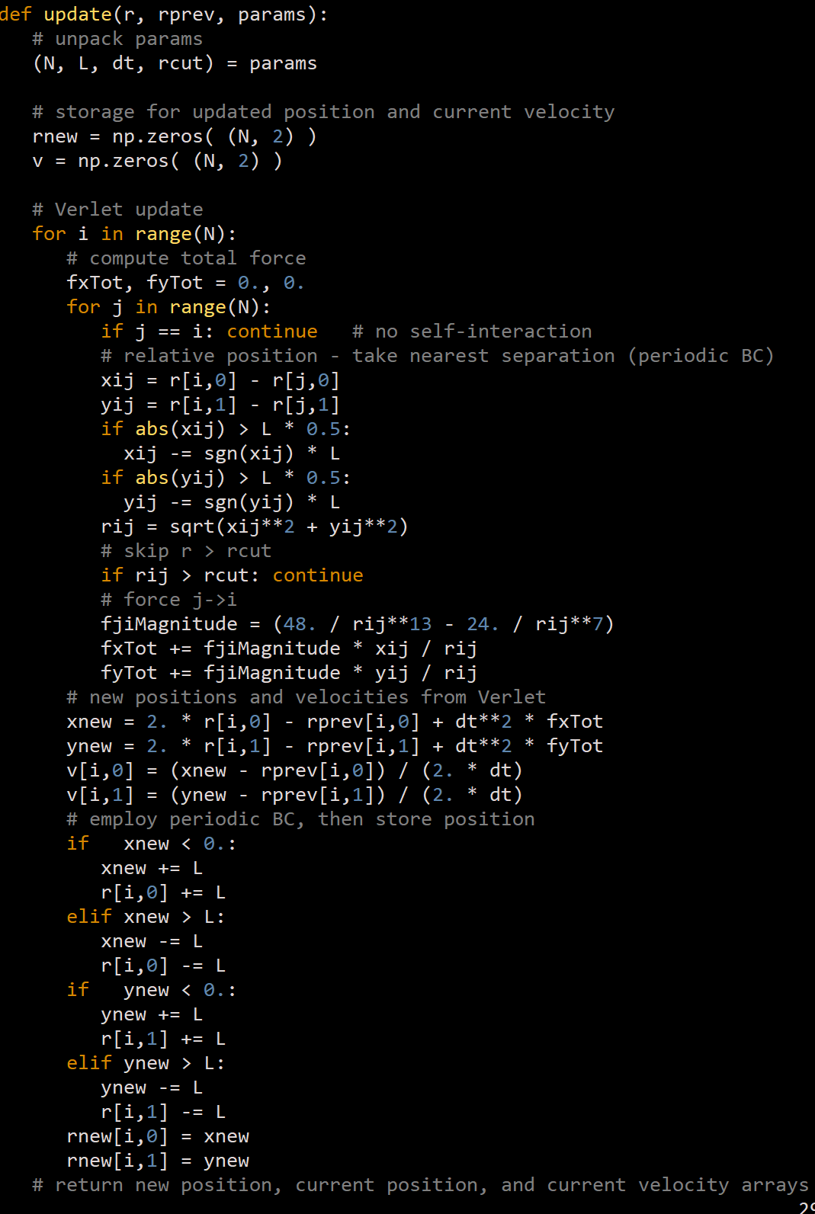
Code
1
Finding distance between two particles, and applying periodic boundary condition
For r >> r_0, the force is too weak, so a cutoff radius is set to ignore ‘long-ranged’ interactions. If r is within this cutoff threshold, we compute the force based on the potential.
We then evaluate position and velocity using Verlet approximation.
2
3

Slide 5
To do
Set up 25 particles in a 5x5 box, with 0 velocity and some displacement, and watch its behavior over time. On the report, include two figures: initial state, and final state.
Try different values of kinetic energy to speed up the convergence. Once a triangle lattice-like structure is obtained, ‘melt’ the frozen lattice by heating the system.
Attempt a similar run for (i) different initial velocity, (ii) different initial position, and (iii) different density (one each is fine). Describe briefly how their behavior converging to equilibrium changes.

