Slide 1
Lab 2

Slide 2
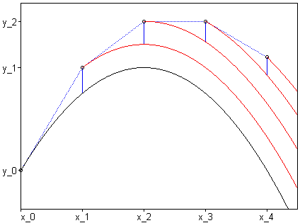
errata

Slide 3
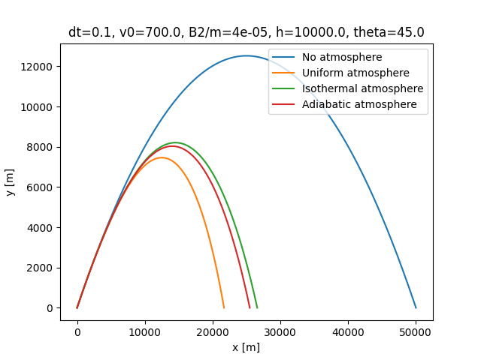
Part 1
Plot the four trajectories:
Uniform atmosphere < adiabatic atmosphere < isothermal atmosphere < no atmosphere
In the code, the function
fD_over_v = B2_m * rho
Gives you drag from isothermal air. To make air density constant, replace the exponent with 1, and to have no atmosphere, set rho to 0.
For adiabatic atmosphere,
rho = (1 – a * y / T) ** (1/(gamma-1))

Slide 4
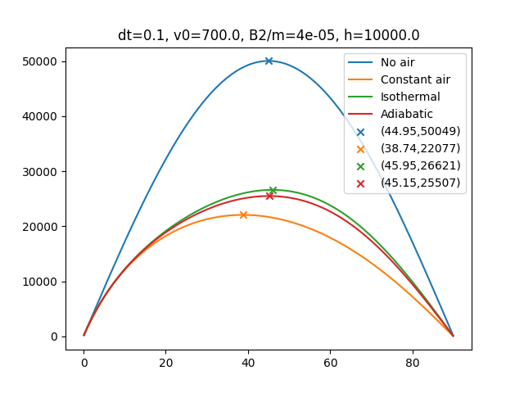
Part ii
You will implement some sort of optimization algorithm to find the value of theta that gives you the maximum distance for each case.
The figure on the left shows you the final distance as a function of angle, along with their respective maxima.

Slide 5
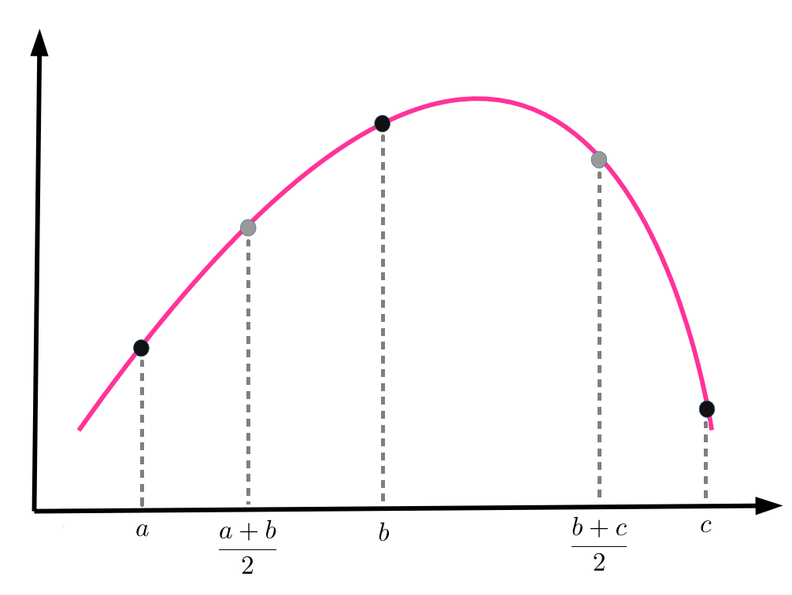
Bisection method
Select two initial angles, a, and c.
Obtain a third angle, b = (a+c)/2.
Calculate the total distance for θ = (a+b)/2, θ = b, and θ = (b+c)/2.
Determine a termination condition (either Δx < threshold or n_iterations)
Set up conditionals:
IF f( (a+b)/2 ) > f( b ) > f( (b+c)/2 ), THEN set a = a, c = b, and b = (a+b)/2.
IF f( (b+c)/2 ) > f( b ) > f( (a+b)/2 ), THEN set a = b, c = c, and b = (b+c)/2.
IF f( b ) >= f( (a+b)/2 ) and f( b ) >= f( (b+c)/2 ), THEN set a = (a+b)/2, c = (b+c)/2, and b = b.
Check termination condition; if condition is not met, continue.

Slide 6
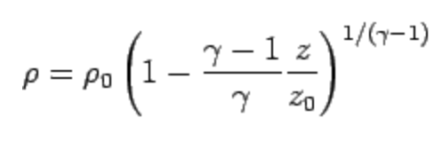
On the report
Part 1:
A plot for the four trajectories with ALL relevant information
Justify the value of a / T used for Adiabatic atmosphere.
Compare the value to the coefficient calculated using the formula:
Comment on qualitative features
Part 2:
Find the maximum distance for each type of atmosphere using whatever method of your choice. Make sure to use the same constants (B2, dt, v0, etc.), and summarize your result in either a table or a plot that contains the four maximal trajectories.
Estimate the magnitude of error.

