Slide 1
Lab 3
You will do things

Slide 2
Part 1 – what to do
Write appropriate codes to simulate a simple linear oscillator using Euler method, Euler-Cromer method, and RK2. (For Euler-Cromer, refer to p.52 of textbook). Plot your results for each method.
Obtain analytic solution, plot global error for each method and comment on the differences.

Slide 3
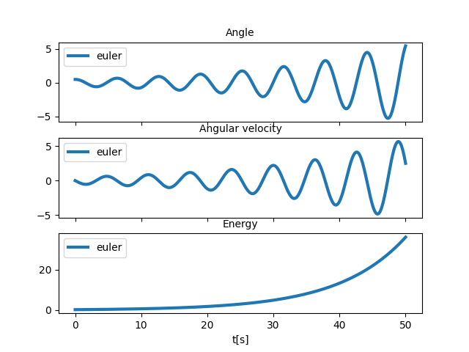
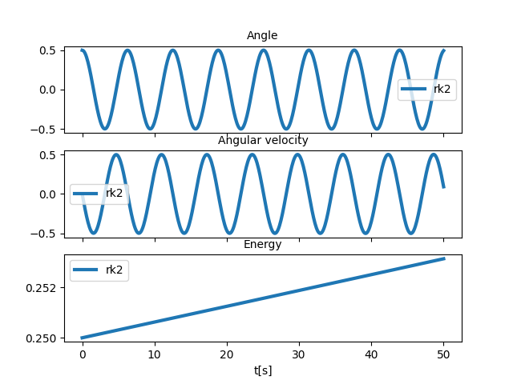
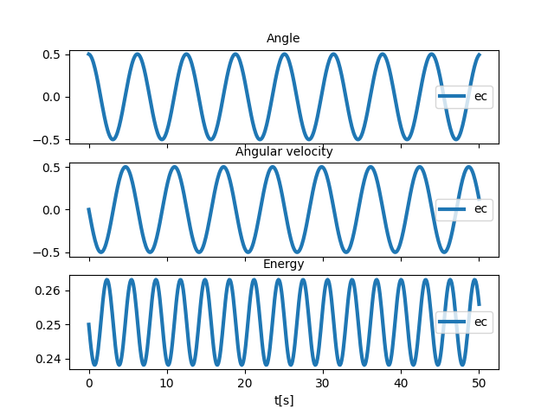
Part 1-what you will obtain

Slide 4
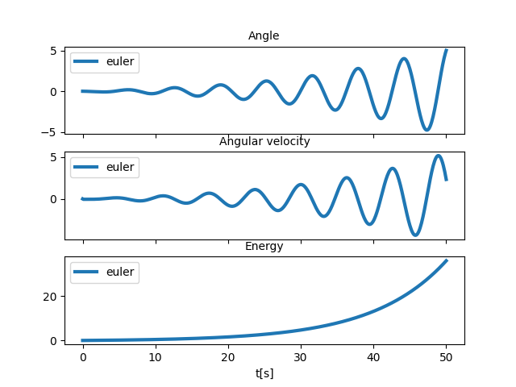
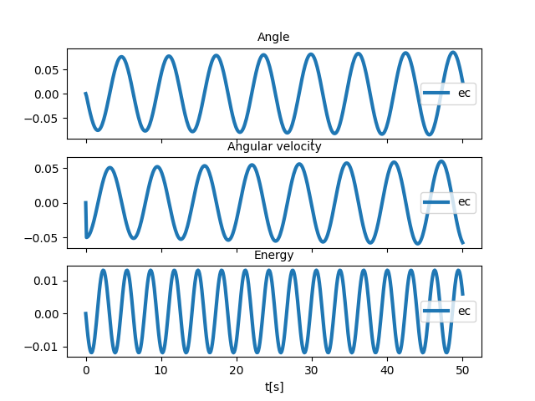
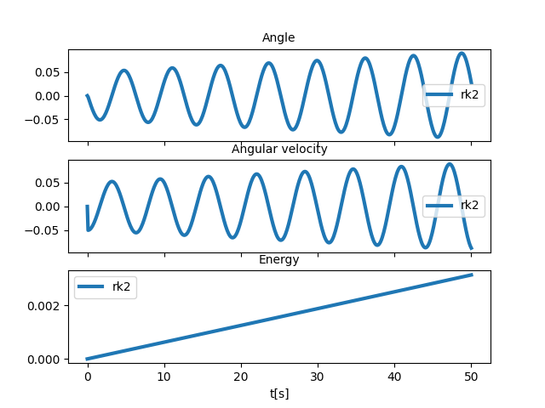
Part 1- error for each method

Slide 5
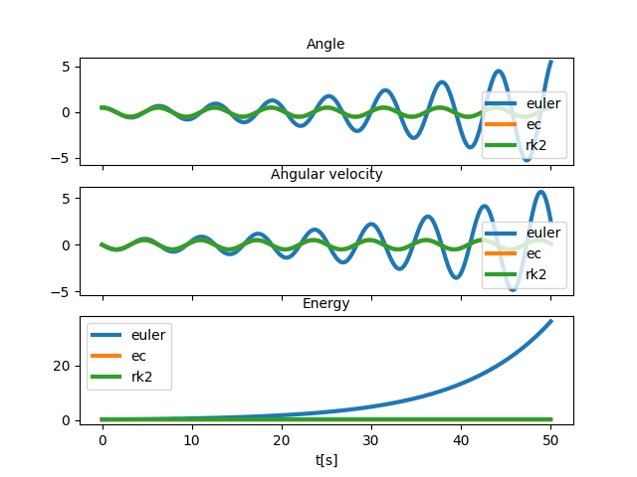
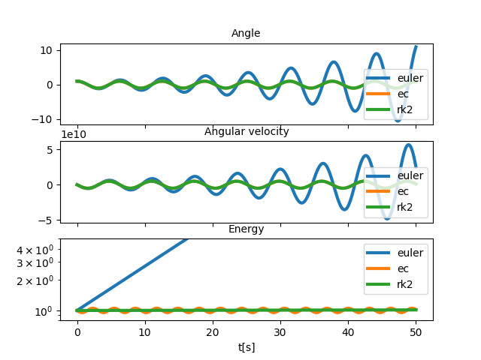
Part1 – what not to do

Slide 6
Part2 – what to do
Write new codes to implement damping and driving force to the simple linear oscillator code in each method.
These equations above gives you all the clues you need for a driven damped oscillator.

Slide 7
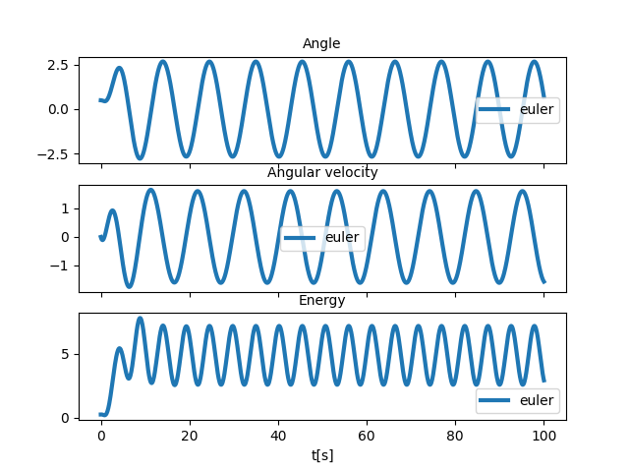
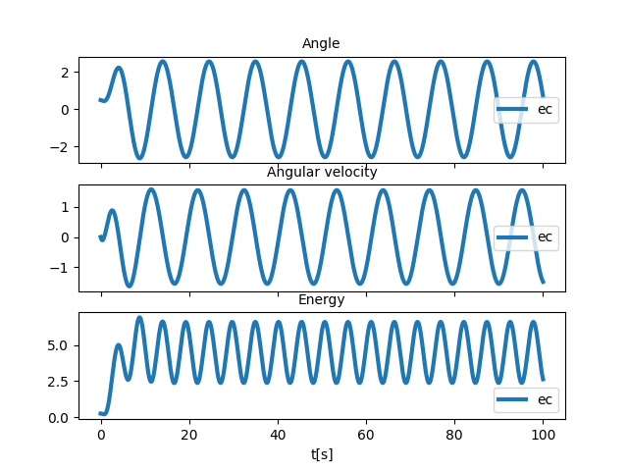
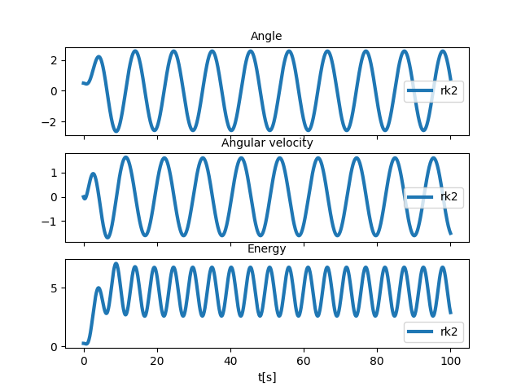
Part2: output example

Slide 8
PArt3: what to do
Implement oscillator with nonlinear dependence
(e.g. for Euler method, use omega[i+1] = omega[i] – w0^2 * Sin(theta[i]) * dt)
Find the periods of oscillation for different amplitude of oscillation; then plot the result and compare it to the analytic solution in the manual

Slide 9
On the report
(1) Three plots, each showing simulation of simple linear oscillator using Euler, Euler-Cromer and RK2 integrators
(1) Three plots, each showing the global error for each of the three simple oscillators.
(2) Three plots, each showing simulations of driven damped linear oscillator using each methods (for any amount of driving/damping)
(2) Three plots showing the underdamped, overdamped and critically damped cases for EC
(3) Three plots showing simulated nonlinear oscillator for each methods
(3) A plot showing the relationship between amplitude and period (use EC for this one), both the simulated one and analytic result.

