Slide 1
Lab 5

Slide 2
Debugging a physics code
Error in syntax
Error in algorithm
Error in physics

Slide 3
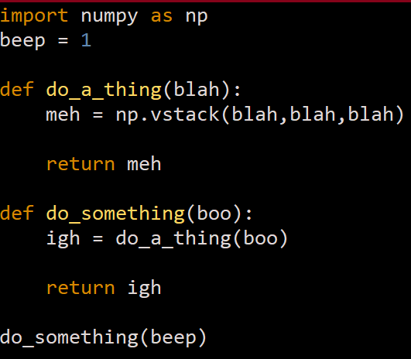
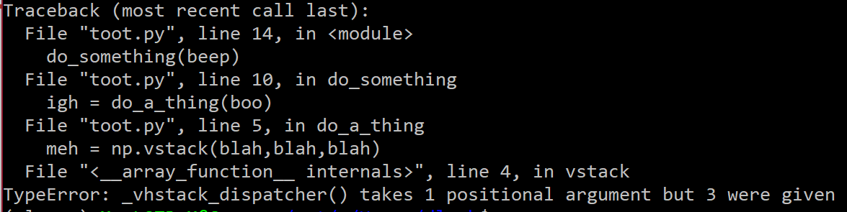
Error in syntax
Most common ones, also most diverse in kind
Easily fixed by following the stack trace in error message (see example) and reading the documentations

Slide 4
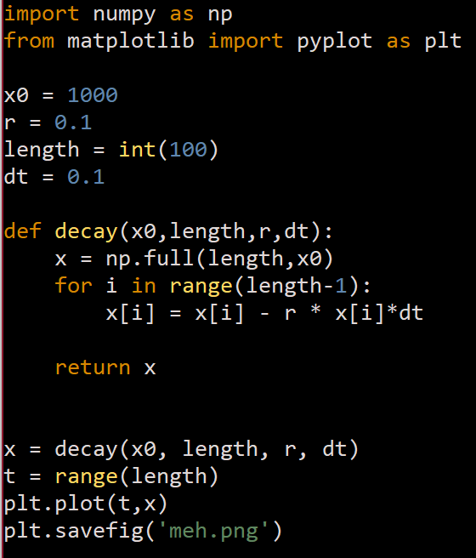
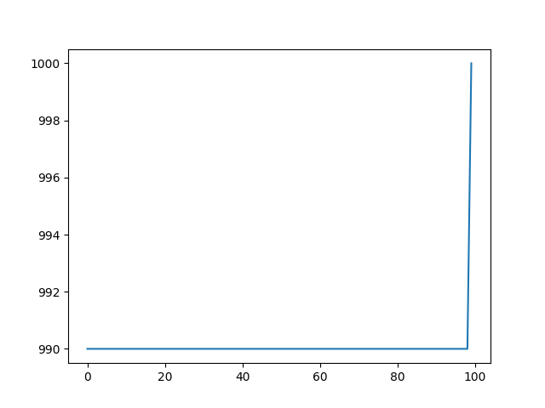
Error in algorithm
Happens when you mess up how your thought is translated to steps that your computer understands.
Sometimes results in error messages, sometimes results in shitty output

Slide 5
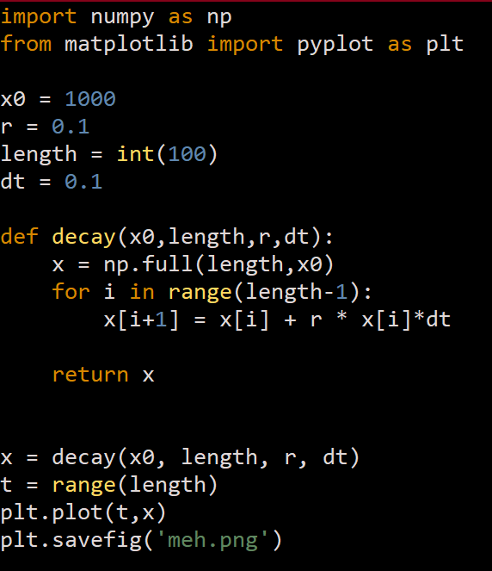
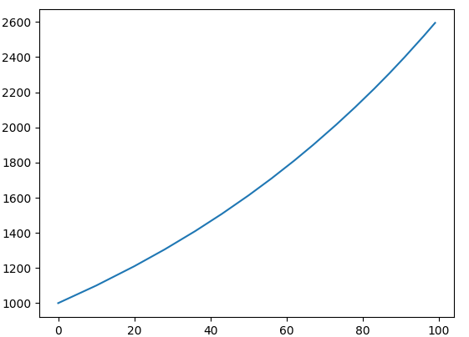
Error in physics
Often the most difficult kind of error to isolate/fix
Often happens without any error message (i.e. no stack trace!!)
100% of the time, you will end up with some result that is contrary to expectation.
To fix this, you have to either 1. carefully think about why you got the result you did, or 2. start solving the physics problem from scratch

Slide 6
When your code misbehaves
Fix syntax error
Yes
Fixed
Fixed!
Code fails
Error message?
Not fixed
Do something else
Fixed
No
Check algorithm implementation
Fixed
Fix shitty physics
Not fixed
Not fixed
RIP

Slide 7
Tips for (slightly) easier debugging
Put space between parentheses; makes parenthesis matching much easier to keep track of.
Solve the problem and write out the core part of the algorithm on paper first, and then transfer it to code.
Write descriptive variable/function names
Make use of the ‘print()’ statements to check you are getting what you would expect to get at each stage of the code (Pay attention to data type/shape, order of magnitude, sign)
At every math operation, do dimension analysis

Slide 8
Lab 5 but for real this time

Slide 9
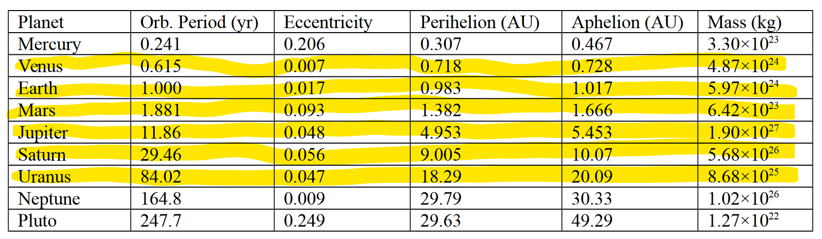
Part 1
Pick a planet, punch the right numbers in, simulate.
NOTE: The default code assumes your system supports functional interactive graphics window. If this is not the case (e.g. graphic panel doesn’t work, or you code on vim/other text-only environment with no graphical support), you need to modify the code to save your output as either 1. a gif stack of frames, or 2. only plot the finished trajectory at the end of the run.

Slide 10
Calculating orbital velocity
T^2 ~ a^3 = R^3 for circular orbit; T / T_E = (R / R_E)^(3/2) Plugging this into v = 2pi R / T = 2pi R / T_E * R_E^(3/2) / R^(3/2) = 2pi / sqrt(R) in A.U. units

Slide 11
Part 1I
Using the same code, simulate the orbit of Shoemaker-Levy 2 comet, and Haley’s comet. (Params given in lab manual)

Slide 12
Part iii
Modify the two-planets.py code to simulate a three-body problem. Start with the approximate case where sun doesn’t move, and find out how big Jupiter needs to be to 1. make earth’s orbit aperiodic, 2. fling earth out of the solar system. Finally, observe what happens when you let sun be a freely moving body too. (i.e. create a separate code to evaluate change in position of sun)

