Slide 1
Lab 4
You will do things

Slide 2
Part 1
Modify code to plot three pairs of Poincare sections:
One for Stable, periodic regime
One for period-doubling regime
One for chaotic regime
(Hint: see textbook chapter 3.3)
Comment on the characteristics, and your choice of parameters.

Slide 3
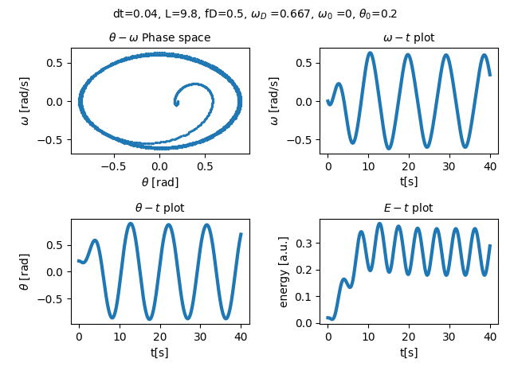
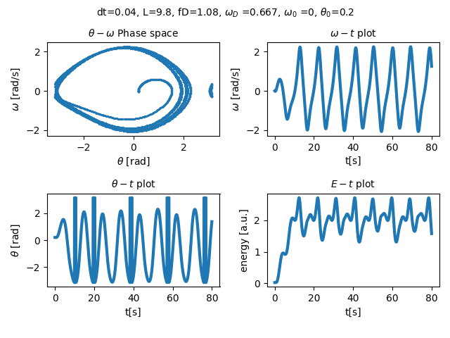
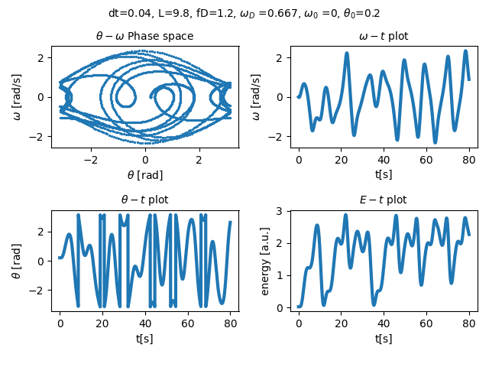
Part 1: Sample plots

Slide 4
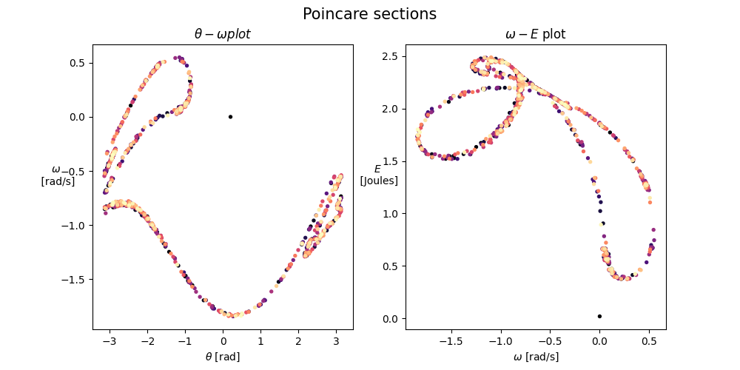
Part 1: sample plot

Slide 5
Part 2, 3, 4
(2) Change the initial values of theta and omega, Observe the change in what you see on the plot.
(3) Change the frequency of phase cut to pi/2, pi and 37 degrees, and compare the output to what’s obtained from part 1 and 2.
(4) Set the sectioning frequency to some value that is incommensurate with driving frequency (i.e. not a rational multiple), and discuss the results.

Slide 6
What to include on the report
(1) Poincare sections in periodic, period-doubling and chaotic regime.
(1) Discussions on the choice of parameters
(2) Poincare sections using same parameters as (1), but with different initial values of angle and angular velocity.
(2) Comparisons with results from (1)
(3) Poincare sections, with same parameters as (1), but with 3 different phase cuts.
(4) Poincare sections, with same parameters as (1), but with different sectioning frequency that is incommensurate with driving frequency.
(4) What do you see in these plots and why does it happen?

