Slide 1
Lab 7

Slide 2
Plotting with python
3d meshed surface is already implemented in the code
Contour plot: matplotlib.pyplot.contourf() (documentation: matplotlib.org/3.1.1/api/_as_gen/matplotlib.pyplot.contourf.html)
Vector field plot: matplotlib.axes.Axes.streamplot() (documentation: matplotlib.org/3.3.2/api/_as_gen/matplotlib.axes.Axes.streamplot.html)

Slide 3
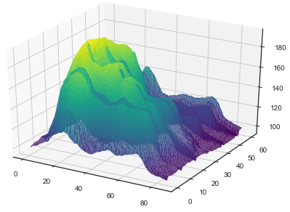
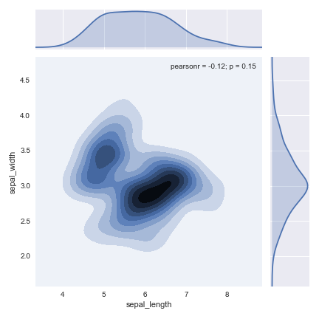
Plots well made
Source: python-graph-gallery.com

Slide 4
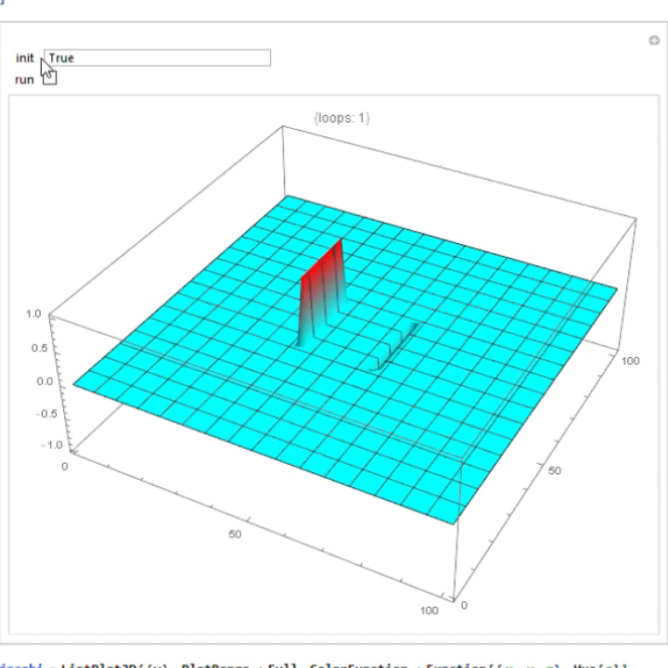
Method of relaxation
Method of relaxation is an iterative, finite-difference approximation to the Poisson equation in two dimensions.
The basic idea of the method is to create an array of discrete coordinates with potential values associated, enforce boundary conditions, and ‘smooth’ the potential field according to the discretization scheme.

Slide 5
Part i
Use the sample code capacitor_Jacobi.py to simulate a parallel plate capacitor. Produce plots showing the potential surface, equipotential contours, and electric field (see p.140-141 for calculations).
Try running the code a few times, and see 1. how many iterations does it take for the error to fall below a threshold value when you change the mesh size, and 2. for a fixed mesh size, how the number of iterations varies as you change the error threshold. For this part, you don’t need to include the graphic output.
How does the simulated output compare to theoretical expectations? (Consider, for example, how they compare inside the capacitor)

Slide 6
Part ii
Make a copy of the code, and modify it to implement the Gauss-Seidel method. (See the file 13-laplace-poisson_equations.pdf under resource tab for detail) produce a 3d potential surface, a contour plot for potential and a vector field plot for electric field.
Compared to the Jacobi method, is there a difference in performance? Also, do the two methods converge to the same potential?

Slide 7
Part III
Add a point charge at some location that is not to close to the boundary or the capacitor, and simulate the code once again (you may use either the Jacobi or Gauss-Seidel method). Visualize the scalar potential and the electric field in this scenario, and make qualitative and quantitative comparison to what you would expect analytically.
Comment on the validity of this scenario; how good of an approximation of a ‘point particle’ is it, and when is it valid/not valid?

