Slide 1
Lab 8

Slide 2
Part 1
Real simple- just add a copy of the magnetic field component of two rings.
When both have the same signs (i.e. current in the same direction and B field is aligned), you get a solenoid-like field; when the two field components have opposite signs (i.e. currents are in opposite directions and B field is anti-aligned), you get something totally different. You only need to plot in the z-x or z-y plane, as the problem is azimuthally symmetric.

Slide 3
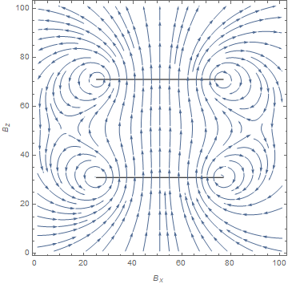
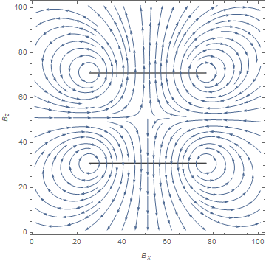
Figures

Slide 4
Part 2
Now you need to simulate the effect of a solenoid with a pitch. This is approximately equivalent to part 1 except your small loop element dl now has a nontrivial z component as well (pitch x angle). Make sure to modify your r > R condition to avoid evaluating on the wire- rz is no longer constant.
Try different values for the pitch (tight vs loose coil) and plot the results as streamlines. You only need to plot in the z-x or z-y plane, as the problem is azimuthally symmetric.
Next, produce four plots showing the B_z along the x-axis (1) inside the loosely wound solenoid, (2) outside the loosely wound solenoid, (3) inside a tightly wound solenoid and (4) outside a tightly wound solenoid.

Slide 5
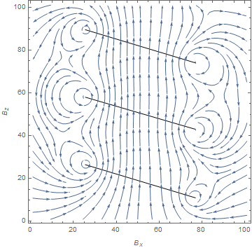
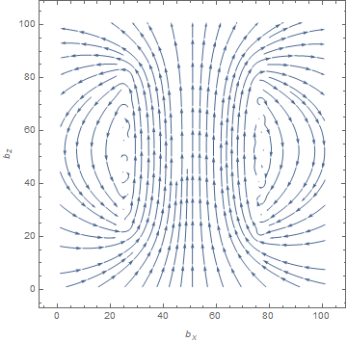
Figures

Slide 6
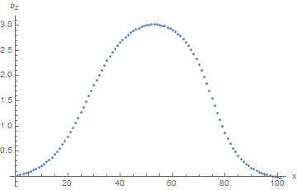
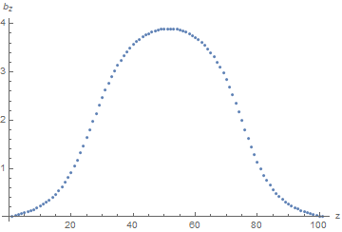
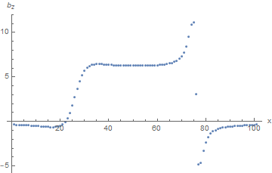
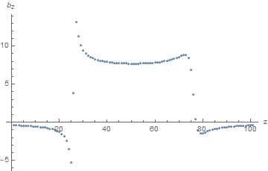
More figures
Outside
Inside

