Slide 1
Lab 13

Slide 2
Logistics
Lab 14 is optional (with bonus points available), and the lab session itself will be done remotely. More details will be sent out later as announcement.
The current lab (lab 13) is due on next Thursday even though it’s during the Thanksgiving week, because there’s homework 6/projects due on Dec. 4th and so it’s probably wise to get the lab done early. If for whatever reason you won’t be able to submit lab13 by Thursday, the deadline can be a bit flexible- just send me an email.

Slide 3

Shooting method
Numerical method of solving differential equations that have boundary conditions at both the start and end of a ‘trajectory’
Hamiltonian is rearranged and approximated as a difference equation
Note that this is a stationary state; the array indices refer to position, not time.

Slide 4
Shooting method
Once we have the difference equation, we ‘shoot’ our solution from both boundary conditions (in 1D problems, left- and right- boundary conditions) and match the two sides at some middle point.
You can do the ‘matching’ in several different ways; the square well potential code uses symmetry/antisymmetry, while the Leonard-Jones potential uses scaling (in the latter case additional care is needed to match the derivative too)
If we do this with the ‘wrong’ value of energy, our solution psi diverges outside the well (which makes sense because we are either adding or subtracting nonzero value to psi if (E-V) =/= 0). So, we check the direction of divergence (+/-) and make smaller values of dE to make corrections.
In the default code, this is done manually (i.e. you have to tell the program, via terminal, whether to increase or decrease energy), but obviously this can be automatized as well.

Slide 5
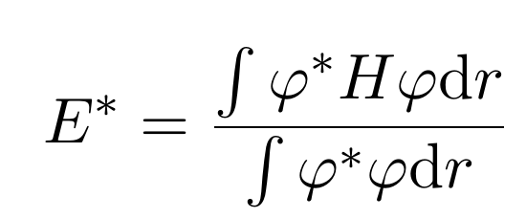
Variational method
We start with some arbitrary ‘guess’ wavefunction phi (in the code, a list of values for each position), and define the guessed value of energy as
The TRUE energy of the ground state, then, is always less than this guessed value, regardless of what the guess function looks like- i.e. Finding the true ground state energy becomes minimization problem for E*. Then, we pick one of the positions (over which phi is defined) at random, change the value of phi according to some random distribution, then evaluate the trial value for energy again. If E*_new < E*_old, then we take the new phi to be our trial wavefunction; otherwise use the old one, and we repeat the procedure until we see that our energy value converges to some number.

Slide 6
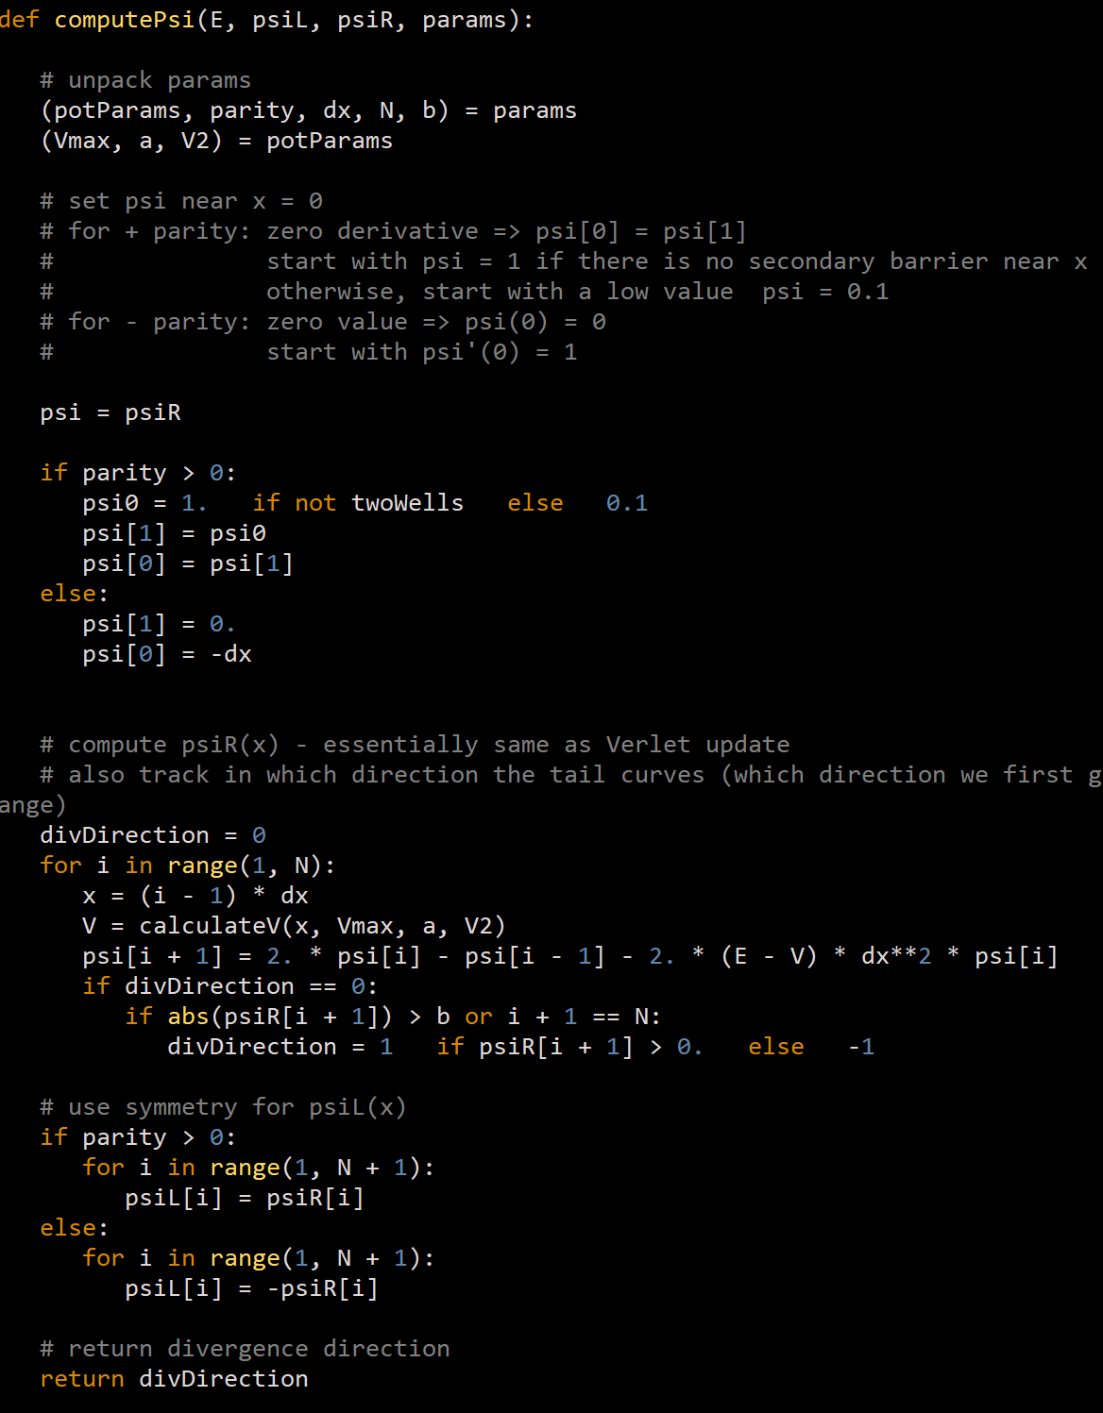
Shooting method
Set the right-side boundary condition based on the parity. Note that we need to specify values for TWO positions because we need both the psi and its first derivative specified at the boundary.
Calculate the value of potential energy at a given spot (in this case, simple question of is it outside or inside the well), and then use the difference equation developed earlier to find psi at the next position. Note: After updating, we check if psi diverges (bigger than some finite threshold). If it does, we keep the sign of divergence.
Using symmetry/antisymmetry, clone (or flip) our right-side solution and paste it to the left side.
Remark: The Leonard-Jones potential code follows essentially the same procedure except its calculateV() function is different, and there is no symmetry argument.
1.
2.
3.

Slide 7
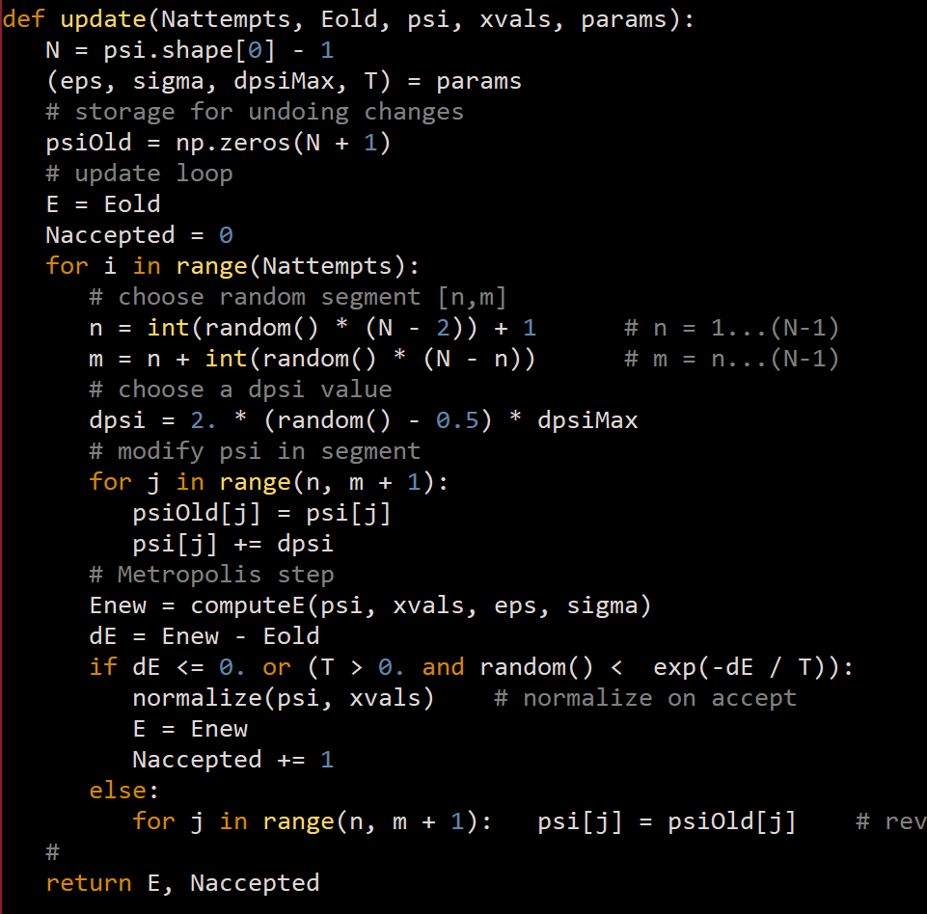
Variational method
1.
Pick a random interval [n,m], and a random variation in wavefunction dpsi. Then, nudge the test wavefunction value in the selected interval by dphi.
Using Metropolis-Hastings algorithm (refer to lab10.pptx if you don’t remember what happens here), update the energy.
If you fail the dice roll for the metropolis, roll back the changes made to psi
Repeat the above steps while I < Nattempts.
1.

Slide 8
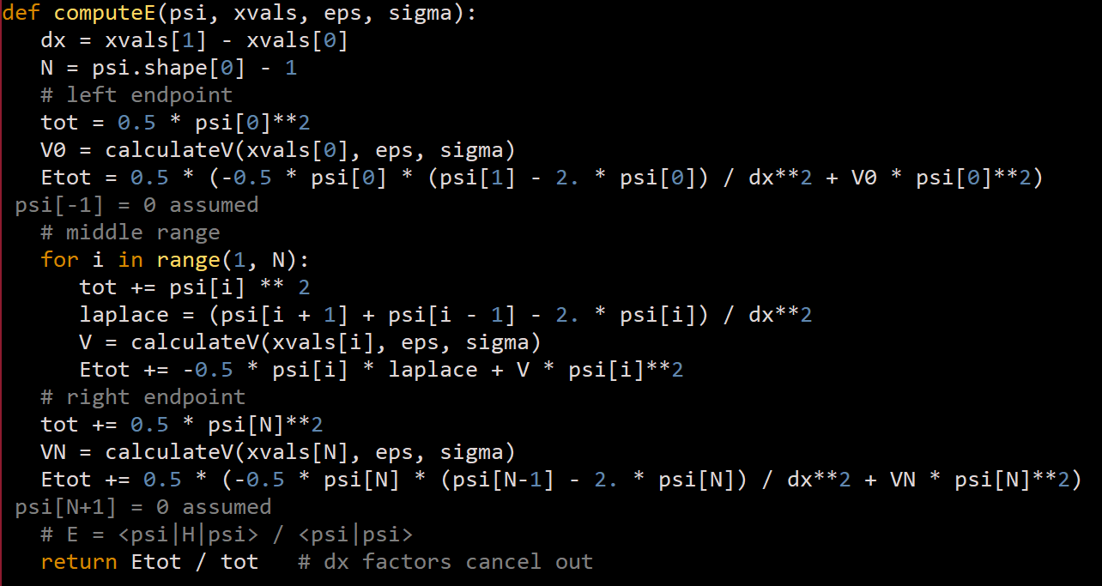
Variational method
1.
Here, we are performing numerical integrations to compute the estimate value for the energy.
Calculate contribution to the total value of estimated energy coming from the right-side boundary condition.
For all intermediate values, use the difference equation we found earlier to compute the energy
Repeat (1) but with left-side boundary condition to complete the integration.
Note that the formula used to evaluate the energy contribution from the boundary conditions are just special case of the difference equation in the ‘middle’ region, because the endpoint only contains half a bar.
2.
3.

Slide 9
Part 1
Make the energy step change process automatic
Using the values V = 100000, dx = 0.01, dE = 1 and appropriate value of E and parity (~1 for ground state), and find the first four states (gnd, 1st, 2nd, 3rd excited states) using the code. Include the figure and the estminated energy values.
Enable the secondary well using input to set up V = 100 for the secondary potential barrier, and get the ground and first excited state energies.
Compare the numerical values to exact values found using (10.6) – (10.8) from textbook.

Slide 10
Part II
Use shooting method to find the ground state energy of the Leonard-Jones potential. Include the wavefunction figure and energy value in the report.
Use variational method code to estimate the same ground state, and compare the two values.
The choice of parameter values for both the shooting and variational method to LJ can be found in appropriate parts of the textbook.
(Optional) Try to obtain the first excited state using variational method.

