Slide 1
Our Growth Curve data

Slide 2
5 csv files
df_GrowthCurve_allData
Enamine_t6_t12.csv
Enamine_t6_t12_ctrls.csv
Enamine_DR_growthcurves.csv
Control_growthcurves.csv

Slide 3
df_GrowthCurve_allData
Concentrations: 0.2,1.2, 7.9, 50
Positive Controls: Ciprofloxacin, Fosfomycin
Negative Control: DMSO
18432 = 16 rows x 24 columns x 12 plates x 4 concentrations
All timepoints: 0,2,4,6,8,10,12
Replicates?

Slide 4
df_Enamine_t6_t12
Only 1 Concentration: 50
Only 3 timepoints: 0, 6 and 12 hours
Two Replicates
64 000 rows (32 000 compounds x 2 Replicates)
Originally did not come with controls

Slide 6
df_Enamine_t6_t12_controls
Concentration 50
2 Replicates
Positive Control: Ciprofloxacin
Negative Control: DMSO
Cipro always second column, DMSO first and last two columns

Slide 7
Enamine_DR_growthcurves.csv
Subset of df_Enamine_t6_t12 compounds that were the most active.
More Concentrations: 0.2, 0.781, 3.13, 12.5, 50 (No 1.2 or 7.9 like df_GrowthCurve_allData)
All timepoints: 0,2,4,6,8,10,12
2 Replicates
No controls though. Leaving no controls for the 0.781, 3.13, 12.5 Concentrations.
2640 rows

Slide 8
Control_growthcurves.csv
1 plate of only controls
No compounds on the first and last two rows/columns
Some readings were cut out for being too noisy

Slide 9
Control_growthcurves.csv
Positive Controls: 'Rifampicin', 'Fosfomycin', 'Ciprofloxacin', 'Trimethoprim’
Negative Control: DMSO
Concentrations: 50. , 0.2 , 7.9 , 3.13 , 1.2 , 0.781, 12.5
6 Replicates. “should be at least 4 replicates of every drug x concentration”
200 rows only

Slide 10
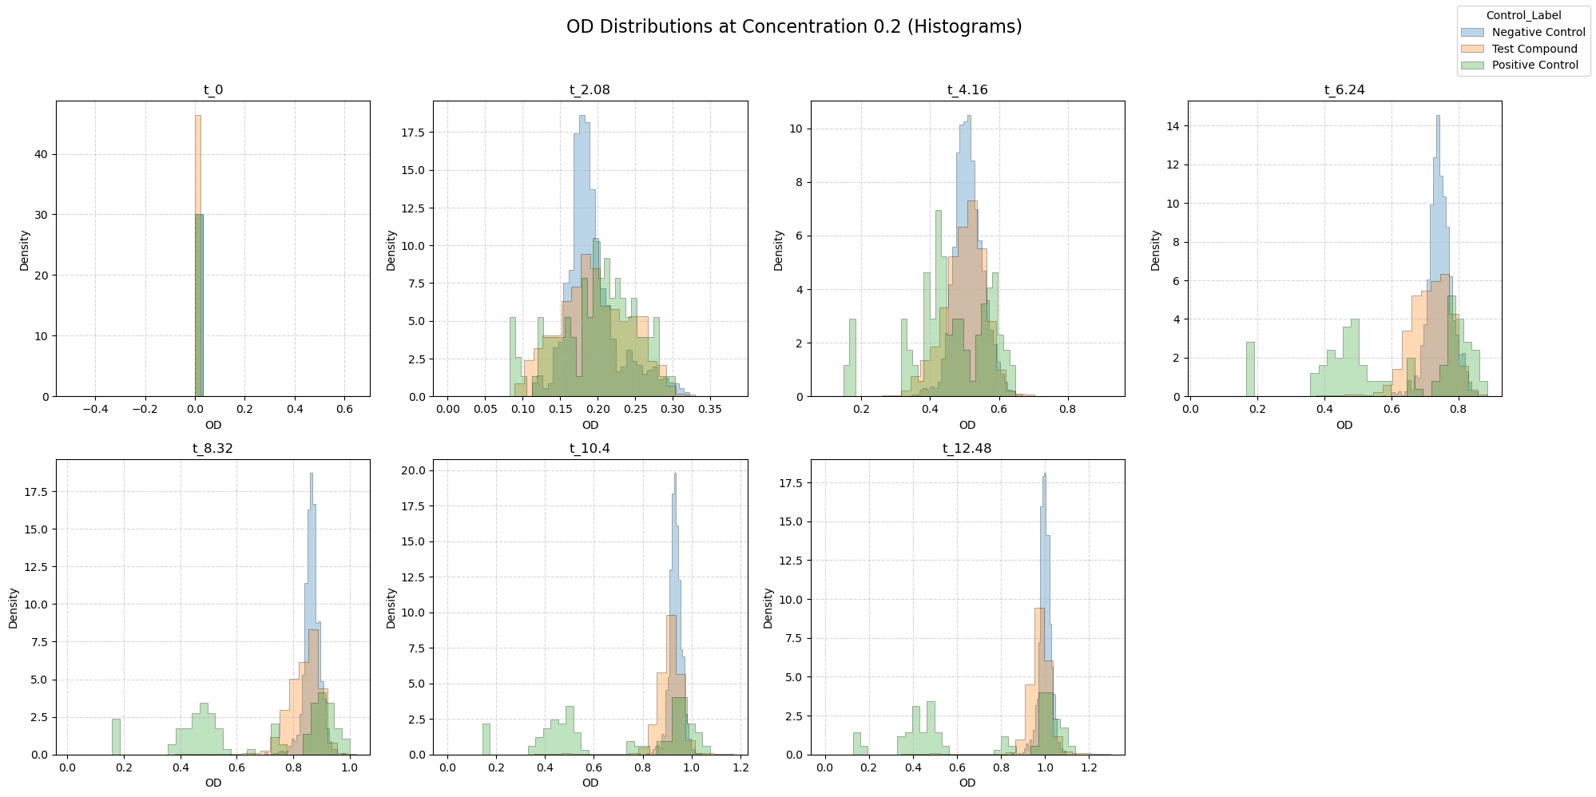

Slide 11
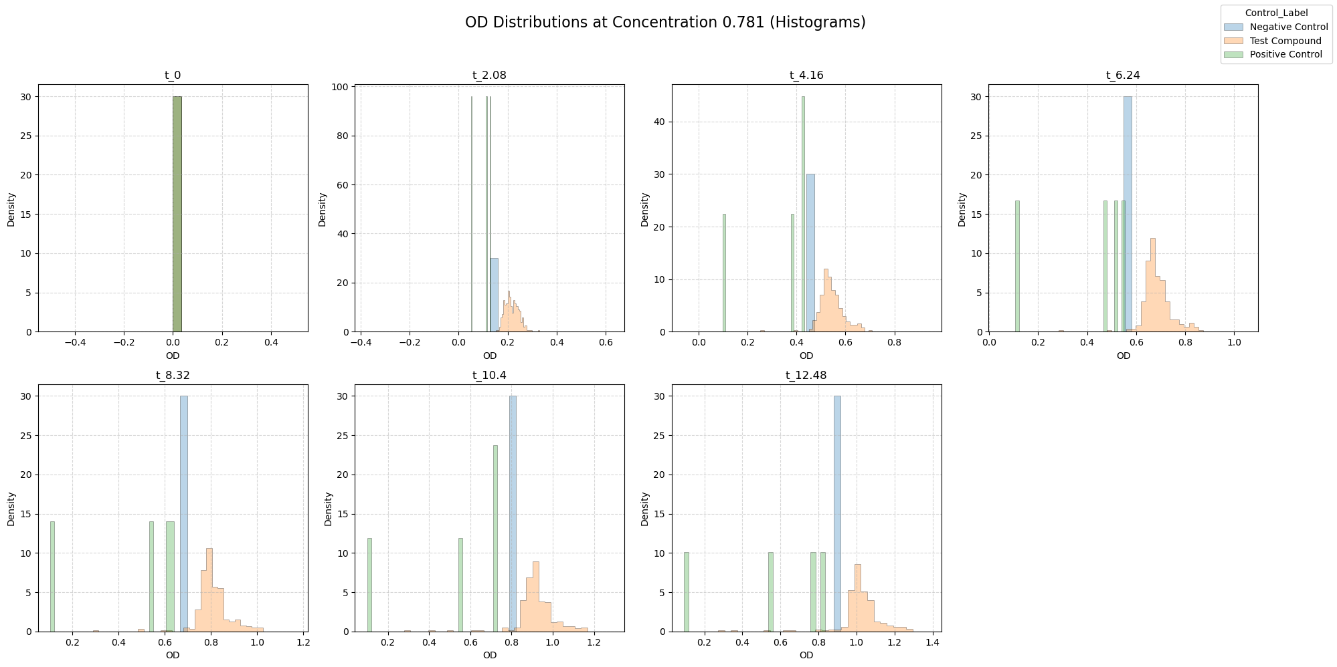

Slide 12
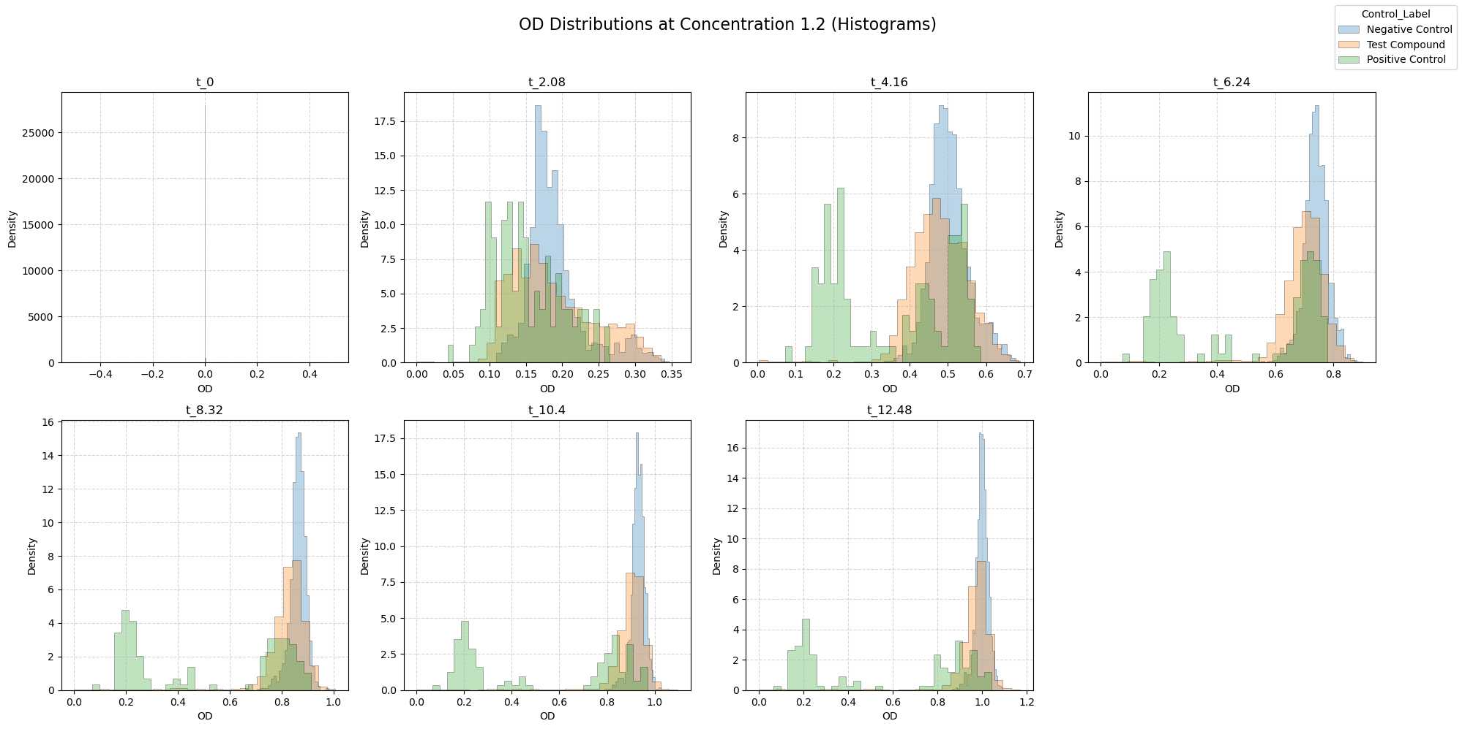

Slide 13
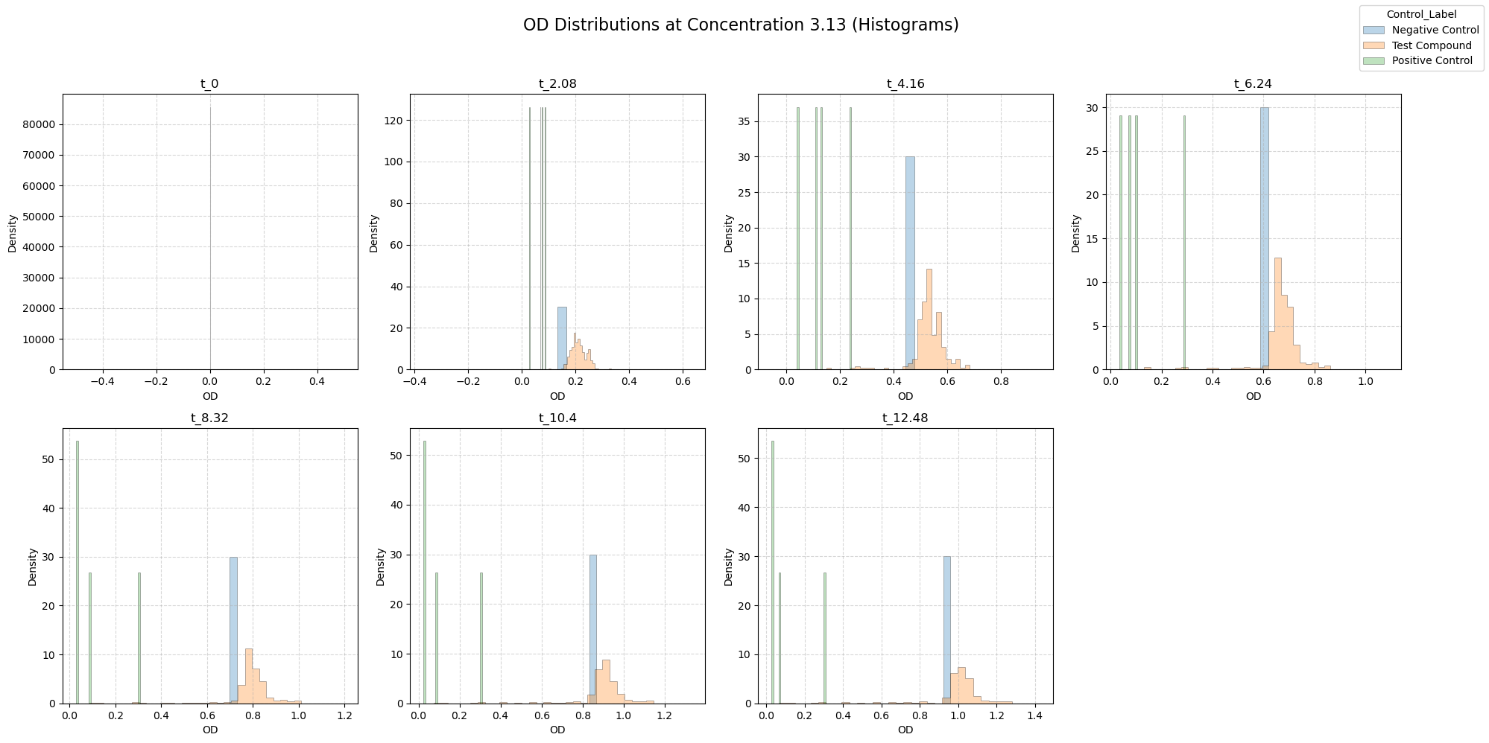

Slide 14
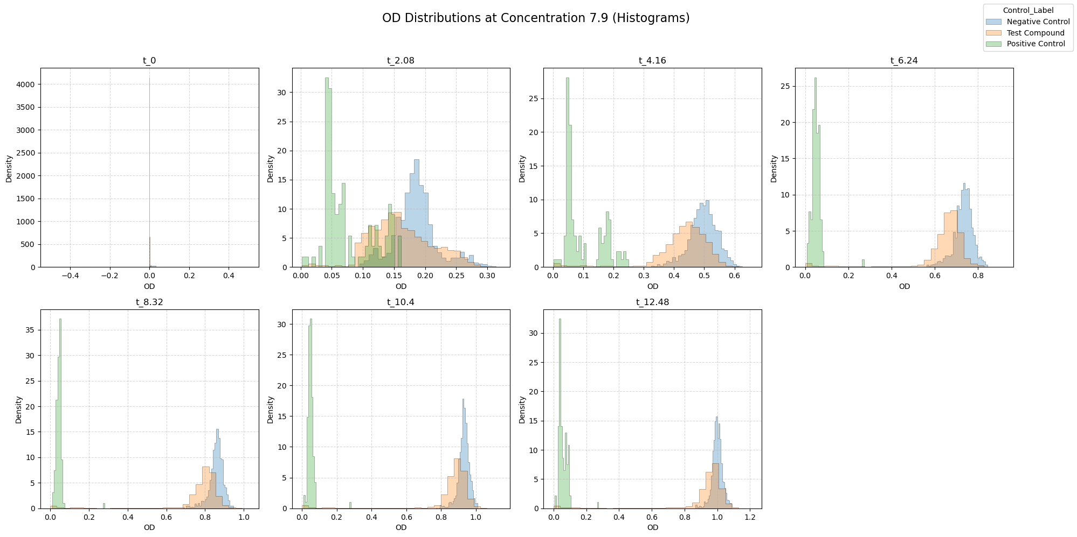

Slide 15
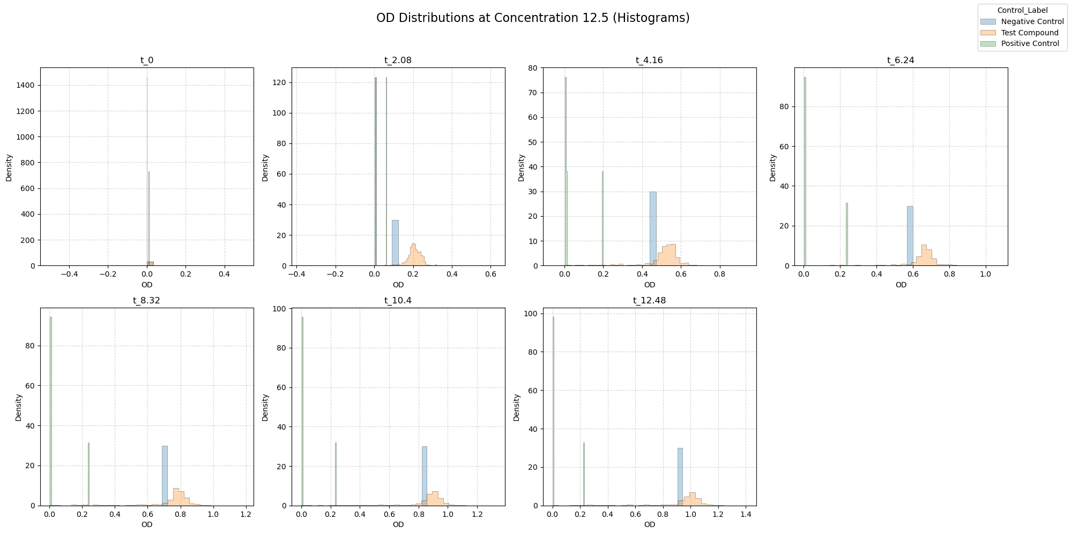

Slide 16
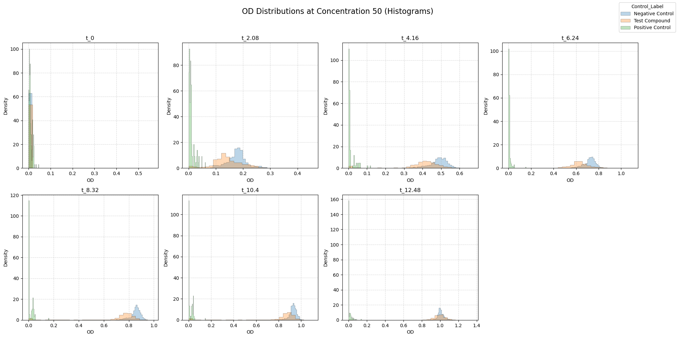

Slide 17
April 21
New stuff

Slide 18
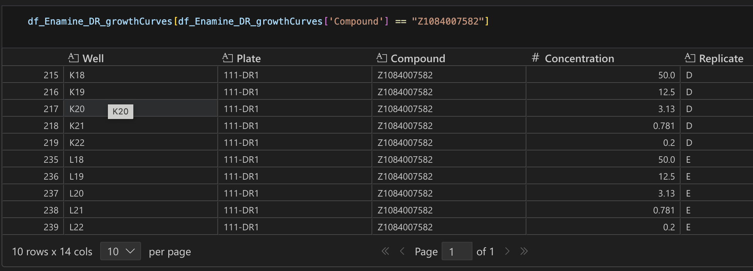
This goes for all the Enamine Datasets

Slide 19
Batch Effects

Slide 20
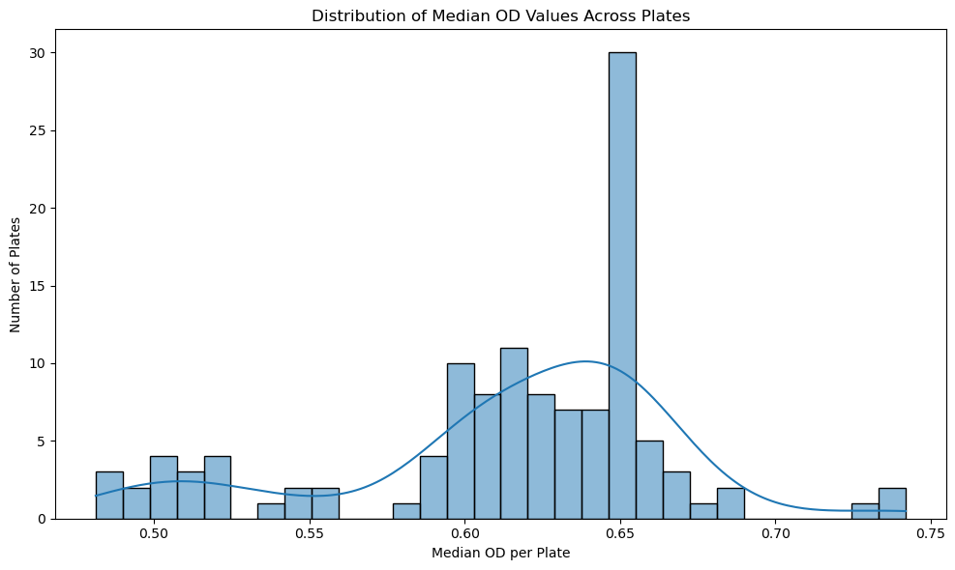

Slide 21
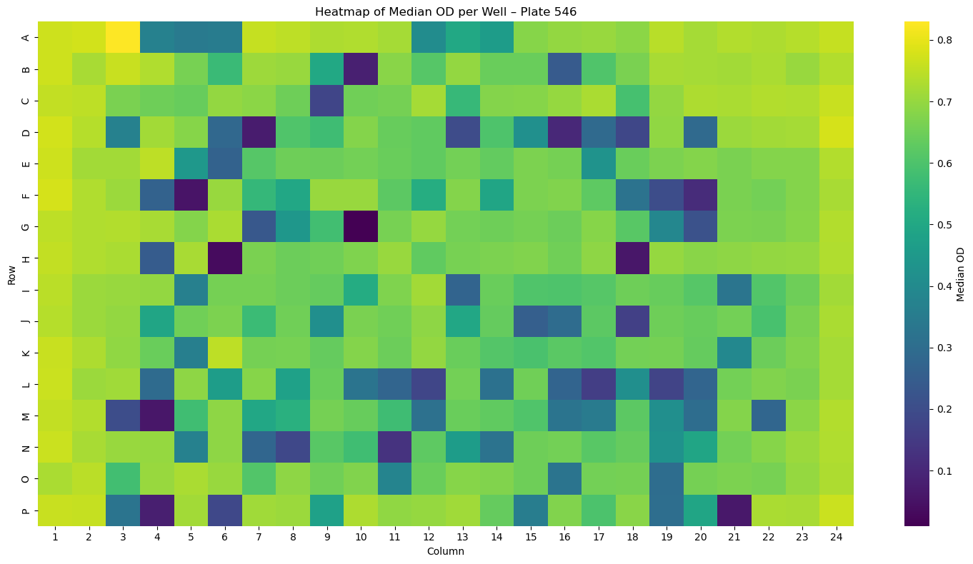

Slide 22
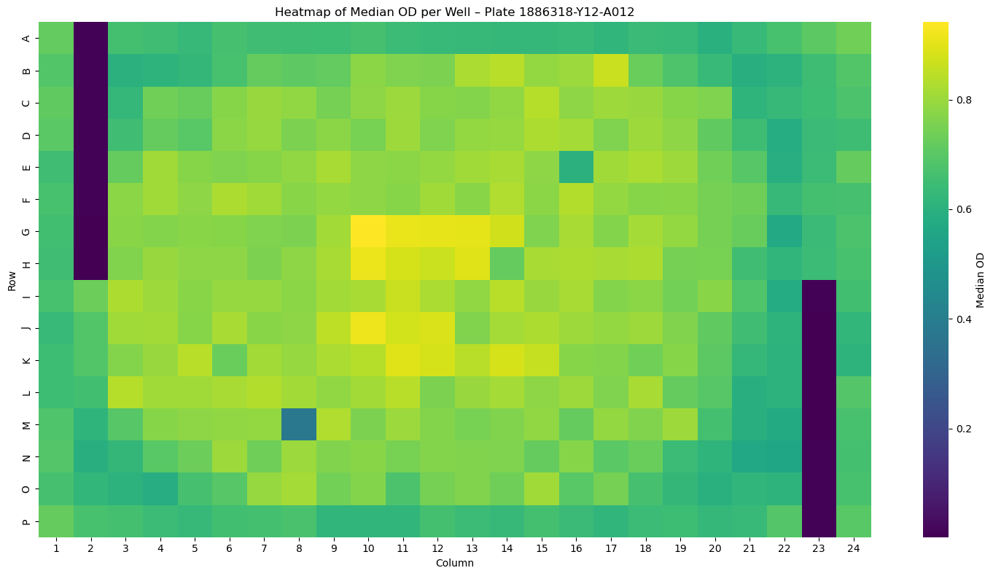

Slide 23
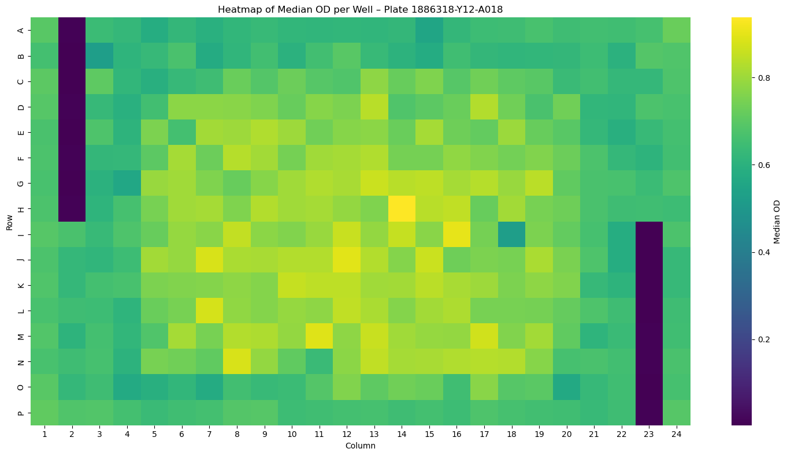

Slide 24
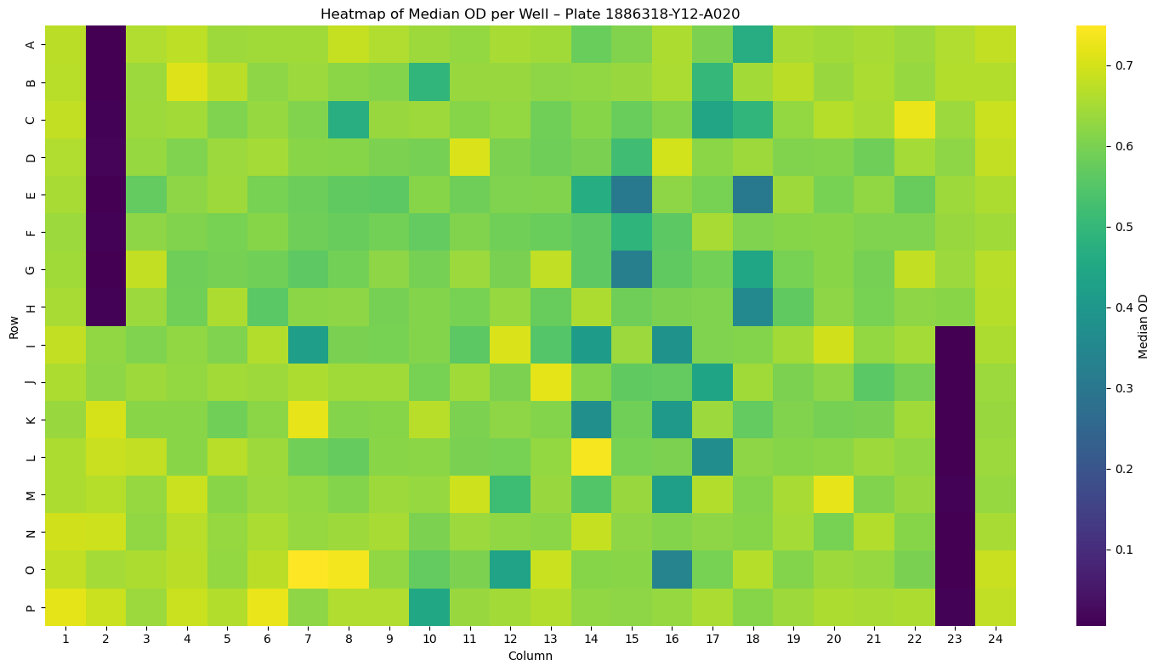

Slide 25
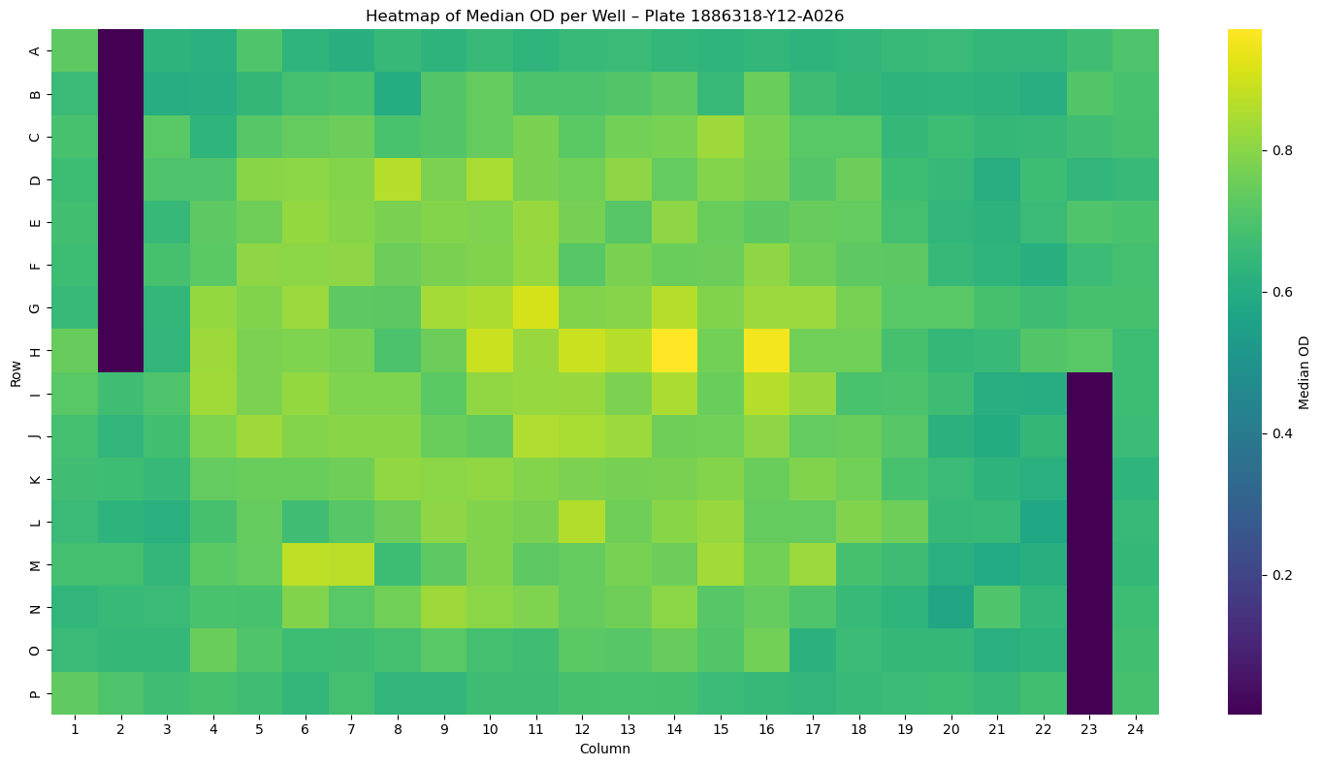

Slide 26
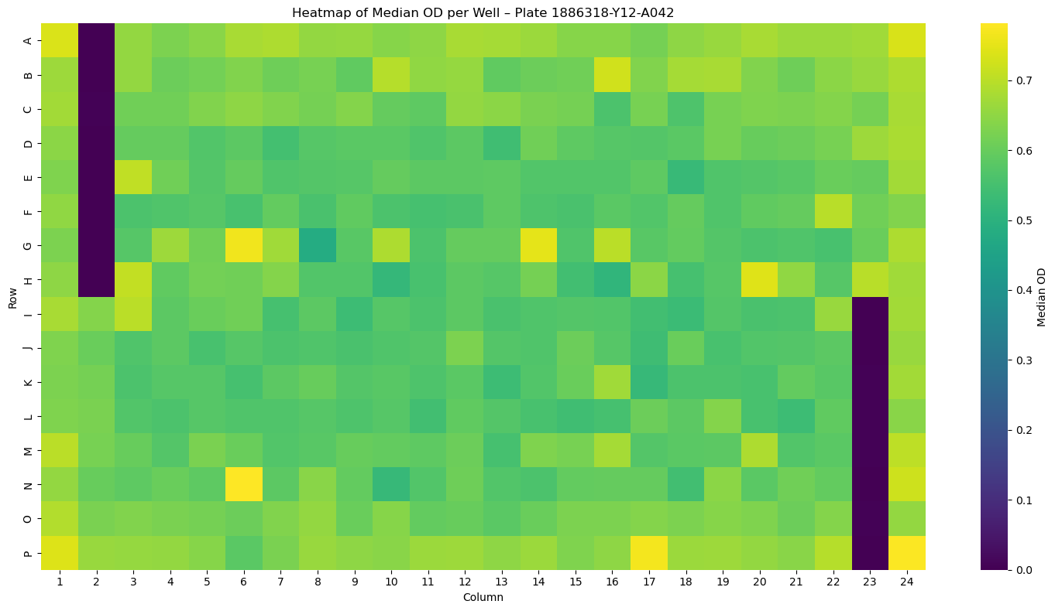

Slide 27
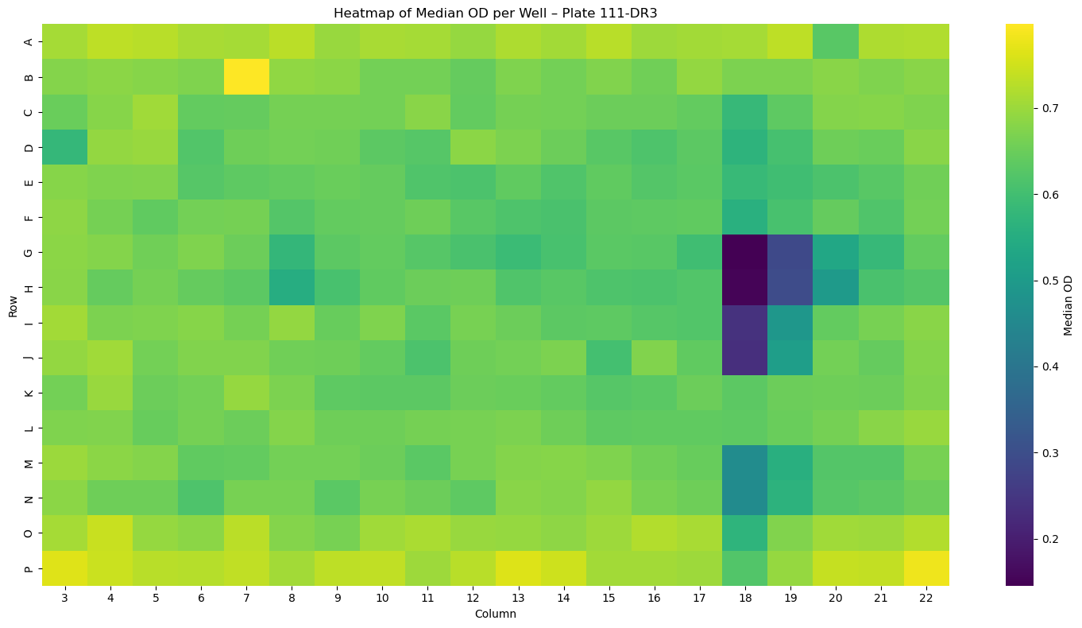

Slide 28
OD distributions

Slide 29
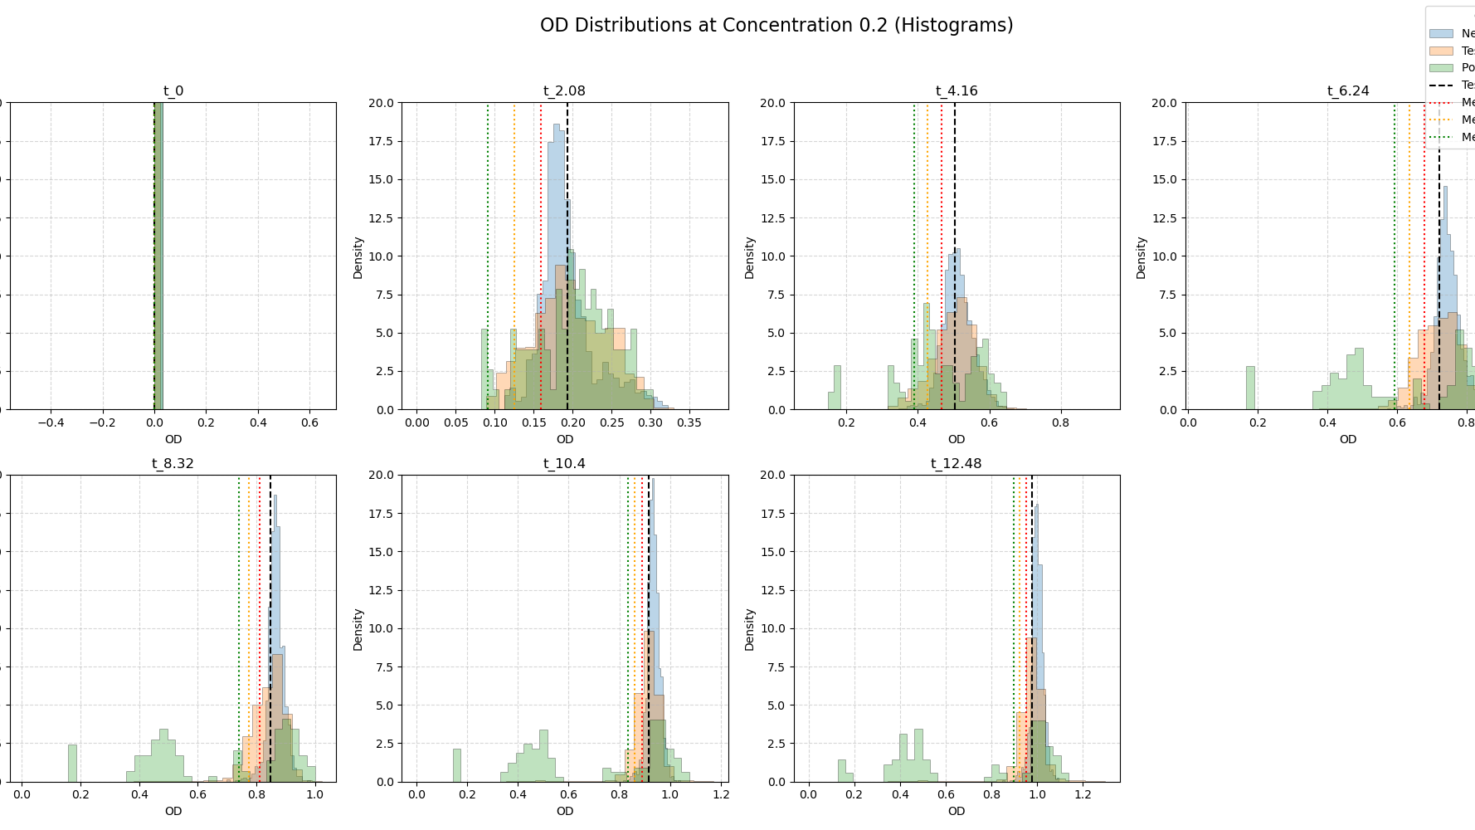

Slide 30
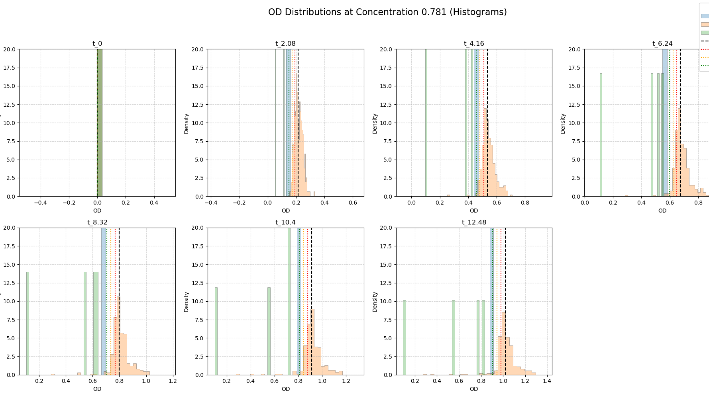

Slide 31
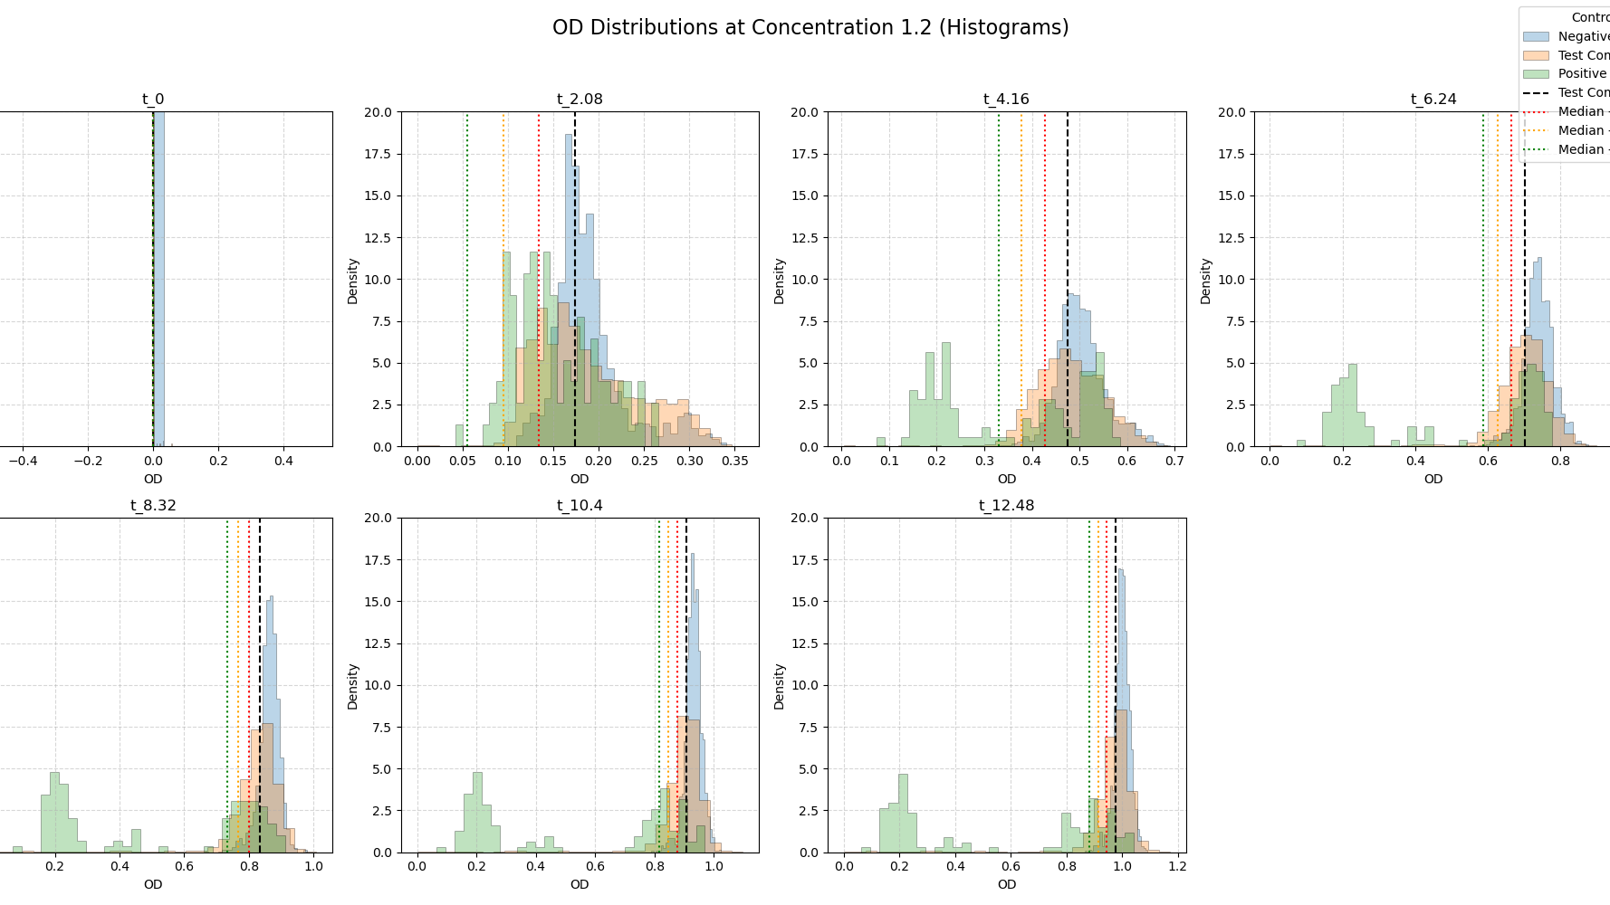

Slide 32
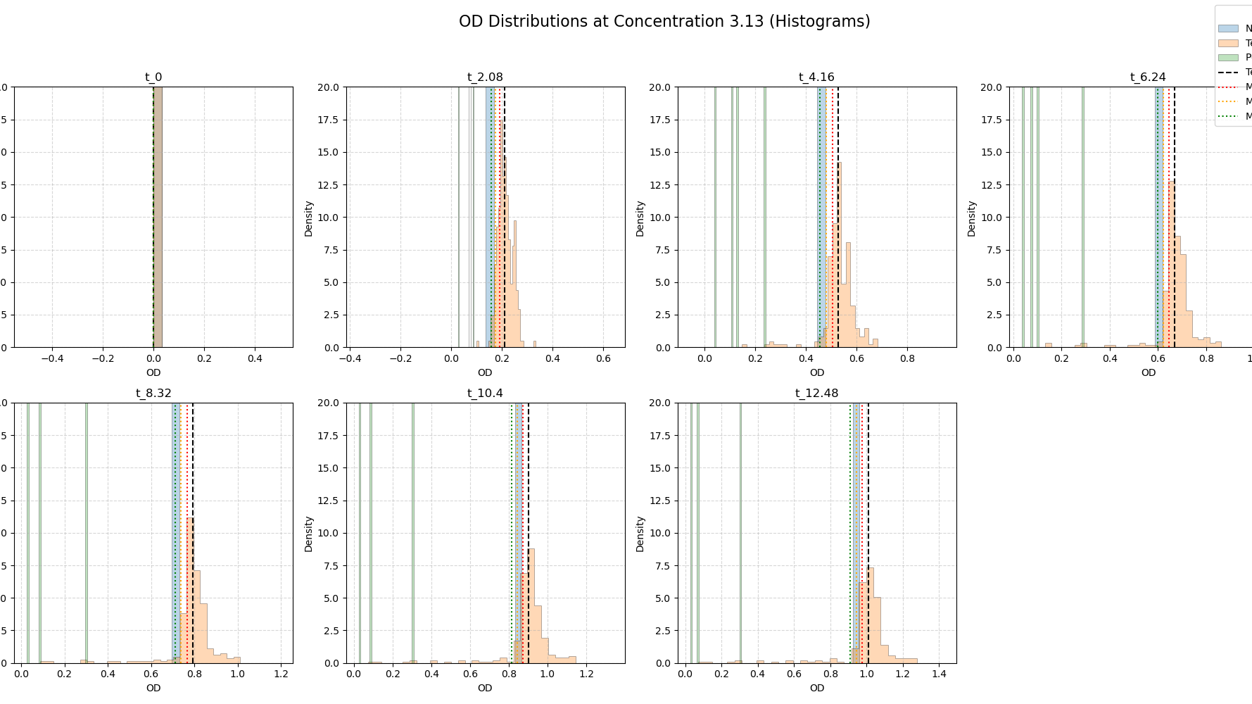

Slide 33
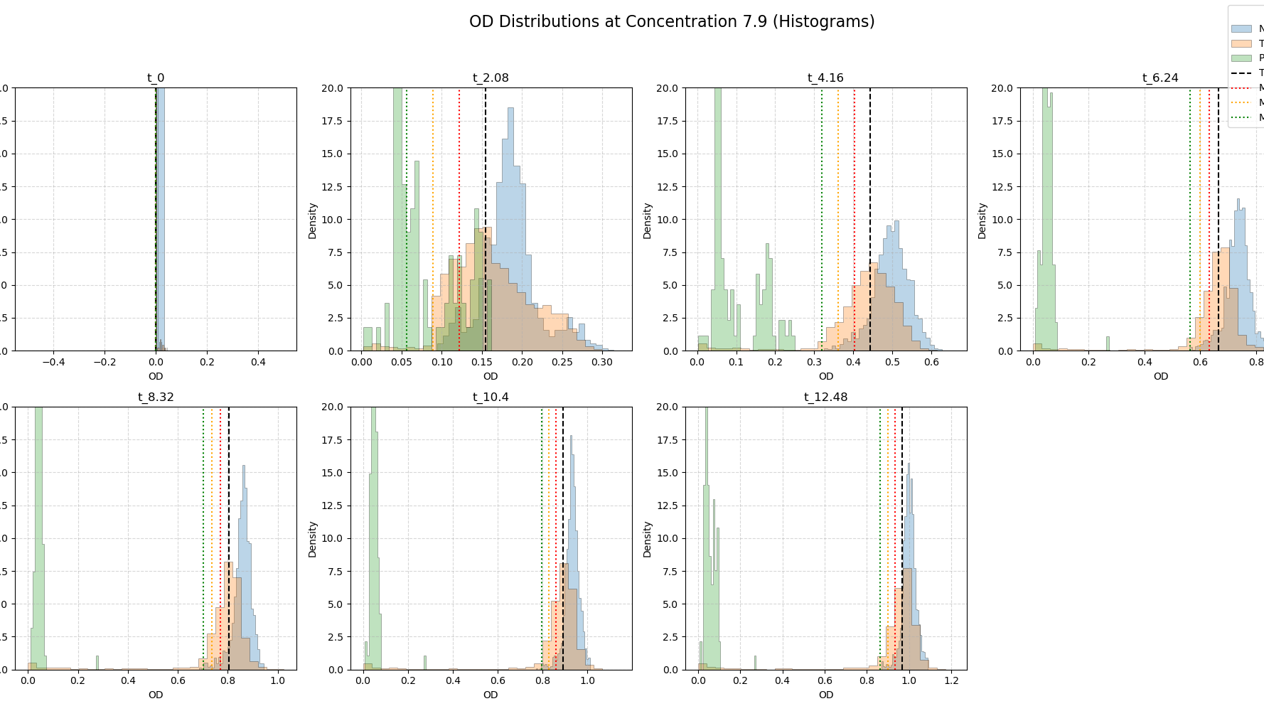

Slide 34
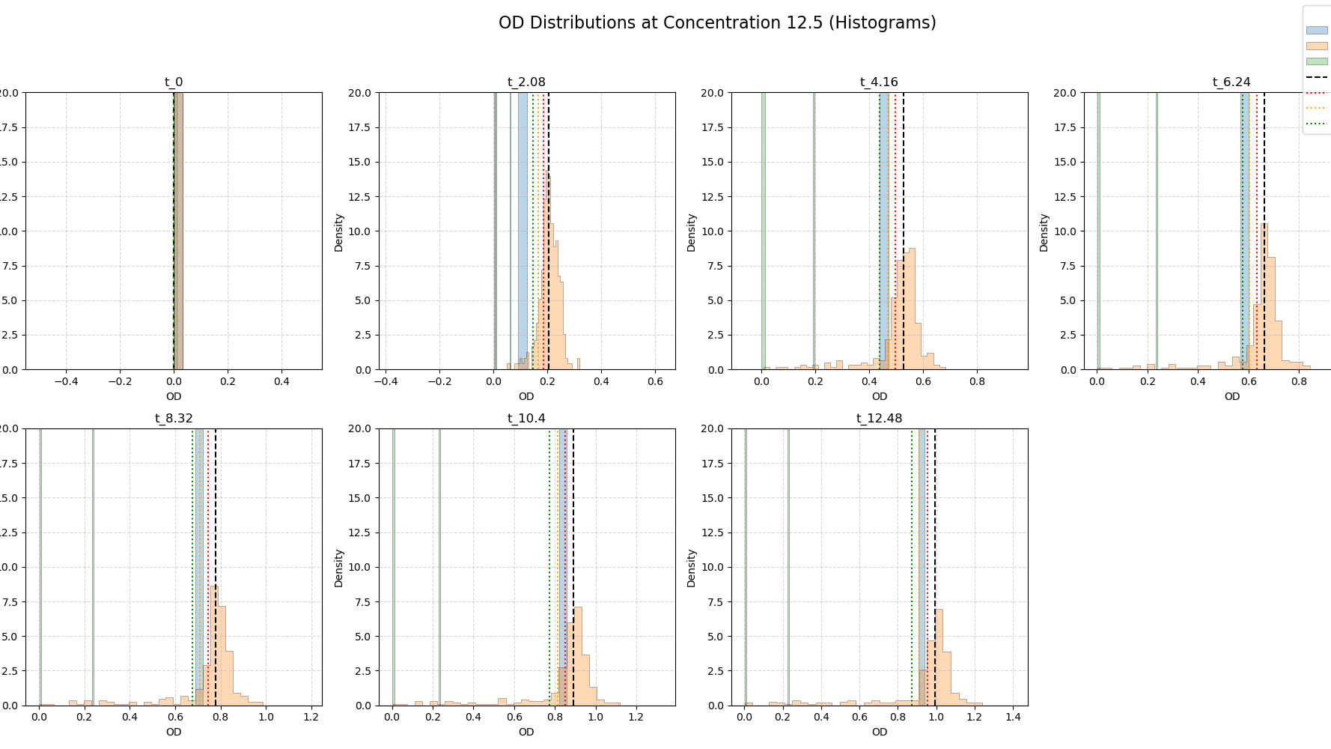

Slide 35
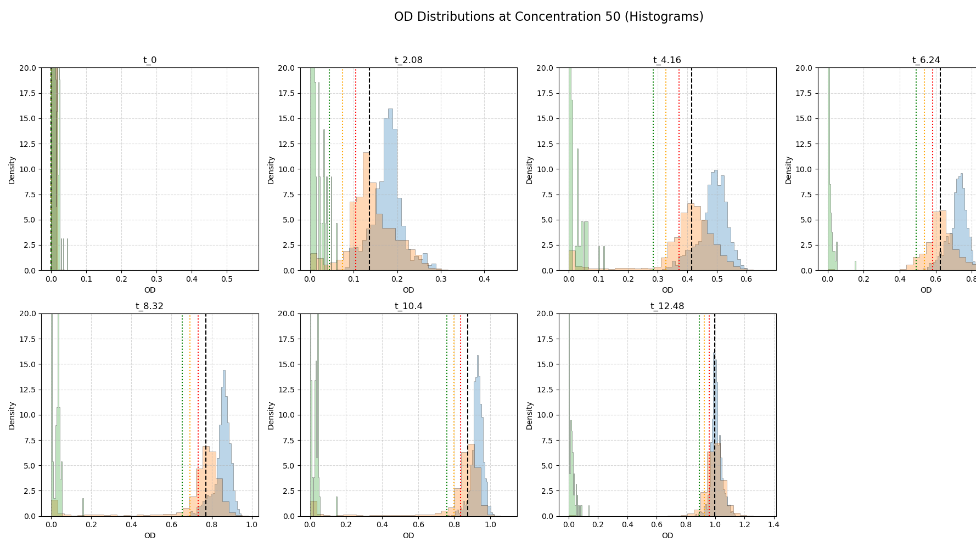

Slide 36
Classification Feature

Slide 37
Making “Active” feature for Compounds
Criteria:
Looking only at Concentration 50
Is the Compound active at at least 2 timepoints
Most general definiton, filter later
Gives us 3833/51723

Slide 38
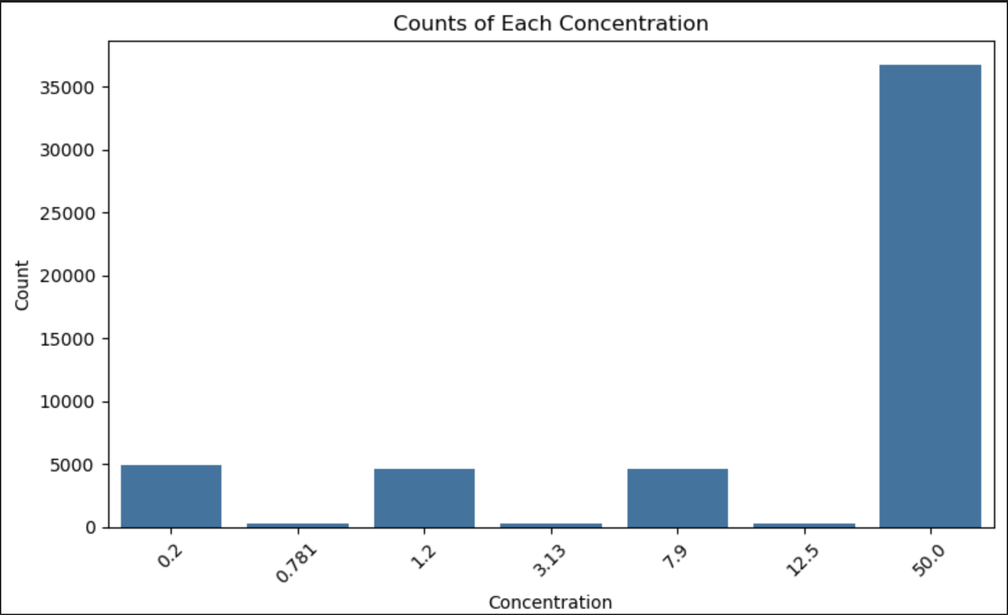

Slide 39
