Slide 1
New data

Slide 2
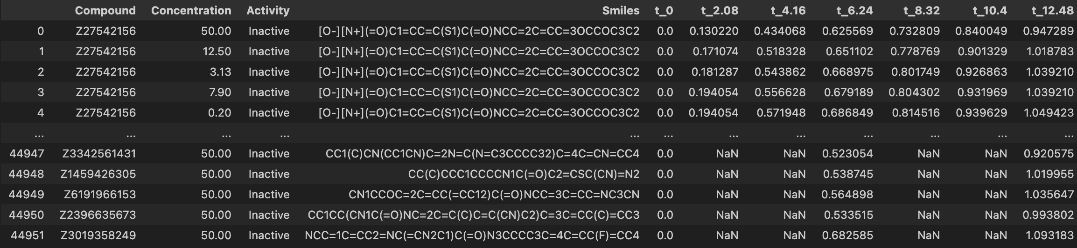
All GrowthCurve Data

Slide 3
Refactoring for learning
Every Optical Density (OD) measurement is its own sample
Time and Concentration are encoded as 1-hot-encodings
Feature Matrix:
Time point encoding
Concentration Encoding
MACCS,ECFP,RDKIT
Target: Regression on OD
Random splitting on scaffolding (80/20 split)
Train set: 143763 x 4286
Test set: 36369 x 4286

Slide 4
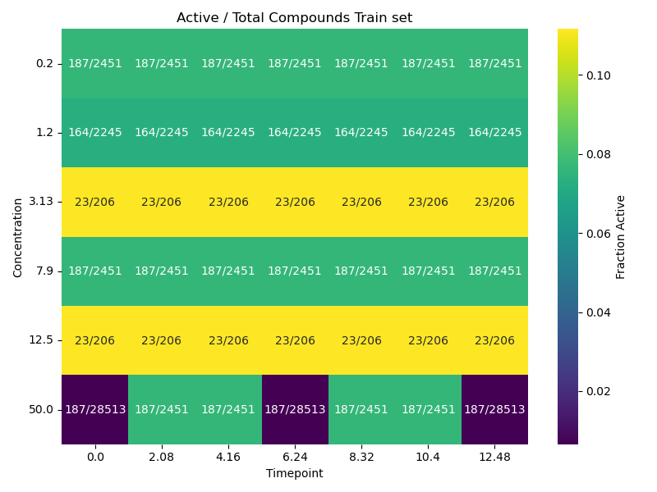
Train set

Slide 5
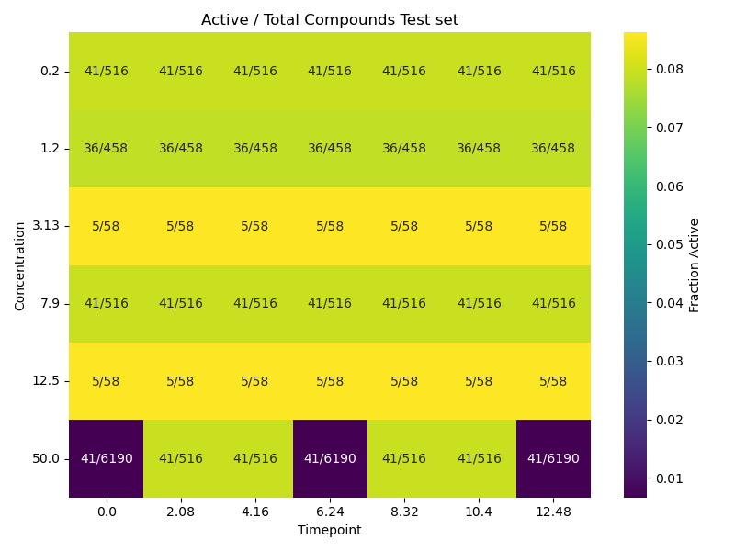
Test set

Slide 6
Neural Network
Fingerprints
1
Time
Concentration

Slide 7
Sweep results
c_dim=256
f_dim=256
t_dim=16
common_dimension=32
dropout=0.21851381992431756
c_layers=3
f_layers=3
patience=15
t_layers=2
batch_size=256
last_mlp_dim=128
weight_decay=2.1024972352758556e-05
learning_rate=0.0005032261457676192
last_mlp_layers=6
Test_loss = 0.0064543 (0.15 for mean)

Slide 8
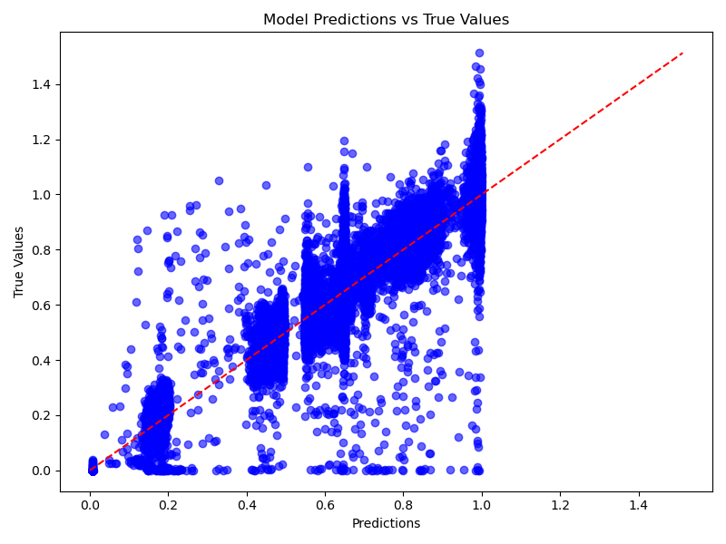

Slide 9
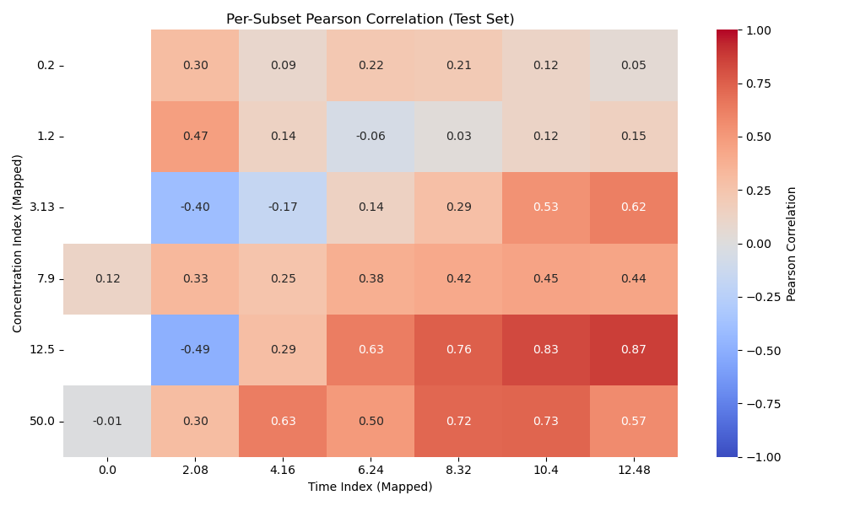

Slide 10
Future
Evaluate performance on Active and Inactive separately.
More data?
Concatenation vs Sum
GNN for Smile embedding ?

